Slide 1
This brief is UNCLASSIFIED

Slide 2
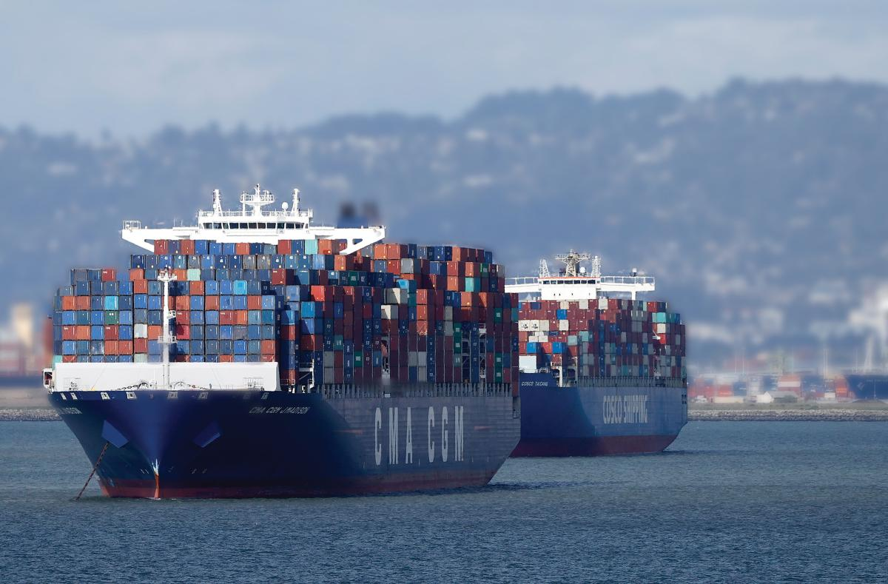
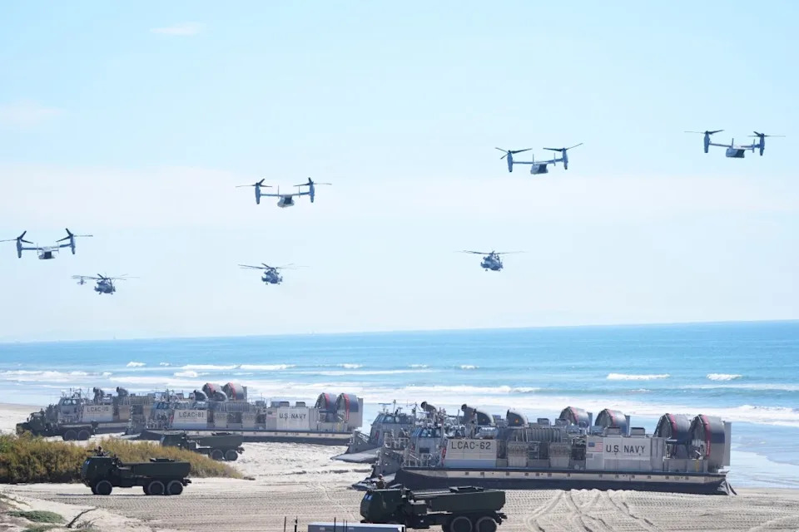
differentiated value
To the American People:
Assure homeland defense
Global Stability and deterrence
Protects maritime trade
To the Joint Force:
Sea control and sea denial
Maritime security
Tailored and credible deterrence
Global replenishment
Freedom of maneuver
Power Projection
“Once you understand why our Navy matters, only then can you define what our Navy and Marine Corps team must deliver”

Slide 3
Hedge Strategy
High-risk, low-probability scenarios
Tailored
Forces
Tailored Offsets
Main Battle Force Capability
Conflict Spectrum & Intensity
Tailored Forces and Offsets Can Include a Mixture of Attributes
Produced and reproduced in relevant timelines and capacities through rapid iteration
Sustainable and employable at the appropriate level of risk for the Fleet Commander
Modular and/or flexible capabilities that create varied effects
Capability has asymmetric cost and lethality benefit
Designed to force multiply and support tailored missions
Designed to operate in areas with higher levels of risk to force and mission
Scalable
Deployable
Adaptable
Cost Effective
Expendable
Attritable
Golden Fleet Initiative is Foundational to our New Fleet Design
All-Domain General-Purpose Forces + Tailored Forces + Tailored Offsets

Slide 4
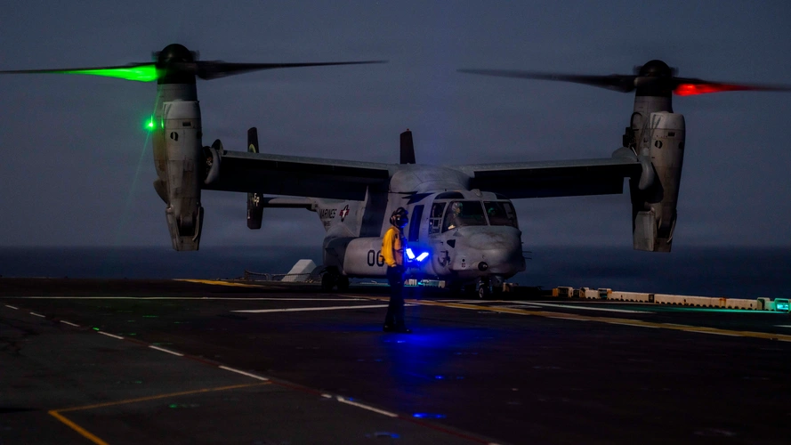
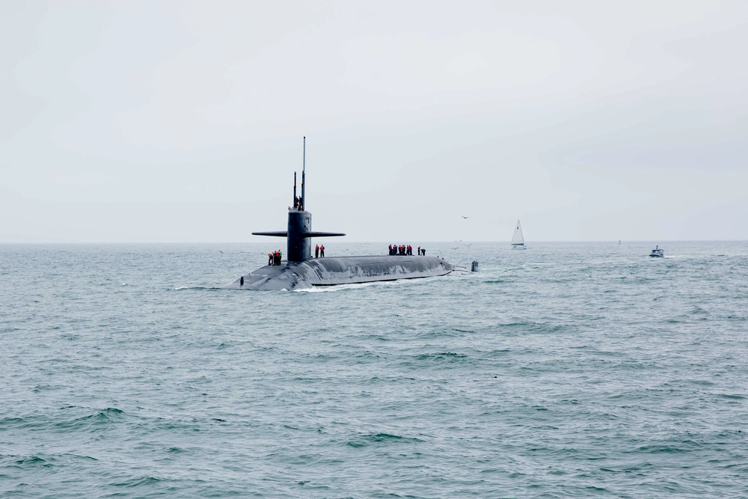
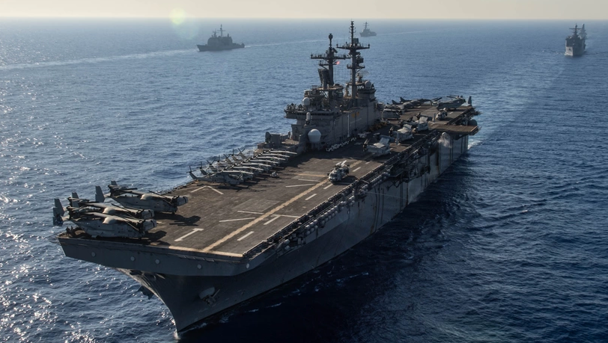
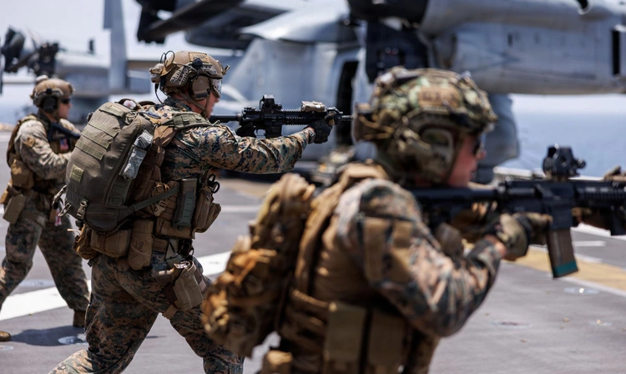
TAILORED FORCES
SEAL Training at Aquarius Reef Base
Responsive and Expeditionary make our Navy the Global Hedge Force
HELIOS Anti-Cruise Missile Test, 2024
Wasp ARG Joint Ops in Med, Jun’24
NSW Joint Training aboard MSC Ship

Slide 5
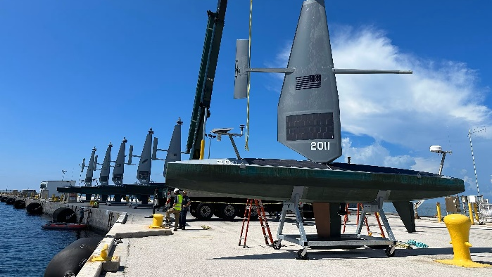
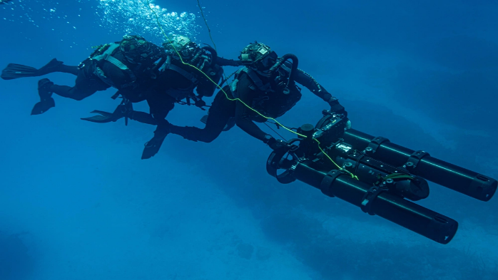
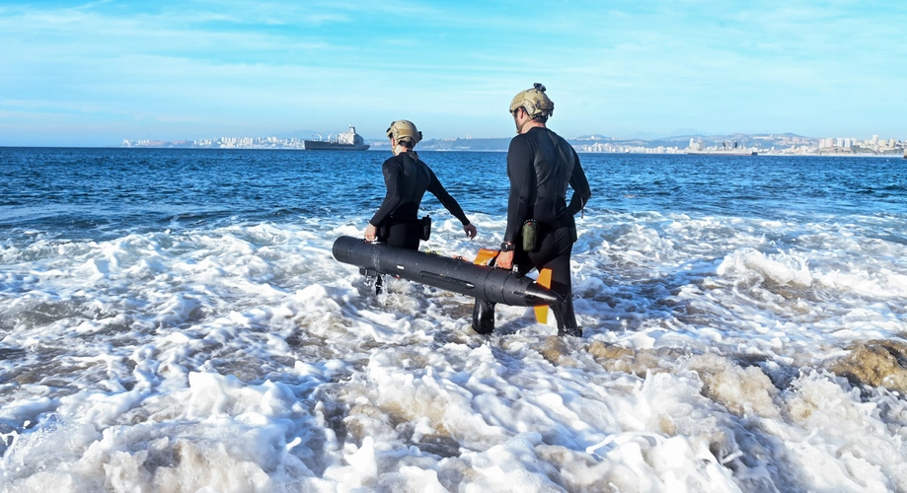
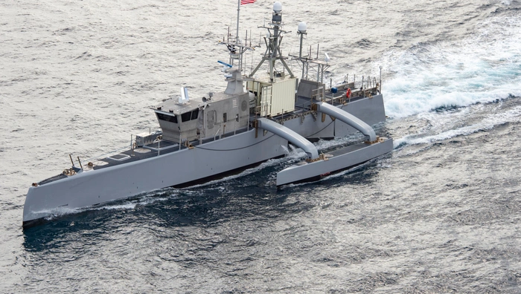
TAILORED OFFSETS
Scalable, deployable, adaptable, and cost-effective
HELIOS Anti-Cruise Missile Test, 2024
Wasp ARG Joint Ops in Med, Jun’24
NSW Joint Training aboard MSC Ship

Slide 6
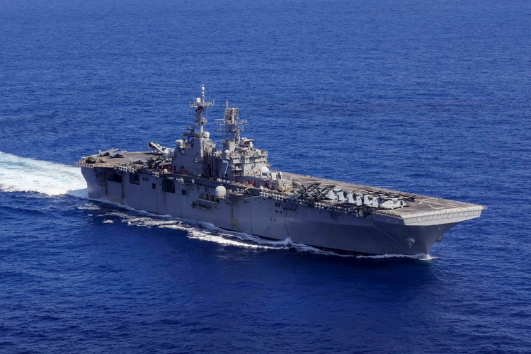
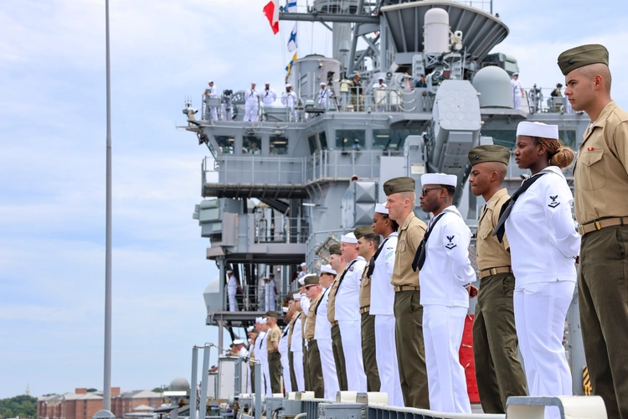
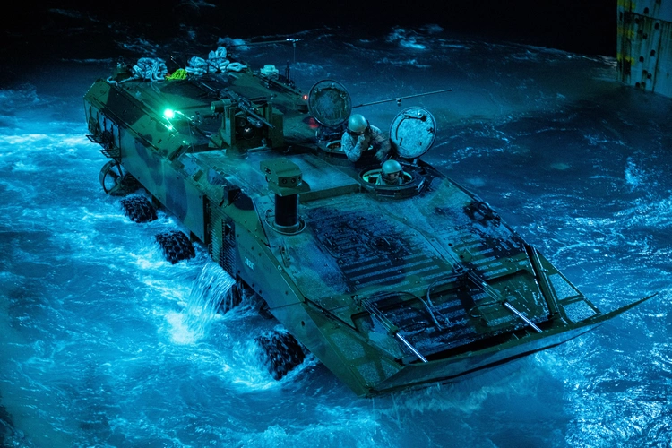
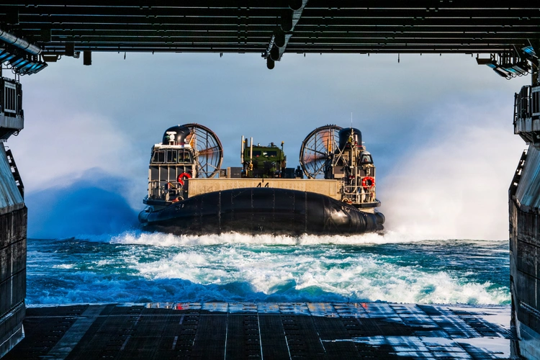
Amphib Readiness
Driving Ingenuity and Continuous Improvement to Deliver 3.0 Presence
HELIOS Anti-Cruise Missile Test, 2024
Wasp ARG Joint Ops in Med, Jun’24
NSW Joint Training aboard MSC Ship

Slide 7



Questions?
UNCLASSIFIED

