Slide 1

Model-Based Systems Engineering
Accelerating system design through model-based methods

Slide 2
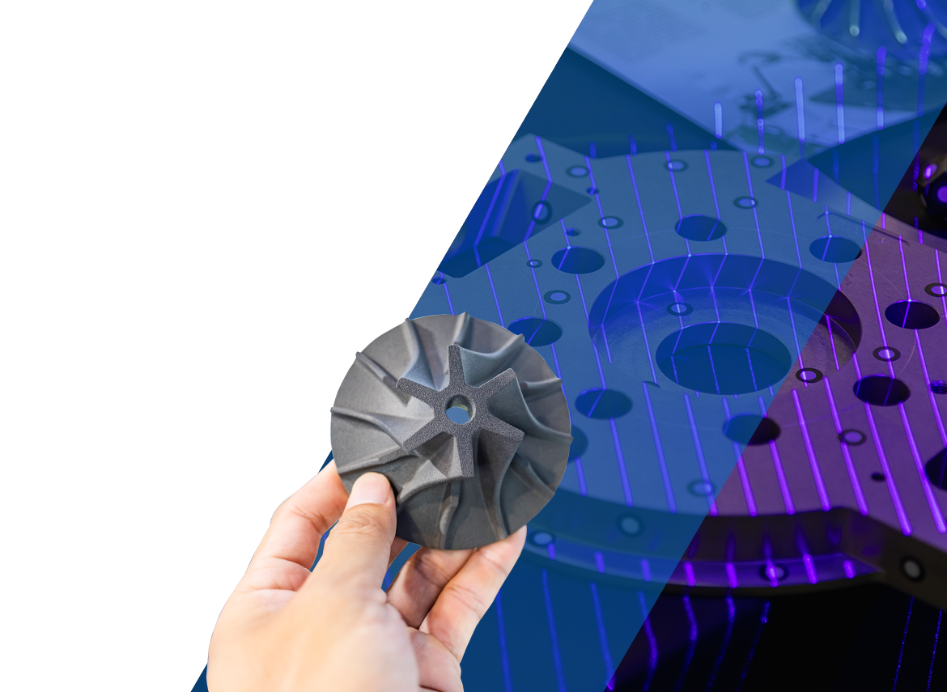
Rapid Prototyping Is Working — But Measurement Gaps Remain
GAO and DoW confirm that Middle Tier of Acquisition (MTA) and Software Acquisition Pathways can deliver capability in 2–5 years when used correctly.
GAO found limited visibility into technical health, architecture maturity and software quality across rapid prototyping efforts, reducing data‑driven oversight.
RAND and GAO report that cost, schedule and transition challenges persist when programs lack early, continuous technical insight.
DoDI 5000.87 requires programs to track performance, speed, cybersecurity and quality metrics using automated tools to inform decisions—not just compliance.
NDIA/GMU research highlights that many prototypes fail to scale due to lack of outcome‑focused measurement, not lack of innovation.

Slide 3



COTS is Widely Adopted — But it Changes the Problem
Why COTS is Attractive
Faster access to mature technology
Reduced custom development
Lower upfront engineering cost
Strong alignment with rapid prototyping pathways
What COTS Does Not Provide
A system‑level architecture or integration view
Ownership of interfaces, data flows or dependencies
Alignment to mission outcomes beyond product features
Insight into how changes affect the broader system
The Resulting Reality
Risk shifts from development to integration and sustainment
Prototypes demonstrate functionality, but scale is uncertain
Technical health becomes harder to assess using cost/schedule alone
Government visibility decreases as vendor complexity increases
COTS accelerates delivery — but it does not provide system accountability, measurement or control.

Slide 4

Why is Systems Engineering (SE) and MBSE a Solution?
No COTS vendor owns system-level interfaces or integration quality
COTS shifts risk into integration and sustainment
Mission outcomes require system-level metrics, not product specs
COTS evolves independently of prototypes and mission timelines
Without SE and MBSE, measurement and prototypes may not scale
Cybersecurity and accreditation are continuous system behaviors
The government needs an authoritative technical and measurement owner
Notes:
COTS products do not equal a system
Buying COTS delivers components; Systems Engineering ensures those components operate as a coherent, mission‑ready system with defined roles, interfaces, and behaviors.
No COTS vendor owns the system interfaces
Interfaces between COTS products—data formats, timing, protocols, cyber boundaries—are not managed by vendors. Systems Engineering establishes and governs those interfaces to prevent integration failure.
COTS shifts risk; it does not remove it
COTS reduces development risk, but it increases integration, configuration, and sustainment risk. Systems Engineering is how that risk is identified, bounded, and actively managed at the system level.
Mission outcomes are not COTS requirements
Vendors build to product specs; Marines operate to mission needs. Systems Engineering translates operational intent into system‑level behavior across multiple COTS components.
COTS evolves independently of the mission
Firmware updates, API changes, and vendor roadmaps occur on their own timelines. Systems Engineering provides impact analysis and continuity so the Government can accept change without breaking the system.
Without SE, prototypes do not scale
COTS prototypes can be built quickly, but without Systems Engineering they remain one‑off demos. SE ensures prototypes are architected to transition into repeatable, fieldable, and supportable solutions.
Cybersecurity and accreditation are system problems
Even when all components are approved COTS, the system still requires a coherent cyber posture. Systems Engineering aligns COTS configurations, data flows, and controls to support ATO and sustain compliance.
The Government needs an authoritative technical owner
In COTS‑heavy programs, Systems Engineering provides the Government with an authoritative, vendor‑agnostic understanding of how the system works, evolves, and is verified.

Slide 5







Perceived Challenges/Reasons against Systems Engineering
“It slows us down.”
“It creates documentation, not capability.”
“We’re buying COTS – the vendors already did the engineering”
“It’s overhead, we can’t afford small or rapid efforts.”
“It feels disconnected from Agile and DevSecOps.”
“The value shows up too late.”
“We’ve delivered systems before without it.”
Notes:
“It slows us down” Systems Engineering is often viewed as front‑loaded effort that delays prototyping or delivery, especially under schedule pressure.
“It creates documentation, not capability” SE is frequently associated with producing artifacts (documents, reviews, models) rather than delivering visible operational outcomes.
“We’re buying COTS — the vendors already did the engineering” There is a belief that COTS products reduce or eliminate the need for system‑level engineering, shifting focus to procurement instead of integration.
* “It’s overhead we can’t afford on small or rapid efforts” SE is perceived as something appropriate for large programs of record, not prototypes, pilots, or MVP‑style efforts.
“It feels disconnected from Agile and DevOps” Teams often see SE as incompatible with iterative development, backlog‑driven execution, and rapid change.
“The value shows up too late” The benefits of SE (fewer integration issues, cleaner transitions, easier sustainment) are realized later, while the cost is paid early.
“We’ve delivered systems before without it” Past success without formal SE is often used to justify skipping it, even when system complexity and scale have increased.

Slide 6
Perceived Problem → How KBR Does it Differently
“It slows us down.”
KBR uses SE and MBSE to front-load clarity, enabling faster prototyping and parallel execution
Models and artifacts are treated as execution tools for backlog priorities, interface decisions and test planning
Heavy focus on integration interfaces, data flows and cyber boundaries to lower risk
Full integration of DevSecOps and SE team from project inception
“It creates documentation, not capability.”
“We’re buying COTS – the vendors already did the engineering.”
“It’s overhead, we can’t afford small or rapid efforts.”
“It feels disconnected from Agile and DevSecOps.”
“The value shows up too late.”
“We’ve delivered systems before without it.”

Slide 7



Quality and Systems Engineering are Strongly Coupled
Quality
Systems Engineering
Defined as engineering attribute
Measured continuously
Assesses stability, testability, evolvability
Clarifies requirements and architecture
Defines interfaces and data flows
Reduces integration and operational risk

Slide 8
Results of our Approach on USMC Efforts (real example)
Metric | Contract Award to KBR | Approximately one year later
Lines of Code | 29,500 | 13,100
Cyclicality Fewer architectural hotspots | 72 | 96
Maintainability Cleaner, more reliable code | 73 | 96
Agility Faster delivery of bug-free features | 35 | 92
Risk Score Defects far less likely to reach the field | 59 | 92
Systems engineering established the baseline and structure
Quality metrics provided continuous validation of SE decisions
Quality was measured independently of compliance artifacts
Architecture improvements were reflected directly in quality outcomes
Quality trends confirmed reduced lifecycle and sustainment risk
Notes:
Systems Engineering established the baseline and structure
At contract award, KBR established a system and software baseline aligned with requirements, architecture, and interfaces—providing a reference point for all future change.
Quality metrics provided continuous validation of SE decisions
Objective code health metrics were used to assess whether architectural refactoring, interface consolidation, and design decisions were improving the system—not just changing it.
Quality was measured independently of compliance artifacts
Code scans were executed in a CUI‑approved KBR environment at no cost to the Government, providing unbiased insight beyond checklist compliance or document reviews.
Architecture improvements were reflected directly in quality outcomes
Significant improvements in cyclicality, modularity, maintainability, agility, and risk demonstrate that SE‑driven architectural decisions translated into healthier code.
Quality trends confirmed reduced lifecycle and sustainment risk
Reductions in total lines of code and architectural hotspots indicate lower long‑term maintenance burden and reduced likelihood of defects escaping to the field.SE ensured complexity was managed, not avoided
While some code complexity increased due to consolidation, SE oversight ensured no introduction of architectural “cores,” preserving system stability and evolvability.

Slide 9



MBSE as a Speed Enabler for Capability Delivery
Digital Backbone for Speed
Early Prototyping and Iteration
Cross-Functional Alignment
Iterative Capability Development
MBSE acts as a digital backbone enabling faster, confident progress beyond traditional documentation timelines.
Upfront modeling supports rapid scoping of minimum viable prototypes for higher operational value first.
MBSE enables alignment among designers, developers and stakeholders reducing rework and shortening feedback loops.
MBSE supports iterative, prototype-driven capability delivery with continuous learning and model-based decisions.
Notes:
Digital Backbone for Speed
MBSE acts as a digital backbone enabling faster, confident progress beyond traditional documentation timelines.
Early Prototyping and Iteration
Upfront modeling supports rapid scoping of minimum viable prototypes for higher operational value first.
Cross-Functional Alignment
MBSE enables alignment among designers, developers, and stakeholders reducing rework and shortening feedback loops.
Iterative Capability Development
MBSE supports iterative, prototype-driven capability delivery with continuous learning and model-based decisions.
Model-Based Systems Engineering (MBSE) is increasingly critical in modern defense programs where the pace of operational change outstrips traditional acquisition timelines. Rather than serving primarily as a documentation exercise, MBSE provides a digital backbone that enables teams to move faster with greater confidence. By establishing a single authoritative model that connects capability needs, requirements, architecture, and verification, programs can begin prototyping earlier and iterate more effectively. For example, when capability objectives are modeled upfront, engineering teams can quickly scope minimum viable prototypes (MVPs) that address the highest operational value first. This reduces the delay typically caused by waiting for complete documentation packages. Additionally, MBSE enables early alignment between system designers, software developers, and stakeholders, ensuring that prototypes are built against a validated architectural baseline. This alignment minimizes rework, shortens feedback loops, and allows programs to learn rapidly through experimentation. In the context of USMC capability development, MBSE supports a shift from linear delivery to iterative, prototype-driven development, where learning occurs continuously and decisions are informed by model-based insight rather than static documents.

Slide 10






Why Rapid Prototyping Demands a Model-Based Foundation
Challenges of Traditional Approaches Document-centric methods cause inconsistent change ripple effects, leading to unnoticed issues during integration or testing phases.
MBSE Enables Impact Assessment MBSE links requirements, architecture and verification, enabling immediate impact analysis of changes.
Support for Parallel Prototyping MBSE defines system boundaries early, allowing multiple teams to prototype simultaneously without conflicts or assumptions overlap.
Faster, Risk-Reduced Prototyping
Using MBSE accelerates prototyping cycles with less integration risk and better alignment with mission goals.
Notes:
Capability-Focused Prototyping
Focusing on capabilities ensures prototypes deliver operational value instead of just technical features.
Mapping Capabilities to Releases
Capability models help map objectives to release plans and prototype iterations clearly and effectively.
Early Feedback and Iteration
Prioritizing high-value capabilities enables early prototypes to gather rapid user feedback and improve designs.
Aligning Prototypes to Mission Goals
Clear capability tracing helps leadership understand how prototypes support broader mission objectives.
A capability-driven approach ensures that prototyping efforts remain focused on delivering operational value rather than technical completeness. In MBSE, capabilities are modeled explicitly and decomposed into achievable objectives that can be mapped directly to releases and prototypes. This allows program teams to identify which capabilities are essential for an initial prototype and which can be deferred to later iterations. By grounding MVP scope in capability models, teams avoid over-engineering and can demonstrate value earlier to stakeholders and users. For instance, in CBM+ development, high-priority maintenance and monitoring capabilities were selected first to inform early prototypes, enabling rapid feedback from maintainers. This approach also supports phased delivery planning, as each prototype increment traces back to specific capability goals. As a result, leadership can clearly see how prototype outcomes contribute to broader mission objectives, improving decision-making and stakeholder alignment.

Slide 11



Capabilities as the Anchor for MVP Prototypes
Capability-Focused Prototyping Focusing on capabilities ensures prototypes deliver operational value instead of just technical features.
Mapping Capabilities to Releases Capability models help map objectives to release plans and prototype iterations clearly and effectively.
Early Feedback and Iteration Prioritizing high-value capabilities enables early prototypes to gather rapid user feedback and improve designs.
Aligning Prototypes to Mission Goals Clear capability tracing helps leadership understand how prototypes support broader mission objectives.
Notes:
Capability-Focused Prototyping
Focusing on capabilities ensures prototypes deliver operational value instead of just technical features.
Mapping Capabilities to Releases
Capability models help map objectives to release plans and prototype iterations clearly and effectively.
Early Feedback and Iteration
Prioritizing high-value capabilities enables early prototypes to gather rapid user feedback and improve designs.
Aligning Prototypes to Mission Goals
Clear capability tracing helps leadership understand how prototypes support broader mission objectives.
A capability-driven approach ensures that prototyping efforts remain focused on delivering operational value rather than technical completeness. In MBSE, capabilities are modeled explicitly and decomposed into achievable objectives that can be mapped directly to releases and prototypes. This allows program teams to identify which capabilities are essential for an initial prototype and which can be deferred to later iterations. By grounding MVP scope in capability models, teams avoid over-engineering and can demonstrate value earlier to stakeholders and users. For instance, in CBM+ development, high-priority maintenance and monitoring capabilities were selected first to inform early prototypes, enabling rapid feedback from maintainers. This approach also supports phased delivery planning, as each prototype increment traces back to specific capability goals. As a result, leadership can clearly see how prototype outcomes contribute to broader mission objectives, improving decision-making and stakeholder alignment.

Slide 12




Using Test-Driven Requirements to Accelerate Learning
Defining Success Early
Verification in MBSE
Rapid Prototype Validation
Accelerated Learning Cycle
Test-driven requirements define success criteria before implementation, enabling rapid prototype validation.
MBSE explicitly assigns verification methods like test and analysis, linking requirements to verification activities.
Executing test cases during prototyping confirms capability objectives, reducing uncertainty and enabling confident iteration.
Integrating verification into models supports fast regression testing and accelerates learning from each iteration.
Notes:
Defining Success Early
Test-driven requirements define success criteria before implementation, enabling rapid prototype validation.
Verification in MBSE
MBSE explicitly assigns verification methods like test and analysis, linking requirements to verification activities.
Rapid Prototype Validation
Executing test cases during prototyping confirms capability objectives, reducing uncertainty and enabling confident iteration.
Accelerated Learning Cycle
Integrating verification into models supports fast regression testing and accelerates learning from each iteration.
Test-driven requirements are a key enabler of rapid prototyping, allowing teams to define how success will be measured before implementation begins. In MBSE, lower-level requirements are explicitly assigned verification methods such as test, analysis, or demonstration and traced to verification activities in the model. This ensures that prototypes are built with validation in mind from the outset. As prototypes are developed, test cases can be executed quickly to confirm whether capability objectives are being met. This approach reduces uncertainty and allows teams to iterate with confidence, knowing that changes can be assessed objectively. For example, in software-intensive systems, test-driven requirements support rapid regression testing as features evolve. By integrating verification planning directly into the model, MBSE helps programs learn faster from each prototype iteration.

Slide 13
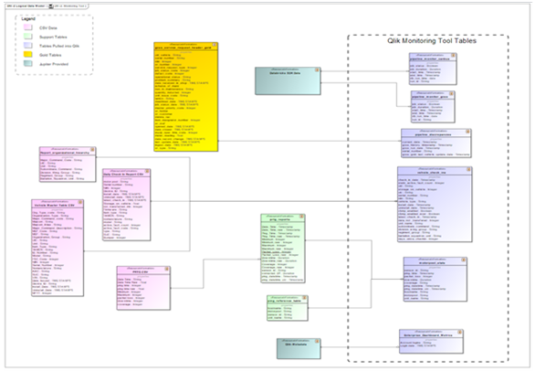
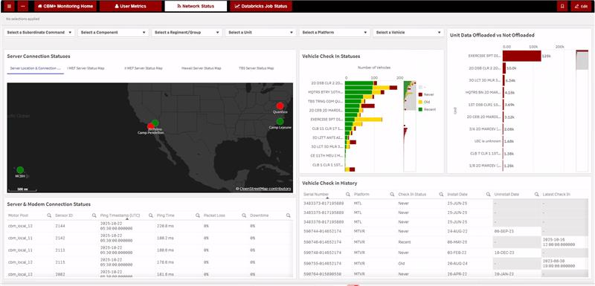
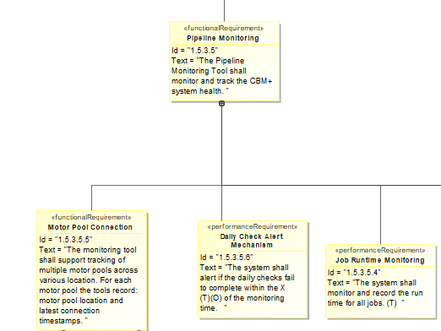
Designing the CBM+ monitoring with MBSE
Requirements
Architecture
Development
Operational and system needs captured in MBSE
Identified requirements most feasible for MVP for a phased approach
Requirements not used in phase 1 will be refined and satisfied in a later iteration
Data architecture developed to identify tables and integration challenges
This ensured all data was ready and available once the development sprint started
MVP prototype and backend work developed within five weeks
Requirements are linked in the Jira ticket so developers can frequently check they are building the right product
These same requirements will be referenced for V&V during the regression sprint
End‑to‑end traceability from mission need to monitoring capability

Slide 14

Key Takeaways on MBSE and Rapid Prototyping
Model-Based Framework
MBSE offers a coherent, model-based approach that enhances speed, learning and confidence in rapid prototyping.
Alignment and Integration
Synchronizing requirements, architecture and early verification supports fast iteration without losing alignment.
Strategic Enabler
MBSE reduces technical risk and enables prototypes to evolve into production-ready systems under tight timelines.
Notes:
Model-Based Framework
MBSE offers a coherent, model-based approach that enhances speed, learning, and confidence in rapid prototyping.
Alignment and Integration
Synchronizing requirements, architecture, and early verification supports fast iteration without losing alignment.
Strategic Enabler
MBSE reduces technical risk and enables prototypes to evolve into production-ready systems under tight timelines.
MBSE fundamentally changes how programs approach rapid prototyping by providing a coherent, model-based framework for speed, learning, and confidence. By anchoring prototypes in capabilities, synchronizing requirements and architecture, and integrating verification early, teams can iterate quickly without losing alignment. The result is faster learning, better decisions, and reduced technical risk. As demonstrated through CBM+ and similar efforts, MBSE enables prototypes to evolve seamlessly into production-ready systems. For programs operating under compressed timelines and changing operational demands, MBSE is not overhead but a strategic enabler of rapid, mission-focused delivery.

Slide 15
Thank you! Questions?

