Slide 1
Tribal Resilience: Ritual’s Place in Suicide Prevention
Captain Jonny Scott
Notes:
Intro: Using collective resiliency to prevent suicide and increase cohesion.

Slide 2
The Problem: - Military suicide deaths have increased steadily since 2011 - 523 service members died by suicide in 2023 - Mental health disorders have increased 40% in last five years - Mental health issues comprised 50% of hospitalizations in 2023
Source: “Calendar Year 2023 Annual Report on Suicide in the Military”
Notes:
Call out problem is continuing despite decrease in combat and increase in mental health funding. Discuss how relationships and social health are the greatest risk factors in suicide

Slide 3
Why current suicide prevention is failing
Individual Experiences Risk Factors
Social Withdrawal
Suicidal Ideation/ Attempt
Removal to Treatment
Isolation from Unit/ Community
Poor Reintegration
Notes:
Explain how

Slide 4
Why current suicide prevention is failing
Individual Experiences Risk Factors
Social Withdrawal
Suicidal Ideation/ Attempt
Removal to Treatment
Isolation from Unit/ Community
Poor Reintegration

Slide 5
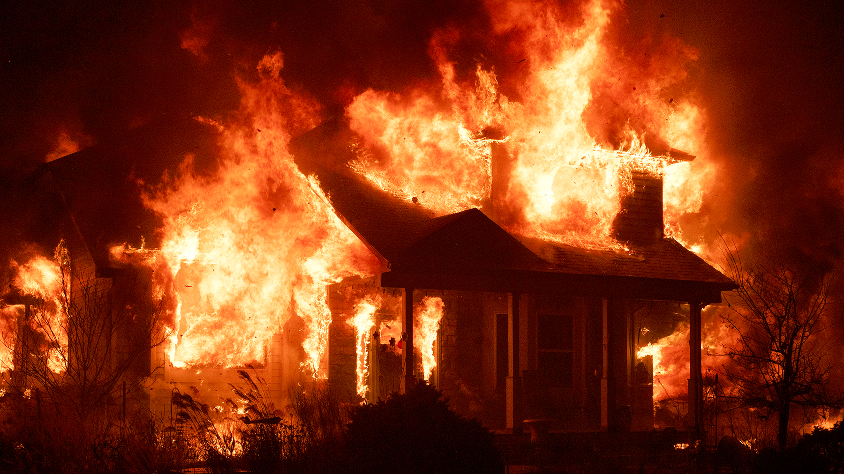

Slide 6
Why current suicide prevention is failing
Individual Experiences Risk Factors
Social Withdrawal
Suicidal Ideation/ Attempt
Removal to Treatment
Isolation from Unit/ Community
Poor Reintegration

Slide 7
Why current suicide prevention is failing
Individual Experiences Risk Factors
Social Withdrawal
Suicidal Ideation/ Attempt
Removal to Treatment
Isolation from Unit/ Community
Poor Reintegration

Slide 8
Unintended Consequences
Pre-Crisis
Performance and community suffers
Peers/ leadership lose respect
Drifts from unit identity
Individual never reintegrates and cycle continues
Resentment from unit for absence
Use of “kid gloves”
Unclear expectations once they return
Post-Crisis
Rumors develop and judgements made
Unit does not know details but must operate without the individual
Individual is removed from unit for medical assessment
During Crisis

Slide 9
Unintended Consequences
Pre-Crisis
Performance and community suffers
Peers/ leadership lose respect
During Crisis
Individual is removed from unit for medical assessment
Unit does not know details but must operate without the individual
Post-Crisis
Unclear expectations once they return
Resentment from unit for absence
Use of “kid gloves”
Individual never reintegrates and cycle continues
Drifts from unit identity
Rumors develop and judgements made

Slide 10
Unintended Consequences
Pre-Crisis
Performance and community suffers
Peers/ leadership lose respect
During Crisis
Individual is removed from unit for medical assessment
Unit does not know details but must operate without the individual
Post-Crisis
Unclear expectations once they return
Resentment from unit for absence
Use of “kid gloves”
Individual never reintegrates and cycle continues
Drifts from unit identity
Rumors develop and judgements made

Slide 11
Why current suicide prevention is failing
Individual Experiences Risk Factors
Social Withdrawal
Suicidal Ideation/ Attempt
Removal to Treatment
Isolation from Unit/ Community
Poor Reintegration

Slide 12
Notes:
The problem with suicide prevention is that the wounds are invincible. Trying to find a person struggling with depression or relationship issues can be overwhelming. A lot of individuals.

Slide 13
Adopting a Framework for Suicide
Interpersonal Theory of Suicide:
1. Capability to Die by Suicide 2. Thwarted Belongingness 3. Perceived Burdensomeness

Slide 14
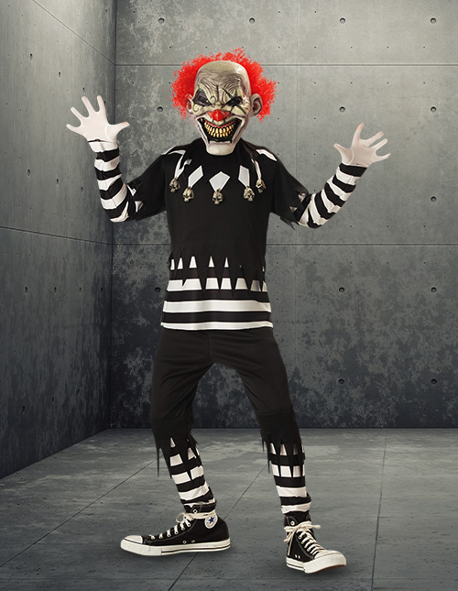
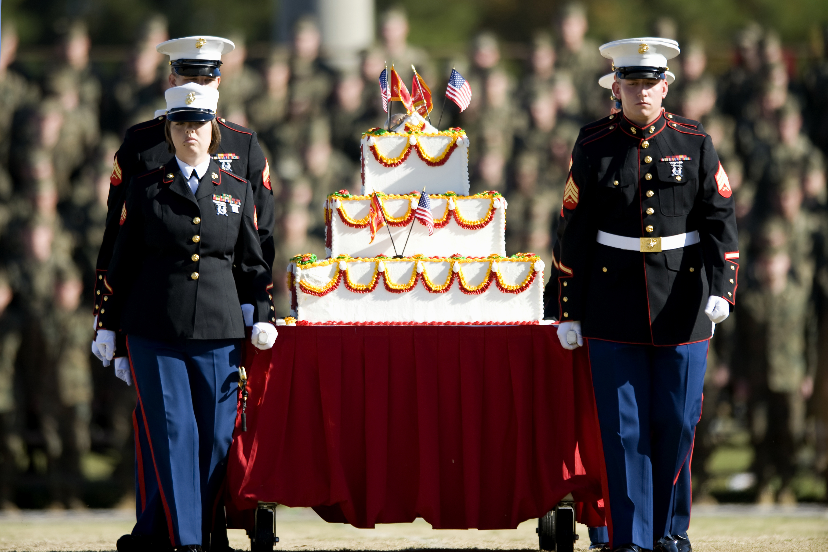
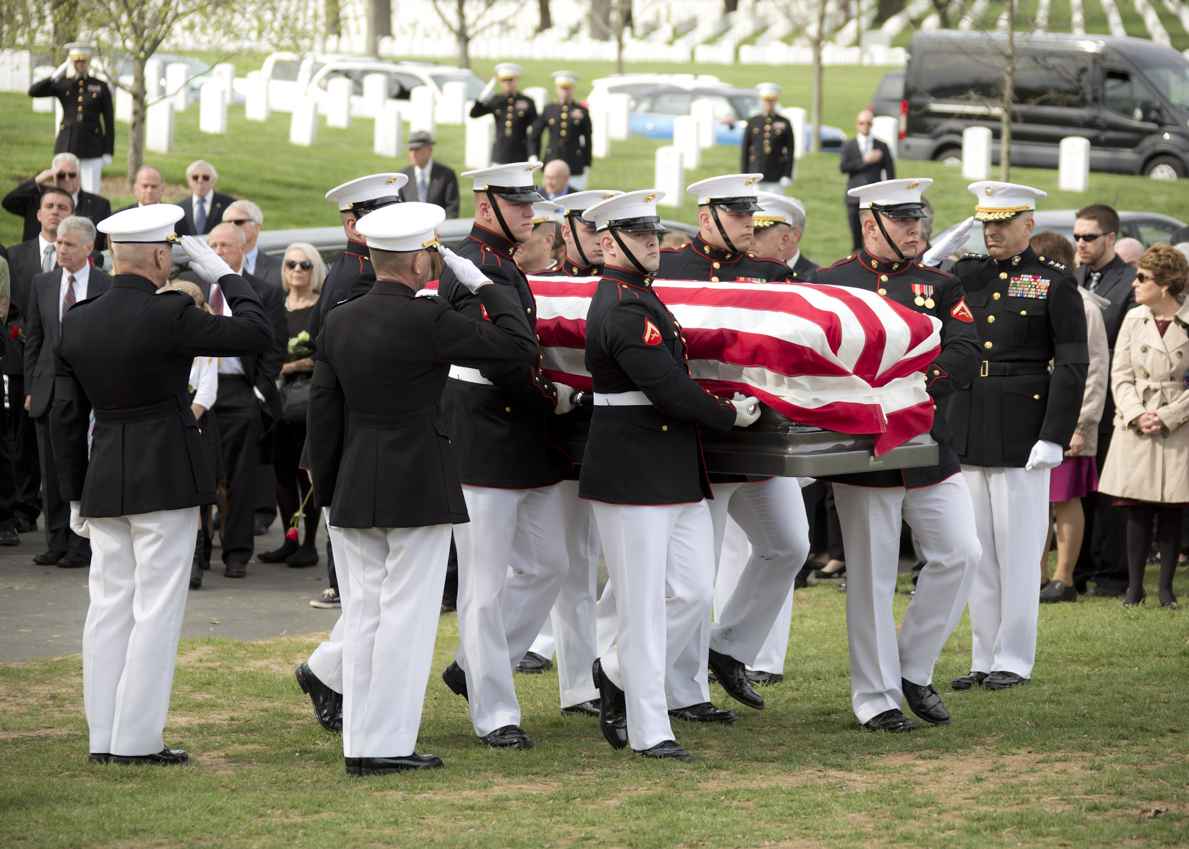
What is ritual?
1. Makes the extraordinary temporarily ordinary
2. Allows groups of people to commune and participate together
3. Follows a known structure to guide and ground participants
Source: Renee Cyr, “Performing Remembrance and Resilience”
Notes:
So what is ritual? Some of you are thinking about robes and candles, but rituals exist in everyday life. Imagine youre locking up for the night, and you hear a knock on the door. (scary picture). What are you doing? Now imagine is Oct 31. Youre probably going to give that creepy little clown some candy instead of a round house. The context of ritual allows for the extraordinary to become temporarily ordinary. Funerals allow groups of people to come together and grieve. Ritual is a tool for humans to have a shared experience and make sense of a confusing world.

Slide 15
Company Commander
Platoon Commander
Chain of Command
Squad Leader
Fire Team Leader

Slide 21
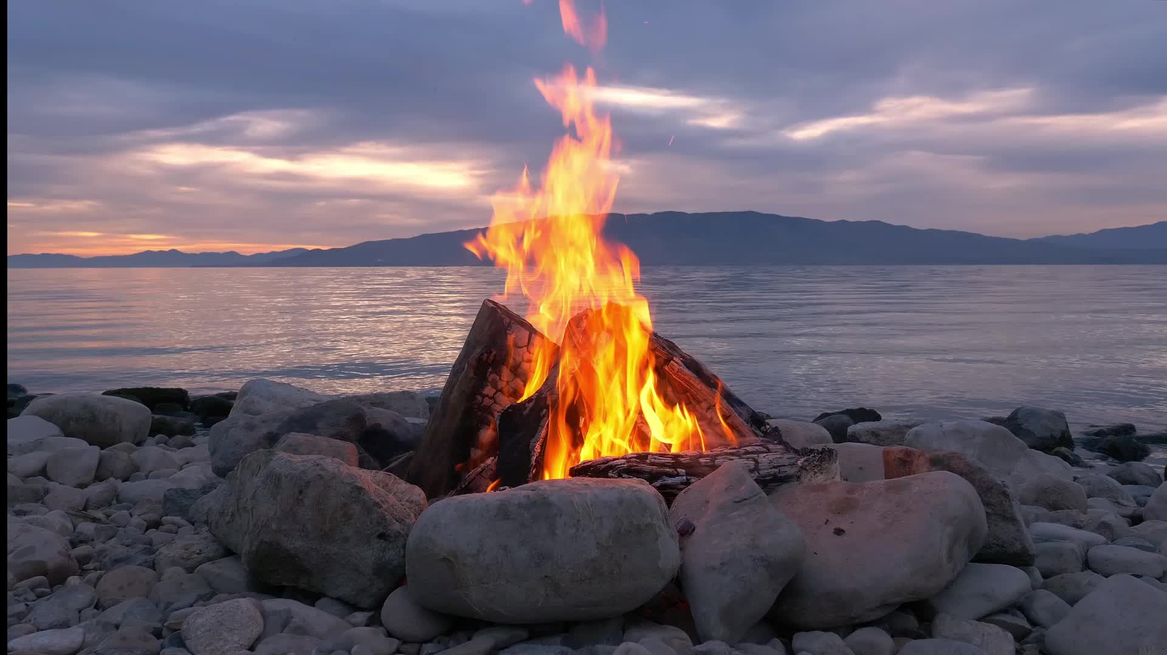
Ritual Example
Notes:
Explain rules:
Lighten mood with a good high five
Prompt 1: Please stand, if someones struggles with substance abuse has negatively impacted your life.
Prompt 2: Please stand if you would be willing to come alongside anyone standing and support them.

Slide 22
Though our burdens are heavy, the tribe is strong.
Notes:
For all standing, we will read the quote on the screen on 3. 1,2,3. Please be seated.
Prompt 3: Please stand if someone in your life has died by suicide.
Prompt 4: Please stand if you would be willing to come alongside anyone standing and support them.

Slide 23
Though we have lost much, we will bear each others' burdens.
Notes:
For all standing, we will read the quote on the screen on 3. 1,2,3. Please be seated.
Prompt 3: Please stand if someone in your life has died by suicide.
Prompt 4: Please stand if you would be willing to come alongside anyone standing and support them.

Slide 24
black
Notes:
Captain Scott personal story. End Ritual

Slide 25
So, what was that?
Normalized and removed barriers to conversations about substance abuse and suicide
Facilitated connections within the group
Established trust in the leader
Notes:
End Ritual: Discuss possible outcomes

Slide 26
Breaking the cycle with ritual
Preemptive or responsive
Normalizes the taboo
Leverages group experience
Communal identity in ritual
Connections outside normal chain of command
Platform for individuals to share
Belongingness
Group assessment
Notes:
If we accept the framework of the Interpersonal Theory of Suicide, we as leaders must deliberately target feelings of thwarted belonginess and perceived burdensomeness if we want to prevent suicides. The problem of traditional methods like counseling's or behavioral health referrals is that its challenging to scale and resource large groups of people. Commanders need a cheap tool to collectively assess their service members spiritual and mental health in a way to establishes both lateral and vertical resiliency chains. Animation. Ritual targets the groups’ identity by leveraging the experience (good and bad) within the group, building time and space for service members to open up and listen to their peers, and connects service members with similar struggles with peers or leaders that are also struggling with similar issues or have successfully overcome them. Ritual destroys the social barriers that prevent us from engaging in otherwise “taboo” topics and lets individuals own and share their experience which enriches the communal identity and destigmatizes weakness while upholding martial culture,

Slide 27
Planning a Ritual
Decide what your unit needs to talk about
Have a leader share their story
Find a way for your service members to participate and contribute during the ritual
Afterwards, continue to normalize and encourage conversations, resources, and support
Notes:
End Ritual: Discuss possible outcomes

Slide 28
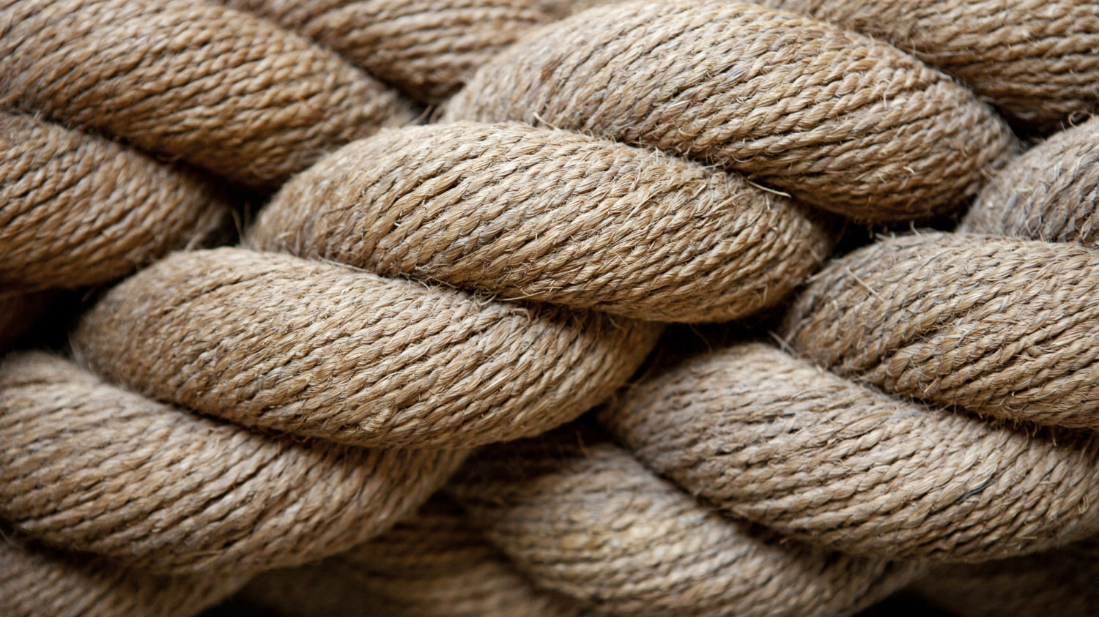
“And though a man might prevail against one who is alone, two will withstand him—a threefold cord is not quickly broken.” - Ecclesiastes 4:12
Notes:
What ill leave you with is: For a three fold cord is not easily broken.
We are willing to die for our Marines. We are willing to endure immense physical and mental hardship, but are we willing to be vulnerable and share our struggles with them. I believe ritual can be the vehicle that allows us to do that, and tt is my hope and prayer that the road to suicide becomes less and less traveled. Thank you.

Slide 29
Questions?

Slide 30
References "Calendar Year 2023 Annual Report on Suicide in the Military." U.S. Department of Defense Office of the Under Secretary of Defense for Personnel and Readiness, n.d. "Department of Defense Releases Its Annual Report on Suicide in the Military for Calendar Year 2023." U.S. Department of Defense. Accessed December 30, 2024. https://www.defense.gov/News/Releases/Release/Article/3964785/department-of-defense-releases-its-annual-report-on-suicide-in-the-military- for/https%3A%2F%2Fwww.defense.gov%2FNews%2FReleases%2FRelease%2FArticle%2F3964785%2Fdepartment-of-defense-releases-its-annual-report-on- suicide-in-the-military-for%2F. Joiner, Thomas. Why People Die by Suicide. Cambridge: Harvard University Press, 2005. Military Sees 40% Spike in Mental Health Diagnoses, Report Finds. https://www.veterannews.org/veteran-news/report-reveals-sharp-increase-in-mental-health- disorders-among-active-duty-troops. Office of the Surgeon General (OSG), Our Epidemic of Loneliness and Isolation: The U.S. Surgeon General’s Advisory on the Healing Effects of Social Connection and Community, Publications and Reports of the Surgeon General (Washington (DC): US Department of Health and Human Services, 2023), http://www.ncbi.nlm.nih.gov/books/NBK595227/. Renee Cyr, “Performing Remembrance and Resilience: Creative Ritual Performances in Response to Traumatic Events of the 21st Century” (University of Kansas, 2024).

Slide 31
Contact Info: Captain Jonny Scott Jonathan.m.scott1@usmc.mil

