Slide 1
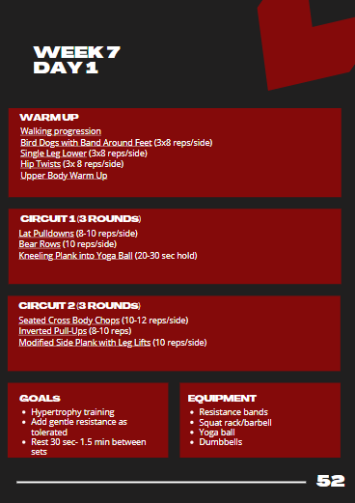
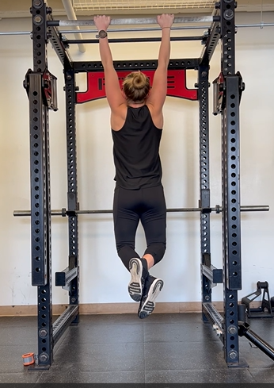
Captain Kerry Whalen, USMC

Slide 2
Agenda
Background
Program Design
Way Forward
Questions

Slide 3
Acknowledgements
Thank you to the individuals below for their invaluable feedback, input and advice in creating this program:
Dr. Aimee Anagnostos, DPT, Pelvic Floor Specialist
Mr. Ben McAndrews, MS, ATC, USMC Sports Medicine Injury Prevention Program Manager, TECOM Human Performance Branch
Mr. Jay Sedory, Med, ATC, EMT-T, Certified Athletic Trainer, Martial Arts & Fitness Center of Excellence

Slide 4
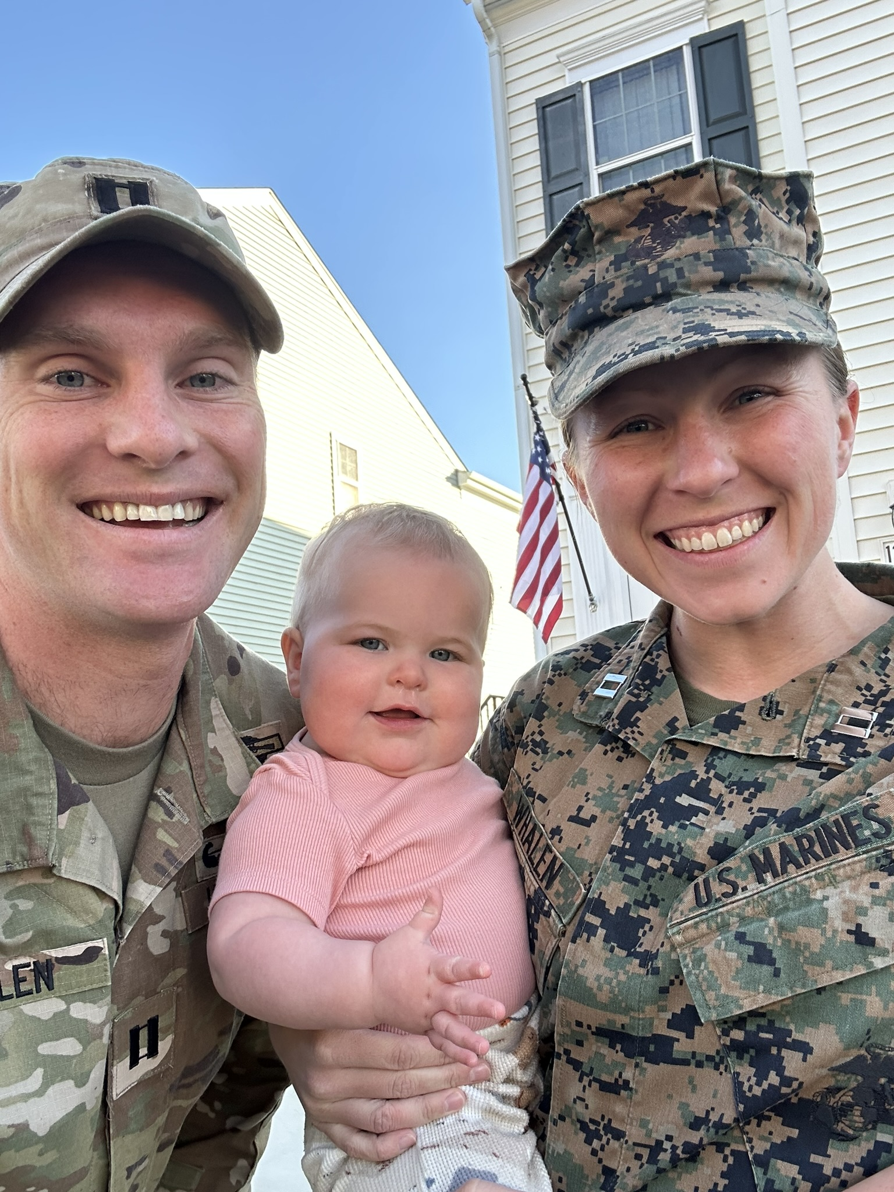
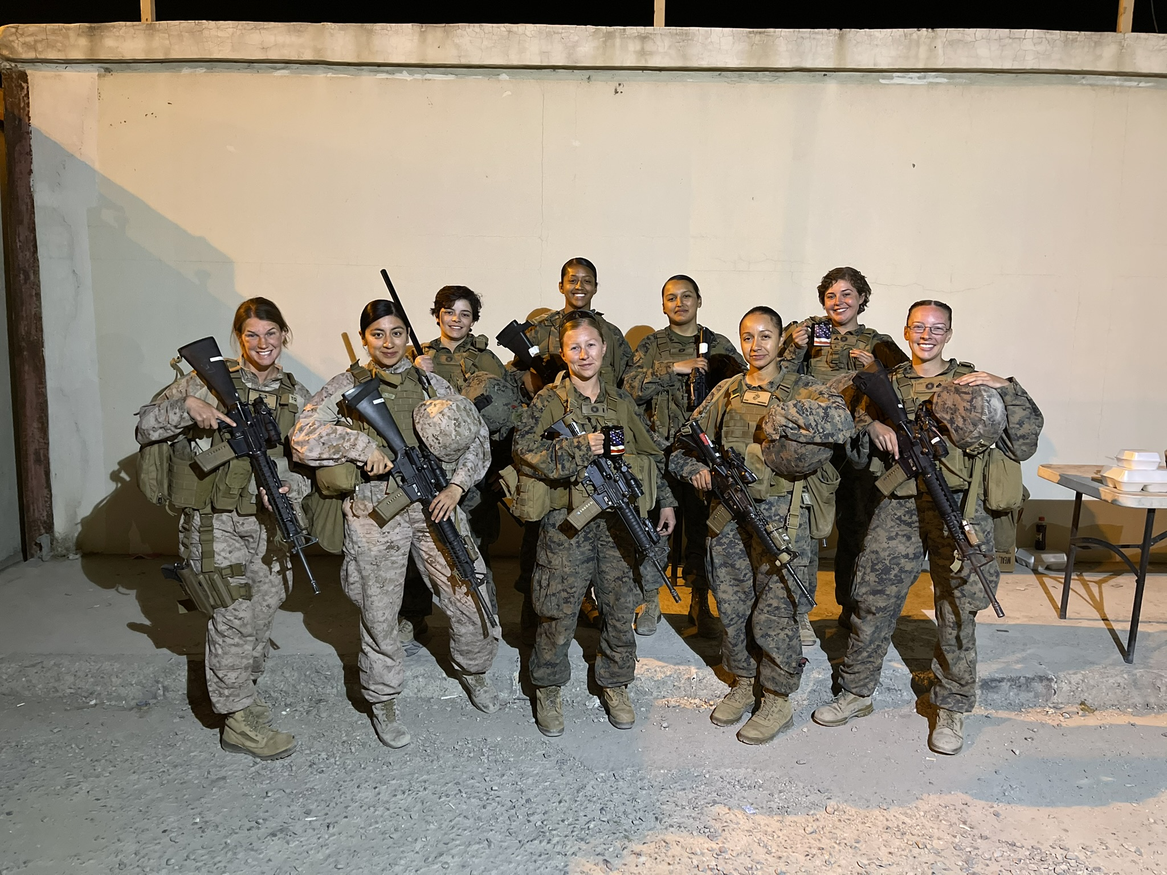
About Me
Marine Logistics Officer
Certified Prenatal and Postnatal Fitness Specialist
Mom

Slide 5
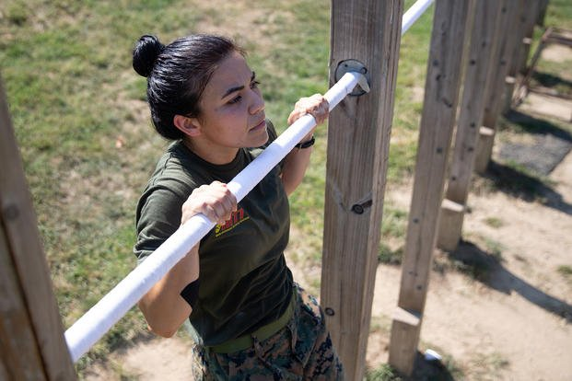
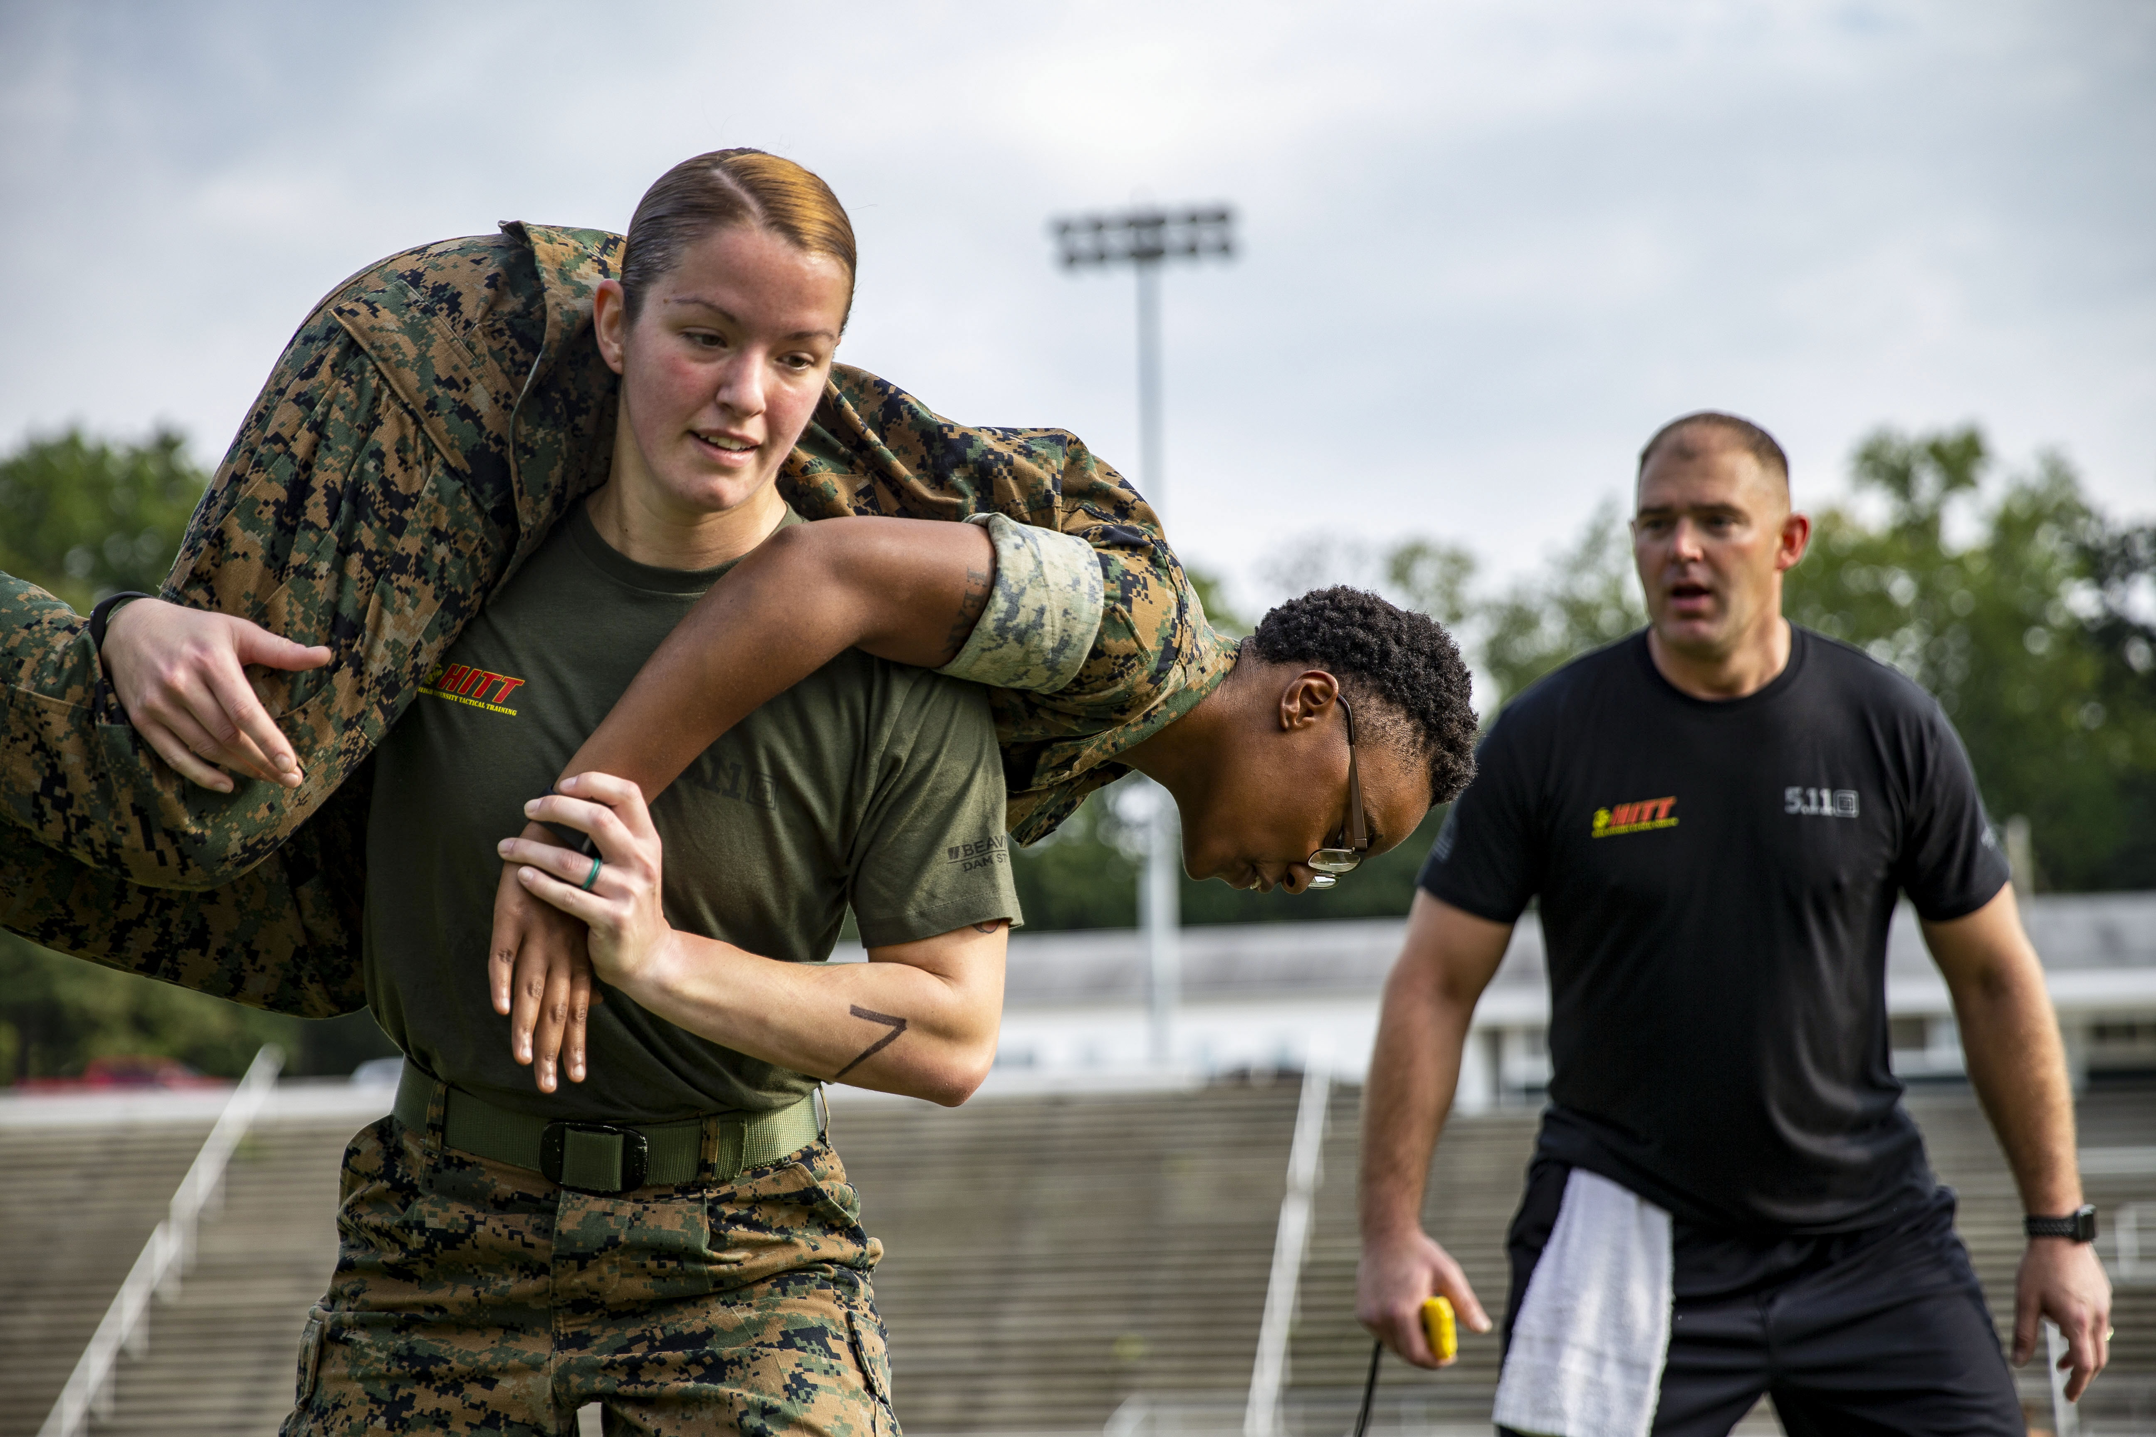
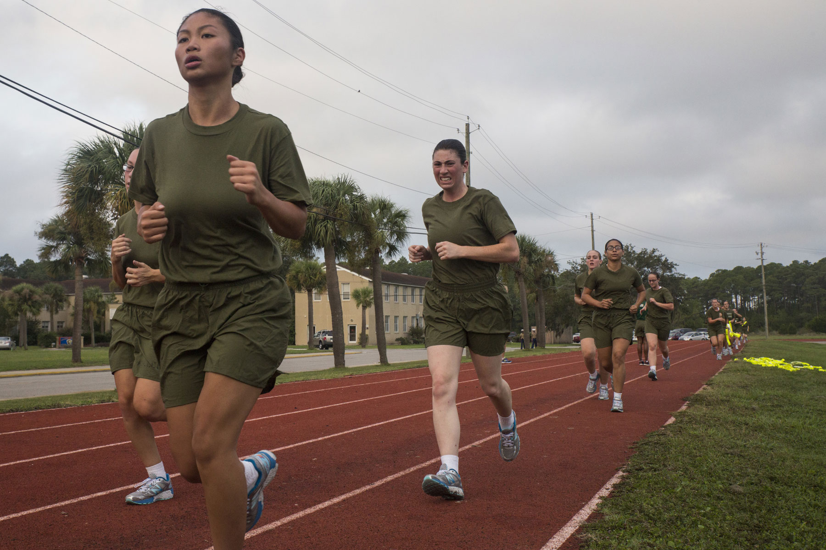
Why Is This Needed?
BLUF: Postpartum Marines lack adequate resources to recover and return to USMC fitness standards
43 percent of active-duty servicewomen have been pregnant while serving (2022 Women’s Reproductive Health Survey of Active-Duty Service Members)
The Marine Corps requires women to meet PFT and CFT fitness standards 12 months following childbirth (MCO 5000.12F)
Existing programs are not tailored to USMC requirements and are costly
12 Months

Slide 6
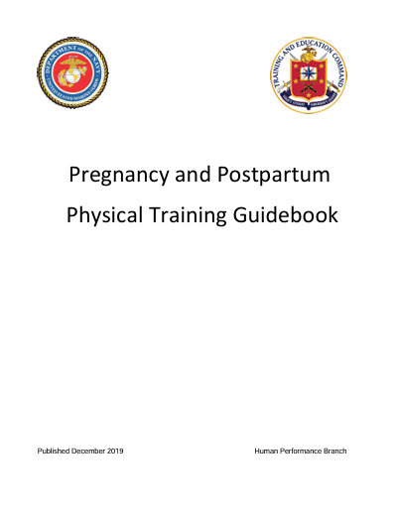
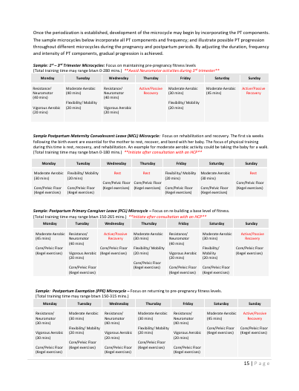
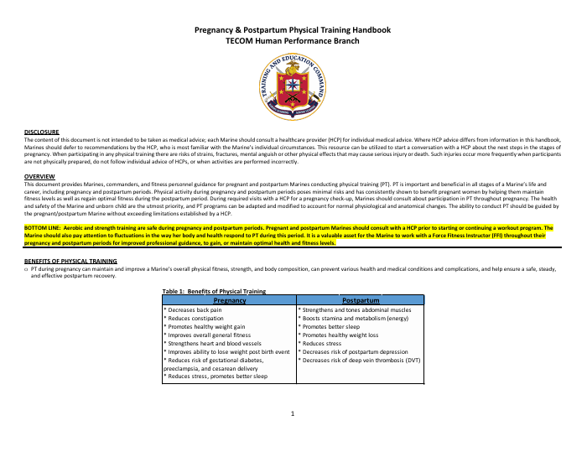
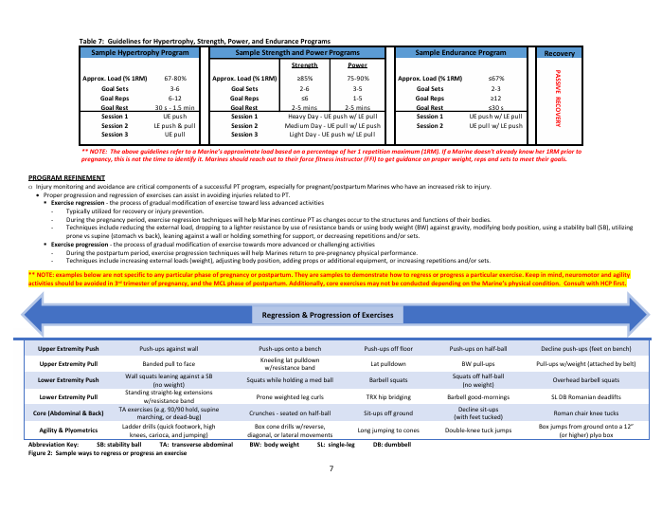
Existing Resources
TECOM Pregnancy and Postpartum Physical Training Guidebook
“The guidebook is intended as an overview, and provides guidance and clarity for adaptation of a PT program that empowers a pregnant or postpartum Marine to design her own PT program. “
TECOM Pregnancy and Postpartum Physical Training Handbook
“This document provides Marines, commanders, and fitness personnel guidance for pregnant and postpartum Marines conducting physical training.”

Slide 7
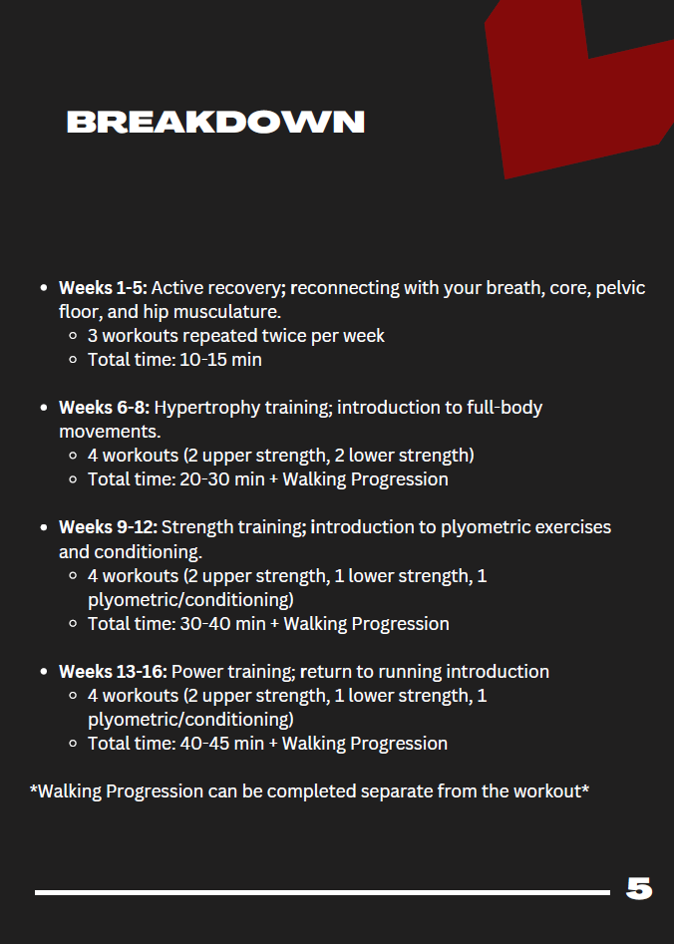
Program Design
16-week progressive program
Periodization training
Focus on:
Pelvic floor rehabilitation
Diaphragmatic breathing
Core strengthening
Lifting/CFT/PFT progressions
Return to run/plyometrics

Slide 8
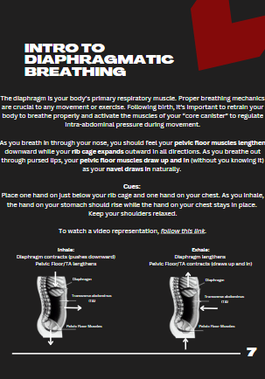
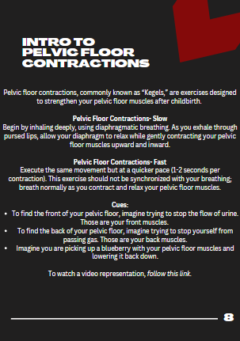
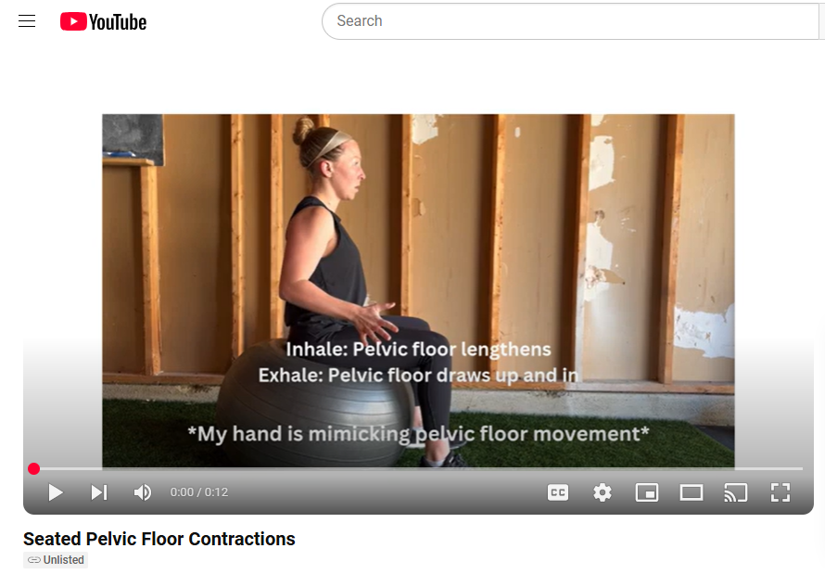
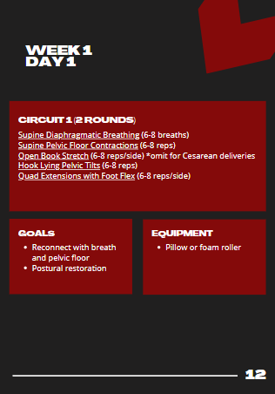
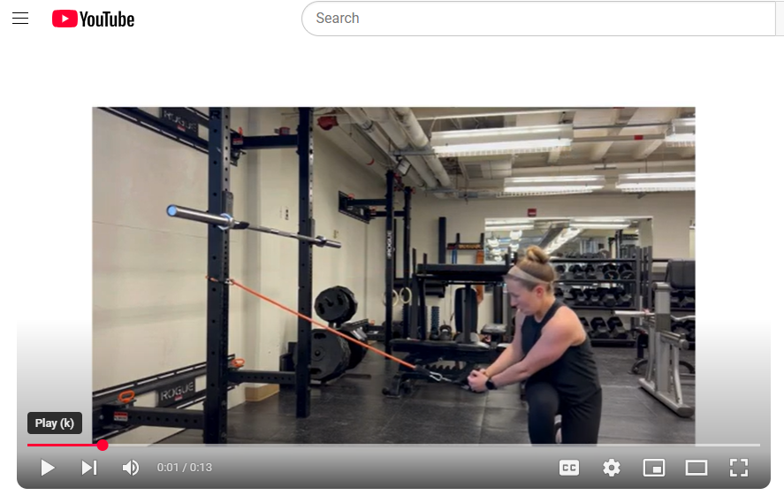
Key Components
1 PDF:
8 informational pages
74 daily follow-along workouts
7 key movements:
Squat, hinge, push, pull, carry, lunge, rotate
200+ embedded instructional video links with modifications
Reviewed by: pelvic floor physical therapist, TECOM Human Performance Branch, and Marine Corps Martial Arts and Fitness Center of Excellence

Slide 9
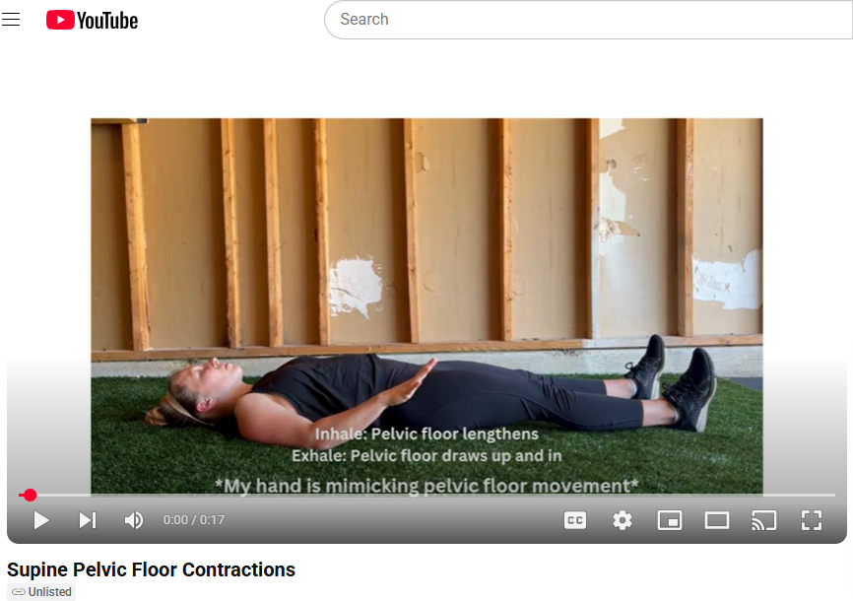
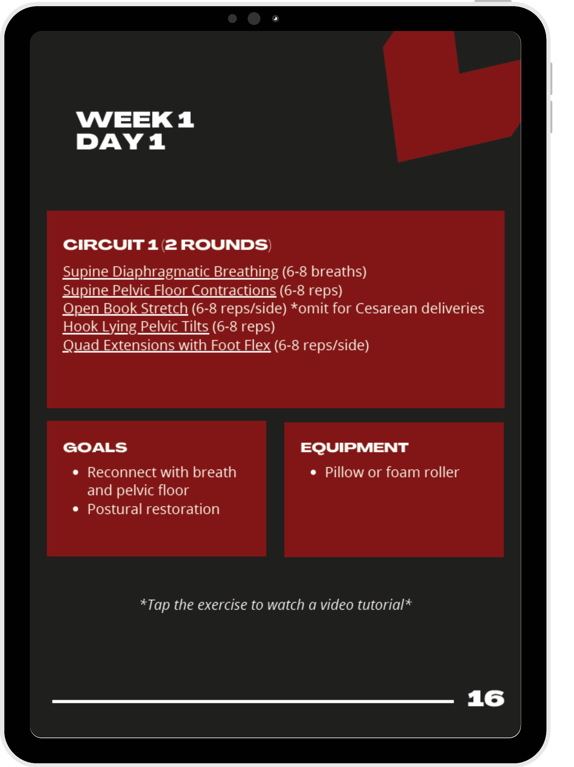

Slide 10
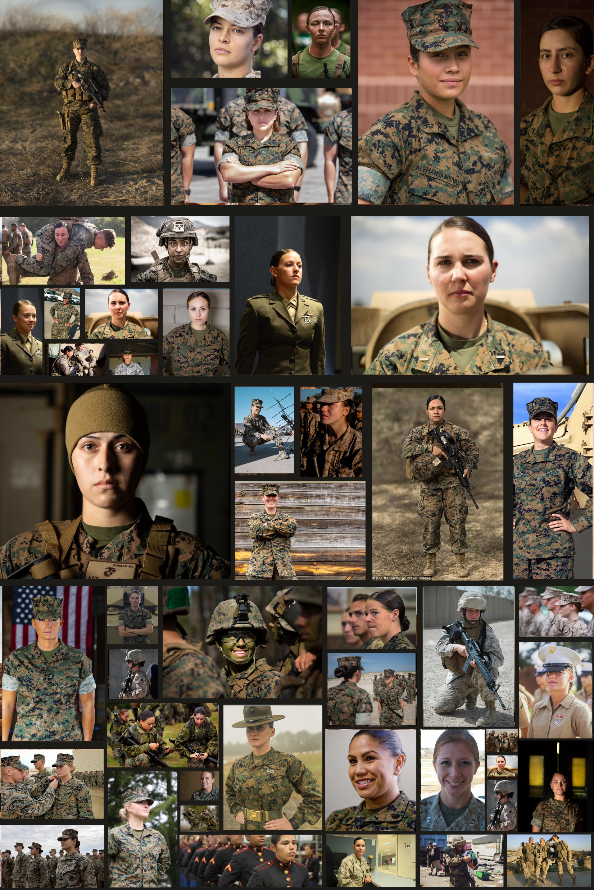
Program Impacts
Fills a gap in resources
Free and accessible program tailored to USMC fitness standards
Tool for leaders
Retention of postpartum Marines = talent management

Slide 11
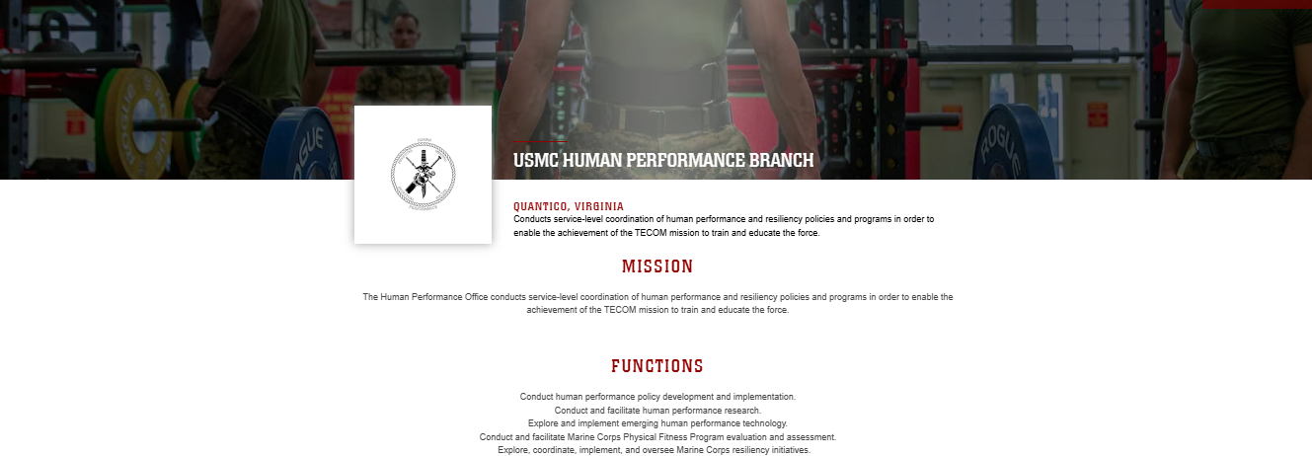
Way Forward
Make available to a larger audience
USMC Human Performance Branch website
QR code flyers at naval health clinics, Baby Boot Camp, CDCs
Transition program to phone application

Slide 12
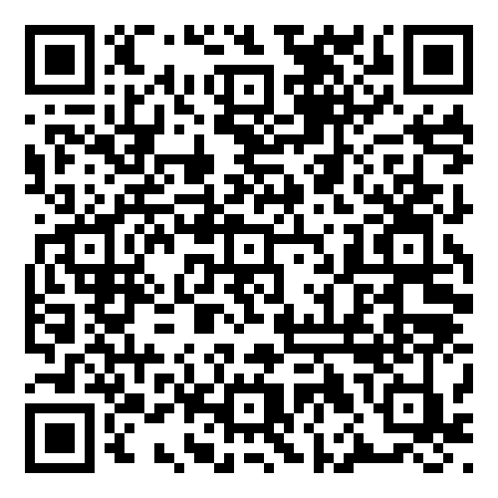
Questions?
Contact Information:
Captain Kerry Whalen
postpartumreturntoduty@gmail.com

