Slide 1
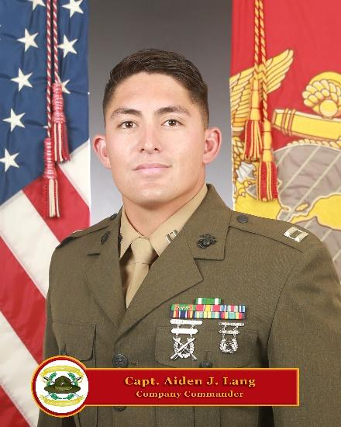
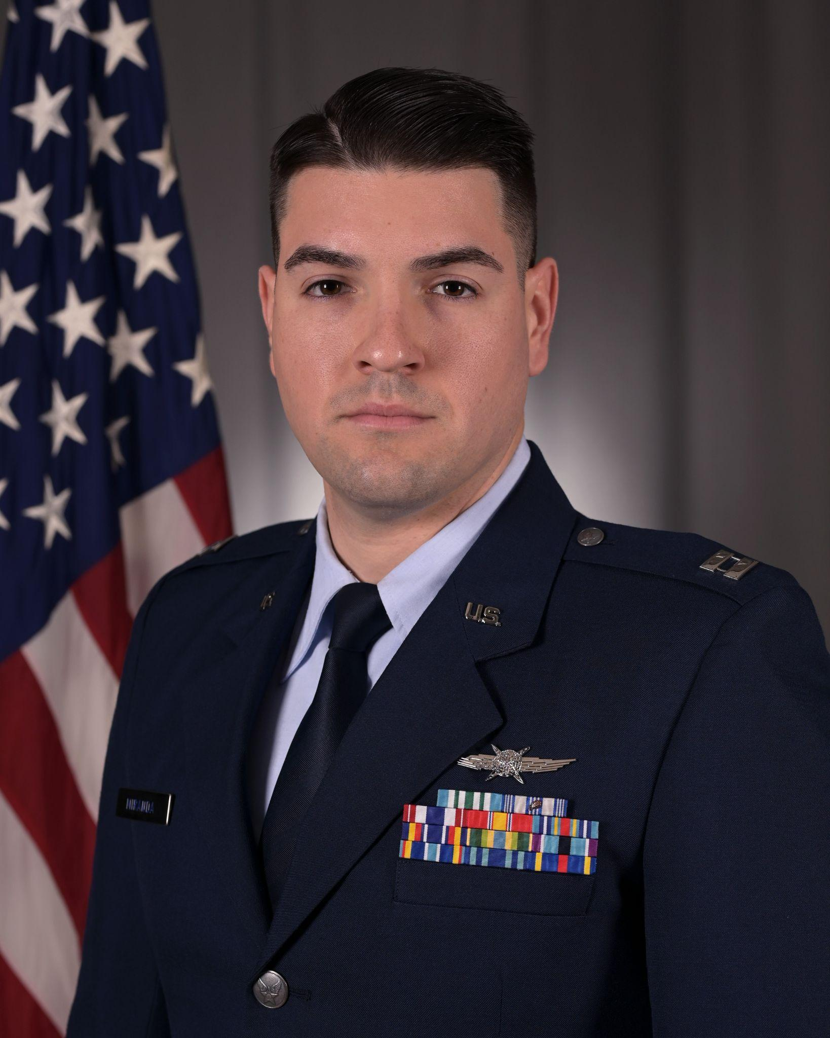
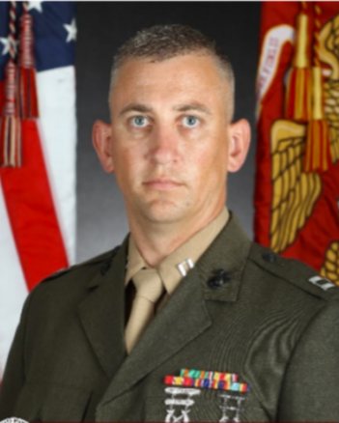
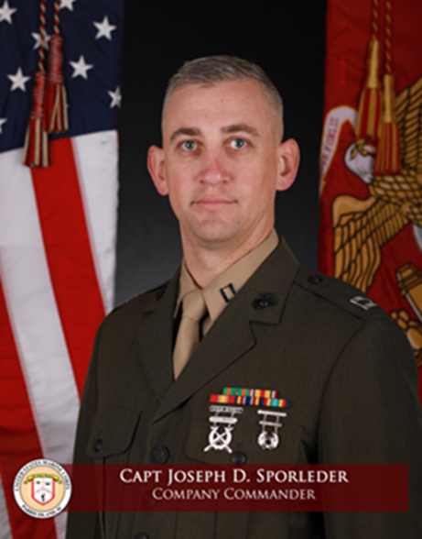
Team Members
CPT Marcelo Castro
USA
12A: Engineer
Contrarian/Red Cell
Capt Aiden Lang
USMC
0302/0303: Infantry & LAR Reconnaissance
Agenda Setter
Capt Craig Miranda
USAF
17D: Cyber Operations
Project Manager
Capt Jackie Sapitro
USMC
7210: Air Defense Control
Recorder
Capt Joseph Sporleder
USMC
0602: Communi-
cations
Research Liaison
Notes:
Personal introduction
Introduce joint team and backgrounds

Slide 2
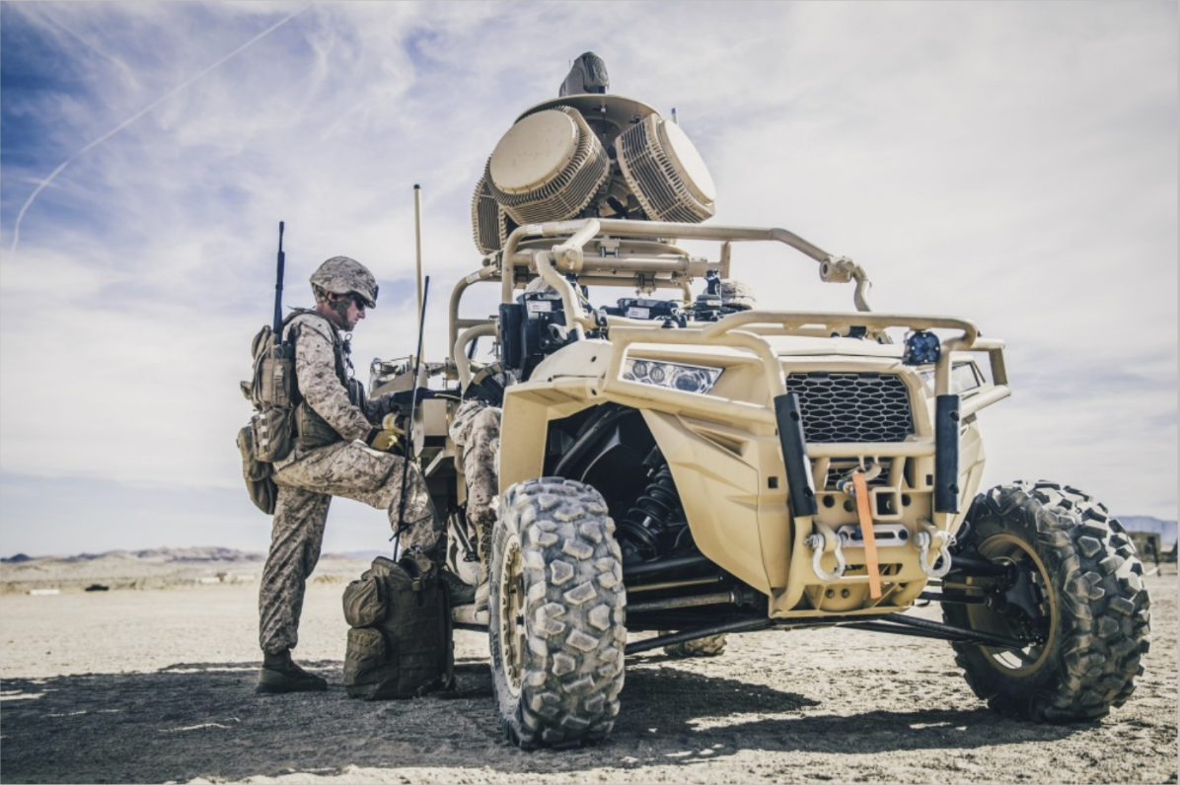
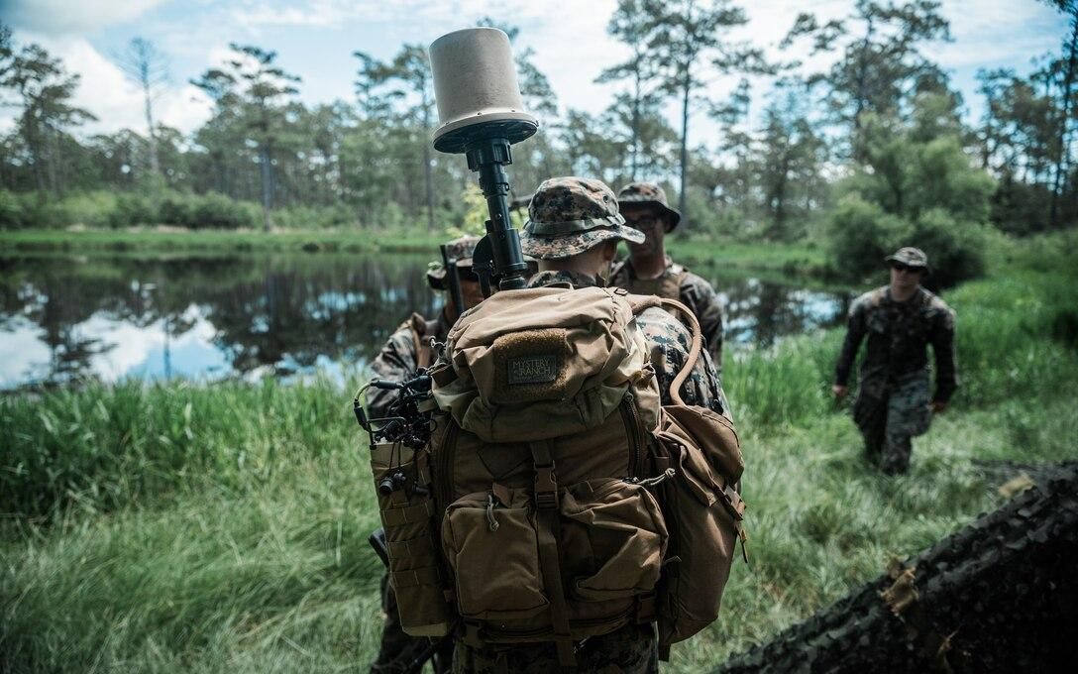
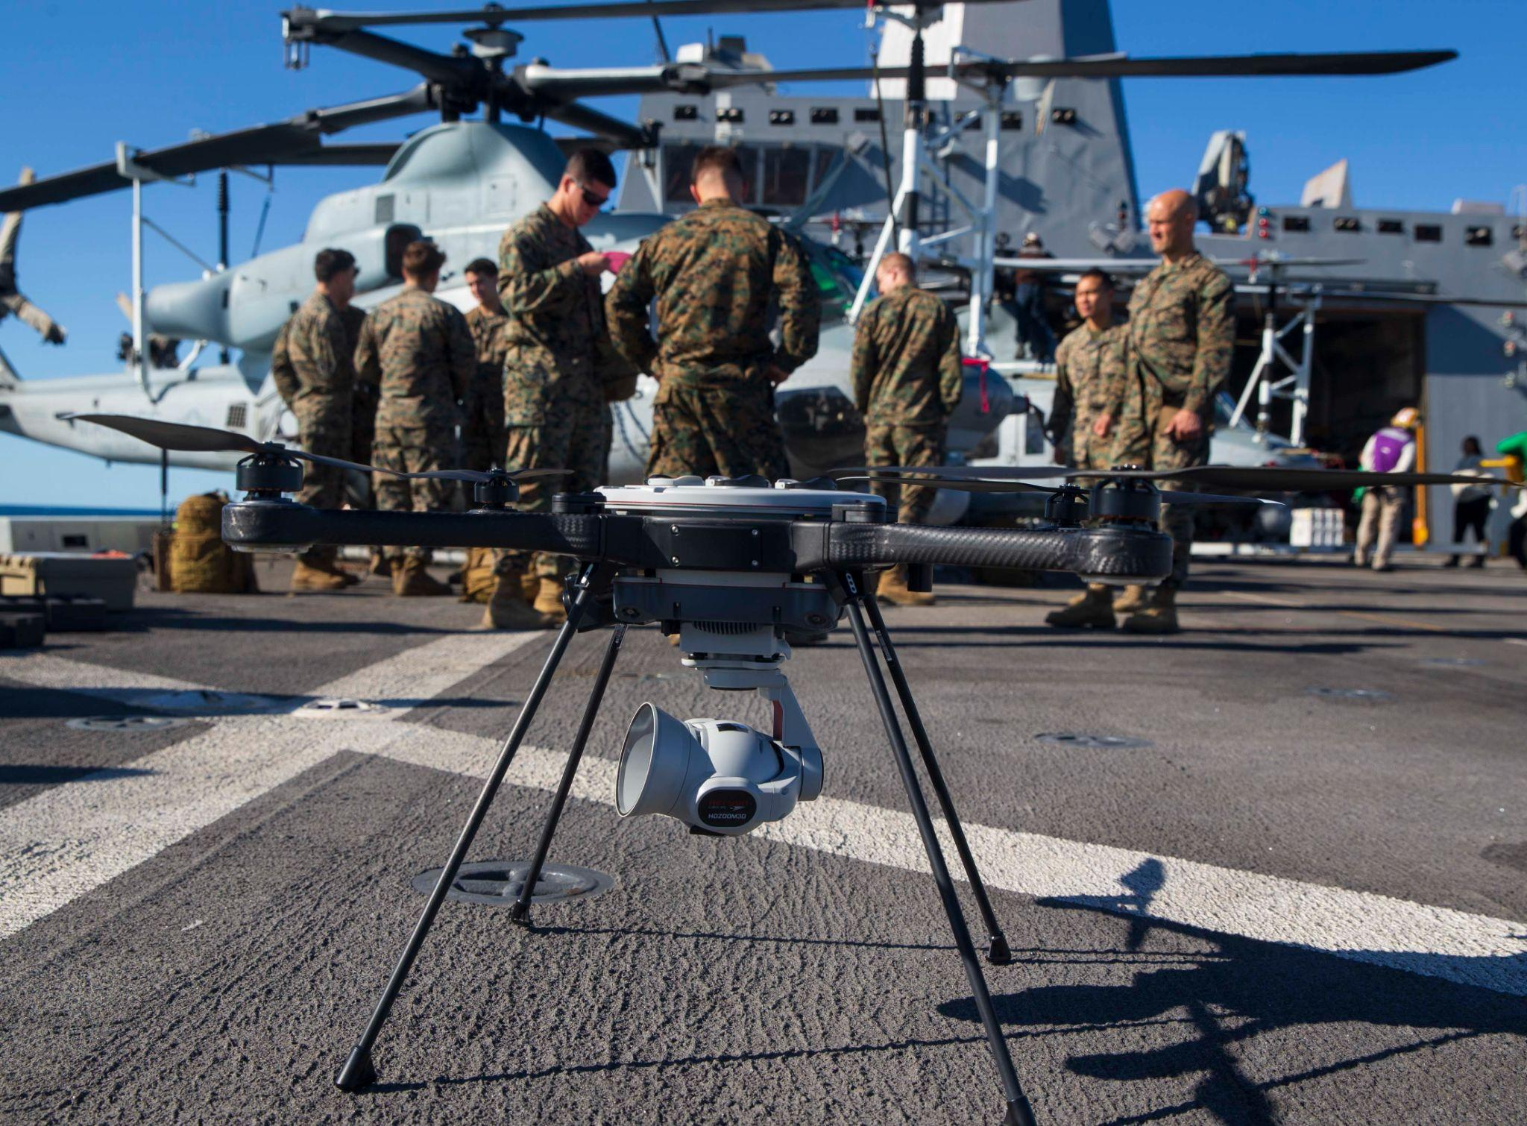
Dominating the EMS: The Battalion EW Fight
Notes:
Challenge we were presented while a student at the Marine Corps University, Expeditionary Warfare School was: How does the Marine Corps dominate the EMS at the Battalion level?

Slide 3
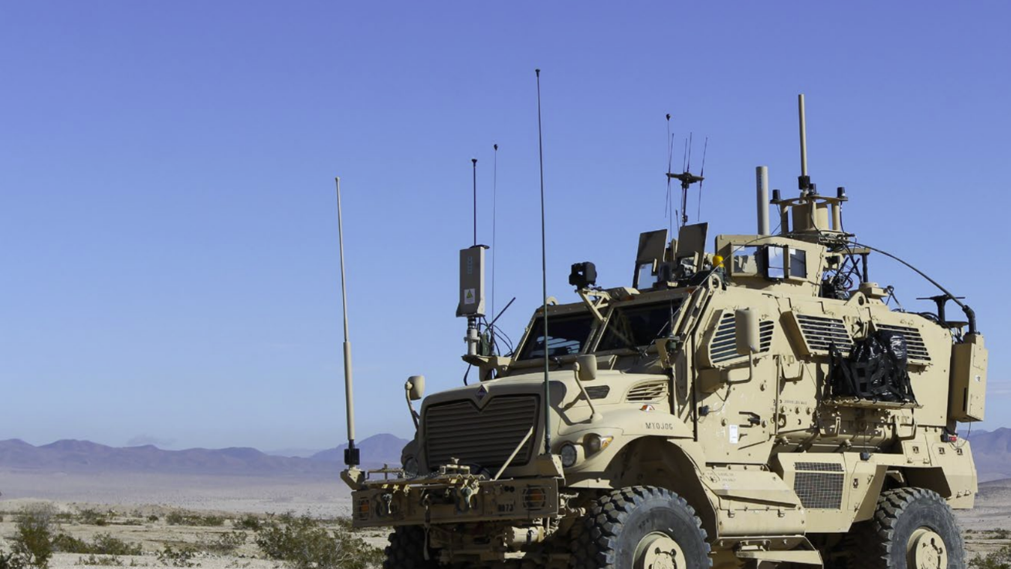
Overview
Problem Framing
Proposed Solutions
Counter Arguments
Case Study: The Falklands War
Proposal
Questions
Notes:
Introduction, Problem Framing, Solution #1 (MTT/IO), Solution #2 (SOP/Doctrine), Case Study/Counter Argument, Questions.

Slide 4
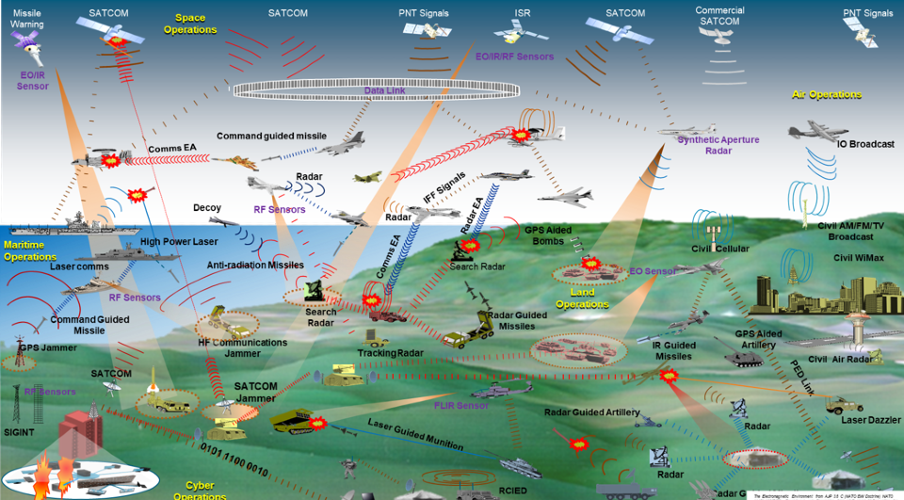
Strategic Context
Figure: The Electromagnetic Environment from AJP 3.6 C (NATO EW Doctrine) NATO UNCLASSIFIED
Notes:
Operational/tactical level: Space Operations, Air Operations, Maritime Operations, Land Operations, and Cyber Operations - congested and contested.
Mil equipment uses EMS sense, track, guide, and communicate.
All domains
The EMS is becoming congested due to the modern battlefields interconnected platforms and due to this, more contested.
Photo: https://www.nato.int/cps/in/natohq/topics_80906.htm
Figure: The Electromagnetic Environment from AJP 3.6 C (NATO EW Doctrine) NATO UNCLASSIFIED; Reproduced with Permission from MoD Head of Delegation for NATO EW within the NATO EW.

Slide 5
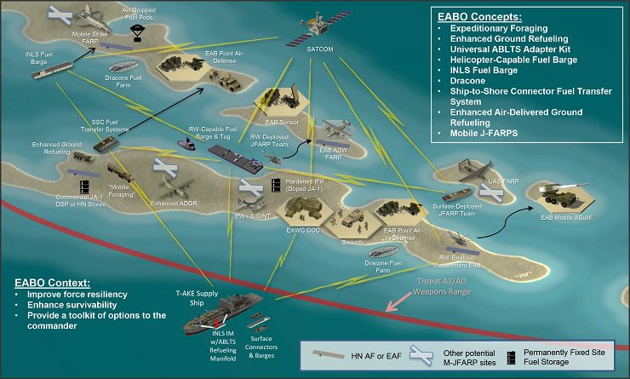
Strategic Context
Figure: The Electromagnetic Environment from AJP 3.6 C (NATO EW Doctrine) NATO UNCLASSIFIED
Notes:
Strategic context: Military Operation -> EABO, this is how we see it play out operating across all domains
This is the future operating construct in an expeditionary environment
Distributed elements
Reliant on C2 and sensor to shooter platforms
Sensors and shooting operating within a web of Kill chains
Technical adversary capabilities to sense or disrupt elements within the WEZ
Photo: https://www.stratagem.no/stand-in-forces/

Slide 6
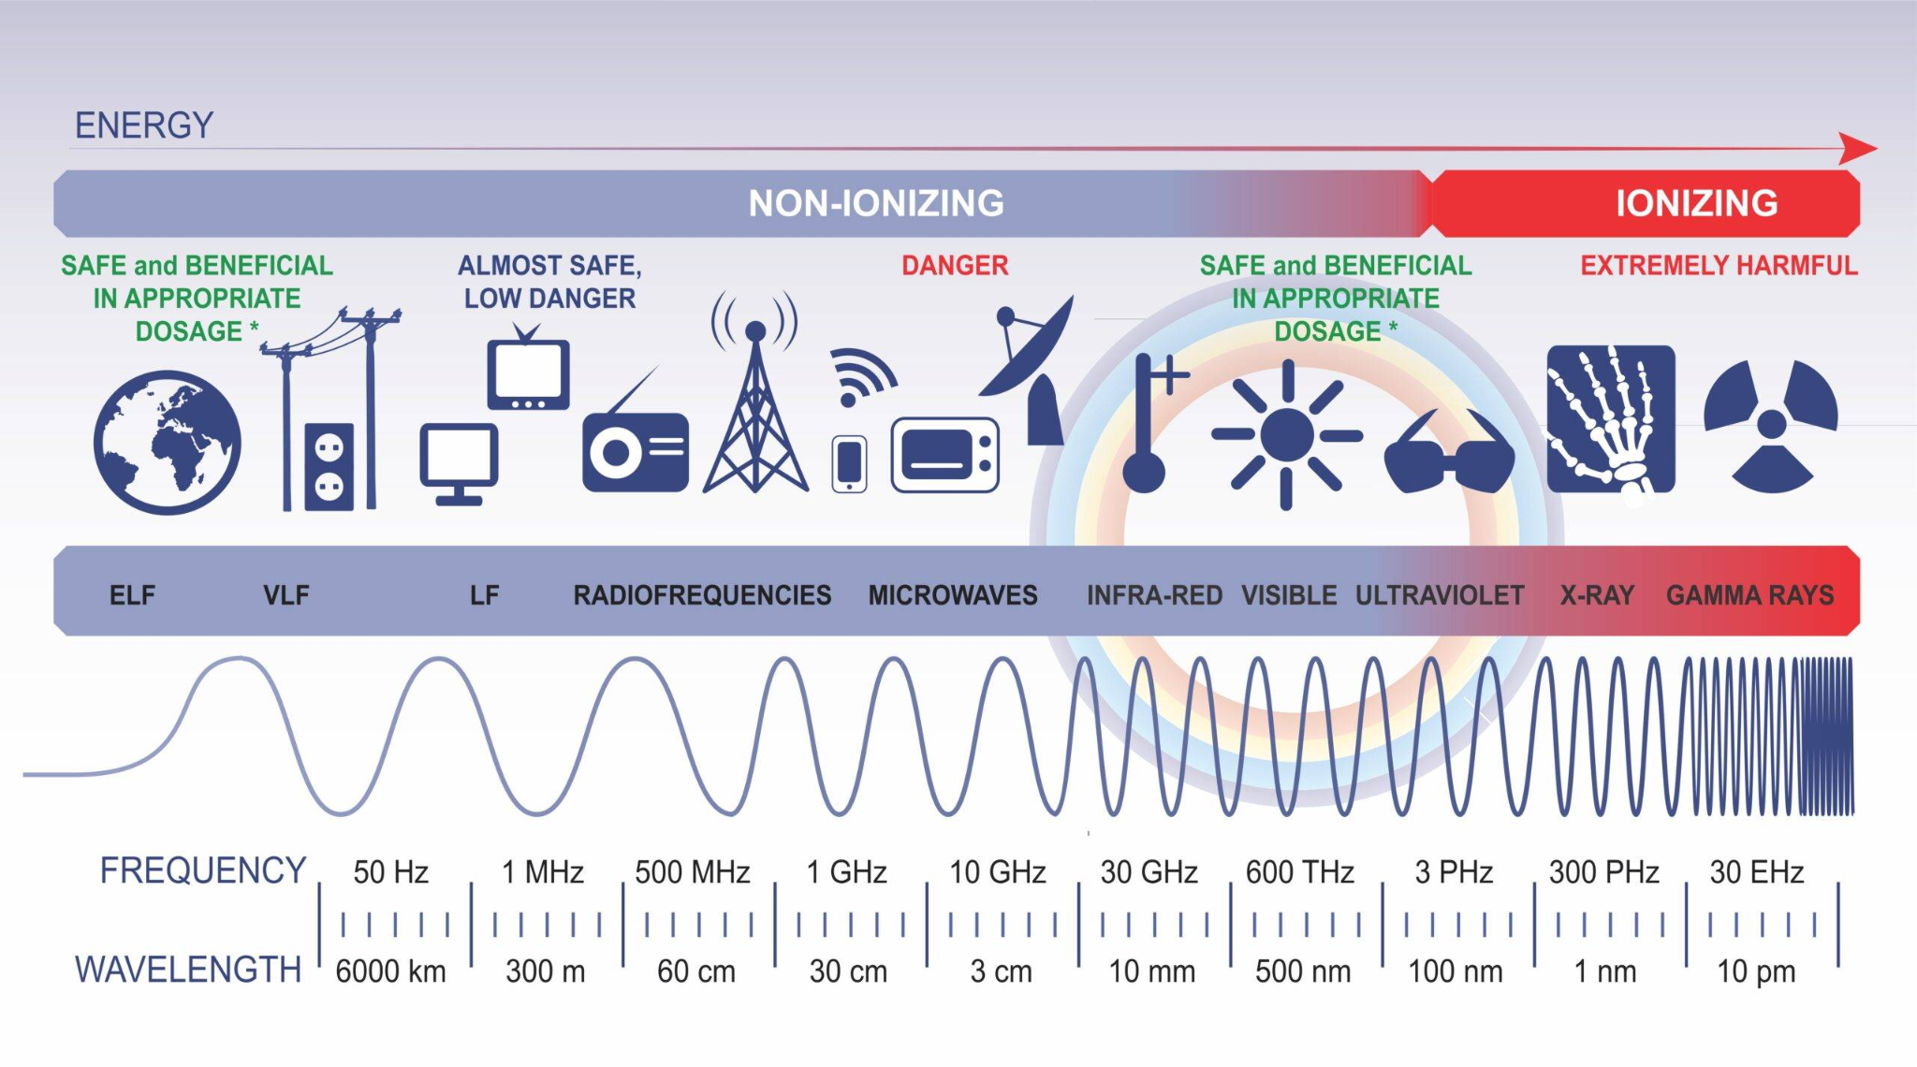
Notes:
Tactical Level: This is the EMS, what is the EMS? Powerlines, tv sets, dangerous microwave, radiological waves. Military Low-Extremely High Freq.
Wifi
Bluetooth
Cyber
Radio
SATCOM
Cellular
Every part of our daily life and our armed services rely heavily on this contested environment to operate. EABO is going to drive the requirement for us to dominate in it.
Picture:https://www.forbes.com/sites/cognitiveworld/2019/04/12/the-weaponization-of-the-electromagnetic-spectrum/

Slide 7
Plan of Action & Milestones
24 Sep 24: FACMENT / PROCOM Review
07 Oct 24:
Revised
Essays
DUE
31 Jan 25:
Phase 3 Brief and Paper Due
Planned
In Progress
Complete
Modern Day Marine:
Current Day
26 Aug 24:
Problems Assigned
26 Sep 24: Receive Feedback/Final Edits
30 Oct 24:
COA
proposals
16 Dec 24:
Phase 2 Brief
24/25/28 Mar 25:
Final Briefs
September
November
January
March
August
October
December
February
April
16 Oct 24:
Paper
feedback
18 Dec 24:
Counter
Argument DUE
10 Sep 24: Initial Draft Submission
01 Oct 24: Phase 1 Brief
07 Nov 24:
Meet with
FACMENT/
CD&I
14 Mar 25:
Phase 4
Paper due
Phase 1
Phase 2
Phase 3
Phase 4

Slide 8
Definitions Matter: Electromagnetic Warfare
Notes:
Electromagnetic Spectrum (EMS) – The range of all types of electromagnetic radiation. (National
Aeronautics and Space Administration (NASA))
Electromagnetic Spectrum Operations – Coordinated military actions to exploit, attack, protect, and
manage the electromagnetic environment. Also called EMSO. (JP 3-85)
Electromagnetic Warfare – Military action involving the use of electromagnetic and directed energy to
control the electromagnetic spectrum or to attack the enemy. Also called EW. [previously Electronic
Warfare] (JP 3-85)
The EMS - Church of the Cosmos, “Electromagnetic Spectrum,” accessed January 4, 2022, churchofthecosmos.files.wordpress.com/2012/12/electromagnetic-spectrum.png

Slide 9
Problem: Outdated Publications and Enabler gap
USMC Publications (MCRP 3-32D) are outdated and no standard operating procedures (SOPs) exist to plan and integrate emergent EMS capabilities
2. Units lack EMSO enablers and equipment to employ EW capabilities at
scale
Notes:
Problem 1: MCRP 3-32d.1 is outdated and fails to adequately guide employment of EMSO capabilities at the tactical level. THIS LEAVES Marine Corps battalions/companies at a disadvantage in the EMS
Problem 2: EMSO enablers are tasked organized at the MAGTF level; leaving a gap at the battalion level with a lack of organic EW capabilities. THIS LEAVES Marine Corps battalions/companies at a relative disadvantage to our adversaries who have organic EW capabilities at the brigade (O6) and battalion (O5) levels.

Slide 10
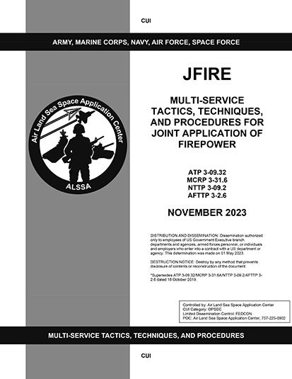
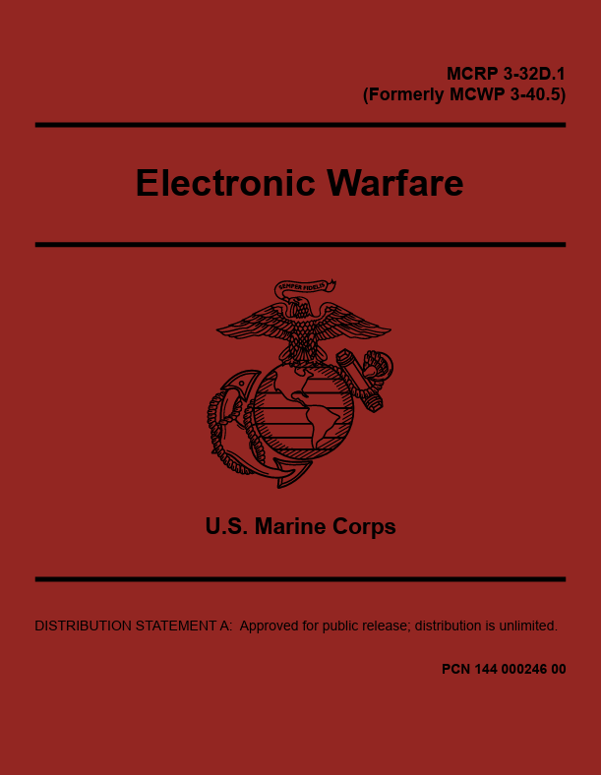
Problem Area 1: MCTP
USMC training and reference publications are outdated and lack sufficient focus on emergent EMS capabilities.
Notes:
MCRP: TITLE/DATE: April 2018
MCTP: TITLE/DATE
JFIRE: TITLE/DATE
Note: photos of each document/reference
-MCRP 3-32d.1 is outdated; it is not nested with the EMS Superiority Strategy which redefined it as Electromagnetic Warfare. Furthermore, it is focused for MAGTF level operations. For example, Appendix A provide procedural methods to request EMSO support from the Joint Force. THIS MEANS THAT subordinate units must pass centralized requests for support AND resort to non-doctrinal requests/ad-hoc supporting relationships below the MAGTF level.
-Lacks tactical level employment considerations - note: NOT employment methods/means/specifics - to facilitate the planning, integration, and employment of EMSO capabilities. THIS MEANS THAT units without an EMSO enabler are unable to gain and advantage in time/tempot due to a lack of ability to plan and integrate effects.

Slide 11
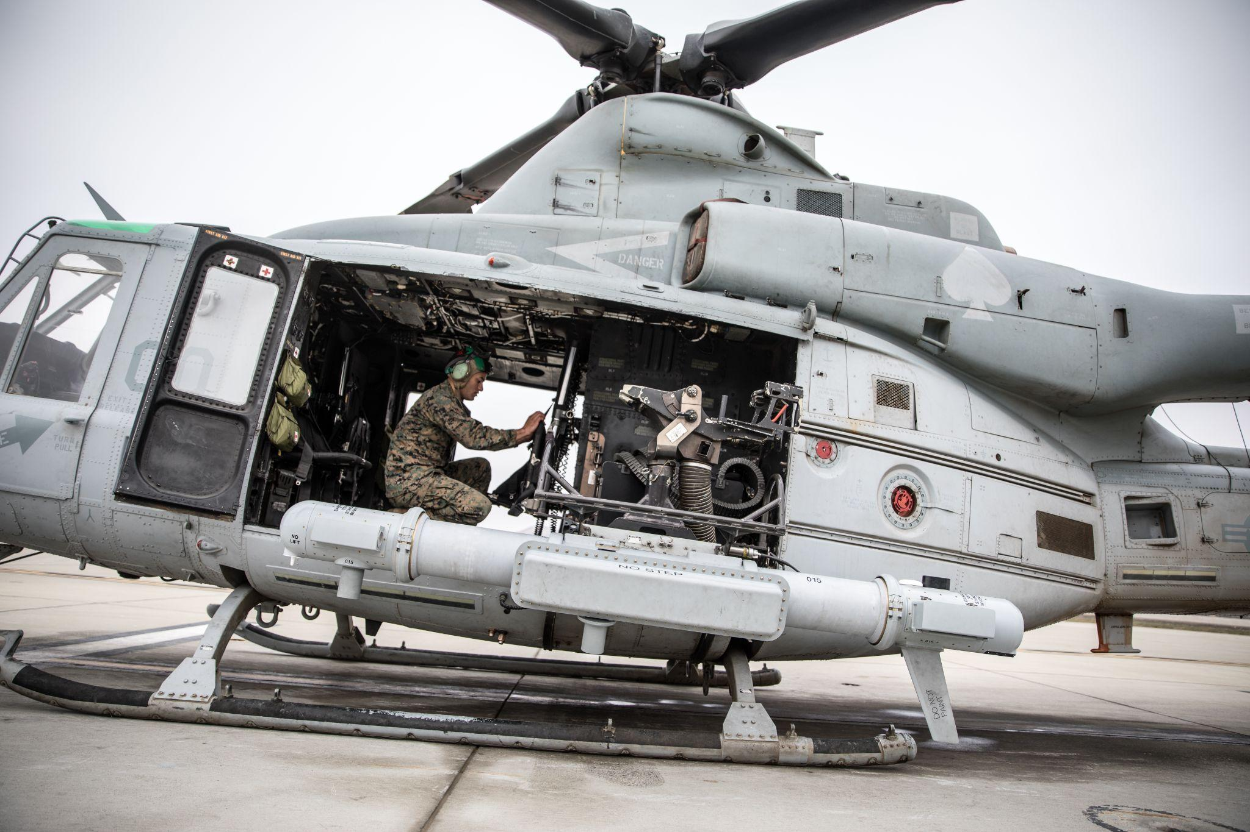
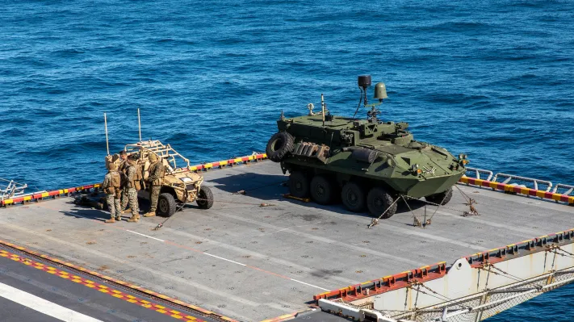
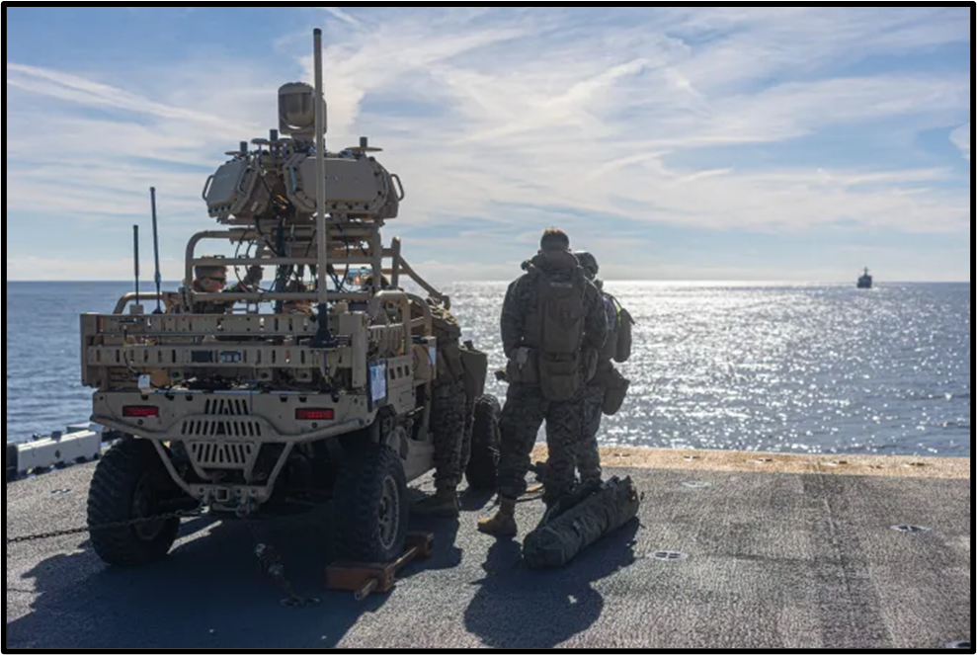
Problem Area 2: Gap in Enablers
Units lack adequate assets and enablers to employ EMS capabilities.
Assets:
L-MADIS
Manpack Systems
Enablers:
Recruitment / Training
T/O/E (GCE organic)
Notes:
-EW Assets, such as the L-MADIS exist but are in limited quantities due to a prohibitive cost of ~$10 million per unit. This capabilities is typically employed at a higher MAGTF echelon - as demonstrated here as a LMADIS and LAV-EW are utililzed in a Defense of the Amphibious Task Group (DATF) role. THIS MEANS THAT battalions and below will be forced to operate in contested environments without a dedicated, responsive EMSO capabilities to counter EW threats.
-EW Enablers, such as 26XX Signals Intelligence Marines, take a long time to recruit, train, and employ across the FMF. A Sergeant capable of leading a team in 2027 would need to have been recruited back in 2023. THIS MEANS THAT even with a push to expand EW capabilities and purchase additional equipment sets, the SMEs will be the limiting factor.
Double down on the IO to help augment because there are few other near term options

Slide 12
Tactical Publication
Endstate: A Marine Corps Tactical Publication (MCTP) Employment of Electronic Warfare Units and Capabilities
Who: CD&I/DCI published MCTP with FMF Input (MLG, LAAD Bn, MCIS)
EA / ES Employment
Employment of EW Units & Caps
Notes:
Who: CD&I led with FMF Input (MLG - RRT/SST units, LAAD Bns, and Marine Corps Intelligence Schools (MCIS) FOR Battalion/MSE level units below the MAGTF level. What: MCTP Development which refines the MCRP, is inspired by fires/effects documents such as the JFIRE, SIGMAN SOP series, and integrated with novel/emergent EW Capabilities. Where: Virtual When: Published NLT 2027 Why: Covered
How: MCIS laid the ground work with the publishing of the SIGMAN SOP series. Their work needs to be expanded to include EA and ES capabilities and employment considerations. The FMF now has access to methods of how to protect itself, but now it needs to transition to the offense. With this MCTP, battalion and below units, leaders, and planners can plan to integrate EW capabilities.
Problem Solved: Outdated Doctrine (MCRP 3-32D.1) and lack of Manpower. This will never replace the advantage of having a SME adjacent to the planner, but EW SMEs are few and far between and take a long time to recruit / train / develop. We must be prepared to cover the gap in manpower with widespread knowledge.

Slide 13
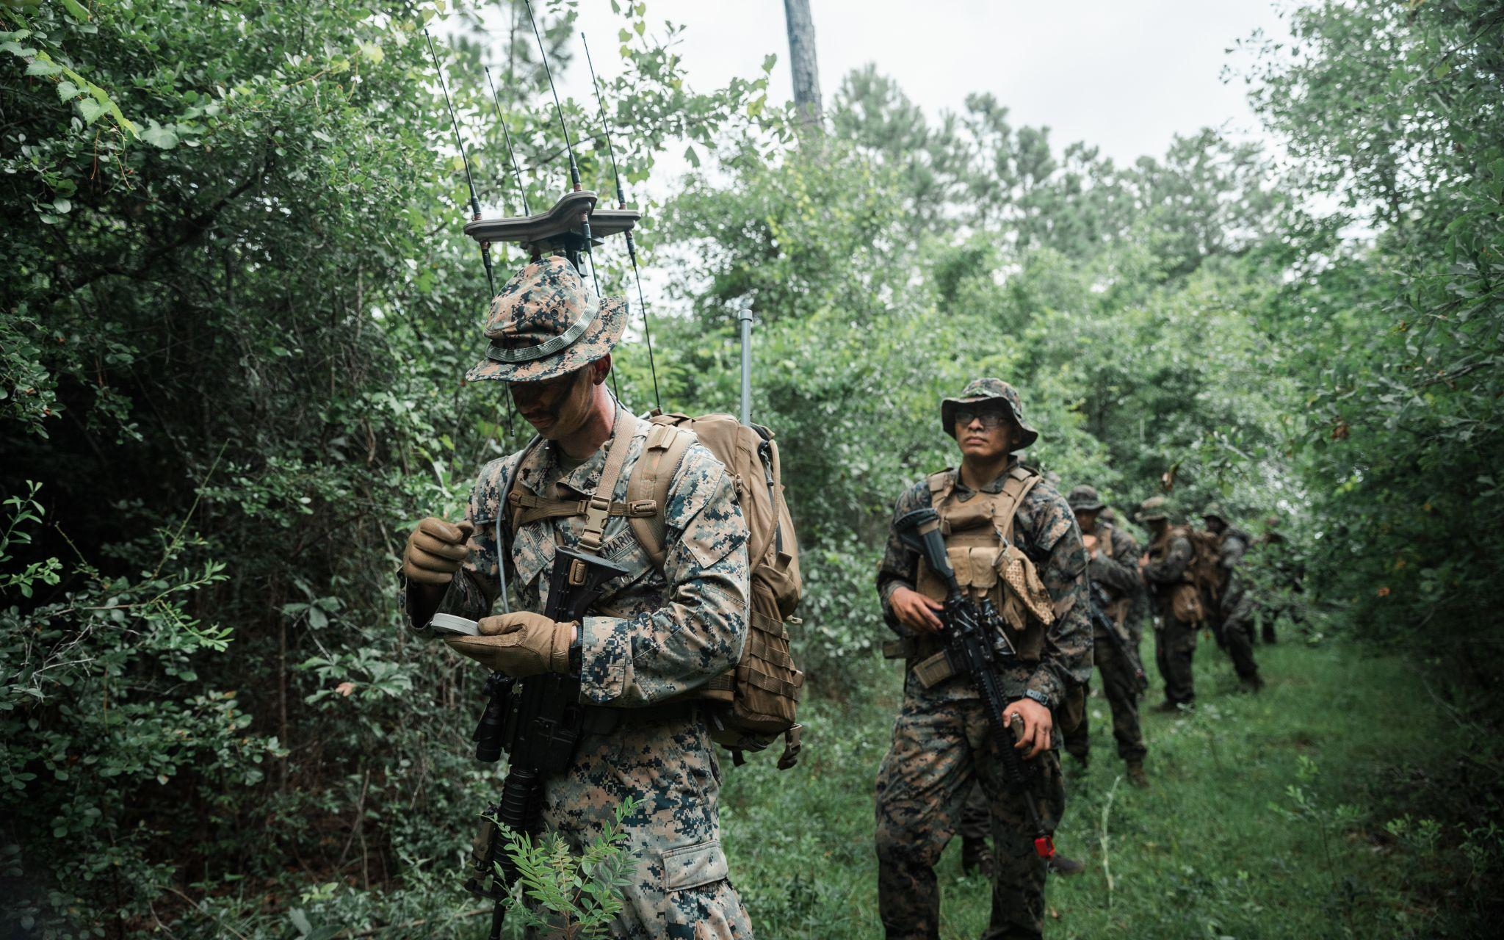
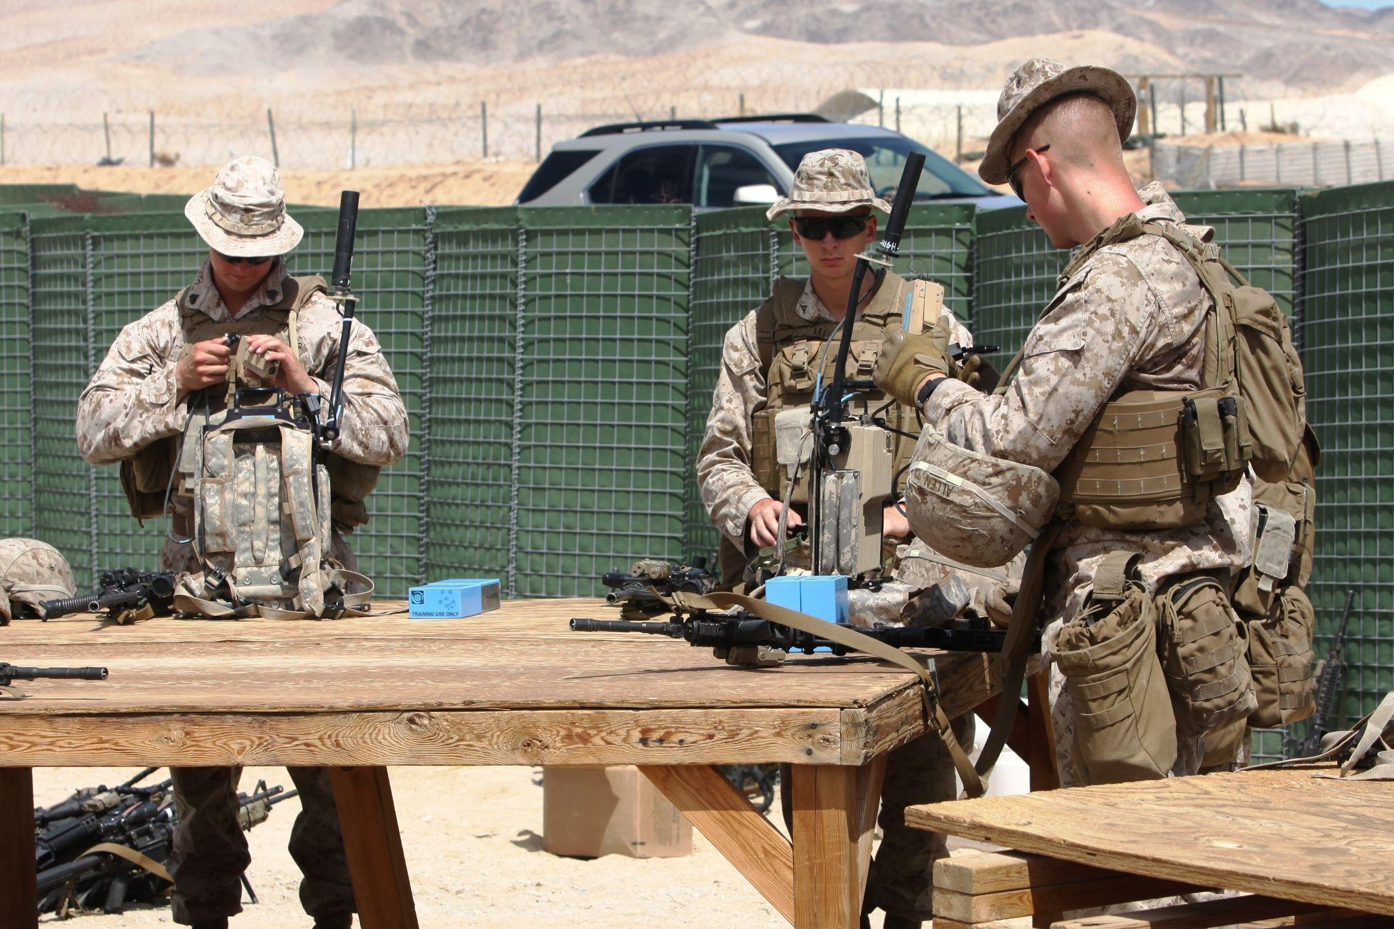
Incidental Operators
Endstate: Electronic Warfare Incidental Operators tasked organized and equipped at the battalion level
Who: TECOM approved courses executed by MIGs/LAAD Bns to train deploying units
Notes:
Who: I MEF led with MSE Input from MLG (RRT, SST, LAAD) FOR Deploying Units (part of pre-MEU/UDP PTP) What: Mobile Training Teams (MTTs) or Incidental Operator Courses MCTP Development which refines the MCRP, is inspired by fires/effects documents such as the JFIRE, SIGMAN SOP series, and integrated with novel/emergent EW Capabilities. Where: Virtual When: Implemented NLT FY 2027. Why: Covered
How: 3d LAAD BN and the 15th MEU (Information Unit of the Year award 2024) laid the groundwork of how to take existing equipment, such as the MODI-II system, reprogram a traditionally C-IED system to conduct C-UAS, and then train incidental operators on its use for widespread employment of C-UAS capabilities across the MEU MSEs (prioritizing the BLT).
Problem Solved: Lack of Assets & Manpower. Replicated across the FMF, this will bridge the

Slide 14
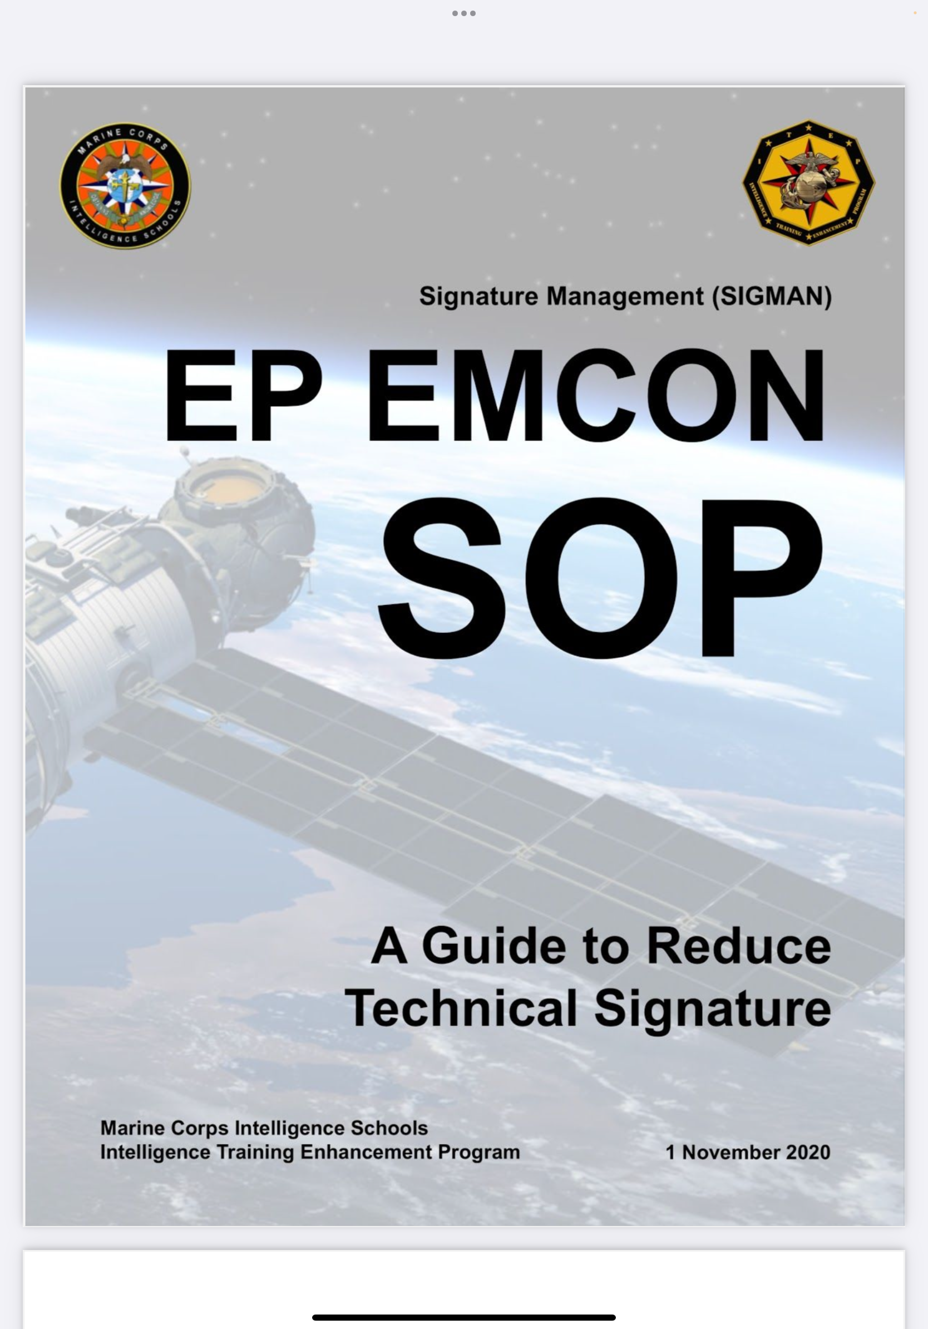
Counter Argument 1
Solution 1: Tactical Publication
Counter:
SOPs alone will not enable Bn to employ EW capabilities
Rebuttal:
EW education will reduce risk from adversary threats
Facilitate planning for units without SMEs
EA / ES Employment
Notes:
Solution 1: Tactical Publication
Counter:
SOPs alone will not enable Bn to employ EW capabilities
Rebuttal:
EW education will reduce risk from adversary threats
Facilitate planning for units without SMEs
Solution 2: Train and Equip IOs
Counters:
IOs will reduce standard infantry capability / capacity
Additional course/schools requirements
Rebuttal:
IOs will increase flexibility
Increase in EW threats & capabilities

Slide 15
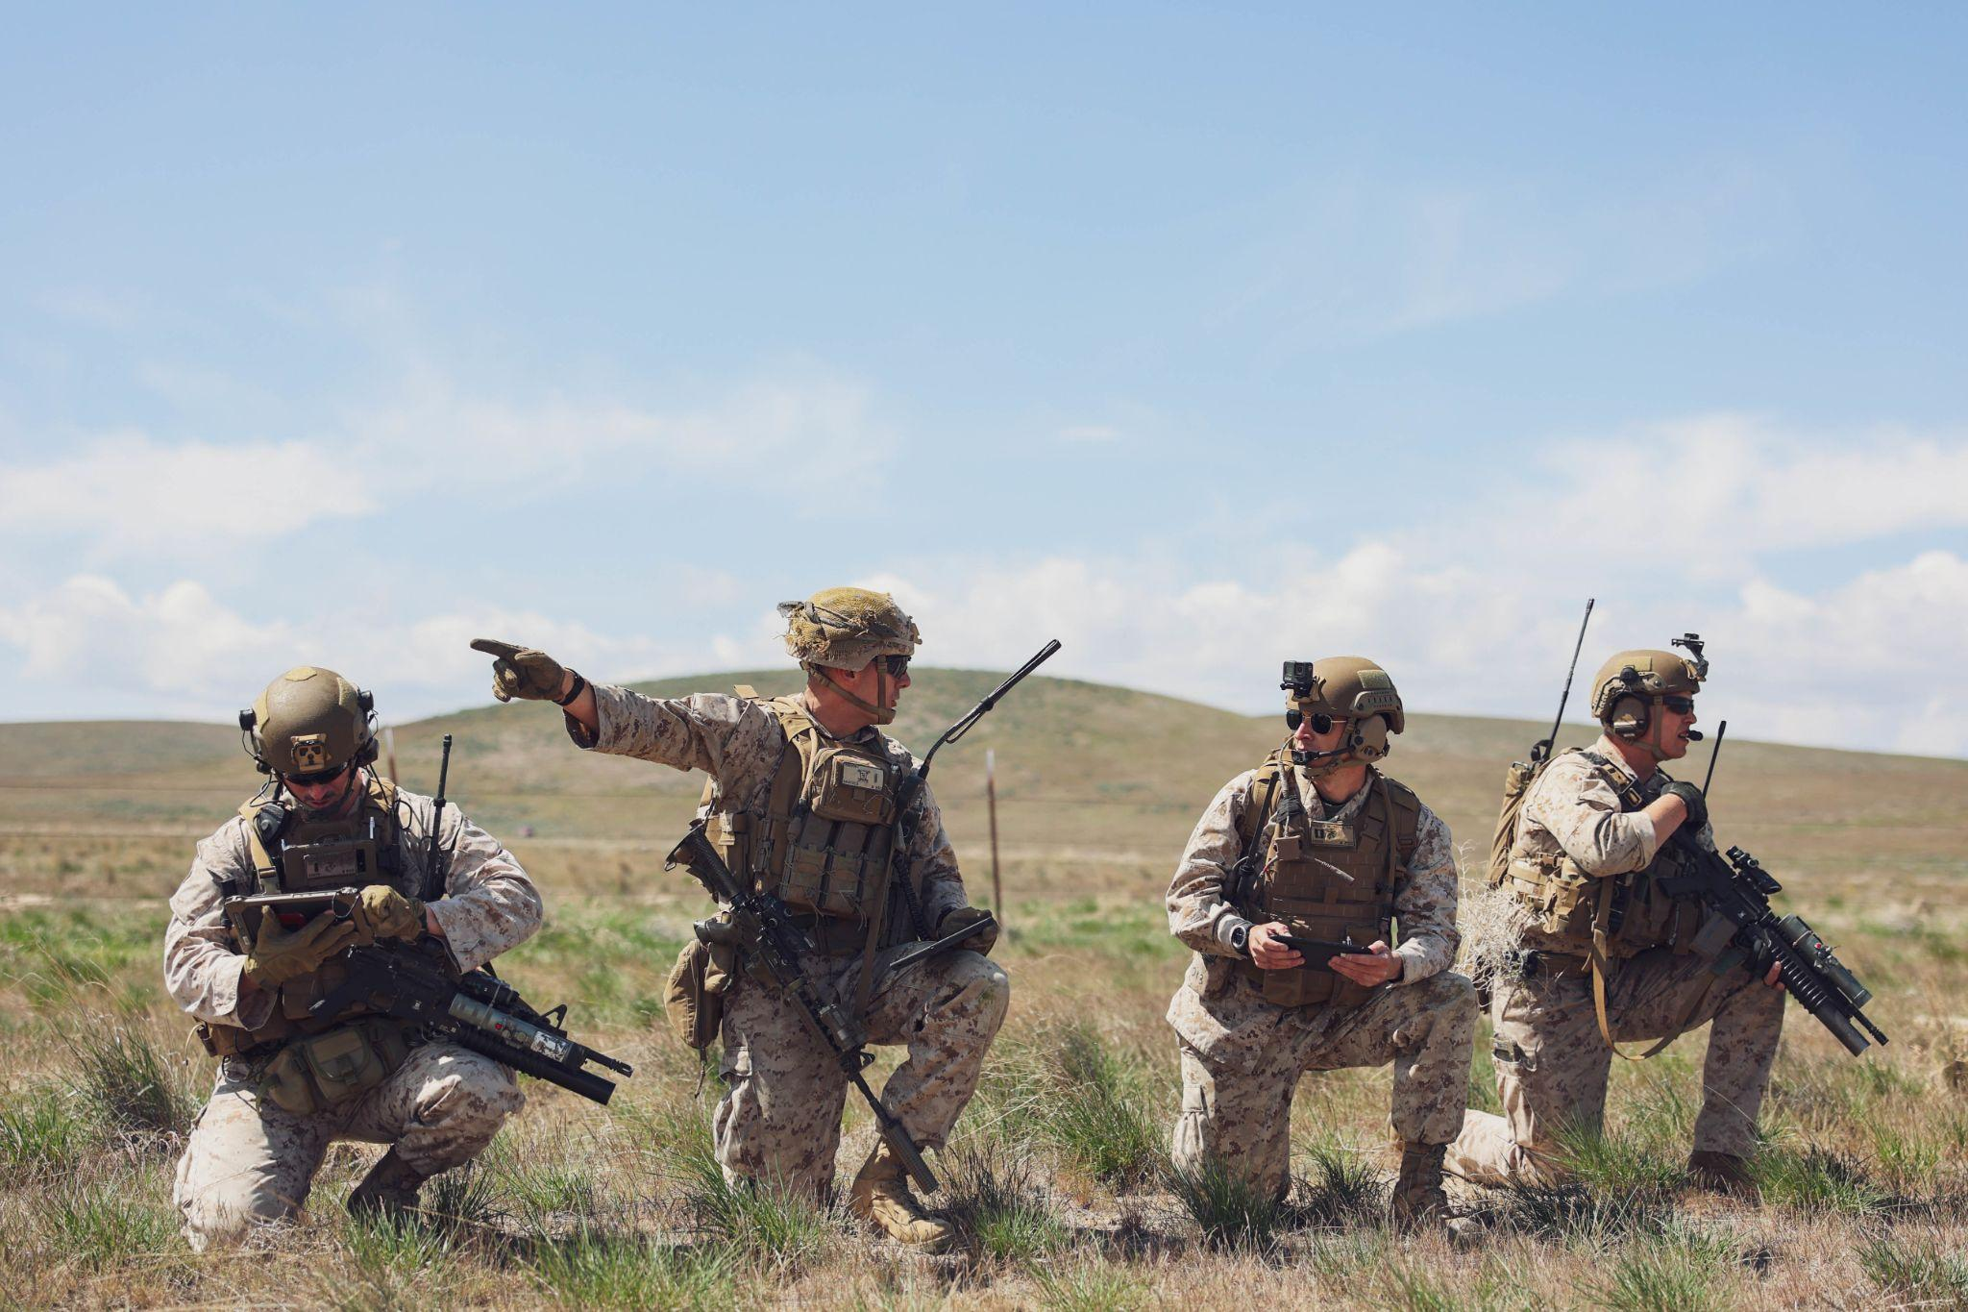
Counter Argument 2
Solution 2: Train and Equip IOs
Counters:
IOs will reduce standard infantry capability / capacity
Additional course/schools requirements
Rebuttal:
IOs will increase flexibility
Increase in EW threats & capabilities
Notes:
Solution 1: Tactical Publication
Counter:
SOPs alone will not enable Bn to employ EW capabilities
Rebuttal:
EW education will reduce risk from adversary threats
Facilitate planning for units without SMEs
Solution 2: Train and Equip IOs
Counters:
IOs will reduce standard infantry capability / capacity
Additional course/schools requirements
Rebuttal:
IOs will increase flexibility
Increase in EW threats & capabilities

Slide 16
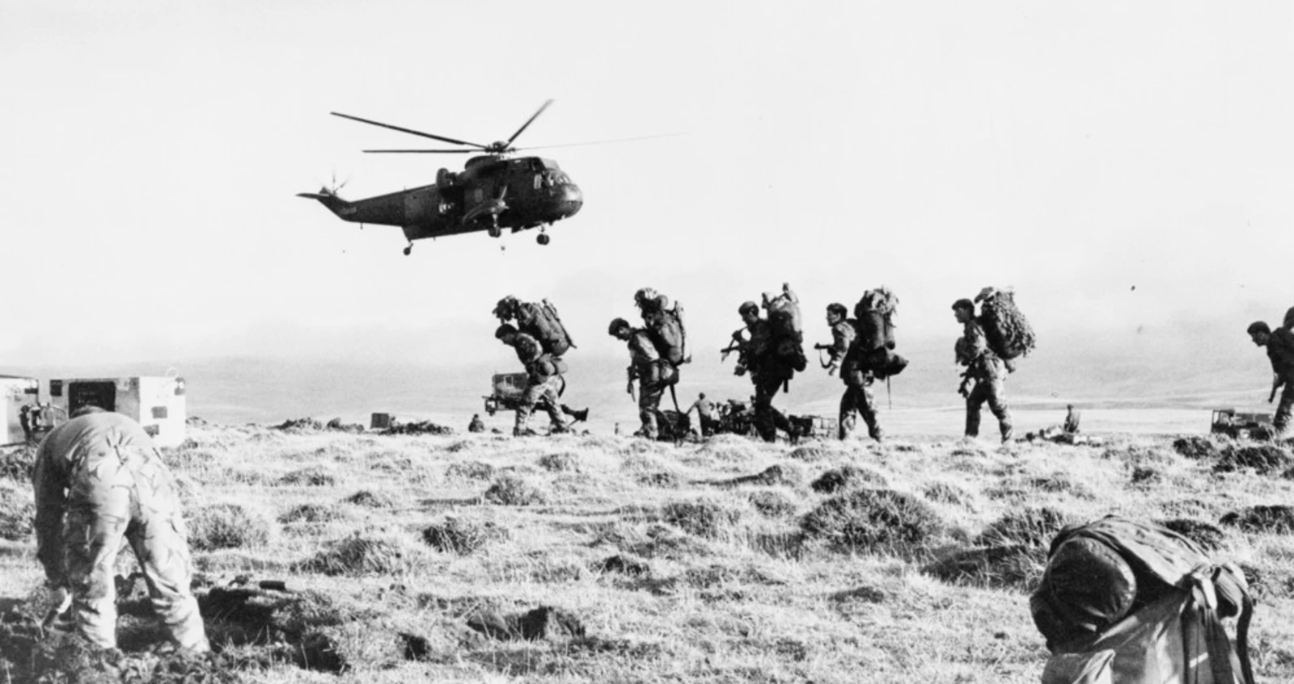
The Falklands War
UK v. Argentina
2 April - 14 June, 1982
Sovereignty of Falkland Islands in dispute
EW advancements and trained operators in military procedures needed
Notes:
Chose this case study to refine our problem.
From essay:
History holds similar problems to the modern dilemma faced with the EMS. The Falklands War between the United Kingdom’s Royal Navy and Argentina serves as an excellent case study for testing and proving the earlier mentioned solutions, particularly in two key areas: the lack of resident knowledge on EMSO SOPs and the lack of trained operators for EW systems.

Slide 17
Historical Lessons Learned
UK Royal Navy:
The Royal Navy had EW advantage
On May 4, 1982, HMS Sheffield was struck by Argentine aircraft
HMS Sheffield turned off their air search radars and the tactical officer abandoned his post
Argentina:
Military forces lacked robust EW assets & operators
Personnel shortfalls required civilian outsourcing
Bolstered their capabilities across the EMS spectrum due to their specialized training and expertise
Notes:
-Although the Royal Navy had a significant EW advantage, they still had gaps in standardization and integration of their SOPs across the fleet.
-The HMS Sheffield chose to turn off their air search radars, to prevent interference with their satellite link. Additionally, the tactical officer on duty considered it pointless to stand his post while the sensors were off, effectively leaving the ship blind.
-This specific example made the Royal Navy use data links more freely. After the war, the Royal Navy updated their SOPs and the data links that they used.
-Solutions Applied: This example in our case study proved that SOPs are important, but also that implementation is equally important. Implementing SOPs becomes crucial at distance.
https://www.defensemedianetwork.com/stories/the-falklands-30-years-later/

Slide 18
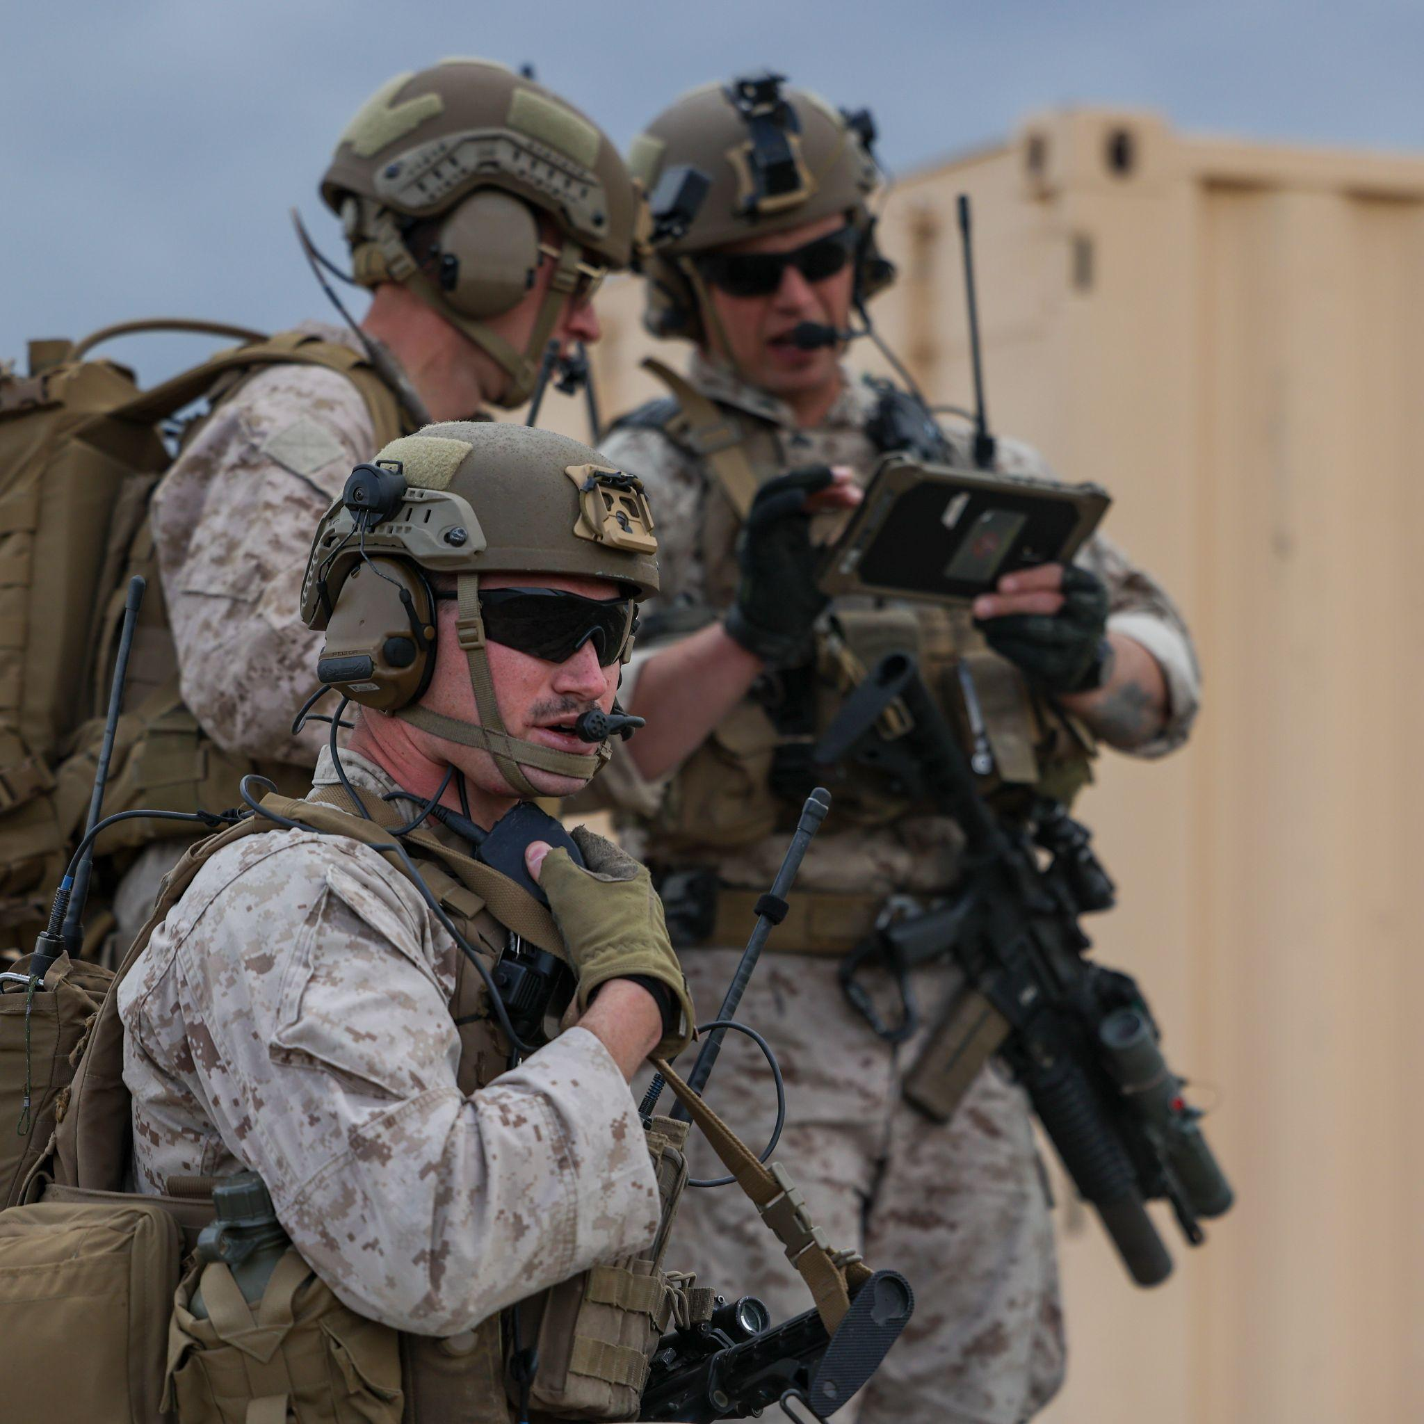
Request MCTP & IO Implementation
NLT FY27, DC, CD&I/DCI to publish a Marine Corps Tactical Publication (MCTP): Employment of Electronic Warfare Units and Capabilities.
MOP/MOE
NLT FY27, TECOM to establish Incidental Operator Courses for EW Equipment and Capabilities.
MOP/MOE
Notes:
NLT FY27, DC, CD&I to publish a Marine Corps Tactical Publication (MCTP): Employment of Electronic Warfare Units and Capabilities.
MOP: MCTP / SOPs updated
MOE: 3D LAAD and 15th MEU conduct (BLT) Bn Level (at a minimum) 3x exercises, refinement, and AAR/command feedback of MCTP.
NLT FY27, TECOM to establish Incidental Operator Courses for EW Equipment and Capabilities.
MOP: 1:1 training team established in IMEF.
MOE: incorporating AAR/command feedback from MMT with LAAD/MEU unit for service level exercises.
3d LAAD / 15th MEU will be the office of primary responsibility (OPR) for the MODI-II C-IED/C-UAS Incidental Operator Course
MOE/MOP on how we know this works (IO course done by the time stated, AARs capture MOEs)
Split case study slide on same one, how does that relate to today. How our solution will prevent the issues of the past

Slide 19
Questions?
Paper
Contact Info
CPT Marcelo Castro
USA
12A: Engineer
Contrarian/Red Cell
Capt Aiden Lang
USMC
0302/0303: Infantry & LAR Reconnaissance
Agenda Setter
Capt Craig Miranda
USAF
17D: Cyber Operations
Project Manager
Capt Jackie Sapitro
USMC
7210: Air Defense Control
Recorder
Capt Joseph Sporleder
USMC
0602: Communi-
Cations
Research Liaison

