Slide 1
Marine Corps Warfighting Laboratory
Wargaming Division
Capability Overview
Col Charles Anklam III, PhD
Director
Wargaming Division
Marine Corps Warfighting Lab

Slide 2
Agenda
MCWL Overview
Wargaming Division Mission
Paradigm Shift in Wargaming
Robert B. Neller Center for Wargaming and Analysis
Question / Discussion

Slide 3
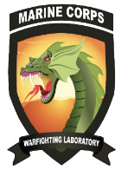
Command Overview
Mission. The Marine Corps Warfighting Laboratory/Futures Directorate examines future operating environments to generate threat-informed operating concepts and capabilities and, through experimentation, provides analytically supported recommendations to inform future force design and development activities.
Wargaming
Live-Force Experimentation
S&T/RCO
Futures
MCWL informs service-level decisions by the Commandant of the Marine Corps. This is accomplished in partnership with the Office of Naval Research, Department of Defense labs, industry, and academia.
The expertise of MCWL personnel blends science with operational experience across the spectrum of competition to conflict.
MCWL is comprised of four divisions operating under the authority of a one-star general.
Notes:
Guidance for Slide :
- Provide command overview and command mission
- Discuss niche contribution

Slide 4
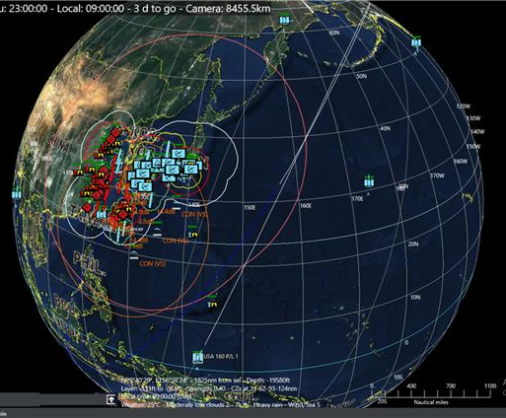
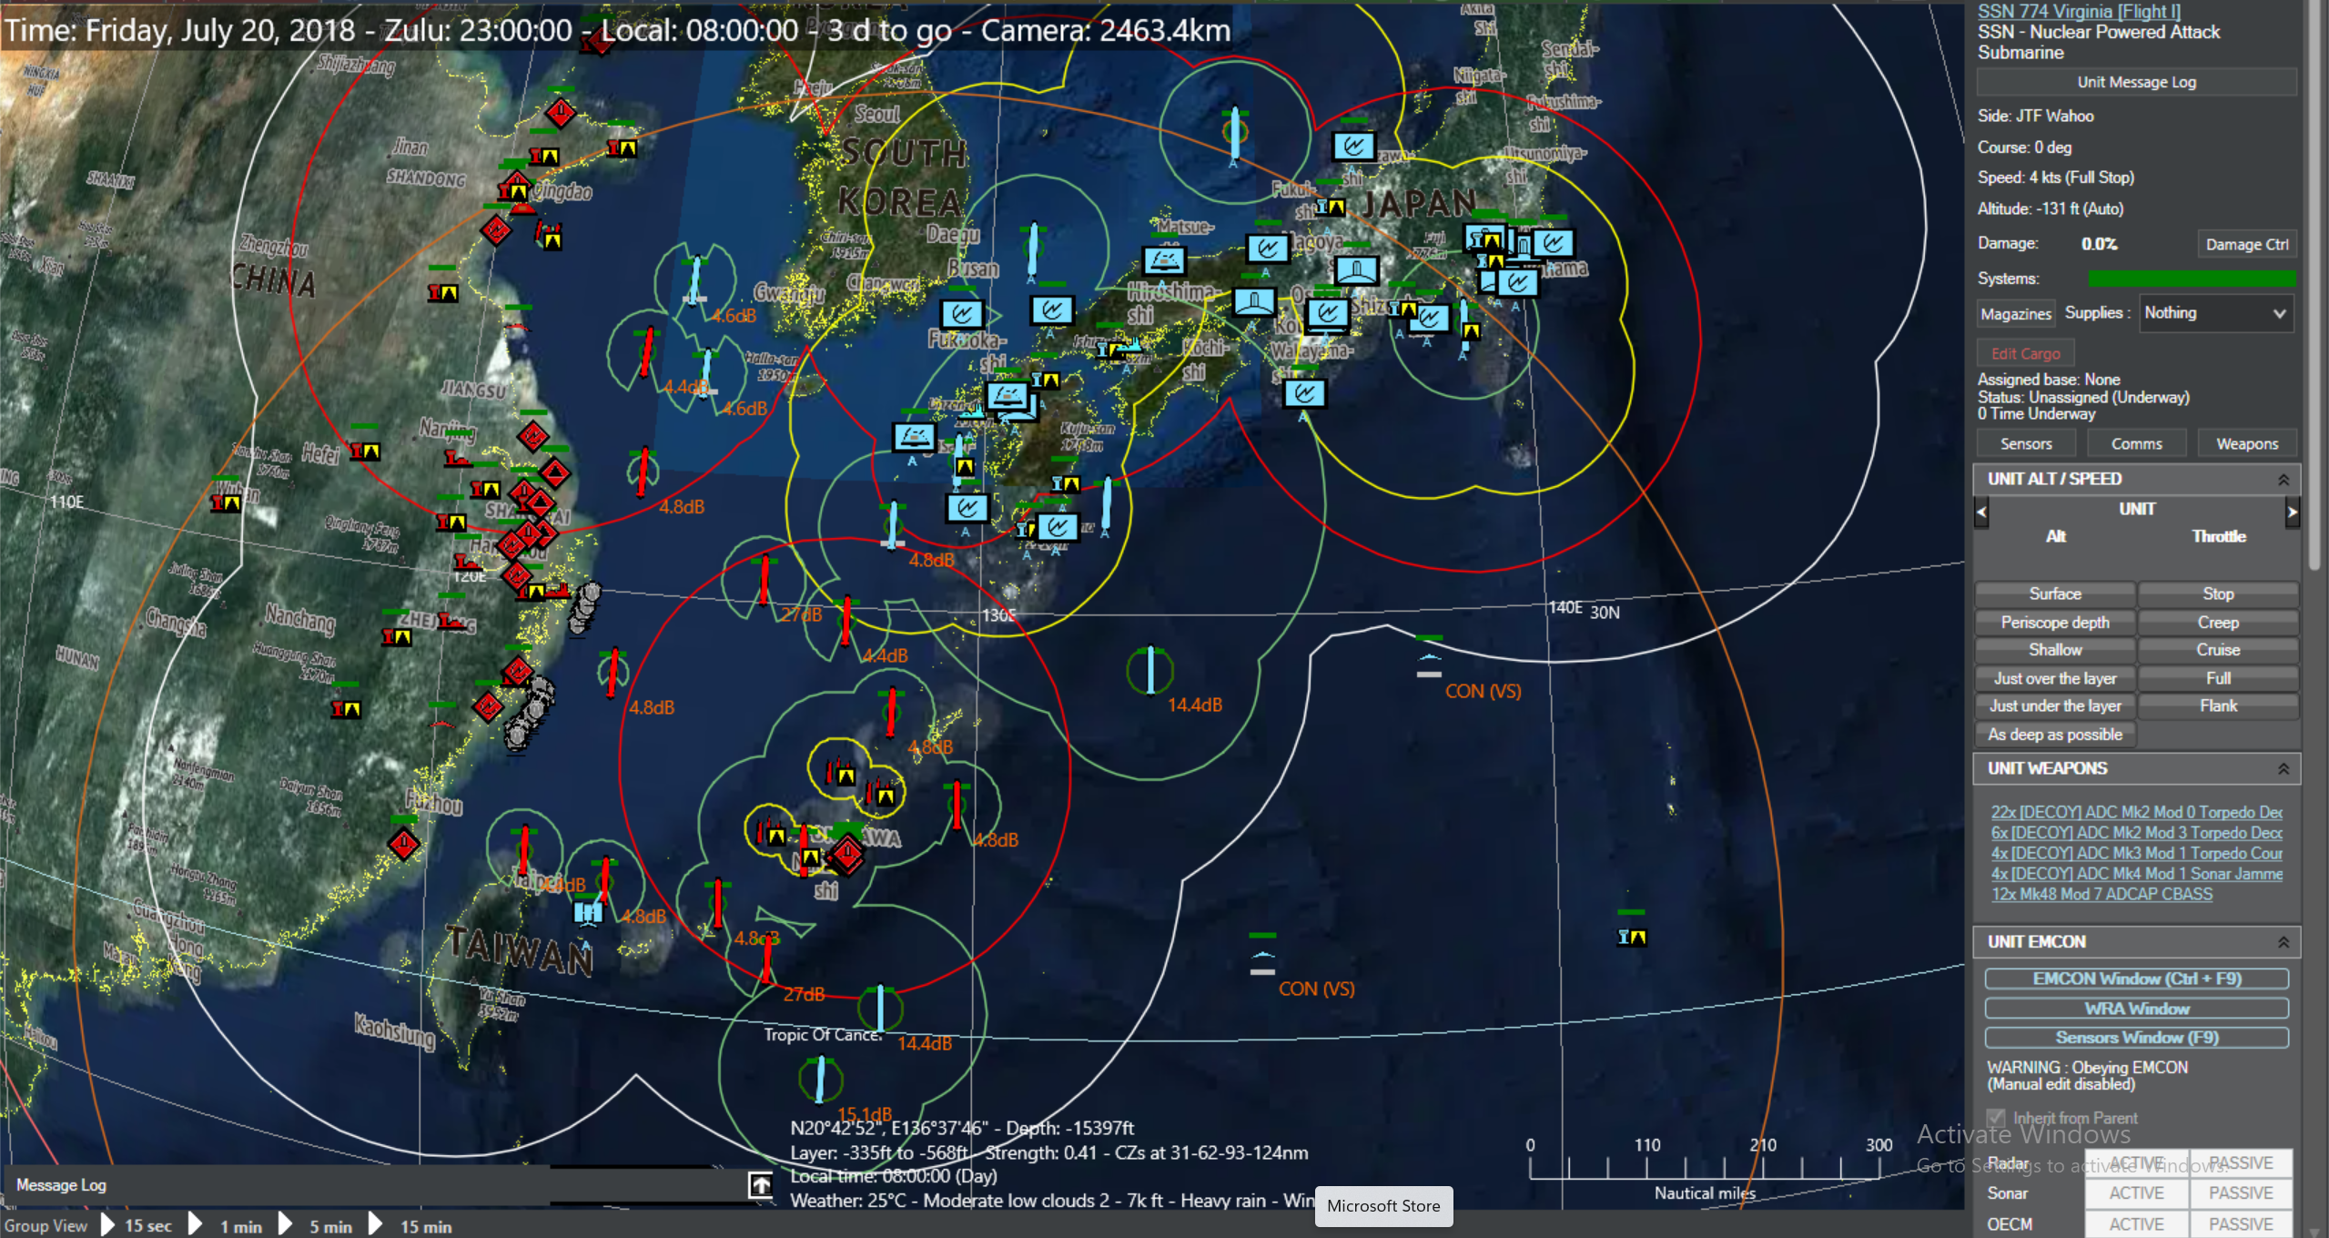
Wargaming Division Mission
Plan and execute the Marine Corps Wargaming Program. Formally report analytical and assessment results. Identify wargame results for further exploration through live-force experimentation, doctrine and policy review, and science and technology examination.

Slide 5
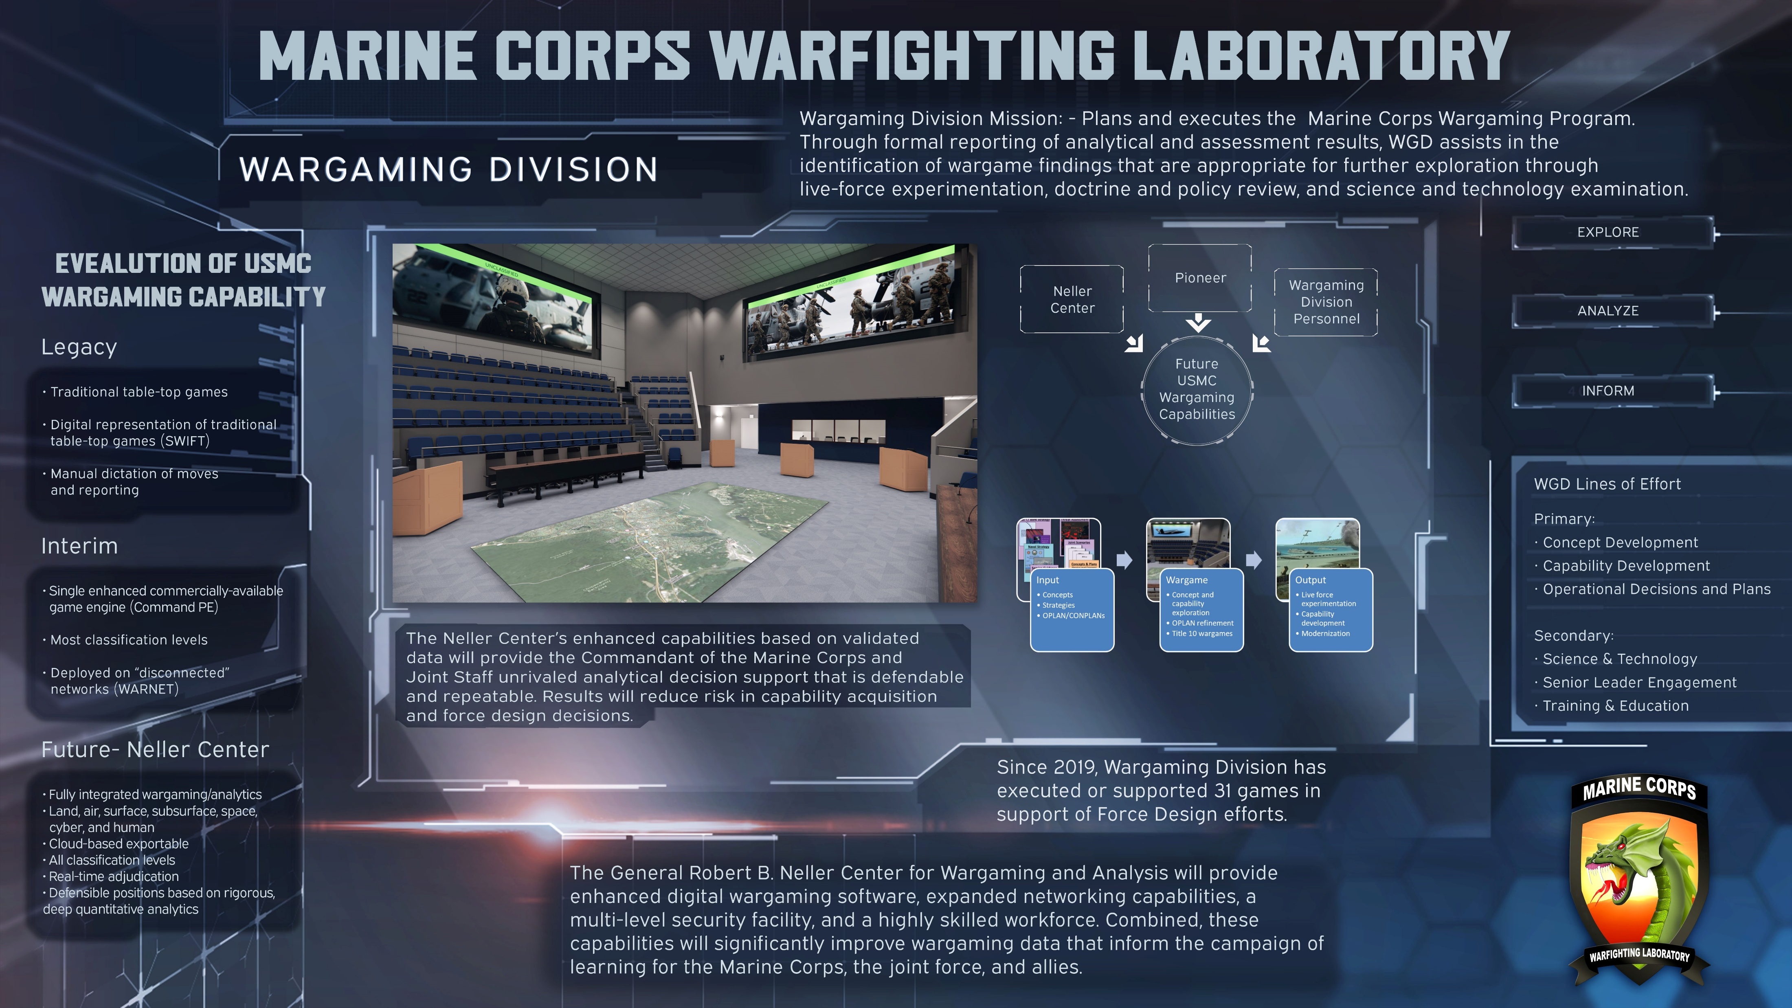
Software
38

Slide 6
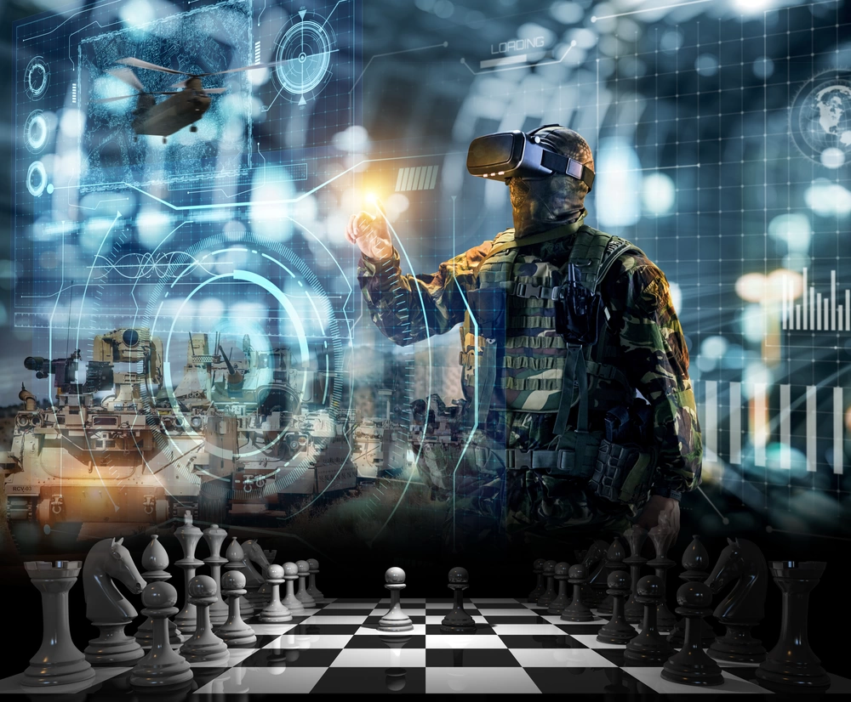
UNCLASSIFIED
Wargaming Capability Overview
A material solution that meets the requirements stipulated in the Marine Corps Wargaming Capabilities Development Document. The system will employ integrated means of data ingest, model federation, and in-stride analytics to synthesize the computational (machine) and cognitive (human) analyses to produce a comprehensive assessment of wargame outcomes.
Fully integrated wargaming/analytics process
Leverages modeling and simulation (M&S) and artificial intelligence (AI)
Simulation engines integrated for specific warfighting domains
Land, air, surface, subsurface, space, cyber
Across all security classifications
Data ingestion from multiple authoritative sources​
Real-time adjudication; in-stride and post-game analytics​
Simulates millions of people and platforms in real-world conditions​
Defensible positions based on rigorous, deep quantitative analytics​
End State: Full Operational Capability:
Interoperability & Modular Open Systems Approach (MOSA): Ensures compatibility across domains and classification levels, with plug-and-play COTS capabilities as needed.
Next-Generation AI & Real-Time Analytics: Advanced AI tools embedded to enhance decision-making and wargame outcome analysis.
Scalable and Adaptable Solution: A future-proof, flexible wargaming environment capable of scaling with evolving mission needs and emerging technologies.
6
UNCLASSIFIED

Slide 7
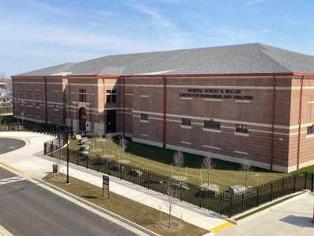
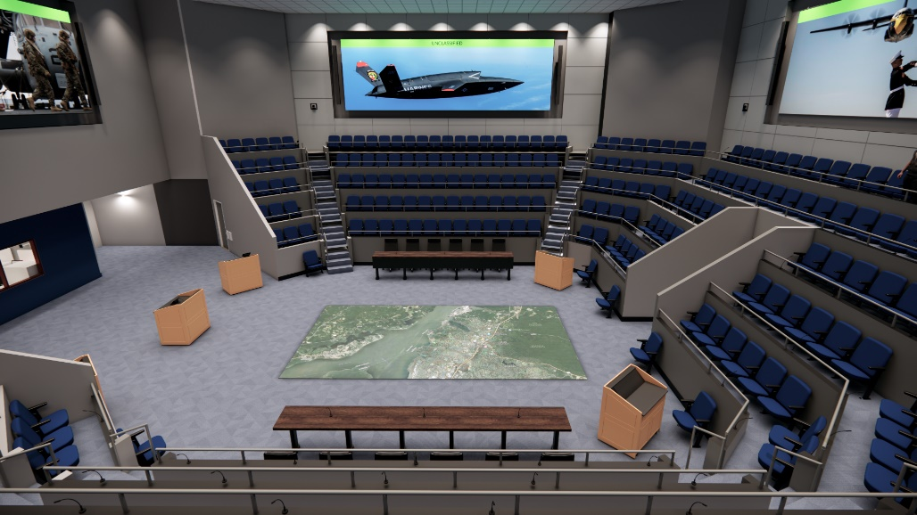
Robert B. Neller Center for Wargaming and Analysis
Critical Capabilities:
Will be able to facilitate up to 20 wargames per year, with up to 250 participants each.
Multiple level security environment to enable more fully-informed wargames.
Leverages data sources across a multitude of DoD networks to ensure the most accurate data is used to design and adjudicate wargames.
Tailored, modular software suite to meet dynamic learning demands and enable use of best available tools.
Authoritative data repository to provide common, consistent data to all wargame systems and tools.
Employs artificial intelligence to “train” synthetic forces on doctrine and TTPs to provide higher fidelity adjudication.
Using AI, collects and compiles data on a previously unachievable scale, enabling rapid, data-supported wargame reporting.
Key Milestones:
Began construction: April 2021
First MCWL Wargame: February 2026
14

Slide 8
Questions / Discussion
MCWL Wargaming Division Points of Contact:
Col Charles Anklam III, PhD
Director, Wargaming Division
charles.anklam@usmc.mil
LtCol Scotty Black, PhD
Senior Technical M&S and AI Advisor, Wargaming Division
scotty.black@usmc.mil
Maj Lydia Fakes
Operations Officer, Wargaming Division
lydia.fakes@usmc.mil

