Slide 1
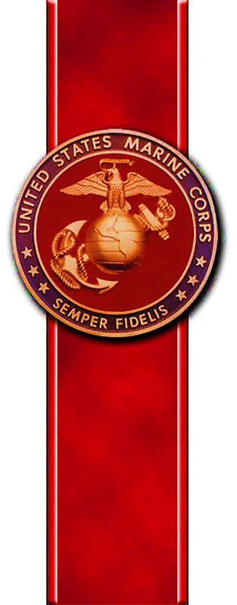
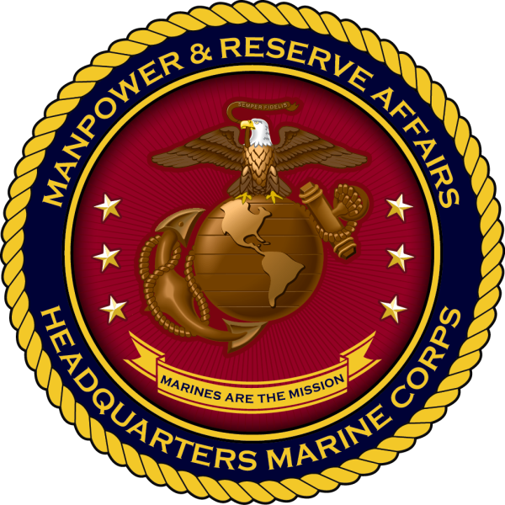
UNCLASSIFIED
The Value of Competitive Athletics for Marines & Families
Semper Fit / Warrior Athlete Readiness and Resilience (WARR)
Joel Hines, USMC Sports & Athletics Specialist
Joel.Hines@usmc-mccs.org
703-432-5472
Notes:
1

Slide 2
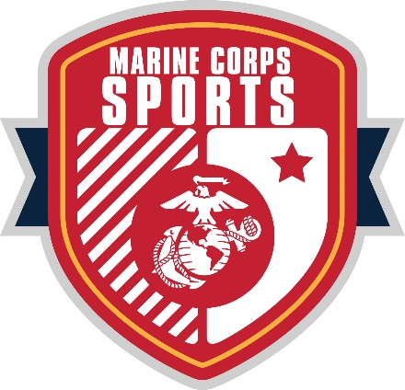
UNCLASSIFIED
All-Marine Sports
Competitive athletics is a force multiplier
Enhances warfighter lethality, resilience, leadership, and readiness
Strengthens families who serve alongside Marines
Aligns with Marine Corps Total Fitness (MCTF)
Physical, Mental, Social, & Spiritual Fitness
National / International USMC representation
Armed Forces Sports Championships
National Championships
CISM (Conseil International du Sport Militaire / International Military Sports Council)
Highest levels of military athletic competition
Basketball, Cross Country, Esports, Golf, Marathon, Rugby, Soccer, Softball, Triathlon, Wrestling

Slide 3
UNCLASSIFIED
The New Approach
Application & Access
Open to all Marines with command endorsement
Performance Metrics
Objective athletic evaluations: speed, agility, strength, endurance, recovery
Athlete Support
Access to WARR professionals: strength coaches, nutrition and sleep educators, mental performance coaches, athletic trainers
Trial Camp
Focused on high-performance preparation
Modeled after collegiate and professional systems
Competition
Installation/Varsity/Regional sports, showcases, combines

Slide 4
UNCLASSIFIED
Marine Corps Success

Slide 5
UNCLASSIFIED
Special Events & Programs
Special Events
The Virginia Gauntlet
London Half Marathon
Marine Corps Historic Half
Torbay Half Marathon
Special Programs
Elite Warrior Athlete Program
Sports/Athletics beyond the scope of All-Marine Sports
Marine Corps Sports Hall of Fame
National Museum of the Marine Corps
Ted Williams, Lee Trevino, Rod Carew, Tom Seaver, Roberto Clemente, Ken Norton, Vince Dooley, Dusty Baker

Slide 6
UNCLASSIFIED
Thank You
26

