Slide 1
UNCLASSIFIED
Marine Corps Total Fitness
&
Warrior Athlete Readiness and Resilience
MF Division, M&RA
Brad Brimhall, Semper Fit / WARR Branch Head
bradley.Brimhall@usmc-mccs.org
703-432-9435
Notes:
1

Slide 2
UNCLASSIFIED
MCTF Timeline and Documents
Charter was signed by the ACMC in February 2022
Working Group began in March 2022
MCTF Strategy was signed by the CMC in October 2023
CMC Designates Responsibilities for MCTF June 2023
M&RA – MCTF system design, delivery, resourcing, and integration (supported)
TECOM – MCTF standards and requirements (supporting)
Work continues:
Marine Corps Tactical Publication, Campaign Plan – concept of employment
Marine Corps Reference Publications – all domains
Marine Corps Order for MCTF
Updated and Integrated Semper Fit / WARR MCO 1700.29
1

Slide 3
UNCLASSIFIED
What is MCTF / WARR
An integrated system of health, wellness, prevention, and performance capabilities that enables the readiness, lethality, and resilience of individual Marines, serve as force multipliers for Marine units, and enhance the well-being and quality of life for Marine families.
The individual Marine and their family are the most important asset
Prioritizes the warfighter (closest to the fight and directly in harms way)
Prevention-based and healthy lifestyles focused.
Recognizes that family wellbeing and quality of life are inseparable components of mission success.
Four primary domains. And other foundational building blocks
2

Slide 4
Domains and Foundational Building Blocks of MCTF and WARR
MARINE CORPS TOTAL FITNESS
Integrated Capabilities / Policy and Practices / Training and Education
Warrior Athlete Readiness and Resilience (WARR) – “Prevention in Real Life”
PHYSICAL
FITNESS
MENTAL
FITNESS
SPIRITUAL
FITNESS
SOCIAL
FITNESS
ALL domains are interdependent
The four domains of MCTF and WARR stand on the foundational building blocks of:
Exercise
Environmental
Nutrition
Medical / Dental
Sleep
Self-Care
Financial
Purpose
Recovery and Adaptation
Occupational
Family
Breathing
Purpose
Connectedness
Service
Forgiveness
Faith
Clear Conscience
Mental Skills
Training
Cognitive Performance
Education
Science
Knowledge
Family
Self-Awareness
Peers
Communication
Trust
Gratitude
Collaboration
Leadership
Marines and Families
Core Values

Slide 5
UNCLASSIFIED
LOEs and Core Capabilities
Integrated Capabilities – Mr. Brad Brimhall (M&RA, Semper Fit)
Policy and Practices – Dr. Theresa Shields (M&RA, Semper Fit)
Training and Education – Mr. Brian McGuire (TECOM, HPB)
MCTF CORE CAPABILITIES
Physical Readiness, Development, and Maintenance
Nutrition, Sleep Science, Recovery, and Performance Education / Support
Applied Mental Skills, Cognitive Performance, Mental Health Services
Spiritual Fitness Resources, Religious Ministry and Chaplain Support
Professional and Personal Development
Social Fitness / Family Wellbeing / Community Connectedness
Medical / Dental Services
Sexual Assault Prevention and Response Resources
Marine and Family Readiness Services
Child and Youth Services
4

Slide 6
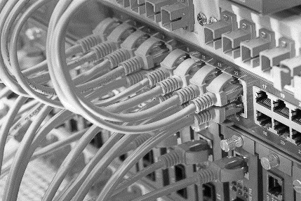
UNCLASSIFIED
Key Operational Concepts
When You “Connect to One You Connect to All”
Prevention – In “real life”
Human Performance and Quality of Life are intertwined
Engage people where they work, train, play, and naturally congregate.
Seamless Fabric and Integrated Network
Continued refinement and evolution
NETWORK
KEVLAR
SERVER
5

Slide 7
UNCLASSIFIED
WARR Teams
Warrior Athlete Readiness and Resilience (WARR) professional teams (349+) across FY25 – FY28
Certified Strength and Conditioning Coaches - 108
Applied Mental Skills Coaches / Consultant - 50
Performance Dieticians - 48
Culinary Arts Specialists - 9
Sleep and Performance Educators - 12
Social Fitness Skill Coaches/RWS - 22
Certified Athletic Trainers - 62
Performance Scientists – 17
Installation Leadership - 11
MCTF Regional/MEF/HQ - 10
23

Slide 8
UNCLASSIFIED
WARR Centers
Transforms 47 Semper Fit fitness centers across the Marine Corps
One-stop-shops and base-stations
Built to support the modern warfighter – think D1, professional sports, Olympics
Accommodates higher throughput
Allows for the application modern methodologies
Supports training that is more transferable to the battlefield
Offers a wider range of exercise options
Base stations for mobile and virtual capabilities
Features visiting professionals from other areas of expertise
Specific Features
Open artificial turf space to allow free movement
Multi-functional rack systems
Implements that support ground-based force production
Recovery Centers – red light, hyperbaric, float, massage, vibration
Reduction of traditional cardio equipment
Assessment and feedback technology
24

Slide 9
UNCLASSIFIED
Spiritual Fitness
The Foundation of what we do and why we do it
Includes religious-based and secular forms of spiritual fitness practice
Must be accessible to all regardless of background or belief
Must avoid moral relativism
Inner Strength from Higher Purpose and Meaning
Purpose in one’s existence, world, family, community, peer group, organization.
Connection to Something Larger Than Oneself
Service / altruism / sacrifice to and… a Source of support / strength from
Contemplation, Prayer, Meditation
Aligning purpose and connection
How do you know if you don’t make time to think about and feel it
Faith
Enhanced ability to endure / persevere
Defined purpose and connection make the outcome acceptable
Forgiveness
How to give it / where to get it
Moving forward vs. anchored to the past.
11

Slide 10
UNCLASSIFIED
Spiritual Fitness (continued)
Maintaining a Clear Conscience
Choose the right, work toward what is right, be what is right
Opportunity versus threat
Gratitude
What resources are available vs. what is lacking - build from what you have.
Satisfaction and peace
Character Development
Create a moral framework/plan
Tangible / definable – set the course.
Knowing One’s Non-Negotiables
What am I always trying to be or become?
What am I always working to avoid?
Practiced / Trained / Measurable (formative)
Formal / traditional learning environments, off-sites/ retreats, activities / exercises
Formative vs. summative (always working to get better)
11

Slide 11
UNCLASSIFIED
Physical Fitness
Cardiovascular
Aerobic / Anaerobic – each with specific results…and costs
Musculoskeletal
Strength / Power / Endurance / Mass
Acceleration and Speed - 14s / 100m or 6.7m/s = +37% survivability in combat
Agility / Change of Direction / Footwork
Reaction Time
Durability and injury prevention
Locomotion / Functional Mobility / Flexibility
Balance (static / dynamic)
Proprioception / Kinesthetics
Coordination
Recovery / Adaptation (there is a difference)
Must be planned / built-in / deliberately considered / specific facilities
Sometime less is more
Breath Work
Body Composition
Concerns on both ends of the spectrum
16

Slide 12
UNCLASSIFIED
Physical Fitness
Physical Fitness is the Engine of the Train
All 4 domains get better with physical activity and exercise
Fitness facilities are the most frequented facilities on base – MUST BE LEVEREGED!
A lot of “goodness” can be packed into the cars of this train
Strength and Conditioning coaches are the service extenders and connectors.
Investing in a modern approach.
Re-imagine how we look at Fitness and Fitness Facilities
We want Warrior Athletes – not necessarily body builders, cross fitters, powerlifters, and runners
Commercial fitness centers versus modern performance facility
Open design with artificial turf space for movement and multi-functional racks for versatility
Provides a framework for training and support across all domains.
WARR Centers serve as base stations for mobile, virtual, and satellite capabilities

Slide 13
UNCLASSIFIED
Physical Fitness
Mental Benefits
Dopamine, Norepinephrine, Serotonin , BDNF, Myokines
Reduced anxiety, depression, overall suicidality
Increased cognitive function and academic performance
Toughness and stress inoculation
Social Benefits
Improved self image and esteem
Improved self-confidence
Confidence across team members
Opportunities for peer support and comradery
Spiritual Benefits
Resilience and grit
Opportunities for contemplation
16

Slide 14
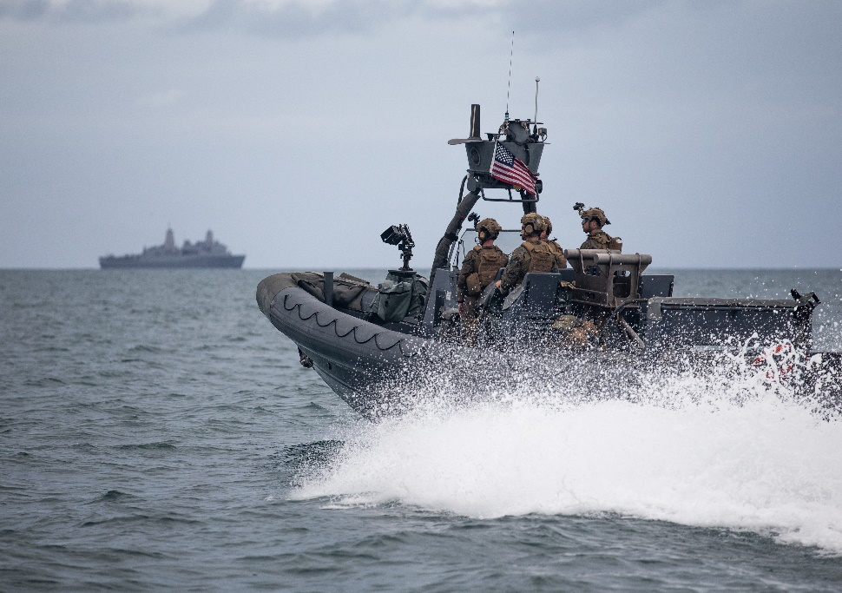
UNCLASSIFIED
Physical Fitness - Aquatics
We are an Amphibious Force – this is a non-negotiable
Must be able to operate around, on, and in aquatic environments
Amphibious warfare focus
Navigation and insertion
Proficiency in swimming, underwater confidence and operating in coastal environments- MCWSP
(A skill set not practiced is a skill set lost)
As Part of an Integrated program
Skeletal unloading
Alternative cardiovascular exercise
Part of your strength and conditioning program
Unit, individual training sessions – cohesion
Active rest
Skills and Benefits
Improve cardiorespiratory fitness
Mental resilience – confidence
Improves physical demands and endurance
Improve strength – resistance of the water
Core strength
16

Slide 15
UNCLASSIFIED
Mental Fitness
Applied Mental Skills – armed and equipped before the challenge occurs
Skills and strategies that can be utilized before, during, and after life events and challenges
Take anywhere / go anywhere
Cognitive Performance
Neuroplasticity / neurogenesis
Establish baselines for improvement, maintenance, and recovery
Learning / memory…fun/recreation makes it easier.
Performance vision
Pathway Framing (excellence isn't easy)
Challenge Anticipation (be ready for hard)
Positive Self-Talk (be nice to you)
Visualization/Imagery (see before doing)
Pre/Post Event Routine (focus/reset)
Confidence Building and Maintenance
Practice Efficiency (deliberate)
Heart Rate Awareness
Breathing Control
Relaxation / Arousal
Compartmentalization
Meditation
Intentionality / Mindfulness
Focus / Attention / Awareness
12

Slide 16
UNCLASSIFIED
Mental Fitness
Learning and Knowledge Acquisition (life-long)
Multiple areas of intelligence
Verbal-Linguistic, Logical-Mathematical, Visual-Spatial, Musical, Bodily-Kinesthetic, Interpersonal, Intrapersonal, Naturalistic, and Existential Intelligence
Professional
Personal
Academic / Career and Technical Education
Street smarts and common sense
Stress Management, Recovery, Goal Temporality/Periodization
Refuel / reset / recharge
Your mind and brain need to recover just like your muscles do
Counseling (non-medical)
Short-term focused solutions
Therapy & Medication (medical)
Continuum of resources
12

Slide 17
UNCLASSIFIED
Social Fitness
Skills that can be developed, practiced, and improved!
Self Awareness and Regulation / Emotional Intelligence
Personality type and individual communication style
Healthy Relationships
Trust / openness
Boundaries / respect
Affection / communication
Give-and-take / equality
Personality Types and Interpersonal Communication
Sender / receiver / message / channel / feedback / noise
Group Dynamics
Social status / Roles / communication / dominance / task / effectiveness
Leadership
Philosophy, style, practice
Opportunities for Social Interaction / Gatherings
Strengthening relationships / building networks
Opportunity to practice and develop skills
13

Slide 18
UNCLASSIFIED
Social Fitness - SMP
Mission Statement
Enhance readiness, improve morale, and foster personal development in single Marines through advocacy, community involvement, volunteerism, education, life skill building, recreation, and leisure.
Pillars of the Singler Marine Program:
Single Marine
Active-Duty Recreation Centers
SMP Councils
Solutions-Based Advocacy for
Quality of Life
Community
Involvement
and
Volunteerism
Education
and Life Skill
Building
Recreation
and Leisure
Opportunities
(refuel / reload)
13

Slide 19
UNCLASSIFIED
Social Fitness - SMP
PURPOSE SINGLE MARINE PROGRAM?
Serves as the voice for single Marines to express concerns and identify solutions related to readiness, morale, quality of life, and personal development.
Supports and aligns with Marine Corps Total Fitness and Integrated Prevention efforts
Provides recreational opportunities, leisure activities, and special events.
Offered aboard 19 Marine Corps installations and throughout the Marine Forces Reserve.
Facilities may include recreation centers, internet cafes, game rooms, and multi-purpose rooms.
13

Slide 20
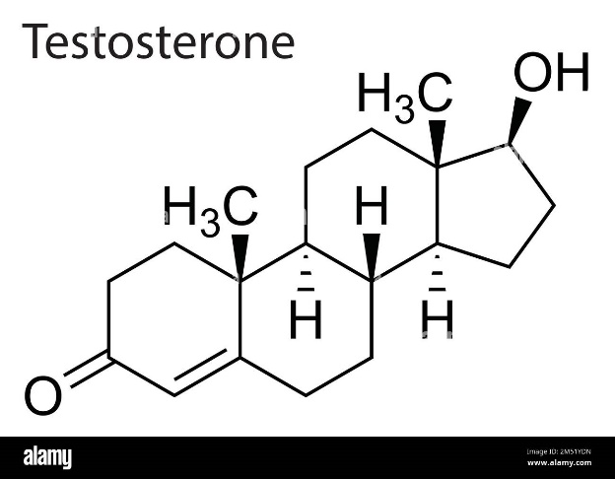
UNCLASSIFIED
Sleep
Why warriors need to sleep
Testosterone / Fertility
Day Light Savings
Pain Tolerance
Injury Rates
Speed / Agility / Coordination
Decreased Memory Recall/Cognitive Function – brain pump
Immune Function
Emotions
Environment
Cool 65-68 Degrees Fahrenheit
Dark – not just for your eyes.
Low Noise
No Cell Phone
Skills and habits that can be developed, practiced, and improved!
Regularity
Hot Shower before bed
C.A.N. 6-4-2
Journal
13

Slide 21
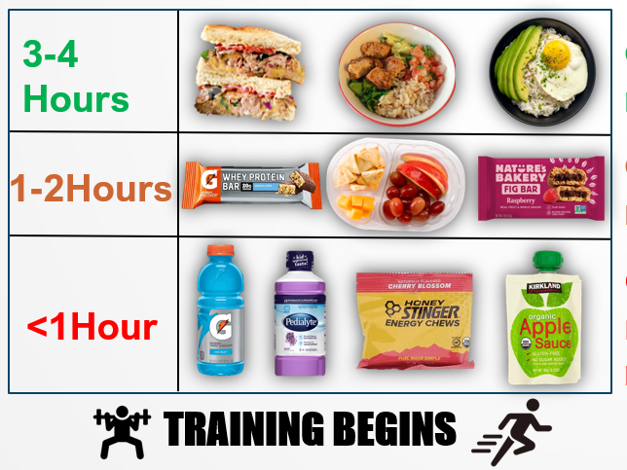
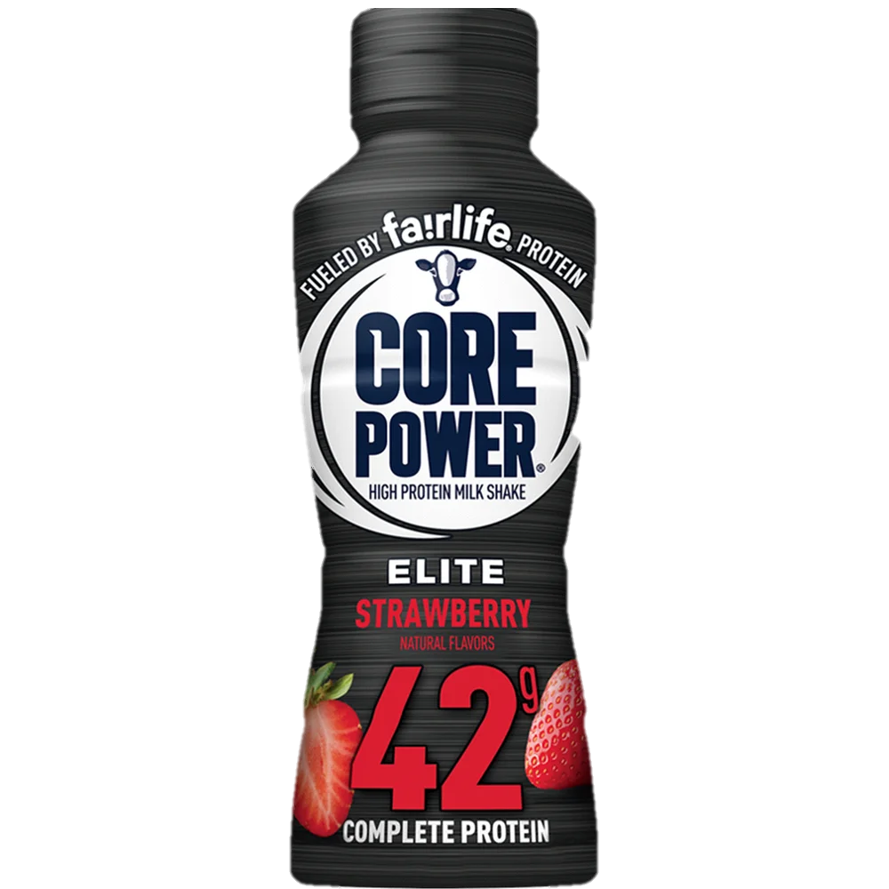
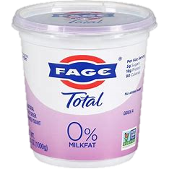
UNCLASSIFIED
Performance Nutrition
The Basics
Carbohydrates: fuel for your brain and workouts
Fats: energy dense, absorbs nutrients & supports brain health.
Proteins: repairs muscles from training
How to Pre-Fuel:
Recovery
When: Within 2 hours after exercise lasting over 60 minutes
Why: Promote recovery and restore what was depleted
How: Balanced Plate or 0.8g/kg carbs with 0.4 g/kg protein
13

Slide 22
UNCLASSIFIED
THANK YOU
26

