Slide 1

Enduring bonds
Why leaders fully commit to their marines
Maj Ted Powers
Commandant of the marine corps fellow
Brown university

Slide 3
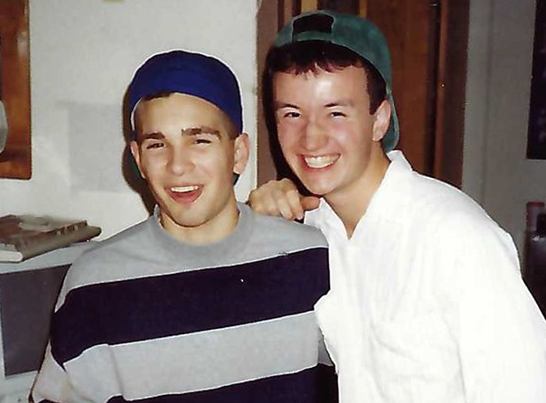
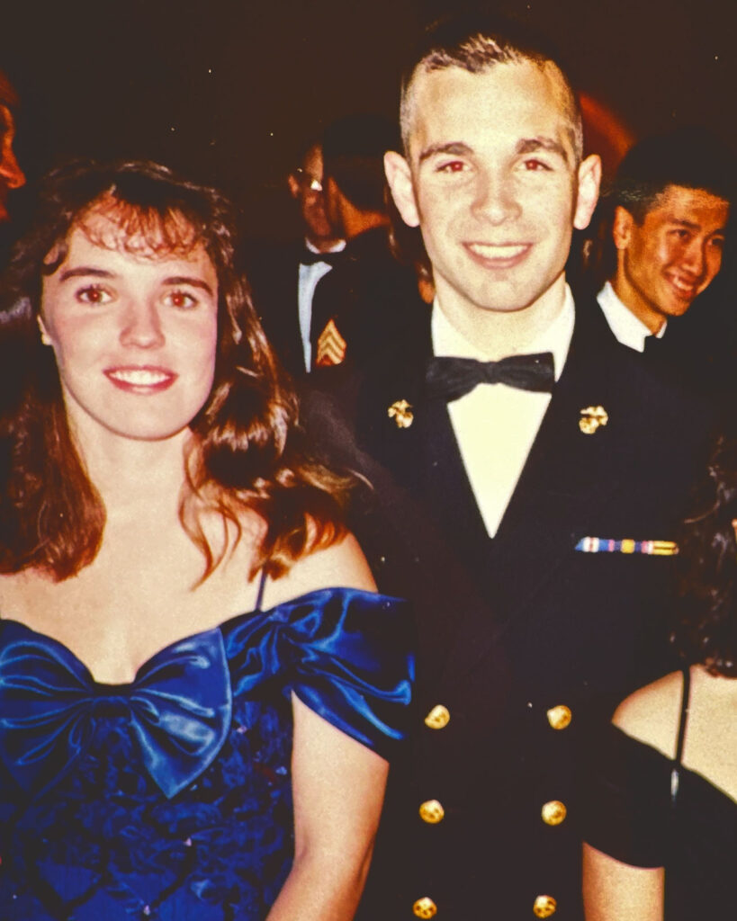

Slide 4
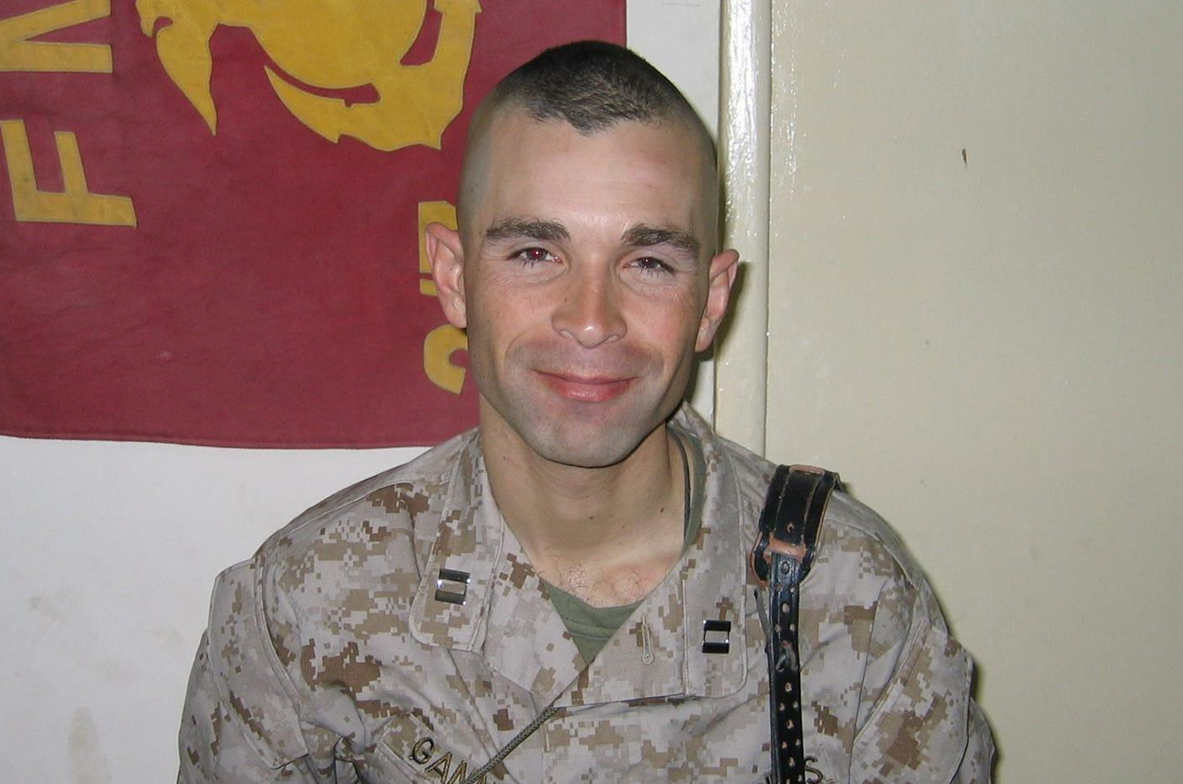

Slide 5
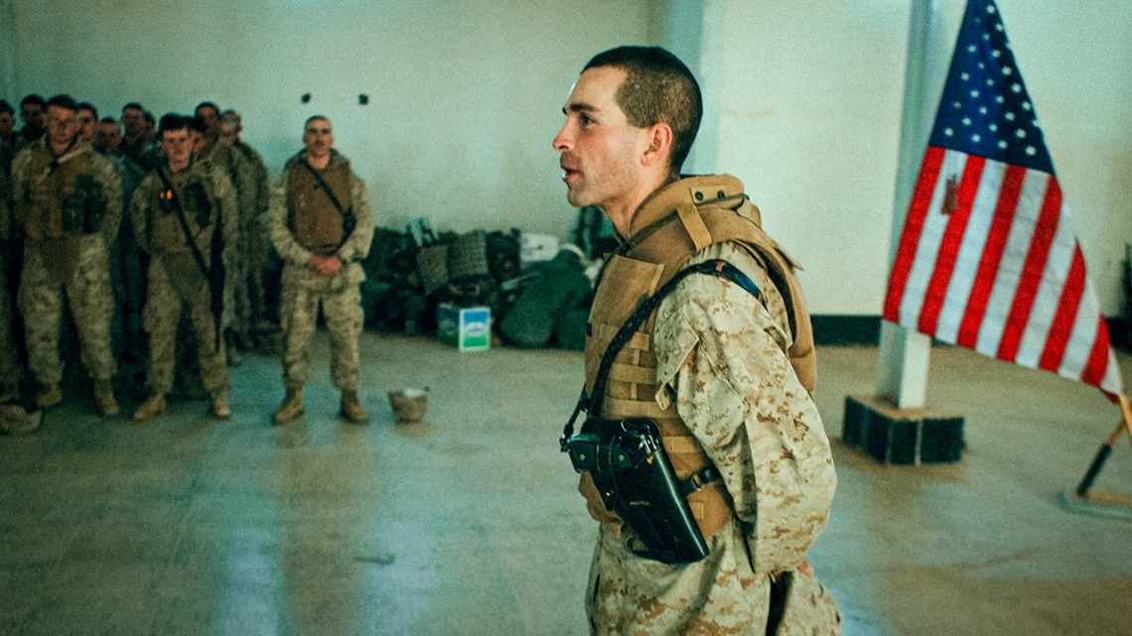
Gannon in formation
\
Photo Credit: Andrew Cutraro via Cornell Chronicle

Slide 6
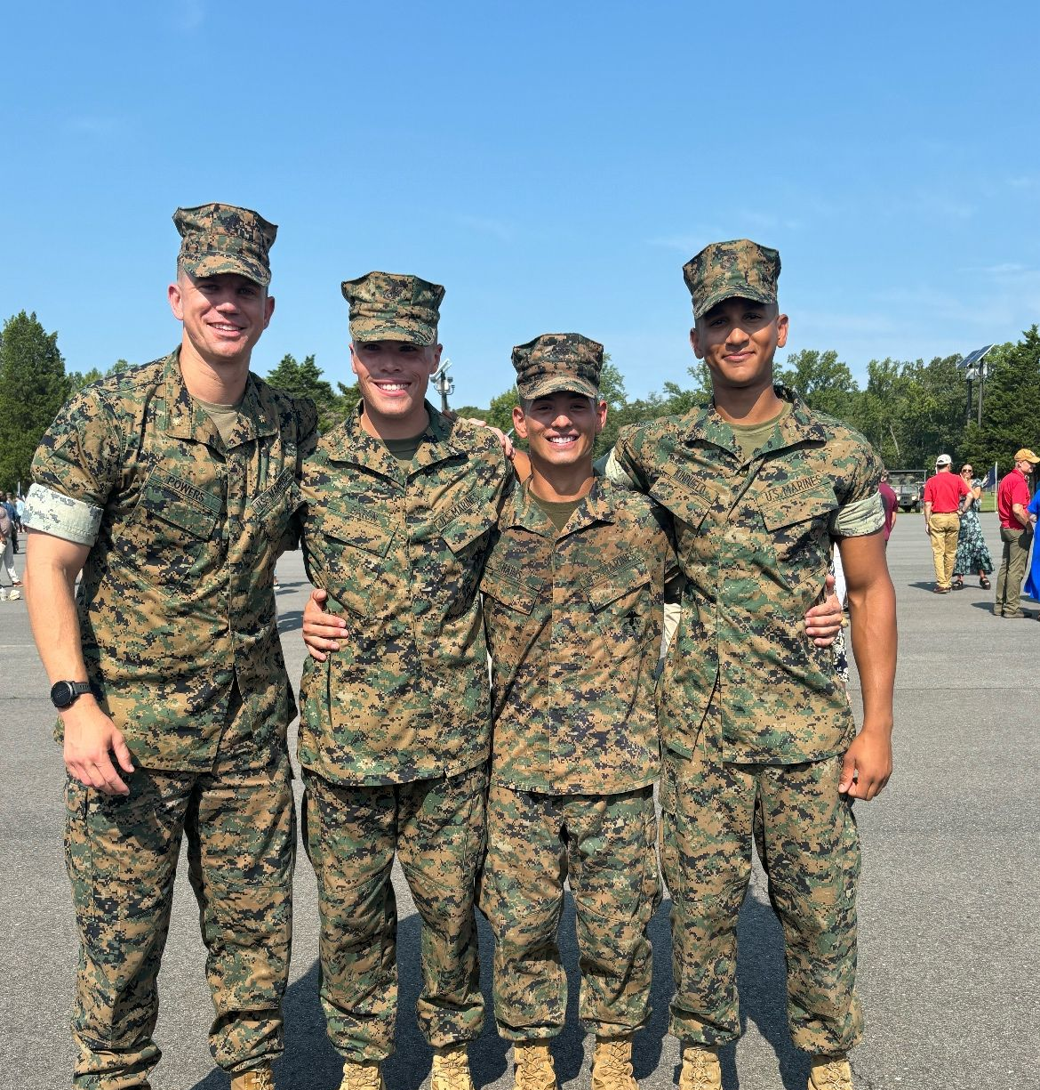
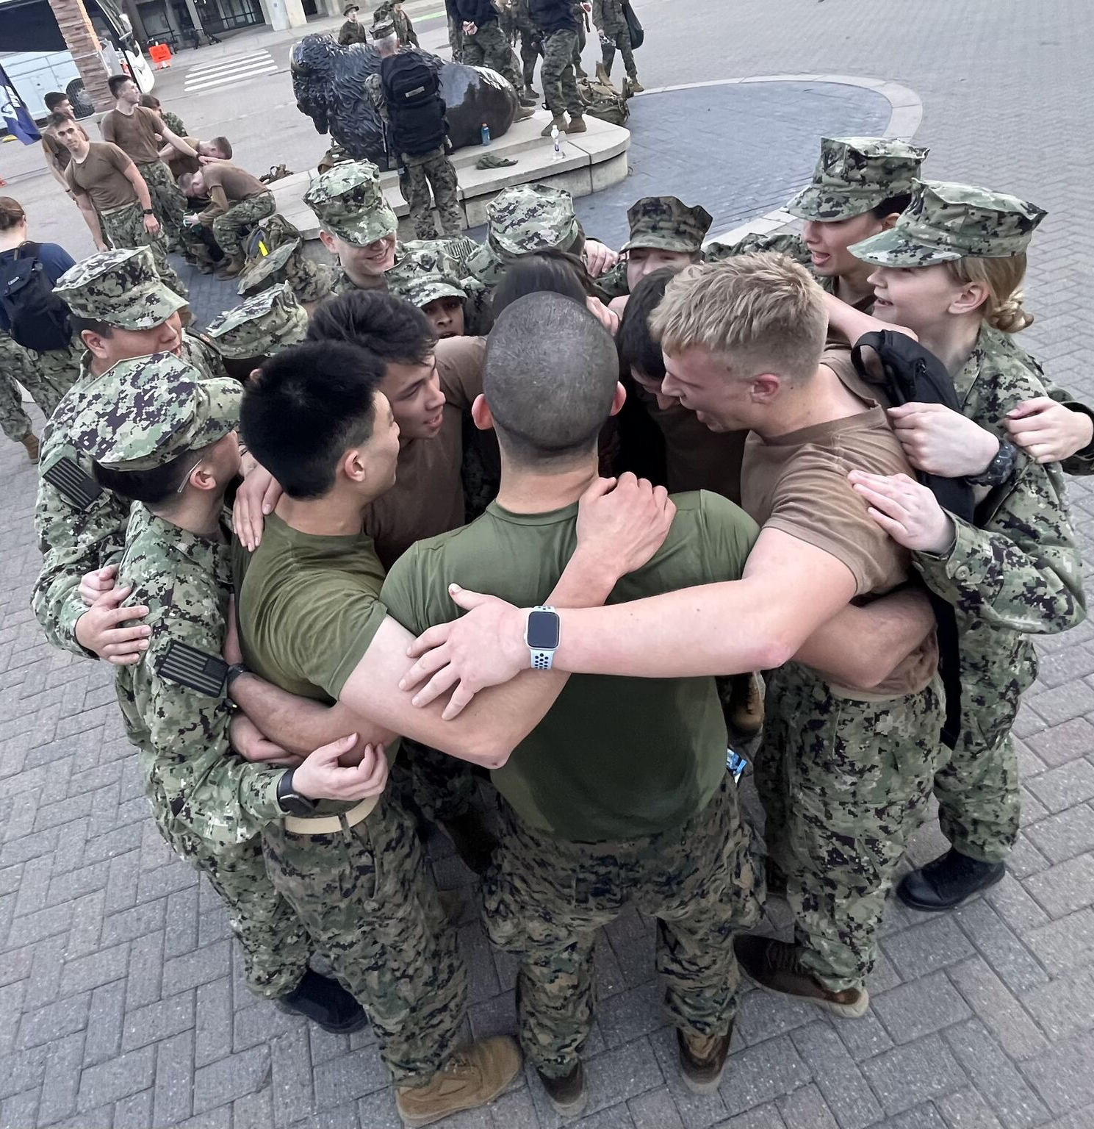

Slide 7
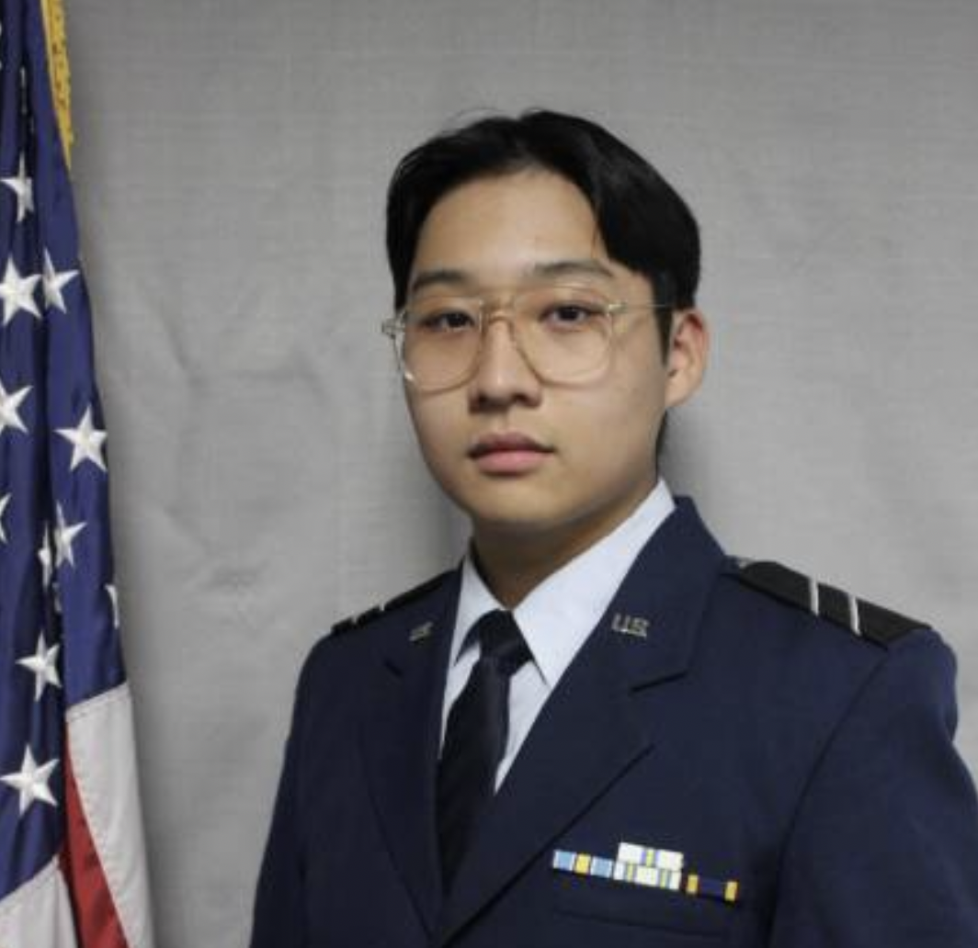
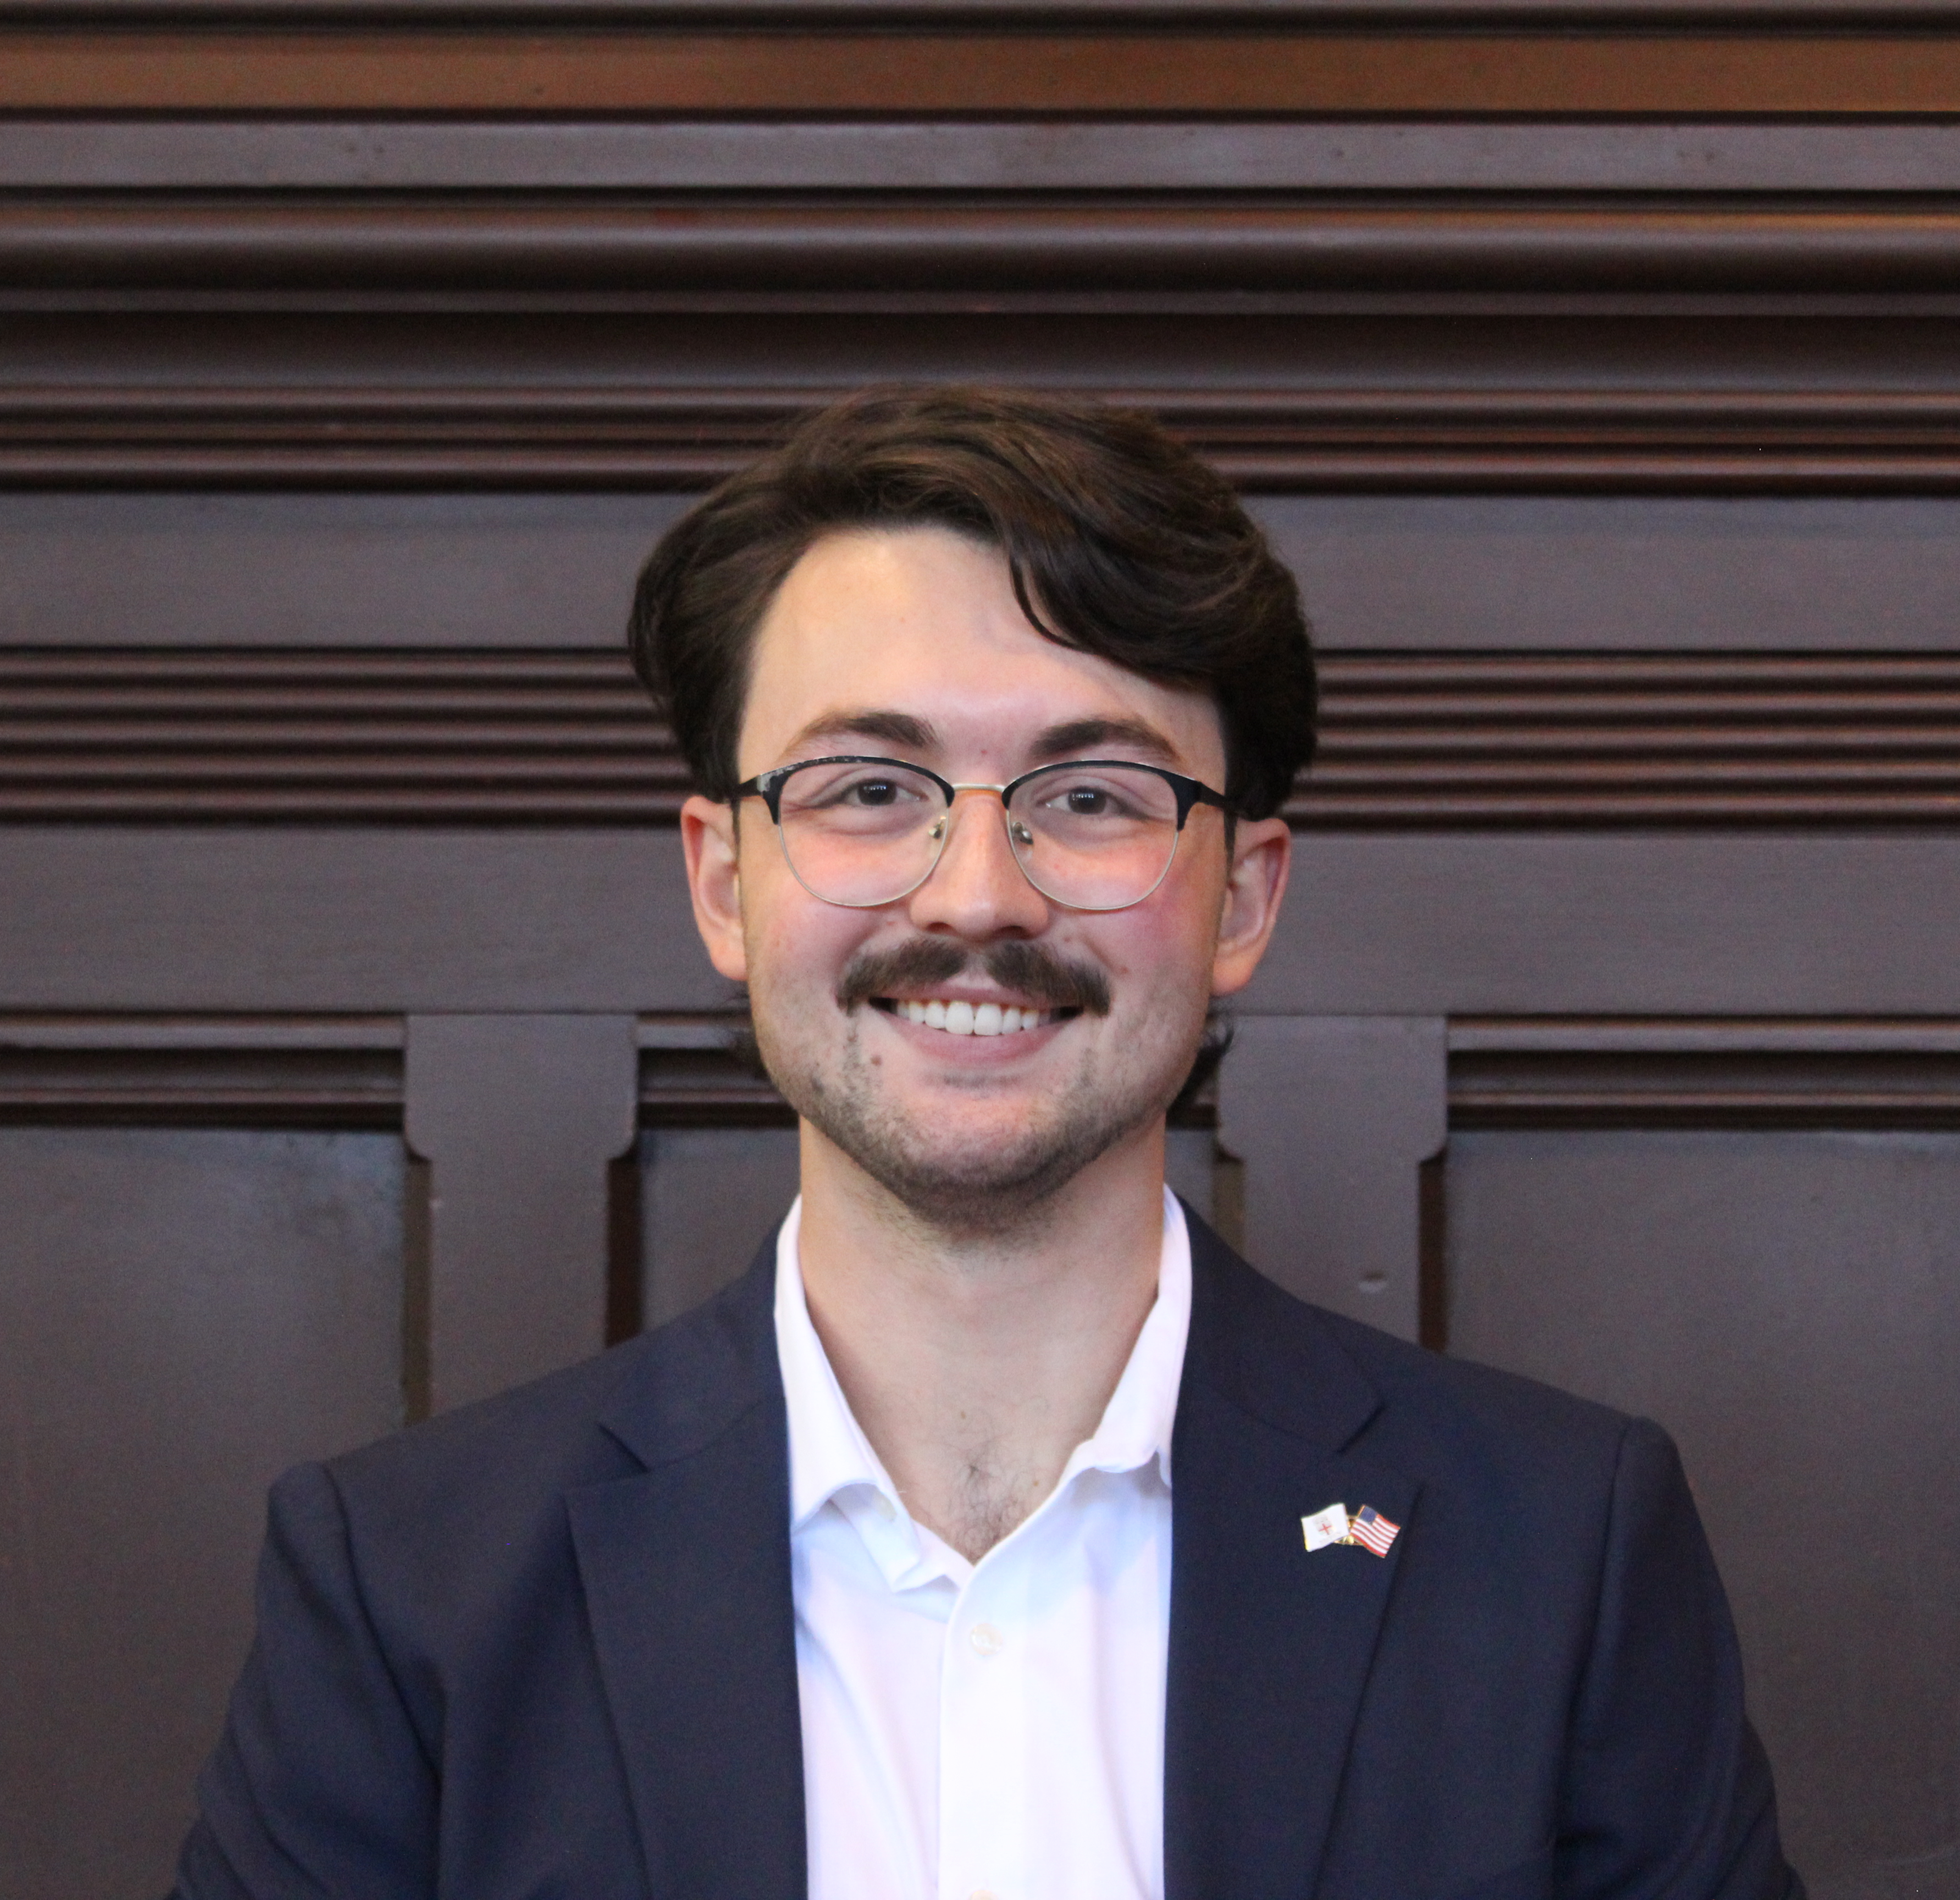
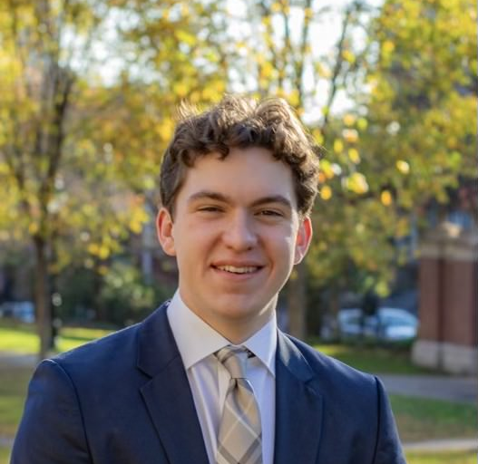
teammates

Slide 8
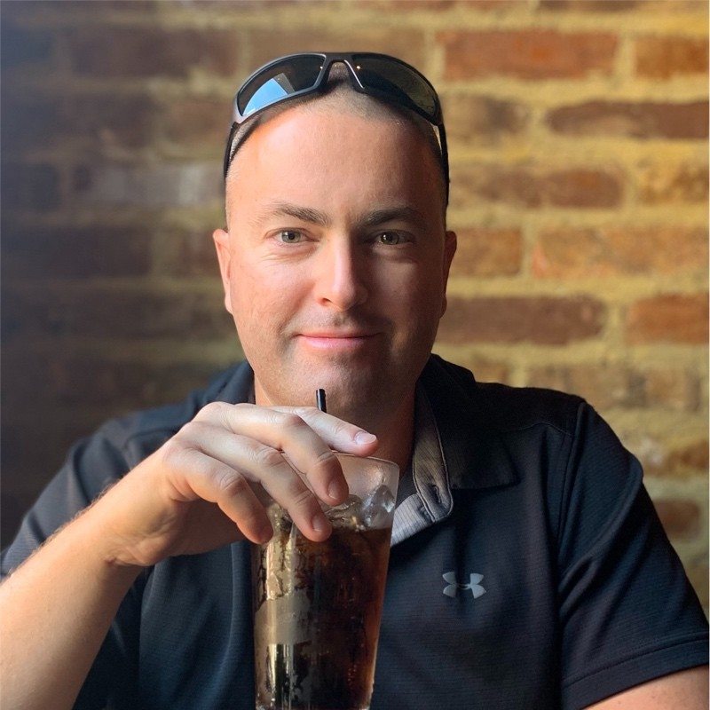
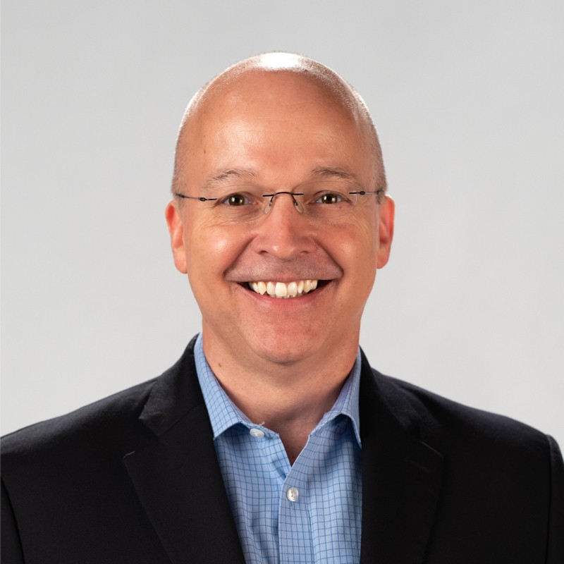
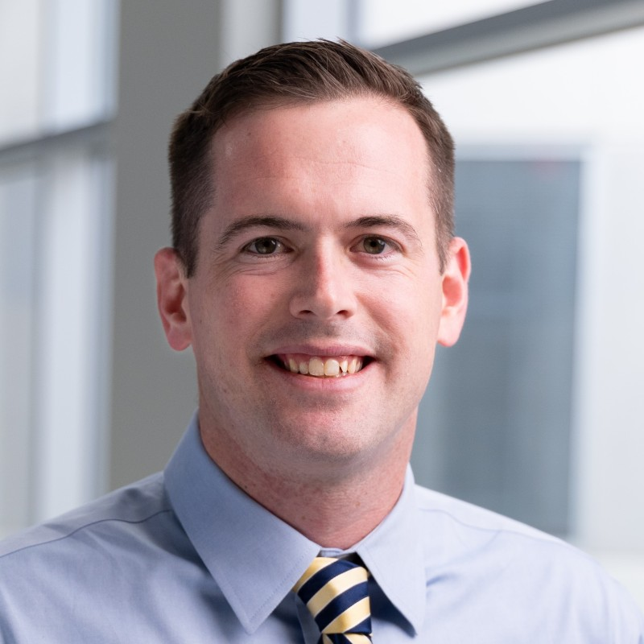
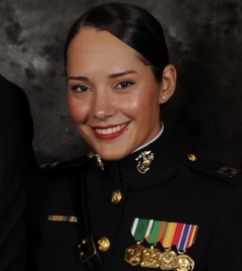
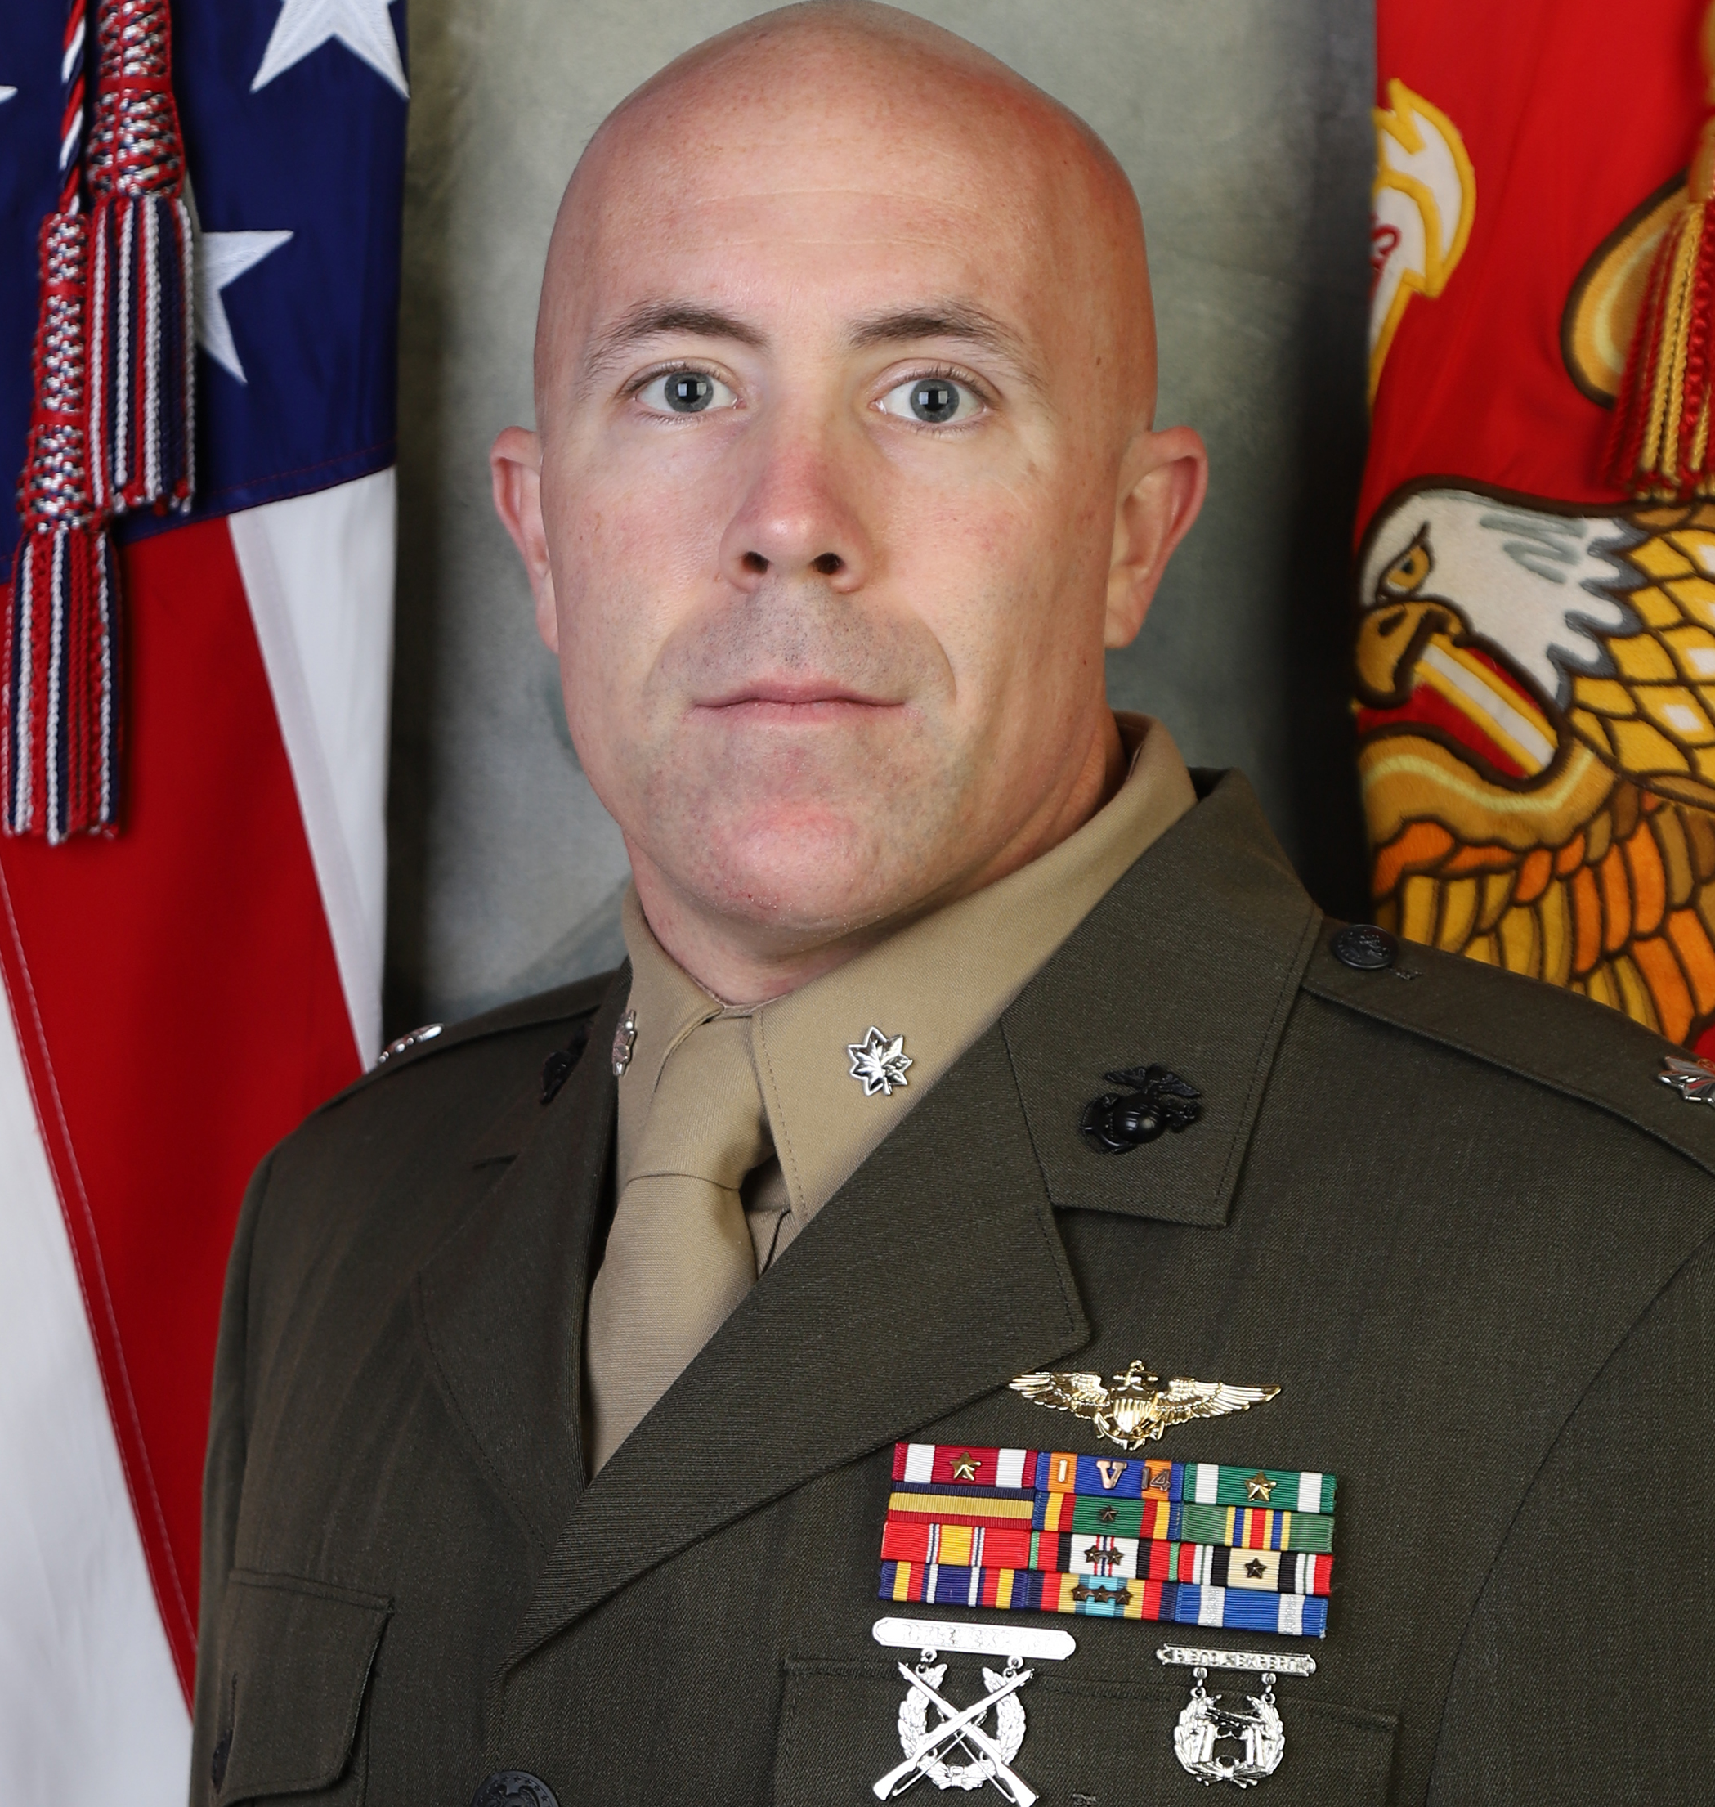
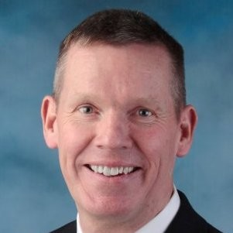
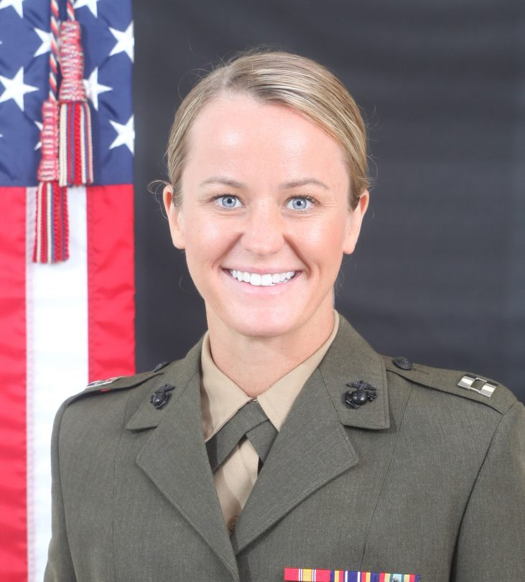
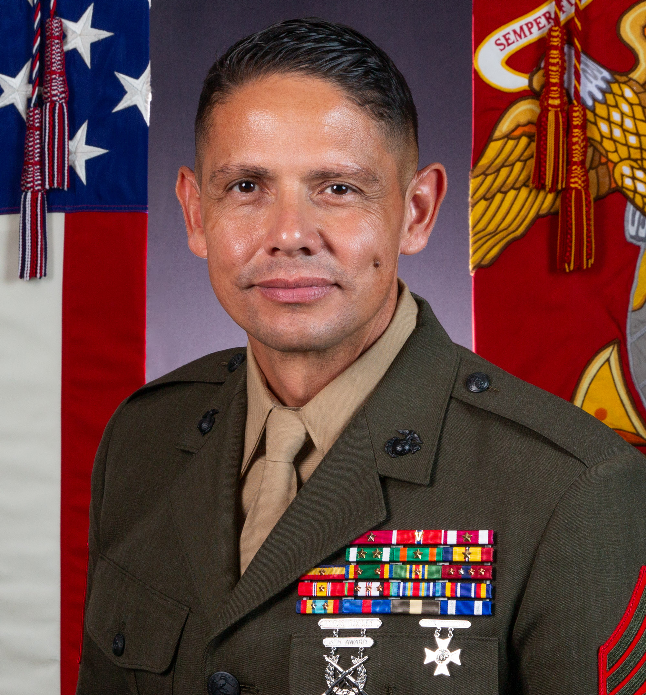
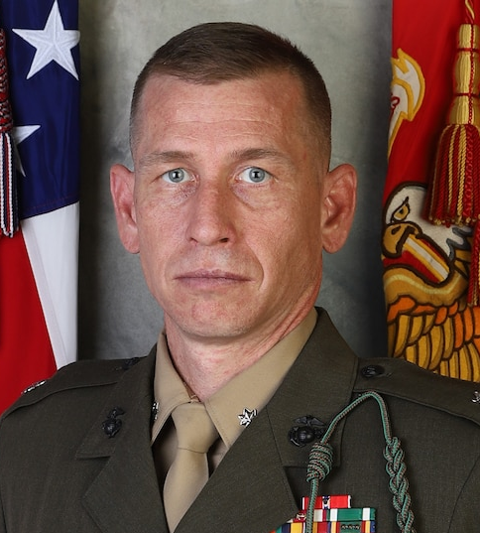

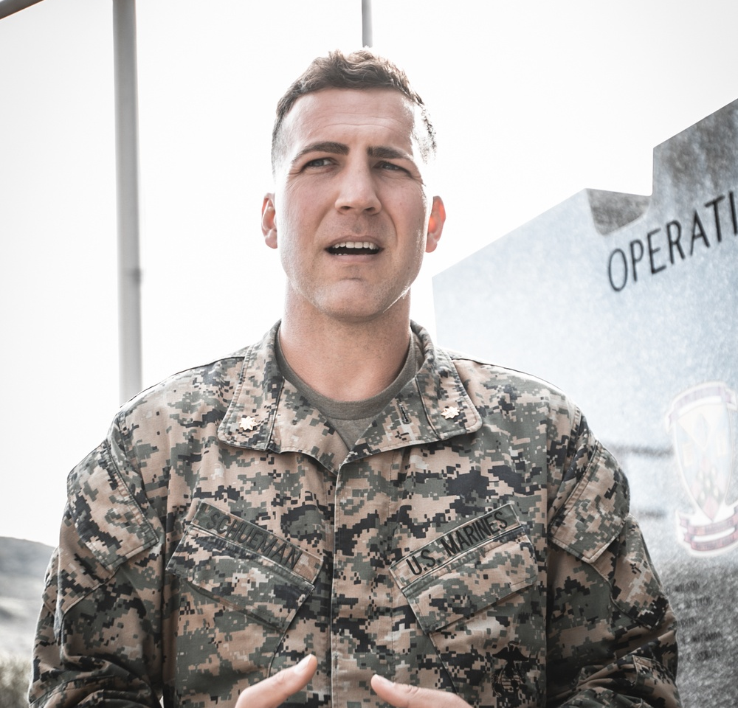
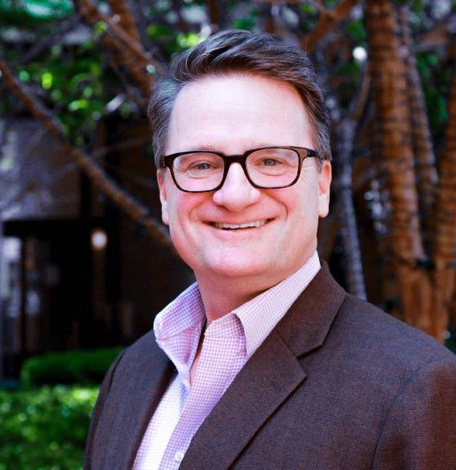
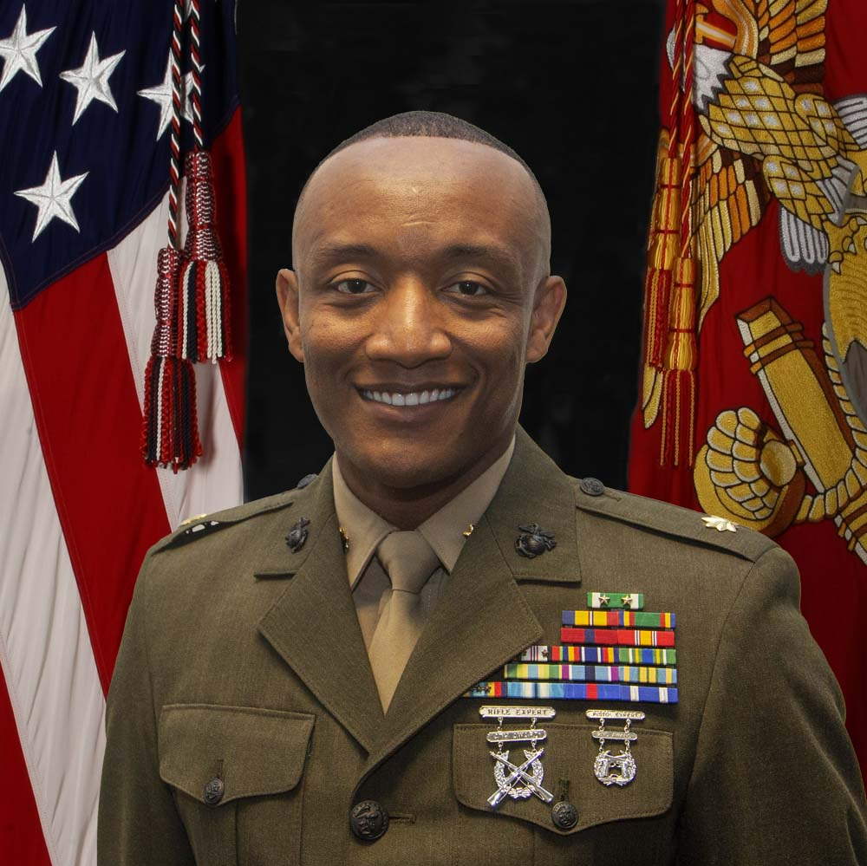
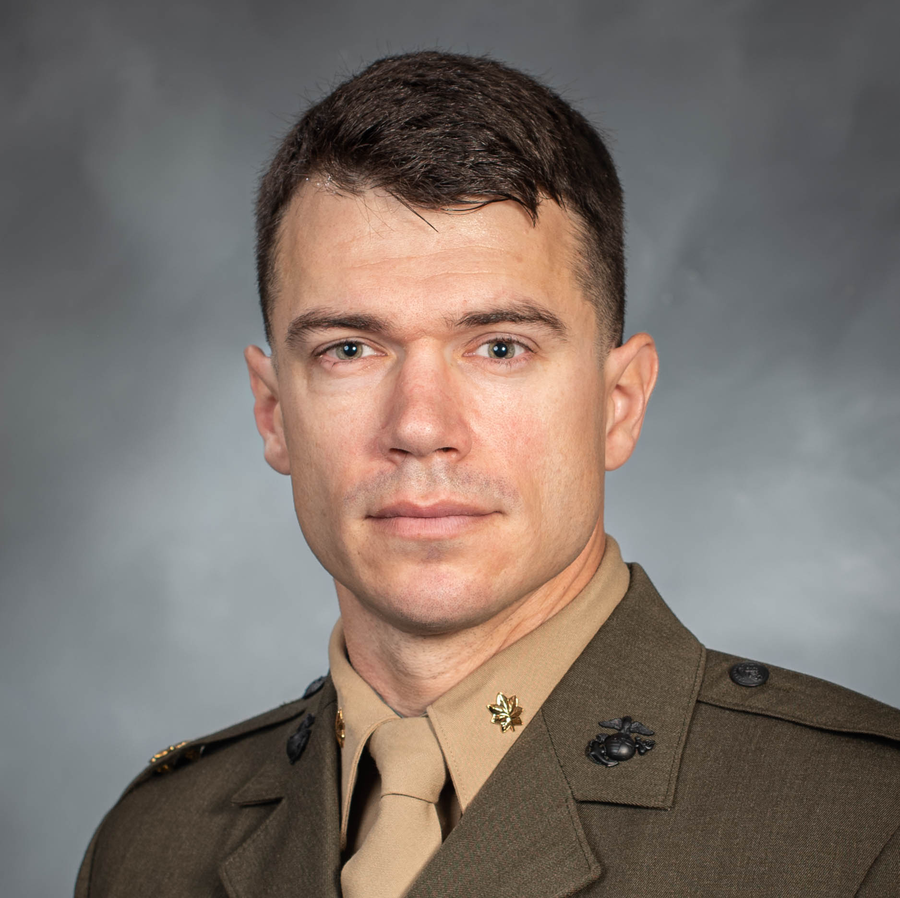
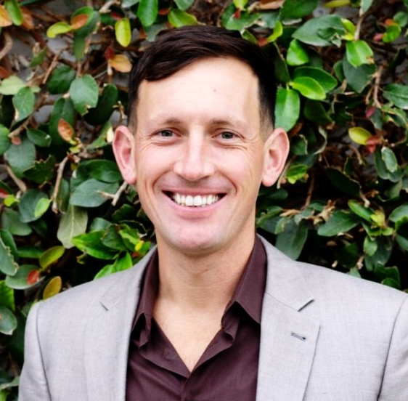
Notes:
Need Tom Duff

Slide 9

Know them
Challenge them
Believe in them
Notes:
EGAs for pictures

Slide 10

“One meaningful conversation per week with each team member.”
-Gallup
Know them - challenge them - believe in them
Notes:
Know them

Slide 11

“Because of the sheer strength of its tradition and the reputation of its standards, the Corps will continue to attract those who want to be the best.”
-LtGen Victor Krulak
Know them - challenge them - believe in them
Notes:
Know them

Slide 12
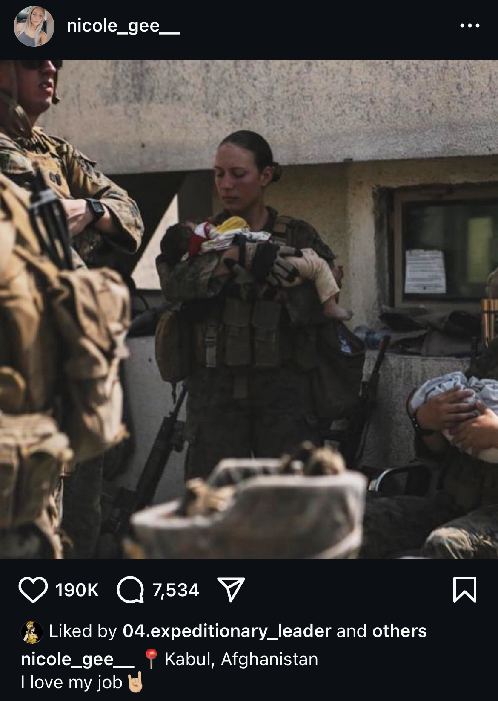
“I love my job 🤘🏼”
-Sgt Nicole Gee, 20 Aug 21
Know them - challenge them - believe in them
Notes:
Challenge them

Slide 13

“The very acme of leadership comes of the ability to lift the powers of the average man-in-the-ranks to the highest attainable level—and hold them there.”
-S. L. A. Marshall
Know them - challenge them - believe in them
Notes:
Know them

Slide 14









Slide 15
79.98
Trainee performance
72.43
65.18
Eden, Dov, & Shani, Abraham B. (1982). Pygmalion goes to boot camp: Expectancy, leadership, and trainee performance. Journal of Applied Psychology, 67(2), 194–199.
Notes:
Statistically significant differences

Slide 16
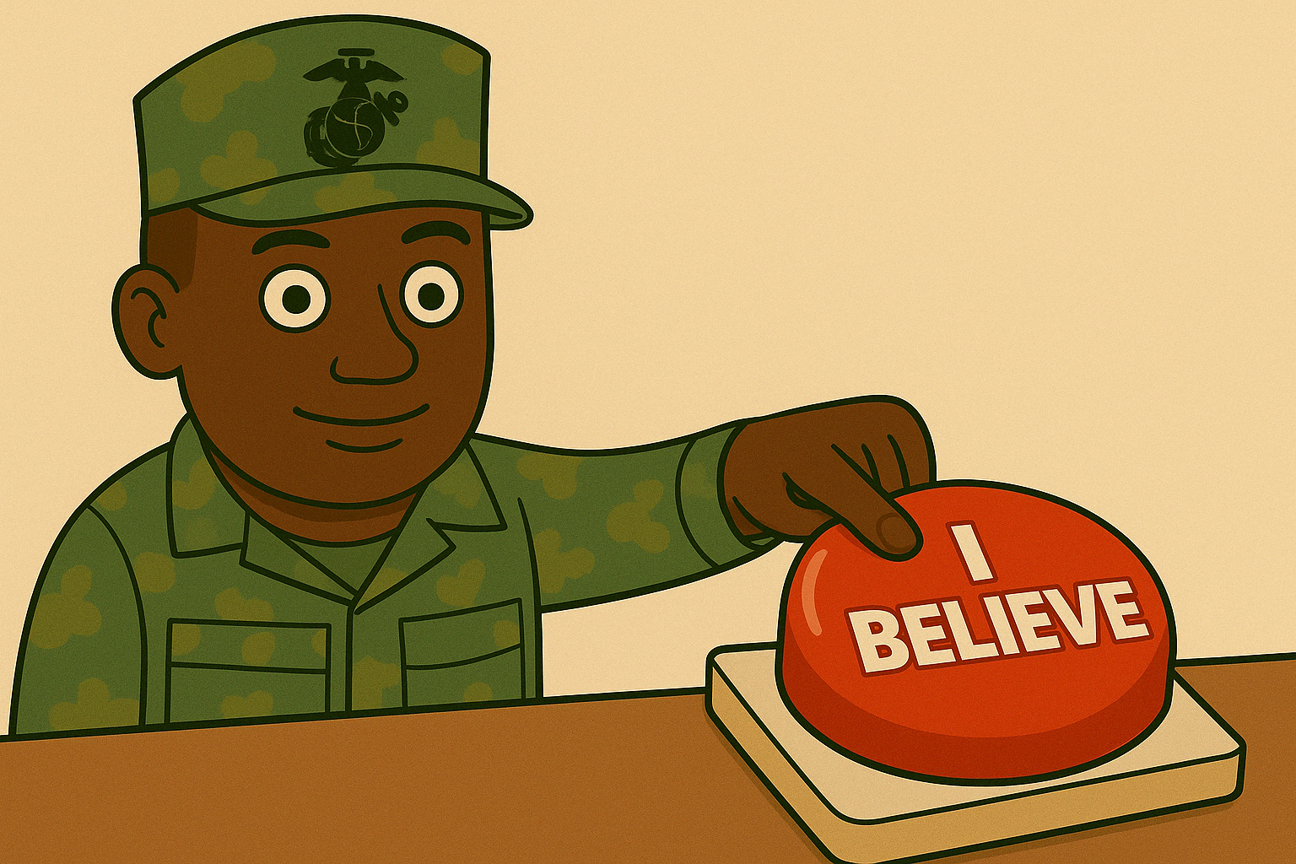
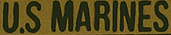
Photo Credit: ChatGPT
Know them - challenge them - believe in them

Slide 17


High-performing teams
5.6 : 1
low-performing teams
1 : 3
Know them - challenge them - believe in them
Notes:
Add citation

Slide 18
Know them
Challenge them
Believe in them
Notes:
EGAs for pictures

Slide 19
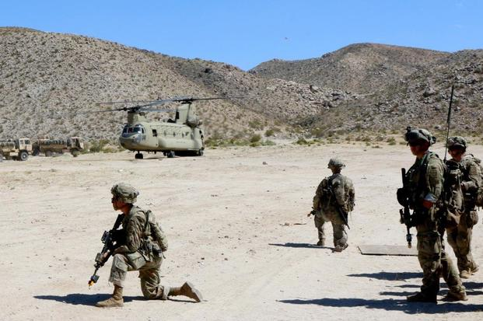
Testing vertical cohesion
Alderks, Cathie E. Relationships between vertical cohesion and performance in light infantry squads, platoons, and companies at the Joint Readiness Training Center (JRTC), March 1, 1992. https://doi.org/10.21236/ada249254.

Slide 20






PLATOON LEADER
PLATOON SERGEANT
SQUAD LEADERS
SQUAD MEMBERS

Slide 21
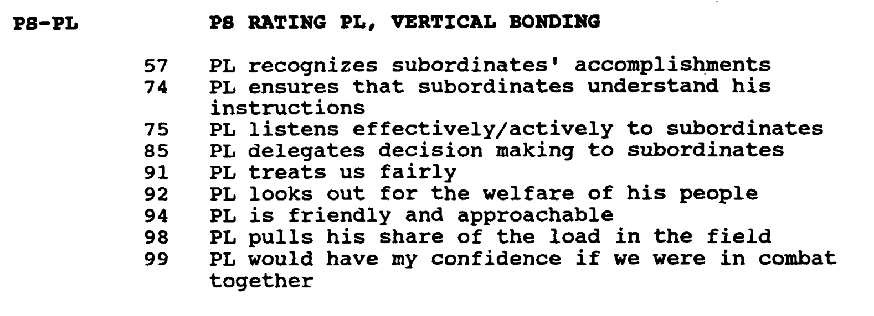

Slide 22

PLATOON LEADER
PLATOON SERGEANT
SQUAD LEADERS
SQUAD MEMBERS

Slide 23
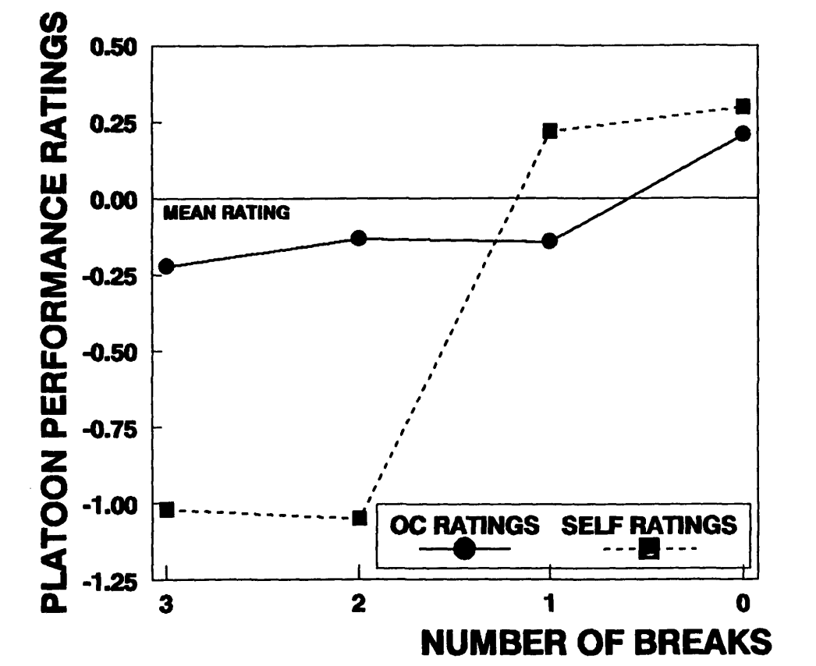
Best performance in simulated combat → Most cohesive platoons
Alderks, Cathie E. Relationships between vertical cohesion and performance in light infantry squads, platoons, and companies at the Joint Readiness Training Center (JRTC), March 1, 1992. https://doi.org/10.21236/ada249254.

Slide 24
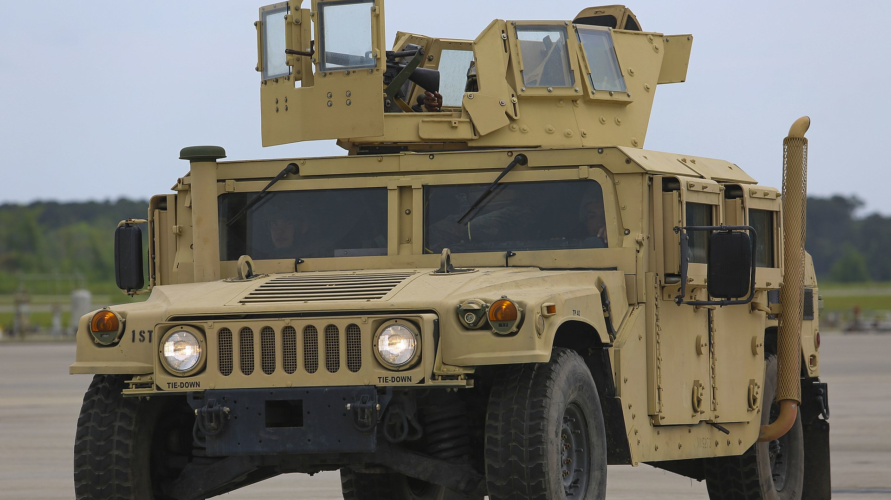

Slide 26
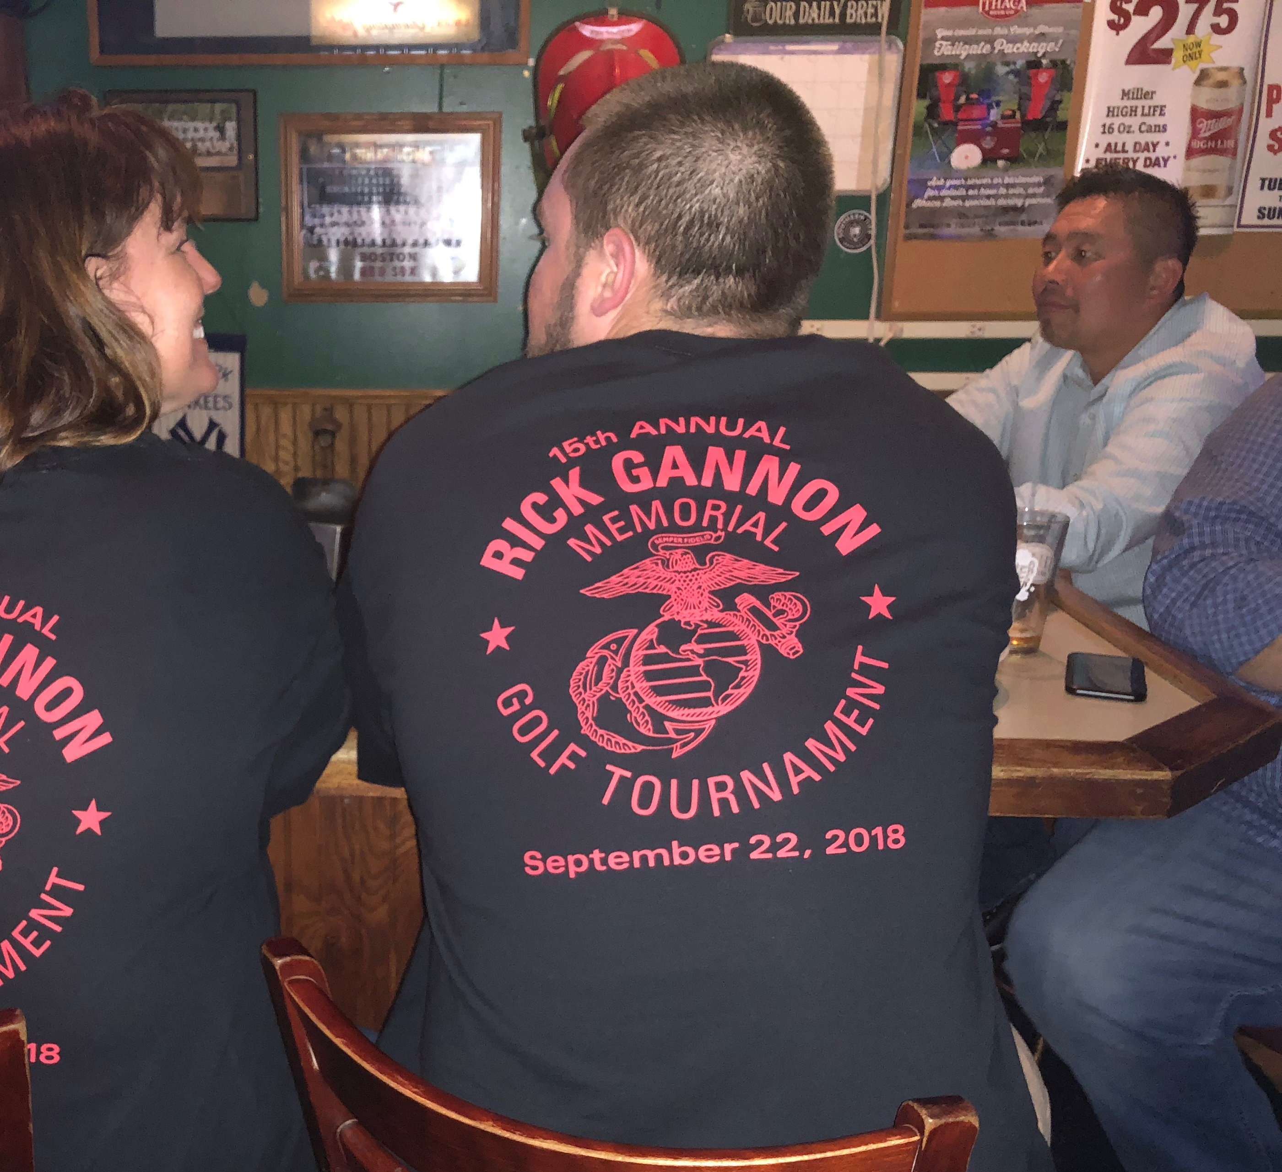
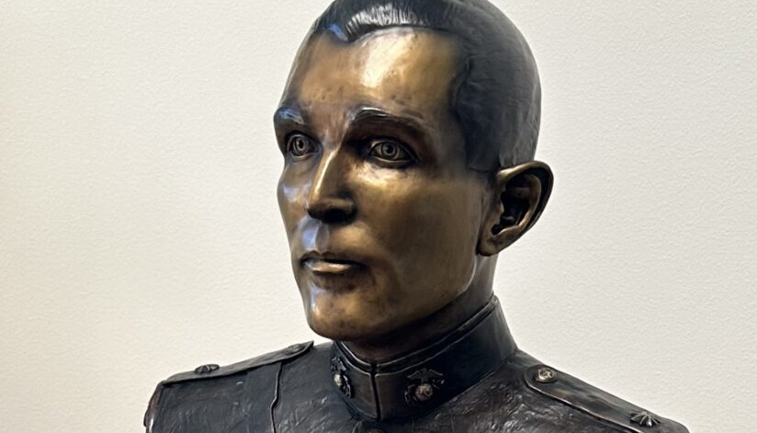
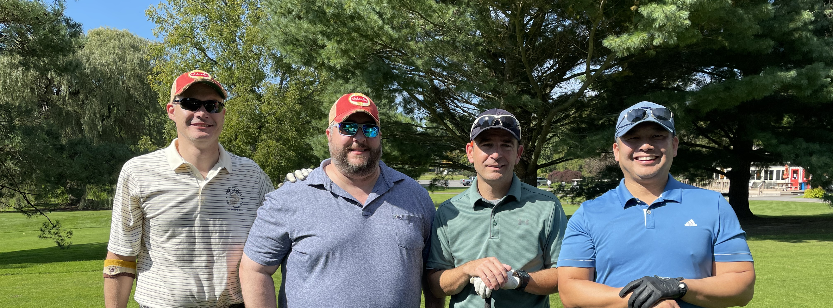
Photos Courtesy of MIDN Frederick Wentzien and Sally Gannon

Slide 27
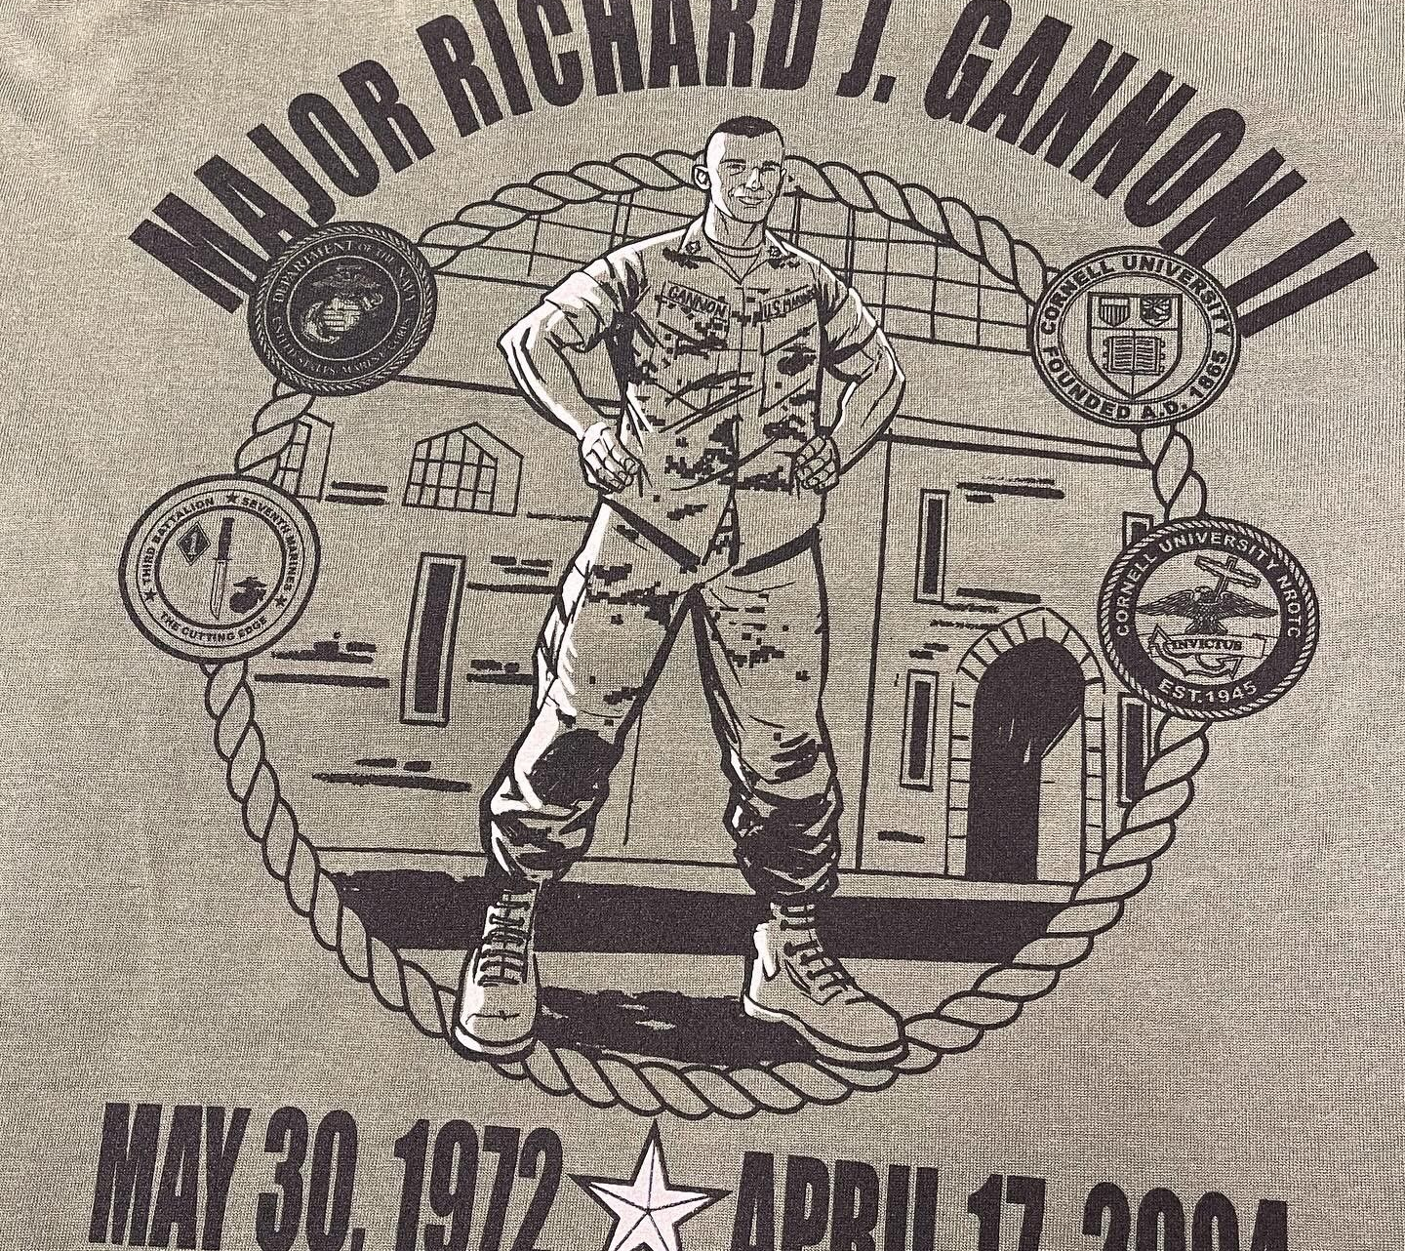
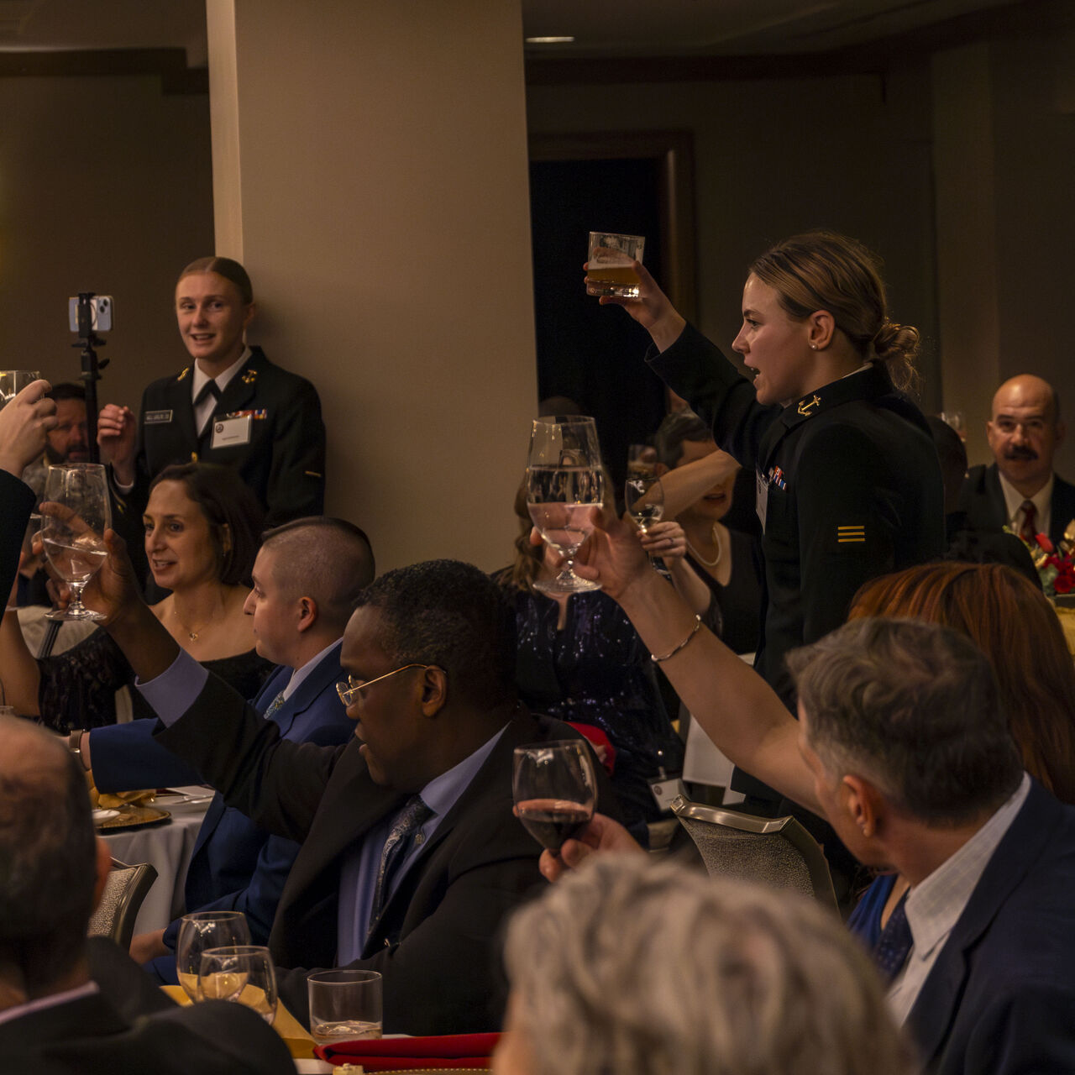
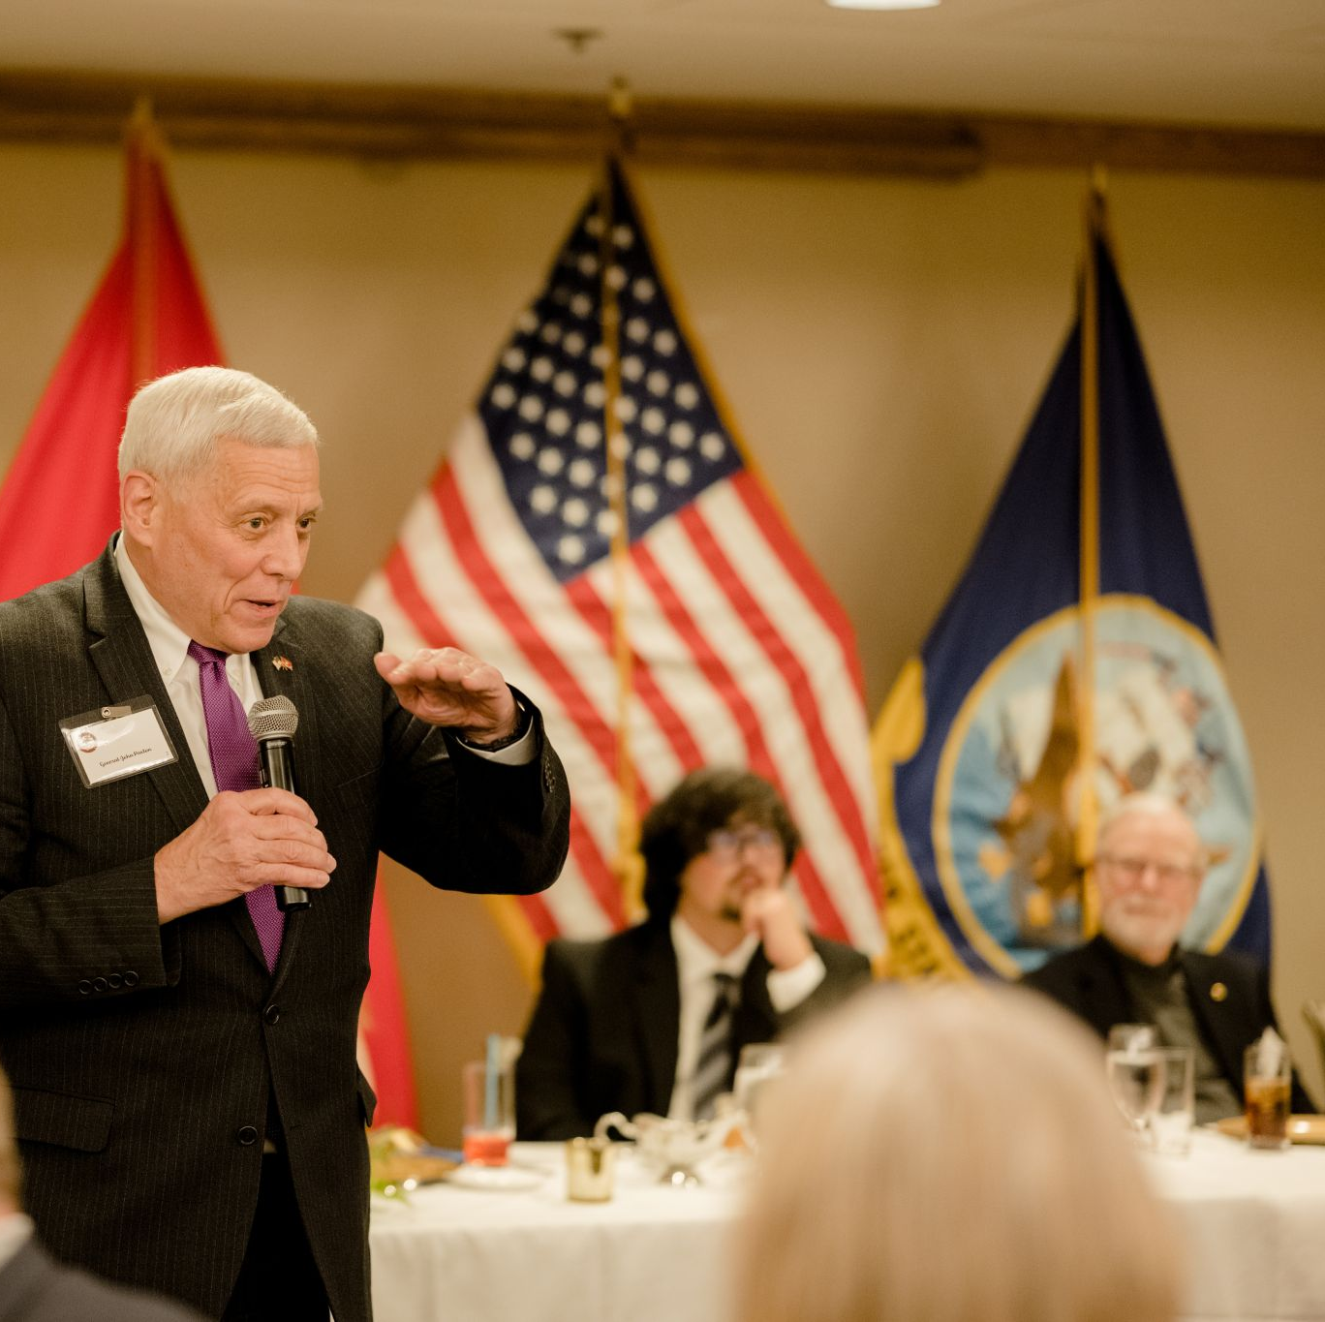
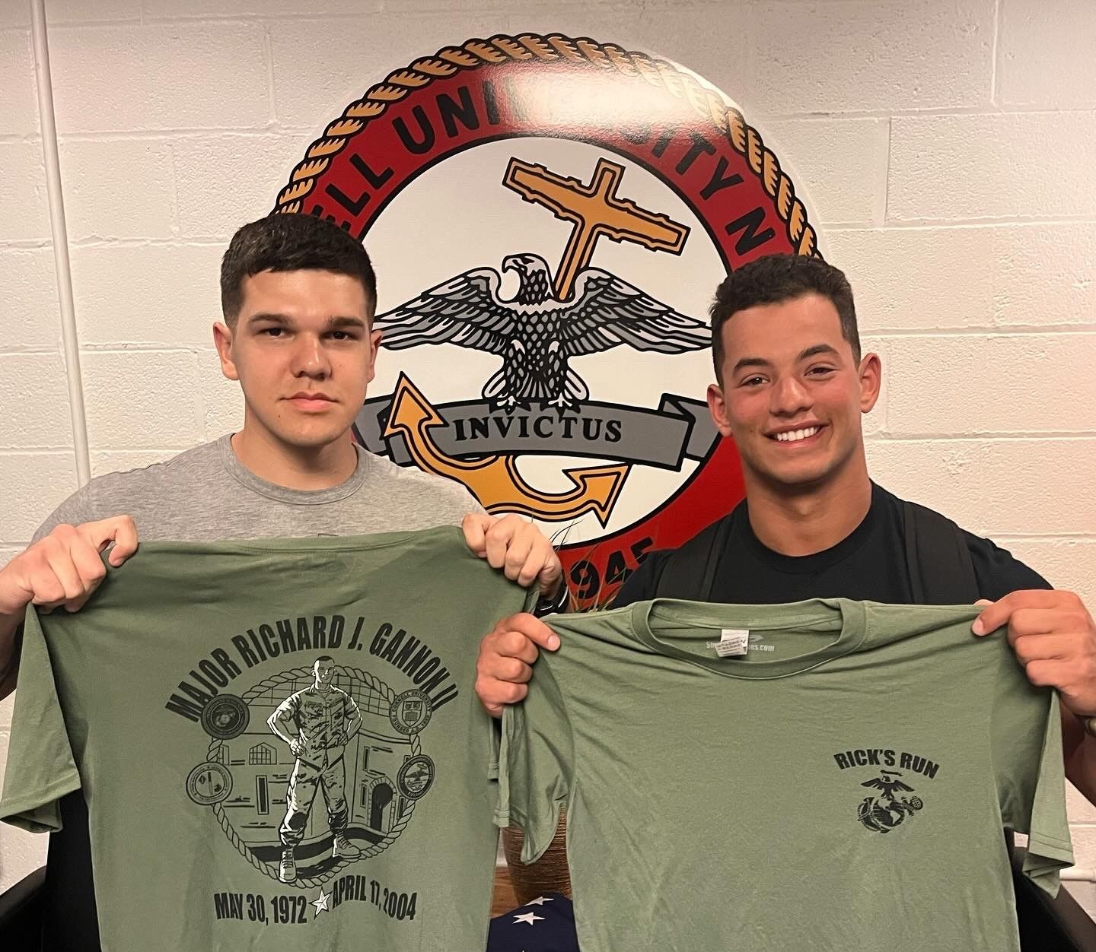
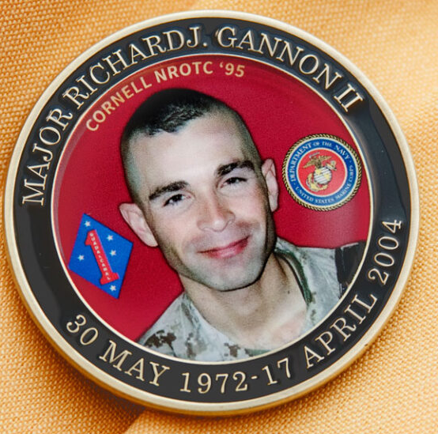
20th anniversary
April 2024
Photo Credit: Danielle Gerritsen and Sgt Gerardo Cano

Slide 28
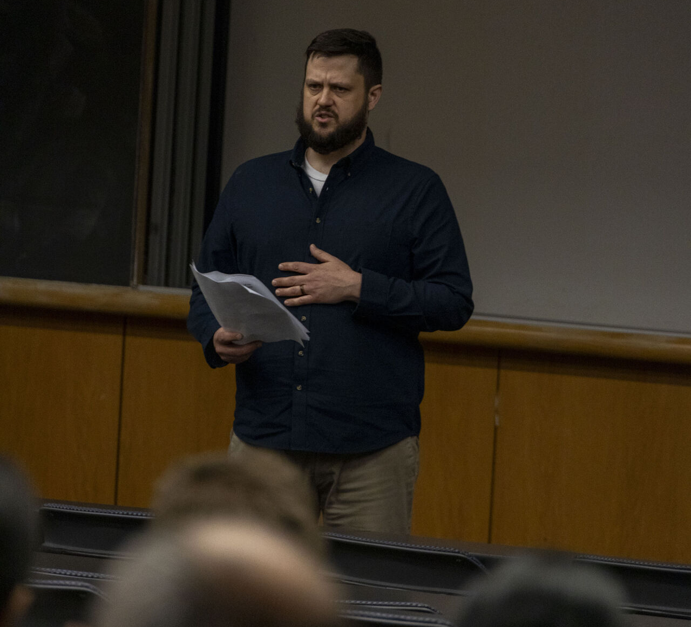

Slide 29
Semper fidelis
Major Ted powers
Edwin_powers@brown.edu

