Slide 1



The Transformational Potential of Command Climate
Theory to Practice
Jackson Kerchis, Partner Warrior Leader Training
Notes:
In 2009 Major General Bob Scales (the retired head of the US Army War College) wrote an essay in which he made a surprising claim. General Scales proposes that the human dimension may be as decisive a factor in the success of modern warfare as kinetic factors were in the prior century. He argues…

Slide 2
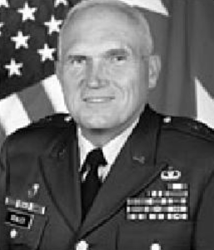
WWI – Chemistry
WWII – Physics
WWIII – Information WWIV – Social Science
Notes:
Summarize his point…
Scales proposes we are in a paradigm shift into World War IV where the key factor will be “human and biological rather than organizational or technological… But more important to victory will be human influencers such as the selection, bonding, and psychological and physical preparation of tactical units.”

Slide 3
We are in a race and the times demand change. Word War IV can only be won by harnessing the social and human sciences as the essential amplifiers of military performance, just as the physical sciences were the amplifiers of past world wars…
Notes:
He further observed: We are in a race, and the times demand change. World War IV can only be won by harnessing the social and human sciences as the essential amplifiers of military performance, just as the physical sciences were the amplifiers of past world wars. Such a shift in how the defense community approaches war will require a fundamental shift in military culture.

Slide 4
Notes:
Today I’m going to run with this argument and propose to you that getting the psychological dimension right is mission critical. We are going to talk about the surprising research that links happiness – that’s right happiness to higher performance for individuals and organizations. And we’ll talk about creating a climate supportive of health, happiness, and human flourishing in our forces.

Slide 5
Notes:
Now my background started years ago when I took an interest in happiness – which I call life’s most important subject. So I decided to study it. I created the world’s first major in happiness. That’s a fun conversation to have with your parents. Then I went on to do research at the u of alabama and teach their first course on happiness. I lived for four months as a Zen monk studying their way of mind training. And I’m now a practitioner. I run two companies bringing happiness wellbeing and positive psychology research into organizations to improve performance: HMB for businesses and WLT for military/first responders. So when I decided to study happiness and then go live as a monk I thought I’m sure I’ll probably end up working with the marine corps some day seems like a natural fit right?... It turns out this work matters for our armed forces. Picking up where gen scales left off there are two studies I want to share with you because emphasis not woo woo goofy

Slide 6
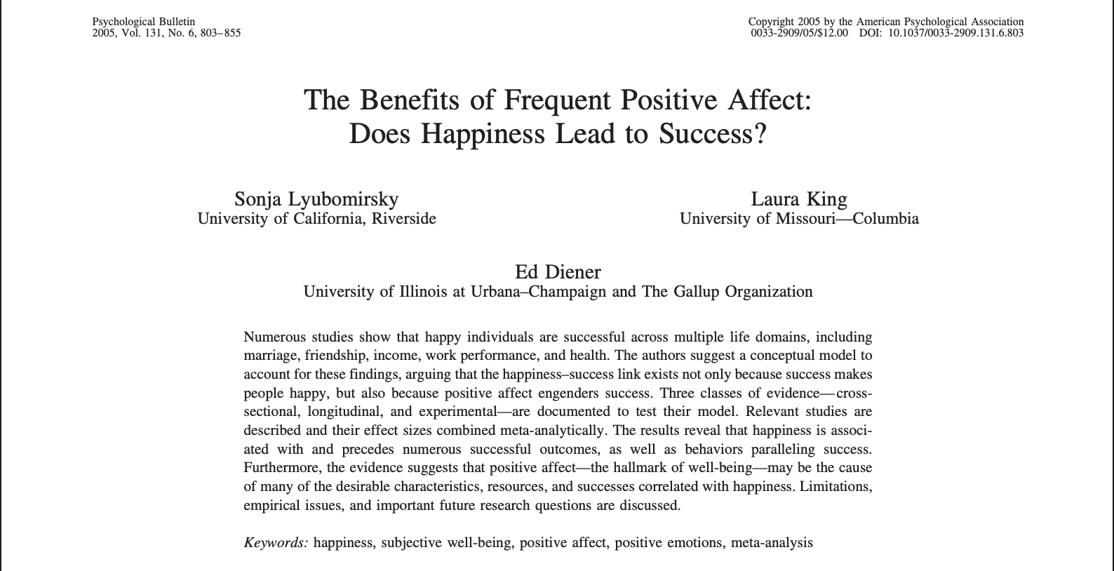
Notes:
The first is one of the most important studies in the last 25 years: the Frequent Benefits of Positive Affect – Does Happiness Lead to Success? In this study researchers set out to examine the relationship between success and happiness. This is a meta study which is an analysis of 200+ studies with 275,000 participants. What they found was that we got it all wrong.

Slide 7
Notes:
We tend to think this recipe of work harder to achieve more and once more successful we will be happier. But it turns out this is not the full story. It turns out happiness leads to more success. They analyzed data points that show happy people are more productive and perform better. They earn more income too. A good mood improves creativity and problem solving. Happier people do better with relationships. And even health is a function of happiness… In just about every personal and professional outcome happiness brings success.… Now lets go from theory to practice a bit more here for our military context.

Slide 8
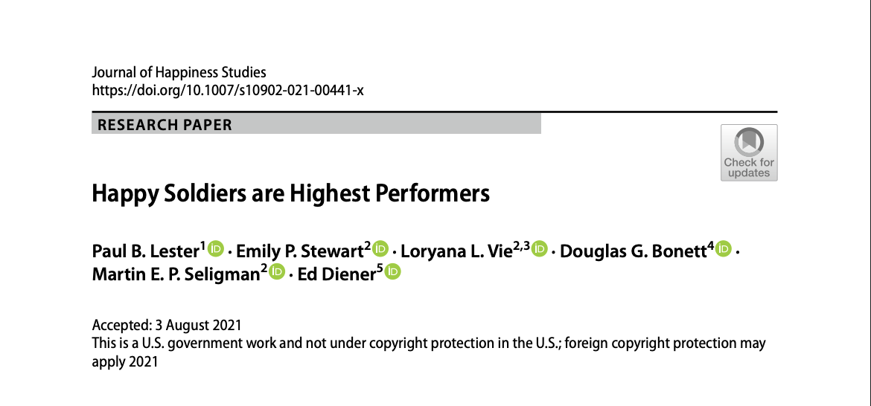
Notes:
A landmark study titled “Happy soldiers are highest performers” was published in 2021. Researchers examined a sample of 908,096 soldiers in the US Army which included over ¼ of a million ethnic minorities and 150,000+ women. They looked at positive affect (PA), negative affect (NA), and optimism. Positive / negative affect refers to a tendency towards positive or negative emotion while optimism refers to how positively / negative one views the future.

Slide 9
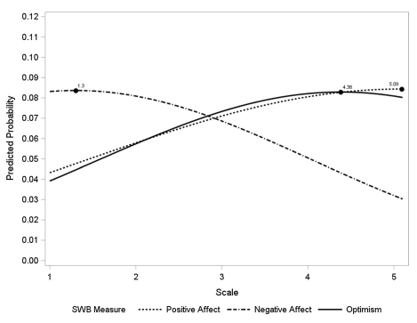
908,096 soldiers
Notes:
They found that high positive affect, low negative affect, and high optimism predicted awards for performance and heroism. These measures – which are the essential features of happiness and wellbeing – determined who was most likely to win an award within a four year follow up window. This pattern applied to men and to women, to enlisted and officers, and across a wide range of ethnicities and backgrounds. Soldiers with the highest vs. lowest happiness were about 4X more likely to win an award. Think if it were software to make you 400%… The study takes an important step forward in establishing the scientific relationship between happiness / well-being and military performance.

Slide 10
Where there’s Happiness, there’s success…
Notes:
So I often say happiness is serious business. I want to ask - do you see the importance of this? Can you know see more of what Scales was talking about? The best fighting force depends upon having people at their best. And that’s where your climate comes in. Because think about it that felt experience, that psychological environment, that leadership culture, that's the water you swim in. Getting that right is how you set up your servicemembers to flourish. It is not your job to make everyone happy all the time. But can we create conditions, resources, circumstances were it is most likely. That is a KSF. Are you with me?... And we know this is true because we’ve seen it happen.

Slide 11
WIARNG RRB Case
Notes:
As of August 2022 the WIARNG RRB was ranked 53 out of 54 in production relative to all National Guards across the country. Production is defined as recruiting / retention outcomes relative to mission targets. As a result, the end strength of the WIARNG was compromised. Further, there were known pockets of toxic leadership.

Slide 12
WIARNG RRB Case
Notes:
In April of 2022 the WIARNG selected CSM Chris Beron and LTC Shannon Hellenbrand to take command of the RRB. There first priority was on creating the optimal command climate supportive of health, happiness, and high performance. They wanted to weed out toxic subcultures and create a culture of people plus production people first. We worked with them through a three day intensive training, ongoing coaching, resources, and strategy development including a new mission, vision, and values for the BN.

Slide 13
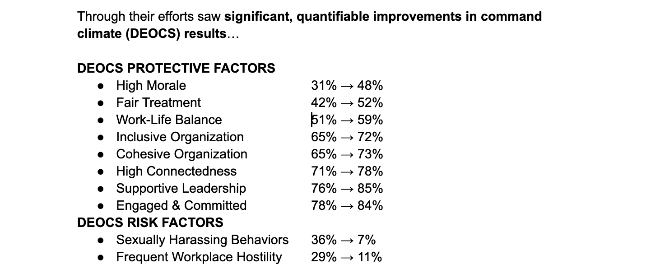
Notes:
Through their efforts saw significant, quantifiable improvements in command climate (DEOCS) results… And what happened? What happens when we get climate right?... In comparing the period from MY24 to MY23 there has been a 34% increase in production with fewer recruiters. The RRB exceeded their retention mission. Despite the fact that it went from 319 to 679 whilst turning over half the team. They met or exceeded all state missions for the first time in six years.

Slide 14
Command & Control
Climate Control
Notes:
So let’s talk about how to do this: couple lessons for getting the climate right. I sometimes call it three lessons to go from command and control to climate control.

Slide 15
1. Establish trust by weeding out toxic leadership and replacing it with emotional intelligence.
Notes:
One - create trust by weeding out toxic leadership. they weeded out toxic and passive leaders. They used DEOCS data but hey also recognized the power of meeting people where they are an leadership presence. So they made an effort to travel all over the state in order to connect with their teams and encourage people to open up. They also shared their “open door policy” for toxic leadership that if anyone came forth to blow the whistle on counterproductive behaviors, it would be investigated and the person who came forth would be protected from retaliation. So manage personality and interpersonal issues like you would performance issues.

Slide 16
1. Establish trust by weeding out toxic leadership and replacing it with emotional intelligence.
Notes:
They replaced his with a shift to emotional intelligent leadership. A key component of this turnaround was getting the E7s as they transitioned to E8 and working with them to broaden their leadership capabilities… Think of this example – DEMO the knife hand.

Slide 17
2. Resource your people: personally and professionally.
Notes:
Two - resource your people… This means doing what you can with staffing, programs, and funding to support their health and development.
One example in WI was CSM Beron looking at NCO-IC to Recruiter ratio. He also recognized a pattern in New York: they went from 12 to 1, then to 8 to 1, then to 5 to 1 and every year their production increased helping them to be the best in the country… CSM Beron estimated that a leader-to-subordinate ratio which was too high led to inadequate development and poor results and he was right

Slide 18
2. Resource your people: personally and professionally.
Notes:
When we look at the guard as a whole their then TAG Paul Knapp lobbied the governor for funds put back into soldier and airmen support: pulled together integrated J-9, resourced Med Detachment with another full-time position focused on placing behavioral health issues with the right kind of service providers and handling case management as well as counselors and other holistic health practitioners, two full timers for CHW, ARPA dollars for leadership development and coaching, and organization wide efforts to report and track SIRs and encourage people to bridge the gap between soldiers/airmen and services.
These initiatives led to cultural shifts, dozens of soldiers sharing the impact it had, and increased saves which are are a measure of people coming forward to access resources to prevent downstream issues saving millions in unwanted attritions.

Slide 19
“Climate Control”
→ Weed out toxic leadership to build trust.
→ Develop emotional intelligence for cohesion.
→ Resource your people.

Slide 20

Practice…
Notes:
Here’s one sample practice you can try that takes about 3 minutes – you could have people do it whilst in the process of hurry up and wait. Gratitude meditation… How do you feel? You train your body and your lethality but what are you doing to train you mind for a bit of happiness? You can train your psychology to flourish…

Slide 21
Notes:
In a short talk I hope you at least have some high level ideas. My message is that the psychological dimension of readiness is easiest to overlook but perhaps the most decisive. We must create a climate with resources and ways of leading that are supportive of health, happiness, and human flourishing... I want to leave you Marines with a challenge. Now I know being Marines you don’t really respond well to challenges. I know you’re not very competitive. To take this knowledge and put it to use. To go from theory to practice. And the way you can do that right now is to share that letter with someone read it to them, call them, or text them. Can I get a yes sir? Do this and you will see the power of these positive organizational interventions!
And second is take some of this back to your org through these lessons or bring this development into your battle rhythm… We know this can move the needle on objectives like end strength, mental health, and productivity – ultimately readiness. We are working to pilot more programs with MCA

Slide 22
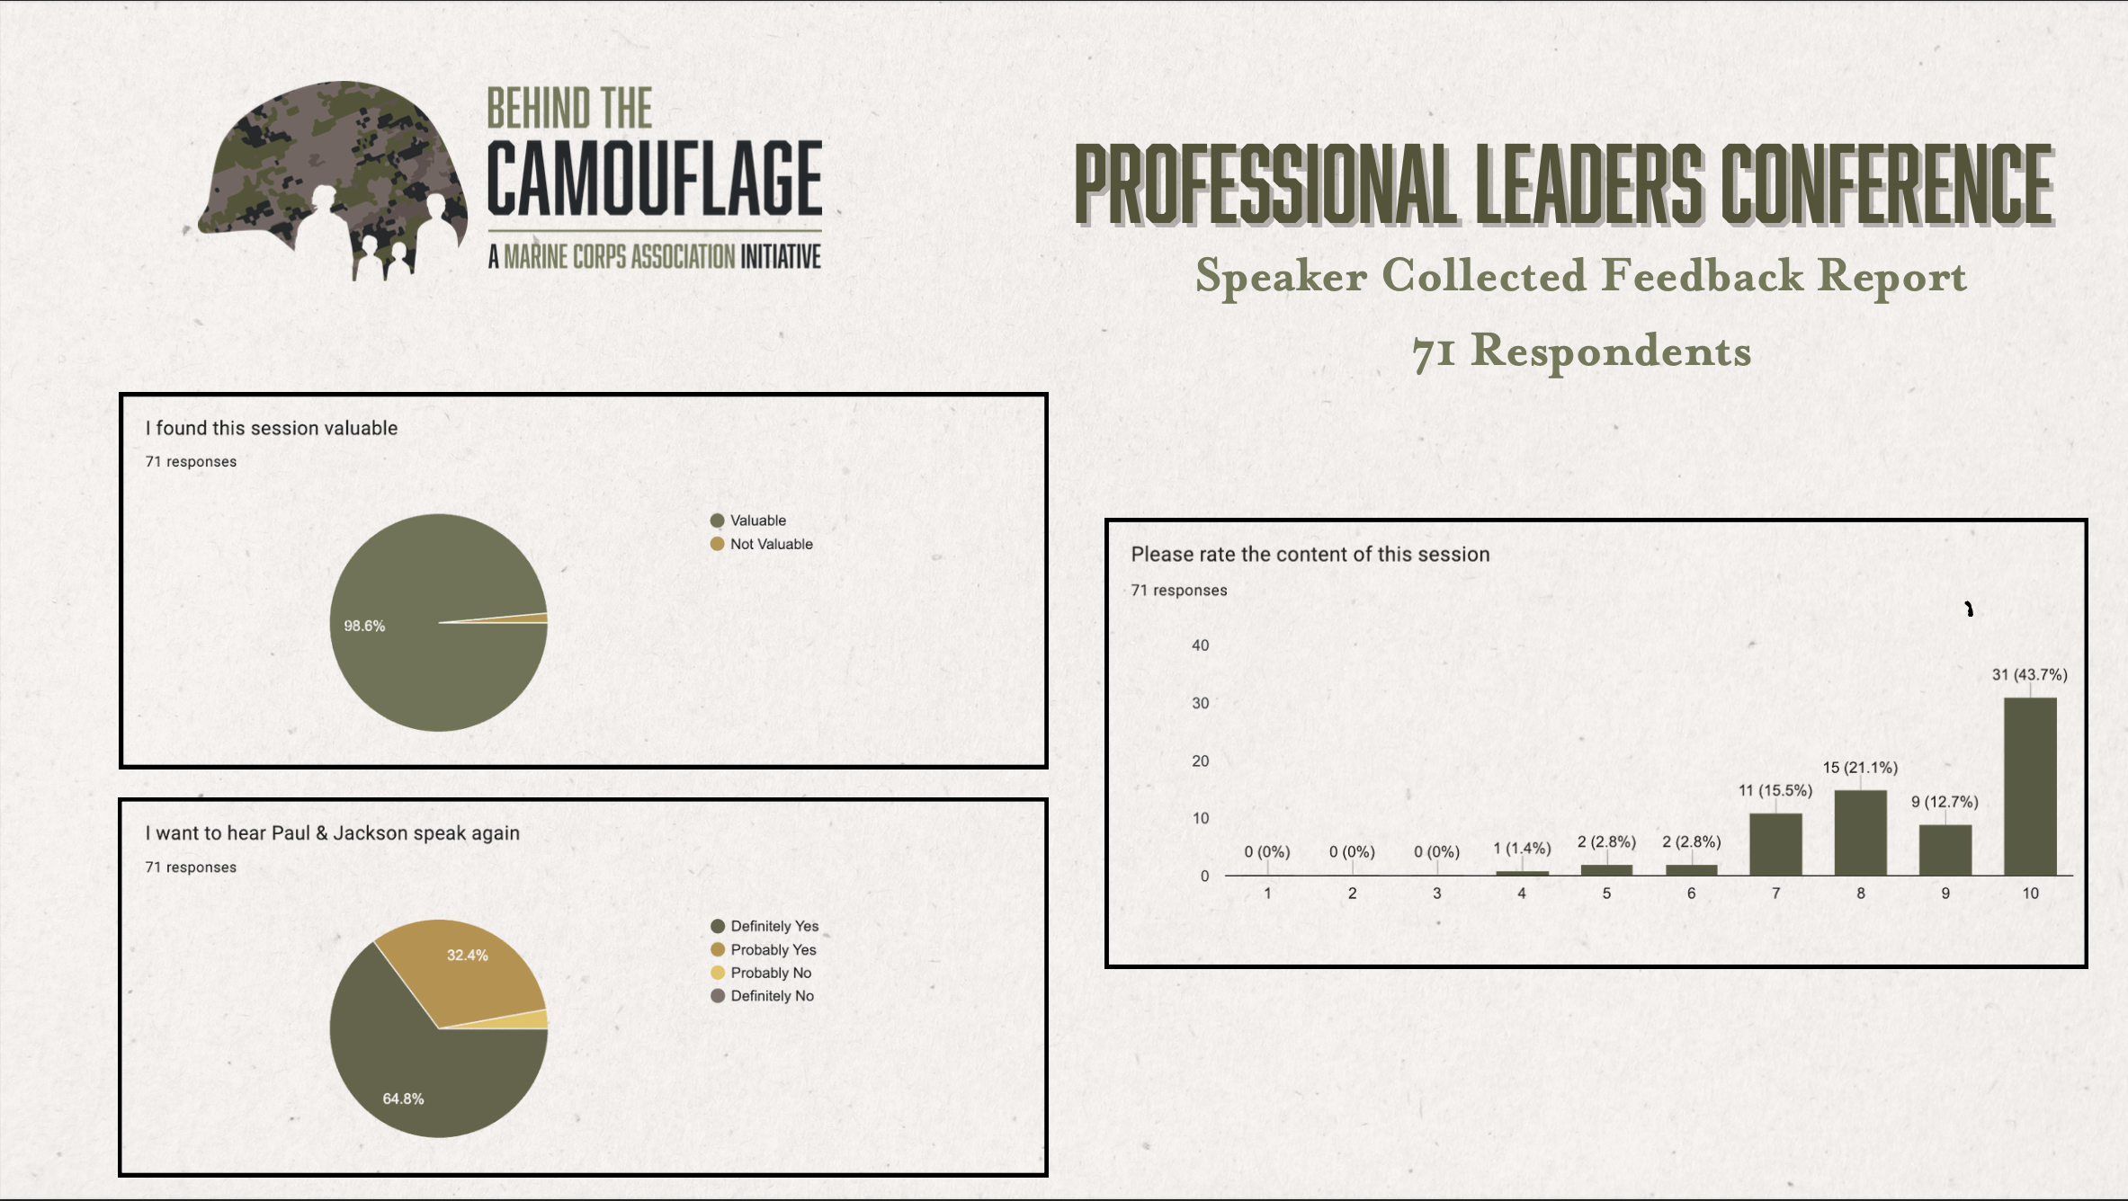
Notes:
We’ve already started bringing this work to Marines and Sailors. Our friends at Arthur Brooks led by Ret Col McDonough have brought this into the Naval Academy. And we led a program with Marines and spouses at MCDR. This is what they had to say.
Thank you so much for the wisdom you shared with our Marines. It was time well spent. You can’t surge trust you have to work on it every day. I’ll be reaching out to MCA as I think events like that are something we can make a part of our regular battle rhythm. – Col Bain

Slide 23
Jackson Kerchis
Jackson@WarriorLeaderTraining.com
724.421.4526
What starts here can change our lives, our organizations, and our world…
Notes:
Leave you with this. After our training a hardened CSM enlisted for 30 years with a big dip in and work boots came up and said you know. I thought this was gong to be some woke BS. But this was pretty good. This is not woo woo PC stuff. This is about empowering leaders to create a psychological climate where our Marines and families flourish. Thank you for your time!

