Slide 1
Enlisted Professional Military Education
The Pace of Purpose

Slide 3
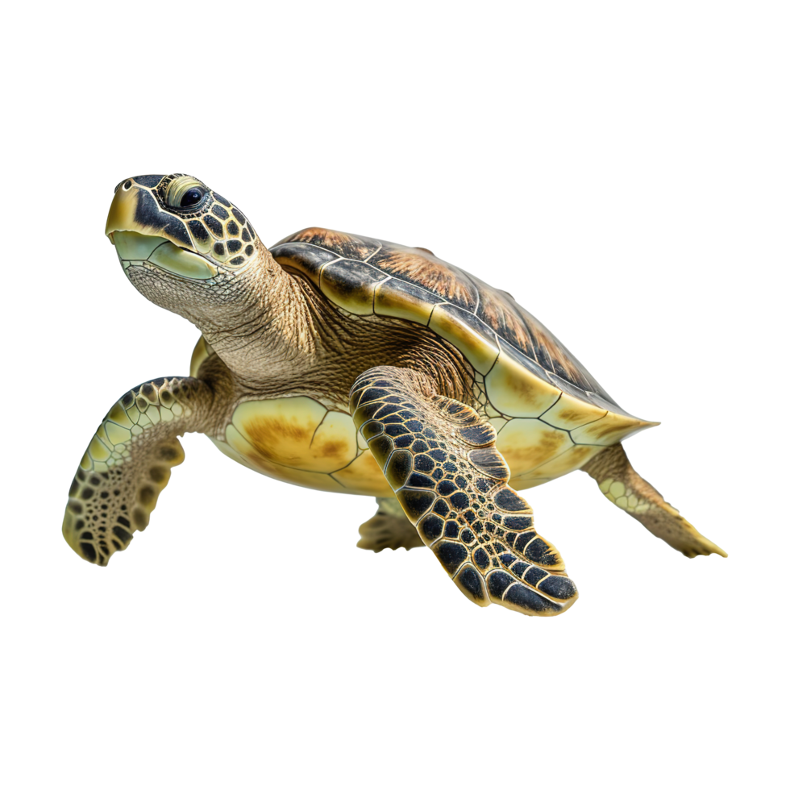

Slide 4
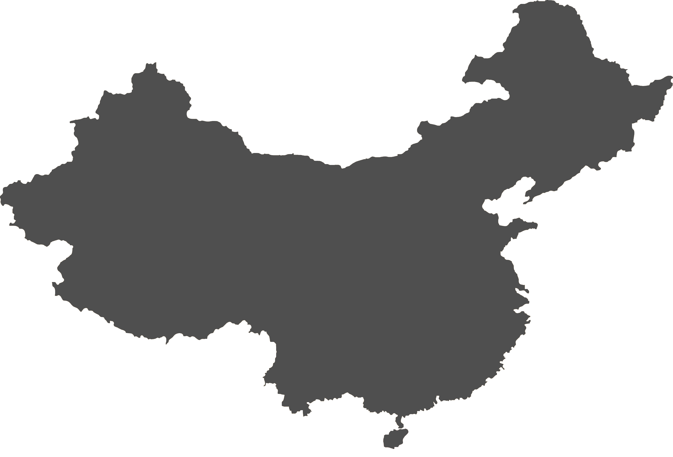
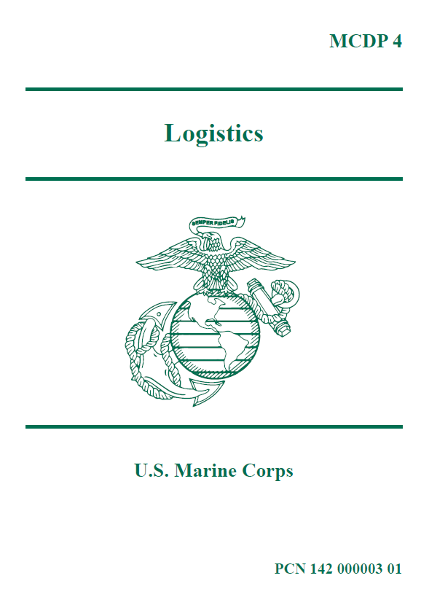

Slide 5
ENERGY

Slide 6
ENERGY

Slide 7
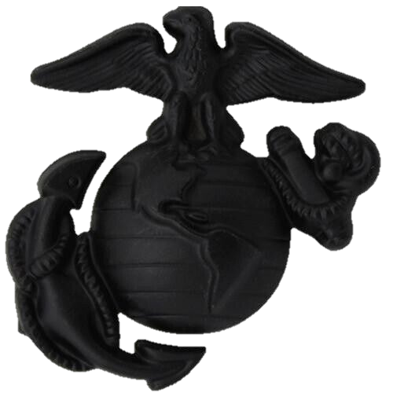
ENERGY
CULTURE

Slide 8
ENERGY
CULTURE

Slide 9
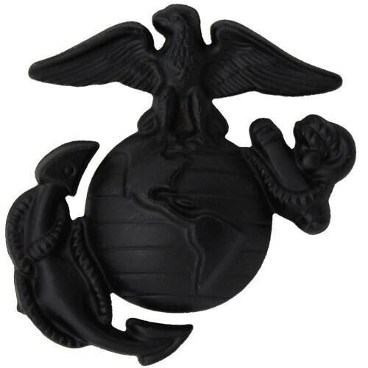
CULTURE
ENERGY

Slide 10
Destructive Behaviors

Slide 11
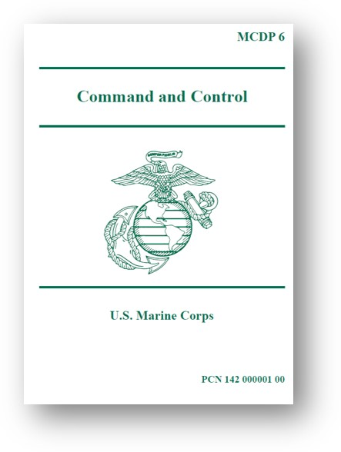
Destructive Behaviors

Slide 12
Destructive Behaviors

Slide 13
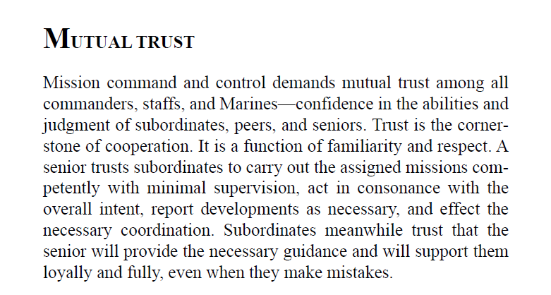
Destructive Behaviors

Slide 14
THE PRACTICE OF PRINCIPLES MUST
PRECEDE THEIR PROVENANCE
Skilled Leader: A trusted mentor and motivator, transitioning policy into action.
Cultural Guardian: A steward of Marine Corps traditions, institutional values, and esprit de corps, ensuring continuity and cohesion.
Resilient Warfighter: Grounded in Marine Corps Warfighting philosophy essential for operational success. Thrives under pressure; adaptable in dynamic environments and delivers creative solutions.
Committed Professional: Dedicated to Country and Corps and the continued professional and personal growth of self and subordinates. Demonstrated strength of character and will to persevere in the face of significant obstacles.
Constitution & Roles of Armed Forces
Creating a Positive Command Climate
Leadership Philosophy
Decision Making
Combating Toxic Leadership
Leadership Ride
Ethics Case Study
Profession of Arms
Organizational Culture
Support Commander’s Leadership Philosophy
Career Progression

Slide 15
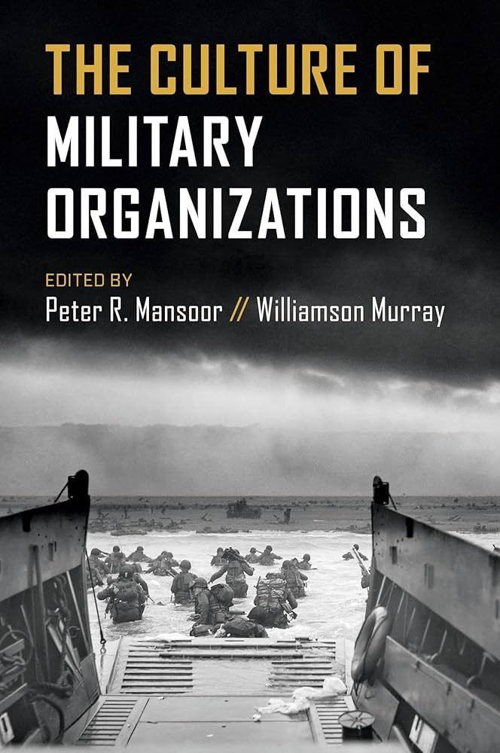
Embedding Mechanisms
Versus
Reinforcing Mechanisms
(Demonstrate)
(Publish)

Slide 16
"The end of knowledge is power; and the use of theorems (which among geometricians serve for the finding out of properties) is for the construction of problems: and, lastly, the scope of all speculation is the performing of some action, or thing to be done.“
-Thomas Hobbes

Slide 17
THE PRACTICE OF PRINCIPLES MUST
PRECEDE THEIR PROVENANCE
Skilled Leader: A trusted mentor and motivator, transitioning policy into action.
Cultural Guardian: A steward of Marine Corps traditions, institutional values, and esprit de corps, ensuring continuity and cohesion.
Resilient Warfighter: Grounded in Marine Corps Warfighting philosophy essential for operational success. Thrives under pressure; adaptable in dynamic environments and delivers creative solutions.
Embedding Mechanisms
Versus
Reinforcing Mechanisms
Committed Professional: Dedicated to Country and Corps and the continued professional and personal growth of self and subordinates. Demonstrated strength of character and will to persevere in the face of significant obstacles.
Profession of Arms
Organizational Culture
Career Progression
Constitution & Roles of Armed Forces
Leadership Philosophy

Slide 18
POLITE PROFESSIONALS THAT PROSECUTE PLANS PURPOSEFULLY AND PROVIDE PROPOSALS
Politeness doesn’t require you to believe in the goodness of others. It simply requires you to behave as if you do. It is a performance, at times, but a useful one. When backed by purpose, though, it becomes more than performance. It becomes an offering of respect, rather than a tactic.

Slide 19
POLITE PROFESSIONALS THAT PROSECUTE PLANS PURPOSEFULLY AND PROVIDE PROPOSALS
Politeness doesn’t require you to believe in the goodness of others. It simply requires you to behave as if you do. It may appear as a performance. When backed by purpose, though, it becomes more than performance. It becomes an offering of respect, rather than a tactic.

Slide 20
POLITE PROFESSIONALS THAT PROSECUTE PLANS PURPOSEFULLY AND PROVIDE PROPOSALS
Professionalism is not self-sustaining. It is upheld by standards. Standards serve as the scaffolding of credibility. They ensure that we never anchor ourselves to personal preference or convenience.
Professionalism may begin in appearance, but it is sustained by adherence.

Slide 21
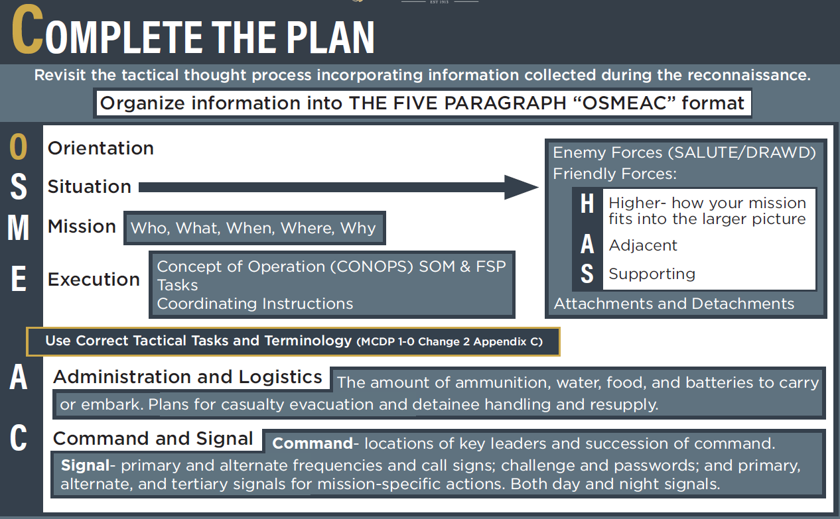
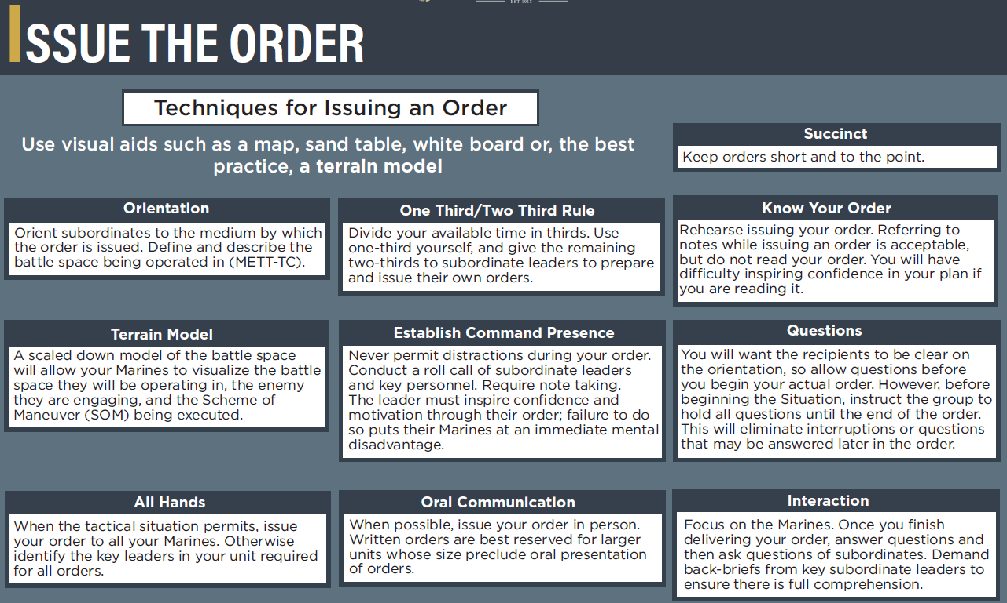
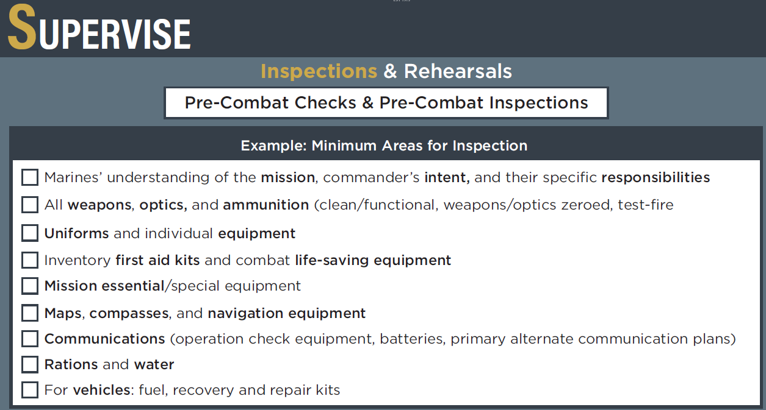
POLITE PROFESSIONALS THAT PROSECUTE PLANS PURPOSEFULLY AND PROVIDE PROPOSALS
Upholding and Enforcing Standards
Effective Communication and Delegation
Discipline and Unit Cohesion
Leadership Development
Problem-Solving and Adaptability
Mission Readiness and Training
Creating a Positive Command Climate
Support Commander’s Leadership Philosophy

Slide 22
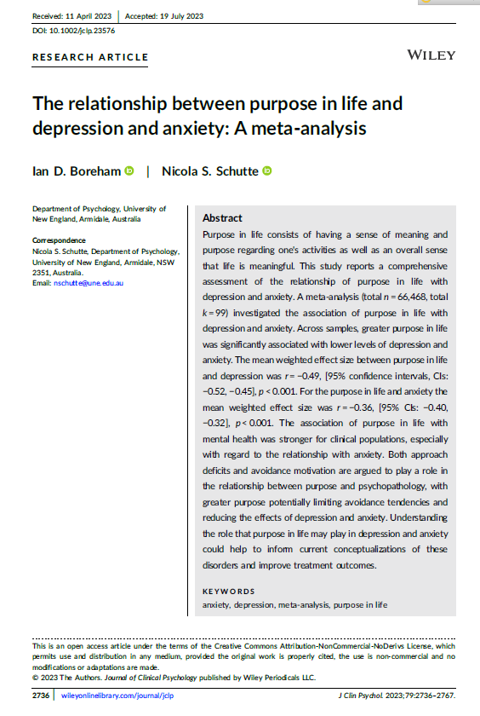
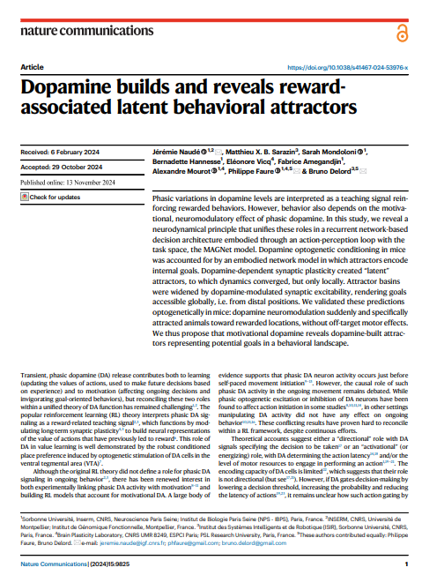
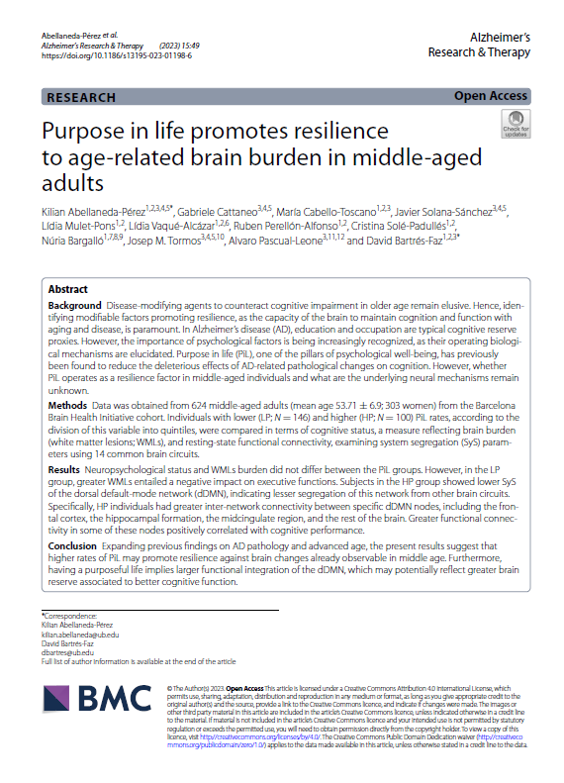
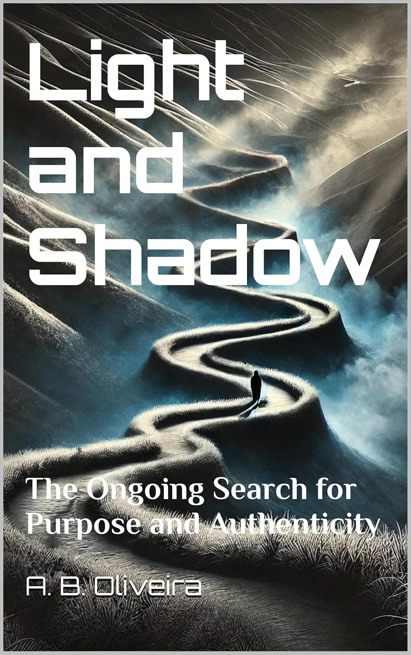
Mental Health
A 2023 meta-analysis, the first of its kind, found a significant inverse correlation between purpose and both depression and anxiety.

Slide 23
Aligning Drive and Stability
Purpose is the bridge between these two systems. It gives people a target to pursue (dopamine) while helping them maintain emotional equilibrium during setbacks and uncertainty (serotonin). Without purpose, dopamine-driven pursuits can become frantic or directionless, and serotonin levels may drop in response to stress.

Slide 24
Cognitive Resilience
Another 2023 study is suggesting that purpose may mitigate the effects of age-related decline by strengthening neural connectivity. The same study demonstrated that individuals with high purpose scores had greater integration in key brain networks, leading to improved executive function and decision-making.
Notes:
17 Books on March 25, 2025 alone.

Slide 25
Over 534 books on ‘purpose’ have been published in 2025
Purpose-driven individuals coalesce into purpose-driven systems
Notes:
17 Books on March 25, 2025 alone.
217 Books in 3 months in 2025 on IKIGAI.

Slide 26
Purpose-driven individuals coalesce into purpose-driven systems
Over 534 books on ‘purpose’ have been published in 2025
Notes:
17 Books on March 25, 2025 alone.
217 Books in 3 months in 2025 on IKIGAI.

Slide 27
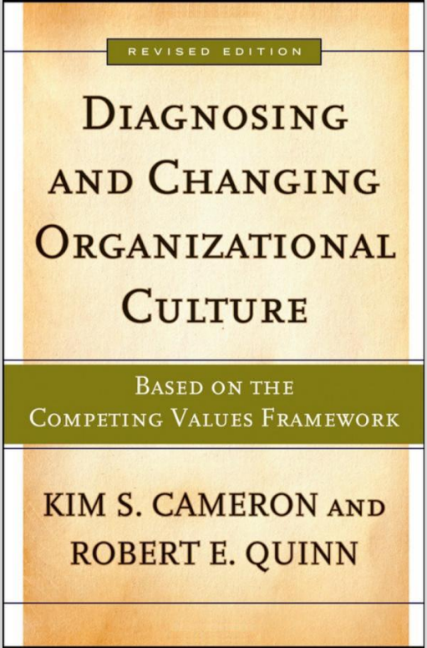
Powerful responses do not come from isolated signals, but from networks firing in sync to generate meaning.
Individual Neurochemistry
Organizational Culture
The same applies to units. Purpose-driven individuals coalesce into purpose-driven systems.
Notes:
Cameron, K.S., & Quinn, R.E. (2011). Diagnosing and Changing Organizational Culture: Based on the Competing Values Framework
This book helps explains how culture is not just a top-down mandate, but emerges from behavioral alignment at the micro level.

Slide 28
Cultural Guardian
Resilient Warfighter
Committed Professional
Skilled Leader
X Purpose
The 2023 neural connectivity study showed that individuals with higher purpose scores have stronger integration between brain networks—especially those related to planning and decision-making. Skilled leadership isn’t just about experience; it’s about the ability to process complexity, and purpose strengthens that capacity.
Professionals do the small things right, even when no one’s watching. Neuroscientific findings show that purpose increases long-term engagement and reduces avoidance behaviors—a key trait of high-functioning, self-driven Marines. This is the quiet strength behind every inspection passed, every plan rehearsed, every Marine led with care.
Cultural guardianship requires balancing continuity with change. Without a sense of why we preserve our values, traditions become performative or obsolete. Purpose activates the emotional-regulation systems that help Marines remain grounded amidst institutional transformation.

Slide 29
Cultural Guardian
Resilient Warfighter
Committed Professional
Skilled Leader
X Purpose
Purpose keeps dopamine-driven systems aligned with mission-focused behavior, preventing the impulsivity or burnout that arises when stress overwhelms intent. Marines with purpose can adapt to uncertainty without losing emotional balance.
The 2023 neural connectivity study showed that individuals with higher purpose scores have stronger integration between brain networks—especially those related to planning and decision-making. Skilled leadership isn’t just about experience; it’s about the ability to process complexity, and purpose strengthens that capacity.
Professionals do the small things right, even when no one’s watching. Neuroscientific findings show that purpose increases long-term engagement and reduces avoidance behaviors—a key trait of high-functioning, self-driven Marines. This is the quiet strength behind every inspection passed, every plan rehearsed, every Marine led with care.
Cultural guardianship requires balancing continuity with change. Without a sense of why we preserve our values, traditions become performative or obsolete. Purpose activates the emotional-regulation systems that help Marines remain grounded amidst institutional transformation.

Slide 30
Cultural Guardian
Resilient Warfighter
Committed
Professional
Skilled Leader
X Purpose
Increases long-term engagement and reduces avoidance behaviors, a key trait of high-functioning, self-driven Marines. This is the quiet strength behind every inspection passed, every plan rehearsed.
Purpose keeps dopamine-driven systems aligned with mission-focused behavior, preventing the impulsivity or burnout that arises when stress overwhelms intent. Marines with purpose can adapt to uncertainty without losing emotional balance.
The 2023 neural connectivity study showed that individuals with higher purpose scores have stronger integration between brain networks—especially those related to planning and decision-making. Skilled leadership isn’t just about experience; it’s about the ability to process complexity, and purpose strengthens that capacity.
Cultural guardianship requires balancing continuity with change. Without a sense of why we preserve our values, traditions become performative or obsolete. Purpose activates the emotional-regulation systems that help Marines remain grounded amidst institutional transformation.

Slide 31
Cultural Guardian
Committed
Professional
Resilient
Warfighter
X Purpose
Purpose leads to stronger integration between brain networks, especially those related to planning and decision-making. Skilled leadership isn’t just about experience; it’s about the ability to process complexity, and purpose strengthens that capacity.
Professionals do the small things right, even when no one’s watching. Neuroscientific findings show that purpose increases long-term engagement and reduces avoidance behaviors—a key trait of high-functioning, self-driven Marines. This is the quiet strength behind every inspection passed, every plan rehearsed, every Marine led with care.
Cultural guardianship requires balancing continuity with change. Without a sense of why we preserve our values, traditions become performative or obsolete. Purpose activates the emotional-regulation systems that help Marines remain grounded amidst institutional transformation.

Slide 32
Resilient
Warfighter
Cultural
Guardian
X Purpose
The 2023 neural connectivity study showed that individuals with higher purpose scores have stronger integration between brain networks—especially those related to planning and decision-making. Skilled leadership isn’t just about experience; it’s about the ability to process complexity, and purpose strengthens that capacity.
Requires balancing continuity with change. Without a sense of why we preserve our values, traditions become performative or obsolete. Purpose activates the emotional-regulation systems that help Marines remain grounded amidst institutional transformation.

Slide 34
Ownership
Tasks
Meaning
Memory
Notes:
The fulcrum of purpose must be forged, not found. Purpose is constructed every time we give Marines ownership, meaning, and memory; ownership over tasks, meaning behind roles, and memories that remind them what it’s all for. Purpose is not a lecture. It is a structure
Why It Matters
Purpose starts with the story Marines tell themselves. That story must tie their identity to the mission. “You’re not just standing post. You’re buying time for someone else to live.” That’s not fluff…it’s functional.
Why It’s Yours
Give them stakes before they’re ready. People don’t grow into responsibility; they grow because of it. Letting them lead small prepares them to lead big.
Why It’s Us
Purpose doesn’t emerge in isolation. It emerges when Marines know they are needed. Specifically, not abstractly. Let them know: You matter, and this unit is different because you’re in it.

Slide 35
Ownership
Tasks
Meaning
Memory
Role
Notes:
The fulcrum of purpose must be forged, not found. Purpose is constructed every time we give Marines ownership, meaning, and memory; ownership over tasks, meaning behind roles, and memories that remind them what it’s all for. Purpose is not a lecture. It is a structure
Why It Matters
Purpose starts with the story Marines tell themselves. That story must tie their identity to the mission. “You’re not just standing post. You’re buying time for someone else to live.” That’s not fluff…it’s functional.
Why It’s Yours
Give them stakes before they’re ready. People don’t grow into responsibility; they grow because of it. Letting them lead small prepares them to lead big.
Why It’s Us
Purpose doesn’t emerge in isolation. It emerges when Marines know they are needed. Specifically, not abstractly. Let them know: You matter, and this unit is different because you’re in it.

Slide 36
Ownership
Tasks
Role
Meaning
Memory
Notes:
The fulcrum of purpose must be forged, not found. Purpose is constructed every time we give Marines ownership, meaning, and memory; ownership over tasks, meaning behind roles, and memories that remind them what it’s all for. Purpose is not a lecture. It is a structure
Why It Matters
Purpose starts with the story Marines tell themselves. That story must tie their identity to the mission. “You’re not just standing post. You’re buying time for someone else to live.” That’s not fluff…it’s functional.
Why It’s Yours
Give them stakes before they’re ready. People don’t grow into responsibility; they grow because of it. Letting them lead small prepares them to lead big.
Why It’s Us
Purpose doesn’t emerge in isolation. It emerges when Marines know they are needed. Specifically, not abstractly. Let them know: You matter, and this unit is different because you’re in it.

Slide 37
Ownership
Tasks
Role
Meaning
Memory
Notes:
The fulcrum of purpose must be forged, not found. Purpose is constructed every time we give Marines ownership, meaning, and memory; ownership over tasks, meaning behind roles, and memories that remind them what it’s all for. Purpose is not a lecture. It is a structure
Why It Matters
Purpose starts with the story Marines tell themselves. That story must tie their identity to the mission. “You’re not just standing post. You’re buying time for someone else to live.” That’s not fluff…it’s functional.
Why It’s Yours
Give them stakes before they’re ready. People don’t grow into responsibility; they grow because of it. Letting them lead small prepares them to lead big.
Why It’s Us
Purpose doesn’t emerge in isolation. It emerges when Marines know they are needed. Specifically, not abstractly. Let them know: You matter, and this unit is different because you’re in it.

Slide 39
Warfighting

Slide 40
Warfighting
The Pace of Purpose

Slide 41
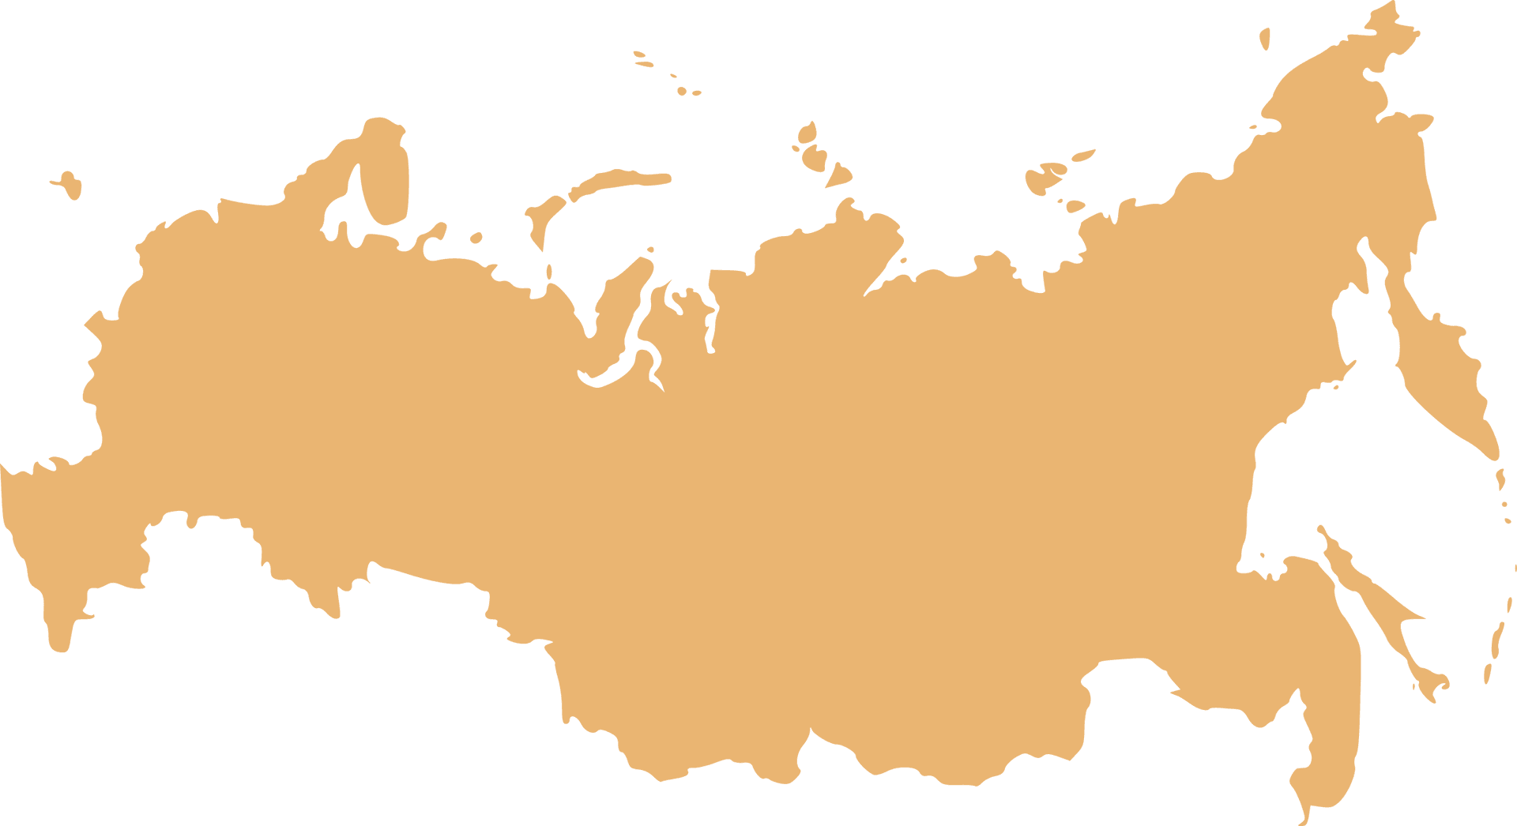
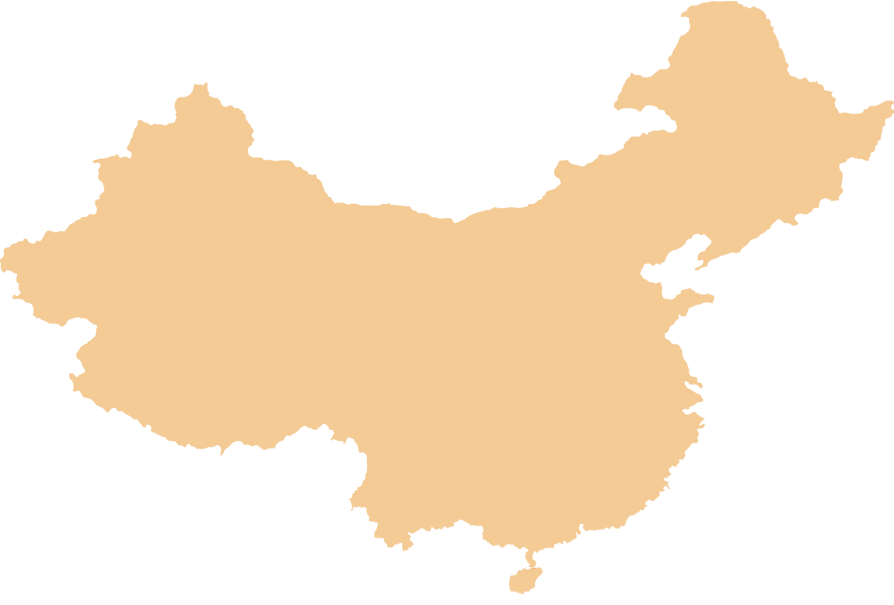
Mental Health
Function
Toxic Leadership
Commodity
Threat
Element
Harassment/Assault
Force
The Pace of Purpose
Warfighting

Slide 42
Mental Health
Function
Toxic Leadership
Commodity
Threat
Element
Harassment/Assault
Force
The Pace of Purpose
Warfighting

