Slide 1
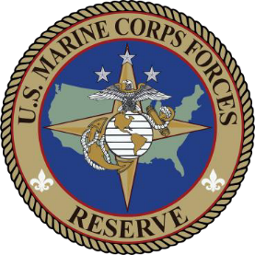
Mobilization:
The Critical Vulnerability
LtCol Doug Toulotte
Overall Classification of this brief is:
UNCLASSIFIED
Notes:
The great myth: In 1950 the Marine Corps went from unprepared for conflict to the greatest surprise landing in its history in only three months. Given this history, the Marine Corps is prepared for next great conflict initiated on short notice.
The last sentence above is false. The reality is the mobilization of the Marine Corps in 1950 was the result of deliberate and careful planning in peace time and the early stages of conflict. To understand this, it must first be understood that in the history of modern warfare (1939 to present), the Korean War is the only case study which aligns to modern predictions of short/no-notice aggression by a peer adversary that turns into protracted conflict.

Slide 2
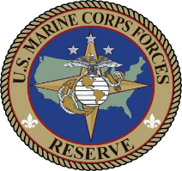
A Reservist on orders for a deployment
Mobilization. The process by which the Armed Forces of the United States, or part of them, are brought to a state of readiness for war or other national emergency.
Partial, Full, Total
“Expansion of the active Armed Forces of the United States…”
“…and the resources needed…”
Notes:
Partial Mobilization. Expansion of the active Armed Forces of the United States resulting from action by Congress (up to full mobilization) or by the President (not more than 1,000,000 for not more than 24 consecutive months) to mobilize Ready Reserve component units, individual reservists, and the resources needed…
Full Mobilization. Expansion of the active Armed Forces of the United States resulting from action by Congress and the President to mobilize, for the duration of the emergency plus six months, all Reserve Component units and individuals in the existing approved force structure, as well as all retired military personnel, and the resources needed…
Total Mobilization. Expansion of the active Armed Forces of the United States resulting from action by Congress and the President to organize and/or generate additional units or personnel beyond the existing force structure, and the resources needed…

Slide 3
WWII
Delayed entry into conflict
Only conflict in the last 111 years in which enemy action required rapid and total mobilization
Korea
Rapid response to unexpected enemy action
Vietnam
Delayed entry into conflict
Desert Shield/ Storm
End strength decreased
U.S. enters conflict
OIF begins
OIF ends
OIF/OEF
Counter-insurgency
Notes:
Korea is the only conflict in which the beginning came with limited/no warning and the Marine Corps was required to rapidly surge the number of Marines on active duty.

Slide 4
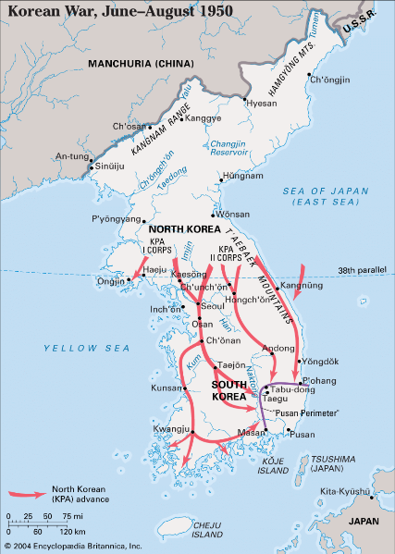
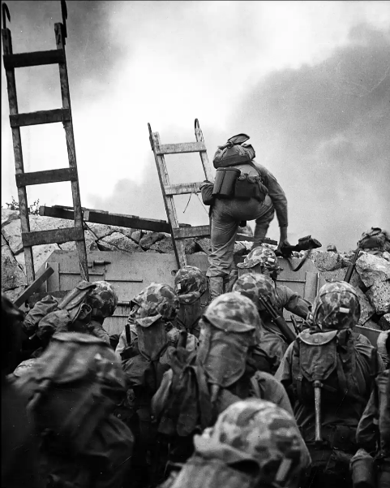
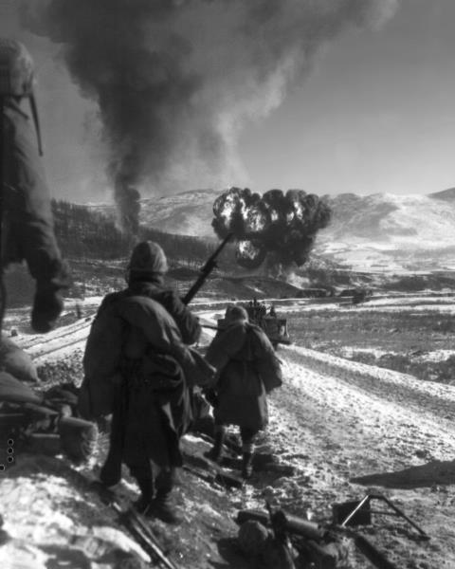
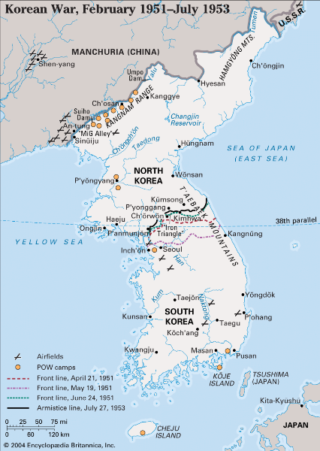
How Marines view the Korean War
Notes:
June 1950 surprise attack, rapid build up and deployment of 1stMARDIV and 1stMAW, Pusan Perimeter
September 1950 landing at Inchon, 1stLt Lopez MoH recipient
Nov-Dec 1950 battle of Chosin Reservoir and breakout to Hungnam, “…in the snow of far-off northern lands…”
Feb 1951-Jul 1953 communist advance halted and stalemate
“We’ve been looking for the enemy for some time now. We’ve finally found him. We’re surrounded. That simplifies things.”
-LtGen Lewis B. Puller
This surface-level analysis of the war in Korea leads Marines to conclude the response to the rapid advance of the North into the South was hastily planned and executed in-stride. The truth is, although elements of the mobilization were conducted in haste, the rapid response to North Korean aggression was in fact the result of deliberate mobilization planning pre-conflict.

Slide 5
How Marines should view the Korean War
1950 1951
Timeline
Jun
Aug
Oct
Dec
Feb
Apr
Jun
UN counter-attacks
Stalemate
25 Jun
Korea People’s Army (KPA) cross 38th parallel
25 Jul
JCS directs 1stMARDIV to war time strength
31 Jul
JCS directs 2dMARDIV to war time strength
15 Sep
Inchon landing
27 Nov
People’s Volunteer Army (PVA) attacks at Chosin
24 Dec
Last UN unit departs Hungnam
Major Actions
50% reduction in CONUS security forces
Short war Long war
16 Mar
UN retakes Seoul
17 Aug
7th Marines activated
25 Oct
Activating reservists receive 30 days delay
Mid-Dec
Augment/replacement drafts to enable rotation of personnel
10 Jan
RC enlisted in officer programs granted delay
10 Feb
RC EAS w/ 28 Feb-9 Jul exempt from recall
15 Apr
First OCS at MCBCL since WWII
Jun
Plan to release reserve Marines begins execution
19 Jul
[SMCR] recall to active duty
28 Jul
RC discharge/ resignation halted
18 Aug
Enlistments lowered from 4 to 3 yrs
Key Decisions
26 Jun
Military intervention authorized
7 Jul
Draft authorized
27 Jul
Enlistments extended
15 Aug
[IRR] E-5 and below to active duty
8 Nov
Activating reservists receive
4 months delay
6 Jan
4 months delay for reservists suspended
6 Feb
SecNav instruction to delay anyone <19yrs
Mar
Preliminary plan to release reserve Marines
10 Apr
DoD plan to receive draftees announced
4 May
Senate bill passes to increase USMC to 400k
23 Jul
9x RC squadrons activated
31 Jul – 11 Sep
[SMCR] ground arrive to Camp Pendleton
Force Flow (CONUS)
20 Jul – 4 Aug
All [SMCR} ground units ordered to active duty
6 Sep – Mar
[IRR] activated by quotas
Mar
6th/7th replacement drafts arrive in Korea
1st homegoing draft departs for CONUS
17 Aug
1st MAW sets sail
21 Aug
Last 1stMARDIV(-) vessel sets sail
1 Sep
7th Marines sets sail
Nov
3rd replacement draft arrives in Korea
Jan
4th replacement draft arrives in Korea
Force Flow (OCONUS)
14 Jul
1st Provisional Marine Brigade (rein.) sets sail
10 Aug
First cargo vessels set sail
14 Aug
First attack transports set sail
24 Aug
Last 1stMAW vessel sets sail
29 Oct
2nd replacement draft arrives in Korea
5 Feb
5th replacement draft arrives in Korea
Apr
8th replacement draft arrives in Korea
May/Jun
9th replacement draft arrives in Korea
Notes:
Mobilization response must be analyzed through four lenses across the first 12 months: major actions, key decisions, force flow within the U.S., and force flow from the U.S. into theater.
When broken down into three key phases, the importance of mobilization planning becomes clear. Phase 1: actions leading up to the landing at Inchon. Phase 2: actions between the landing at Inchon and the PVA attacking at Chosin (deliberate shift from “short war” mentality to “long war”). Phase 3: the blunting of the second communist advance, the beginnings of stalemate, and the decision to increase the end strength of the Marine Corps.
Pre-conflict: 1947 study of RC availability and baseline RSO&I planning for mobilization
Phase 1: peace time to war time strength, activation of organized reserve (air/ground) and volunteer reserve (E-5 and below), weekly reception plan at Camp Pendleton and Camp Lejeune, creation of 7th Marine Regiment with AC/RC as cadre, discharge/resignation halted, expiring enlistments extended, new enlistments reduced, OCONUS movement
Phase 2: activating RC given longer delay periods, replacement draft ships sailing on intervals, volunteer reserve activations continue, steady-state force flow achieved before surprise attack(s) at Chosin
Phase 3: delay reduced for activating RC, officer accessions deliberately protected, combat veterans rotated back to CONUS, plan developed for release of RC Marines on active duty, plan to receive draftees announced
The conditions set in Phase 0 and 1 allowed the Marine Corps to execute a mobilization plan which enabled the Service to rapidly respond and blunt the initial attack and absorb and respond to the transition from short to long war (Chosin). In the first year of conflict, the Marine Corps fought using existing AC and RC Marines, with draftees and end strength increase not seen until mid-1951. This first year included expanding capability (7th Marines), deliberately setting conditions for draftee reception (rotation back of combat veterans to serve as training cadre), and phasing out activated RC Marines.

Slide 6
Then
74,279 AC
39,869 Organized Reserve (Ground + Air)
89,920 Volunteer Reserve
~204,068 Marines
Now
~172,000 AC
30,812 Selected Reserve (SMCR + IMA + AR)
49,900 IRR
~252,712 Marines
9 AC + 26 RC = 35 infantry battalions
15 AC + 30 RC = 45 fighter squadrons
“and the resources needed…”
WWII equipment stockpiles
98.3% material readiness (1stMARDIV)
95.6% material readiness (1stMAW)
RC “operated up-to-date equipment”
20 AC + 8 RC = 28 infantry battalions
18 AC + 1 RC = 19 fighter squadrons
“and the resources needed…”
Global Positioning Network (GPN)
Exquisite equipment / munitions
Force modernization has RC last
“…24 November 1947, a study of Reserve availability indicated an 80 percent availability of the Organized Reserve.”
“...put into execution its plans for limited mobilization.”
Last DoD mobilization plan dated May 1988
Notes:
Addition of approximately 59,700 Retired Reserve would increase current end strength to ~312,400 Marines
Then: “Peace time” vs. “war time” strength
Now: Authorized Strength Report (ASR) manning
Then: ~1 Battalion + security forces OCONUS
Now: III MEF + GFM requirements OCONUS
Then: Avg 702 Marines per day reporting for duty
Now: Deployment Processing Centers (DPCs) East/West ~400 Marines per week throughput
Then: Extensive resources available within CONUS
Now: Limited resources available, long lead time for industry, forward positioning risks being out of position, RC behind AC in equipment modernization
Then: Deliberate studies of RC availability and baseline RSO&I planning pre-conflict
Now: Last mobilization plan dated 1988

Slide 7
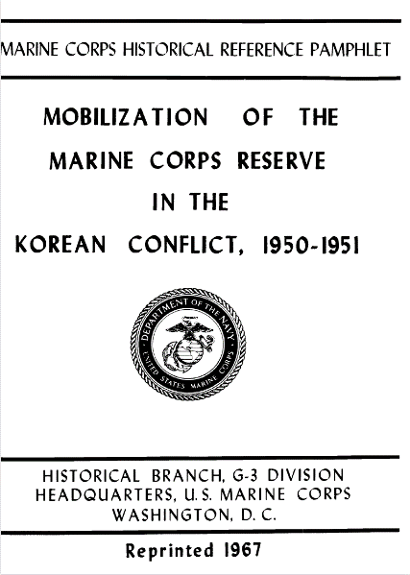
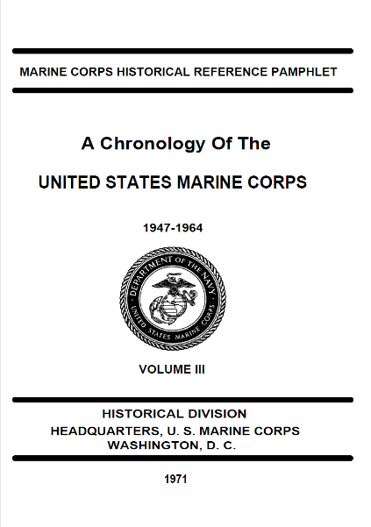
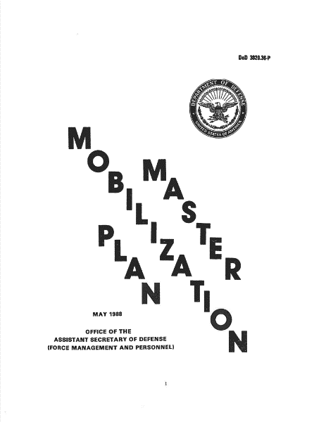
612 days until 1 January 2027
Notes:
The modern era is far more complex than the world in 1950. Forward positioned forces and equipment, the risk of a contested homeland and logistic lines, and the Strategic Planning Framework approach to global conflict make force flow far more complex than what was faced in Korea 1950.
Failure to deliberately assess and plan for mobilization will leave the Service paralyzed/bottlenecked as the enemy, playing a “home game,” rapidly advances on their objectives.

