Slide 1
Modern Day Marine
April 2026
Overall Classification: Unclassified

Slide 2
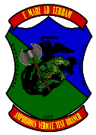
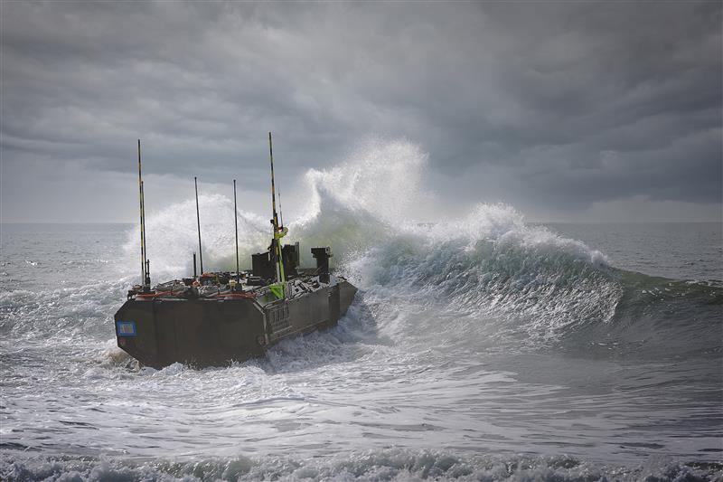
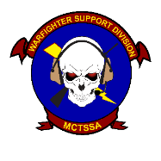
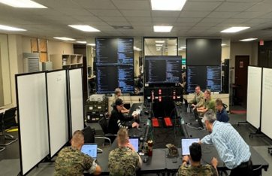
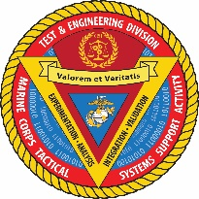
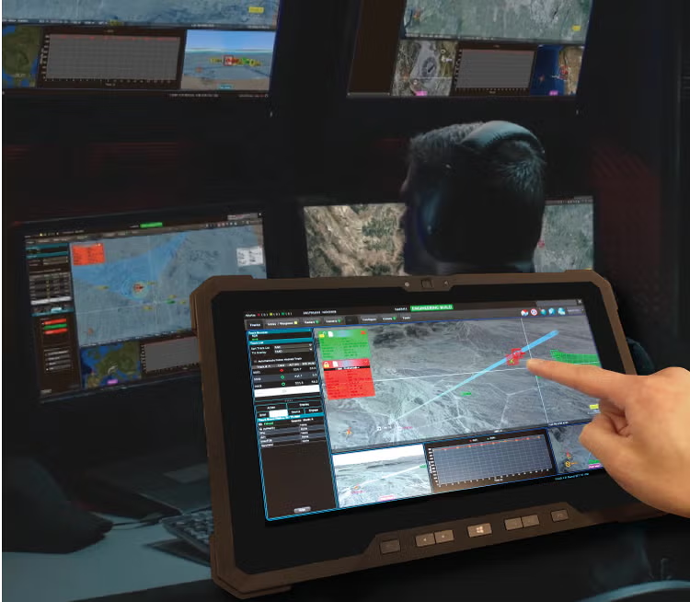
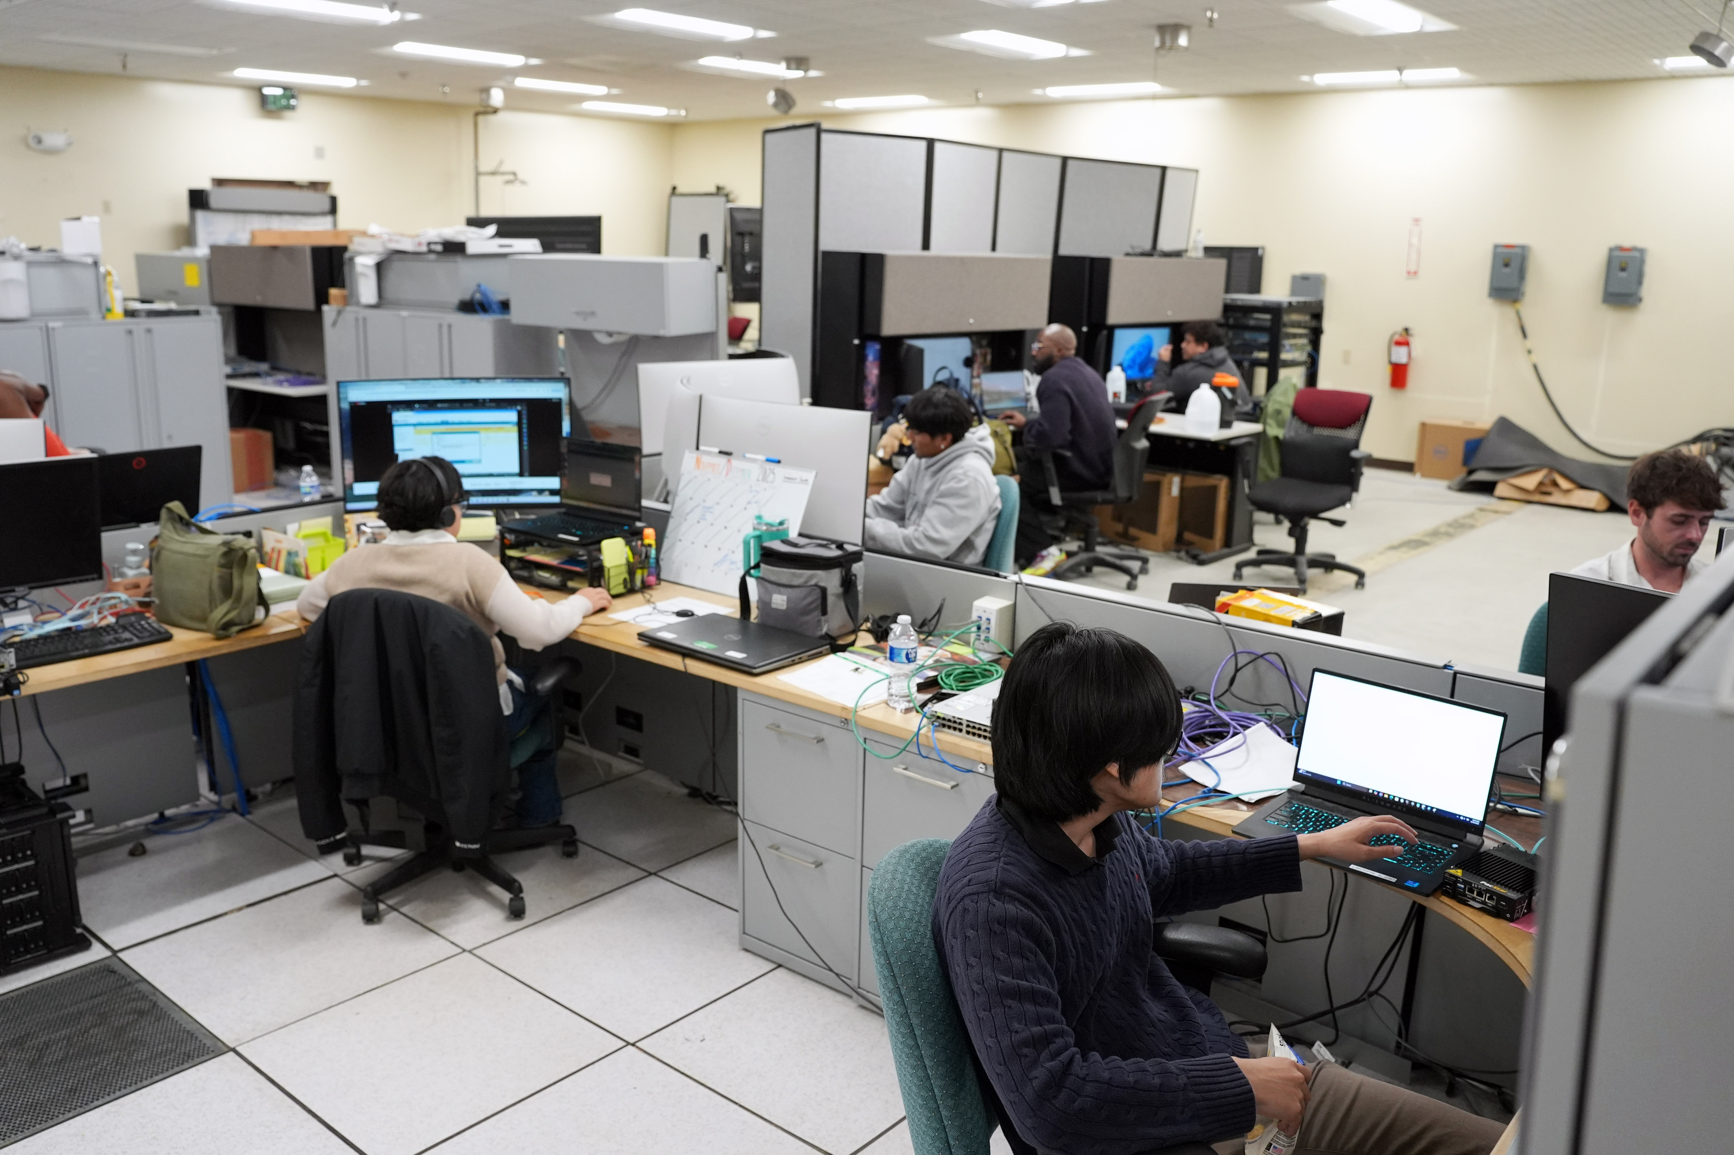
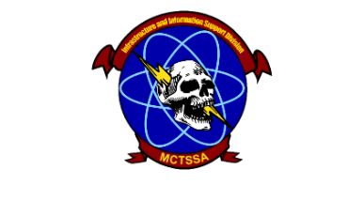
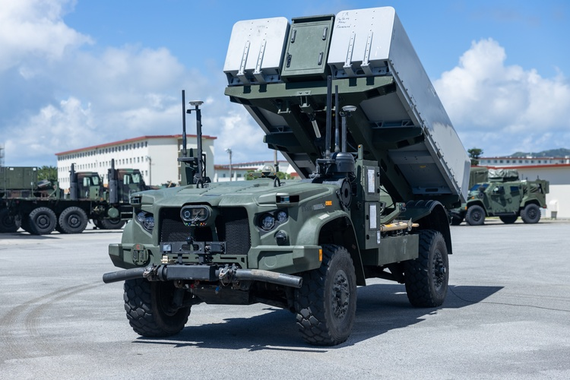
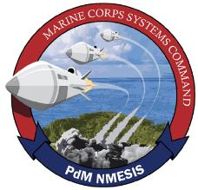
Command Overview
MISSION: MCTSSA provides 24/7 global technical support for Command, Control, Computer, Communications, Cyber, Intelligence, Surveillance, Reconnaissance, and Targeting (C5ISRT) systems; and conducts research and development, engineering, testing and evaluation, and supports experimentation for C5ISRT systems and littoral platforms in order to inform acquisition decisions and make the Fleet Marine Force more capable.
Amphibious Vehicle Test Branch (AVTB) - Plan, execute, analyze, and report developmental and integrated test and evaluation events to characterize the performance of amphibious and ground combat vehicle systems, robotic and autonomous systems, and other platforms that operate in the littorals to enable informed acquisition decisions.
Warfighter Support Division (WSD) - Provide 24/7 global support to the FMF & Joint force to bridge the gap between current or legacy systems and emerging capabilities to optimize operational effectiveness. Collect real-time data from USMC operations and exercises to inform acquisition strategies, while providing agile software development to ensure the FMF remains at the forefront of the technological advantage.
Test and Engineering Division (TED) – Perform threat informed Program Engineering, Developmental, Cyber, Shipboard, and concept-based testing and experimentation of existing and emerging USMC C5I systems in support of the acquisition community and the naval enterprise. Provide Military Standards expertise to achieve interoperable, integrated, and certified solutions to meet USMC, Joint, and Mission Partner requirements.
Infrastructure and Information Support Division (I2SD) – Provide compute, transport, storage services, critical IT infrastructure and Cybersecurity Authorizations as well as Cryptologic Services to support developmental testing and engineering of USMC C5I systems.
NETT - The New Equipment Training Team (NETT) tests and validates updates to the Navy Marine Corps Expeditionary Ship Interdiction System (NMESIS) and instructs newly fielded units on system capabilities and operations.
Priorities: Support to Program Offices – Support to the Warfighter– Support to Force Design

Slide 3
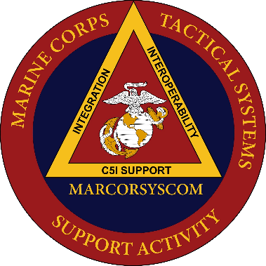
CJADC2 Placemat
CJADC2 EXPERTISE
A
Project Dynamis
US MARINE CORPS
B
Project Olympus
COALITION & MISSION PARTNERS
A
NATIONAL,
DoD, & JOINT
STAFF
VALIDATION
F
B
EXPERIMENTATION
C
Project Overmatch
E
C
D
Advanced Battle Management System (ABMS)
D
US ARMY
US NAVY
E
Project Convergence
NAVAL R&D ESTABLISHMENT
F
MPE (SABRE, CPE & IMN)
US AIR FORCE

Slide 4
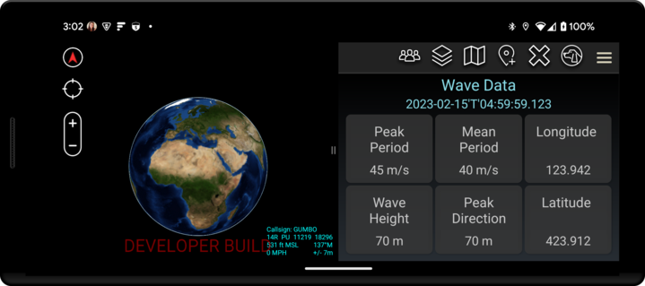
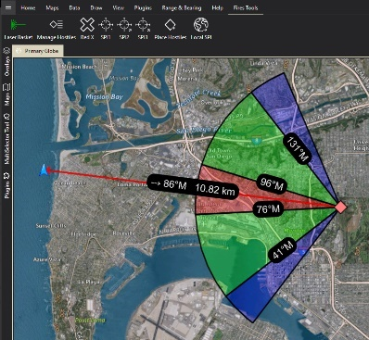
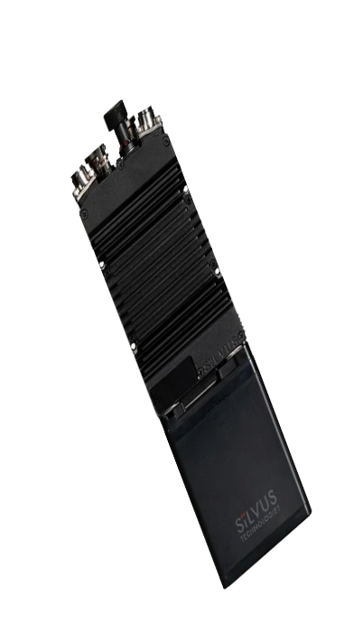
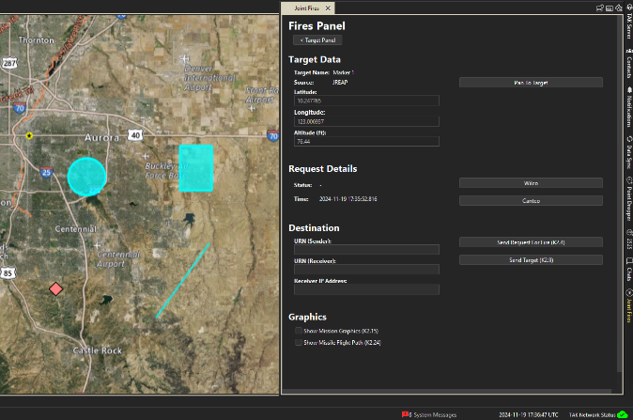
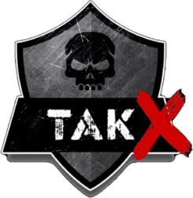
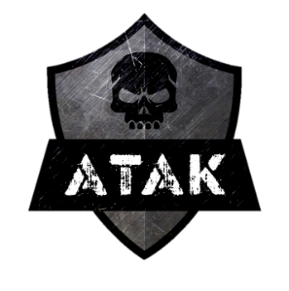
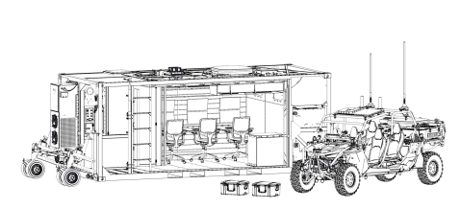


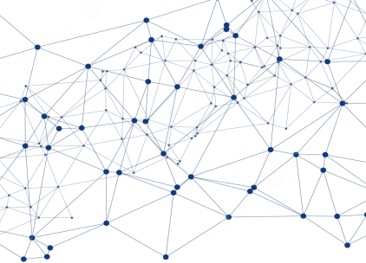

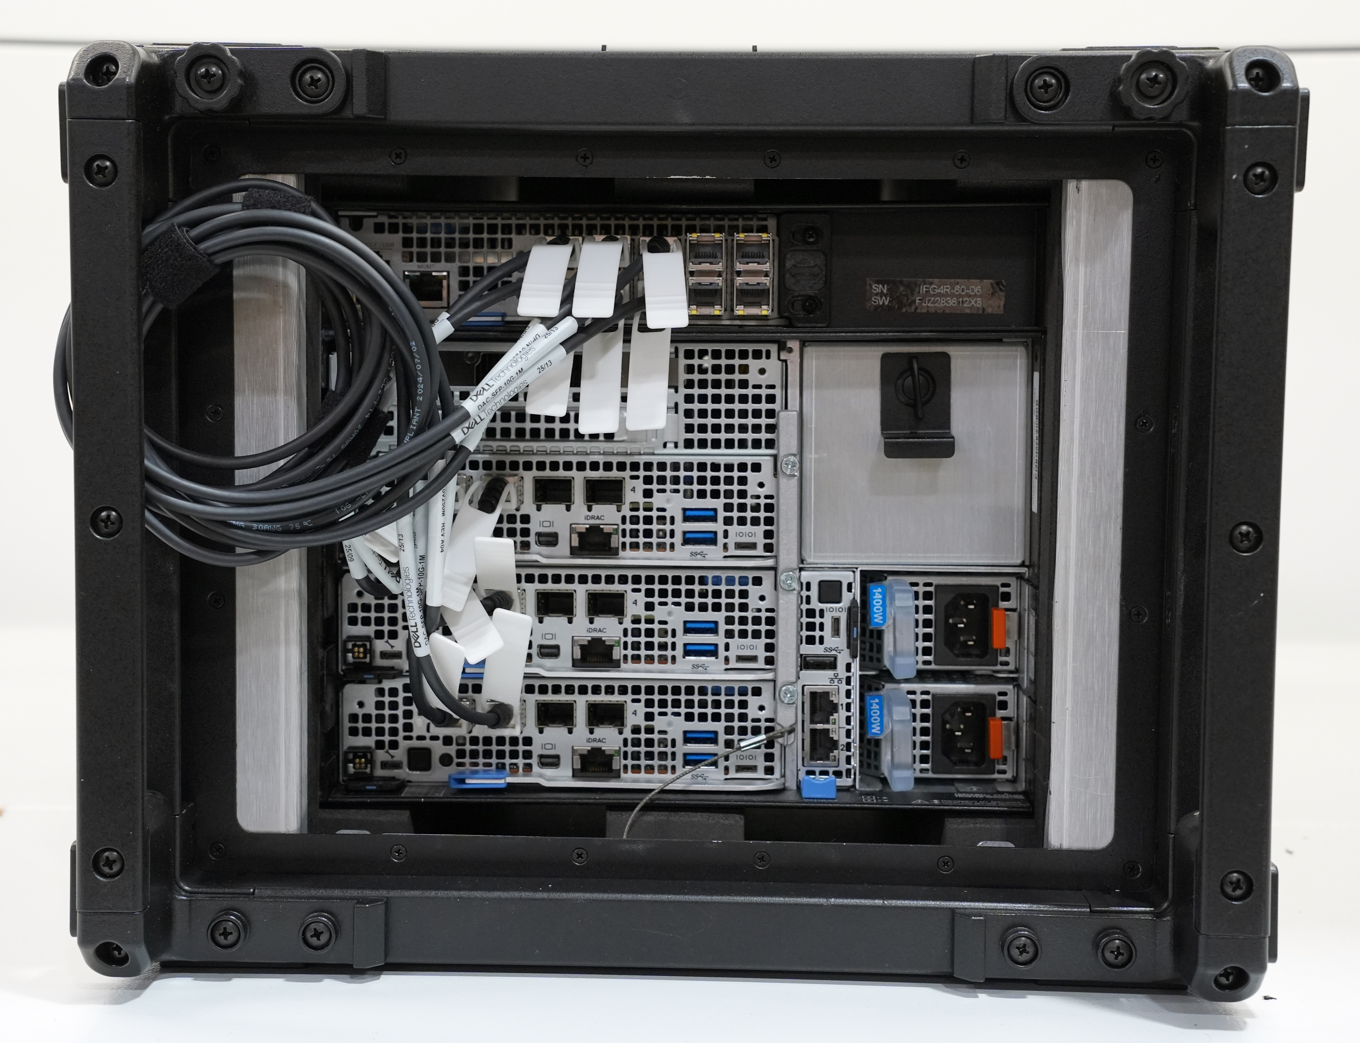



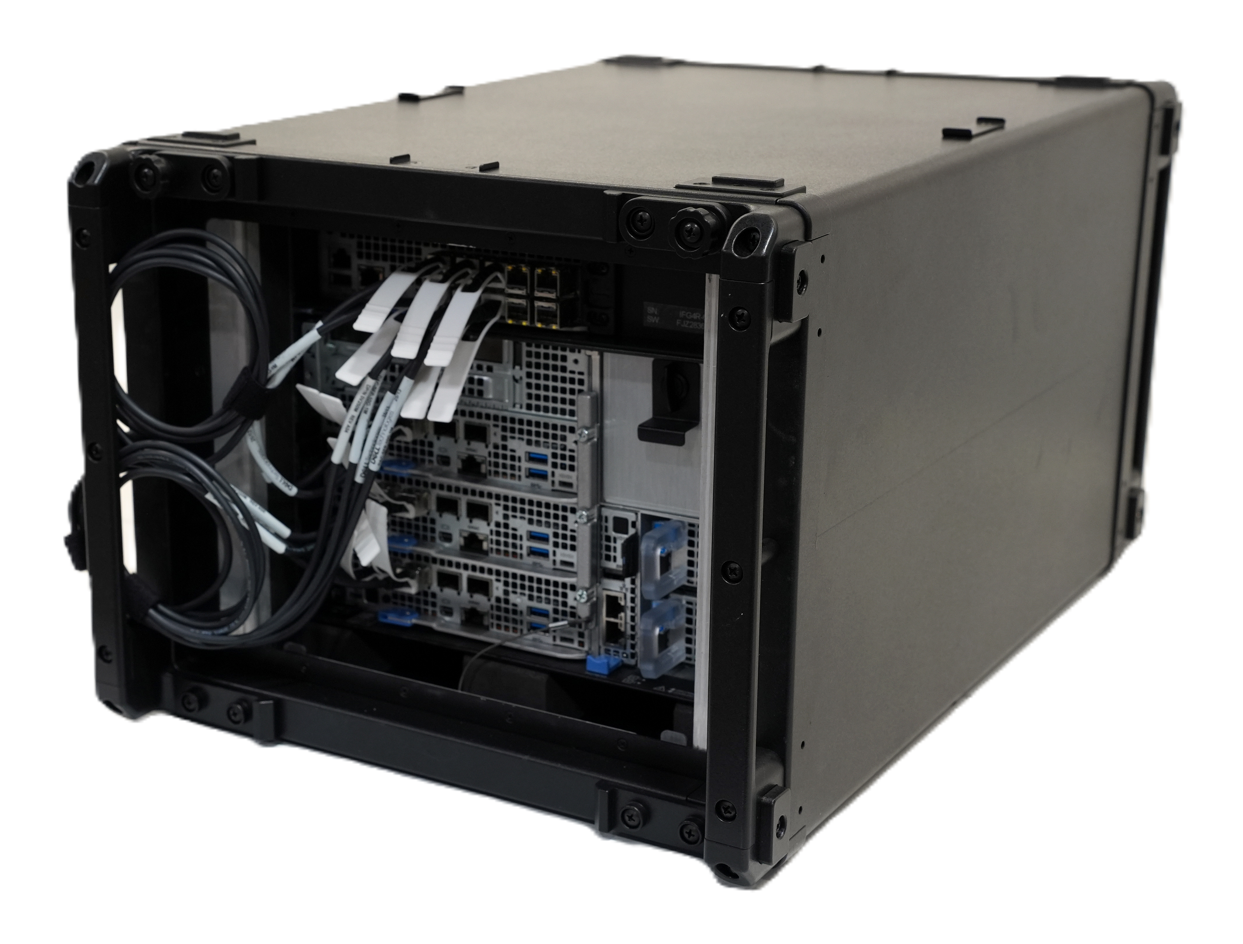

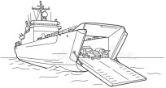
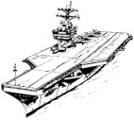

Sensitive But Unclassified – Encrypted Kit
Edge Nodes
Menace / MAGTF C2 Prototype
Tactical Assault Kit/Team Awareness Kit (TAK)
UxS
JFN
Data Mesh
Any
Shooter
MAGTF C2 Prototype v2 (MCPv2)
ARG/MEU
MOC/ ADOC
CVN Edge Node
Joint, Interoperable and resilient data ecosystem

Slide 5
Back-up slides

Slide 6

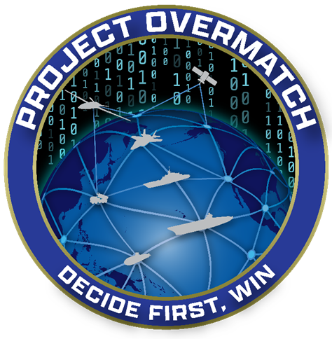


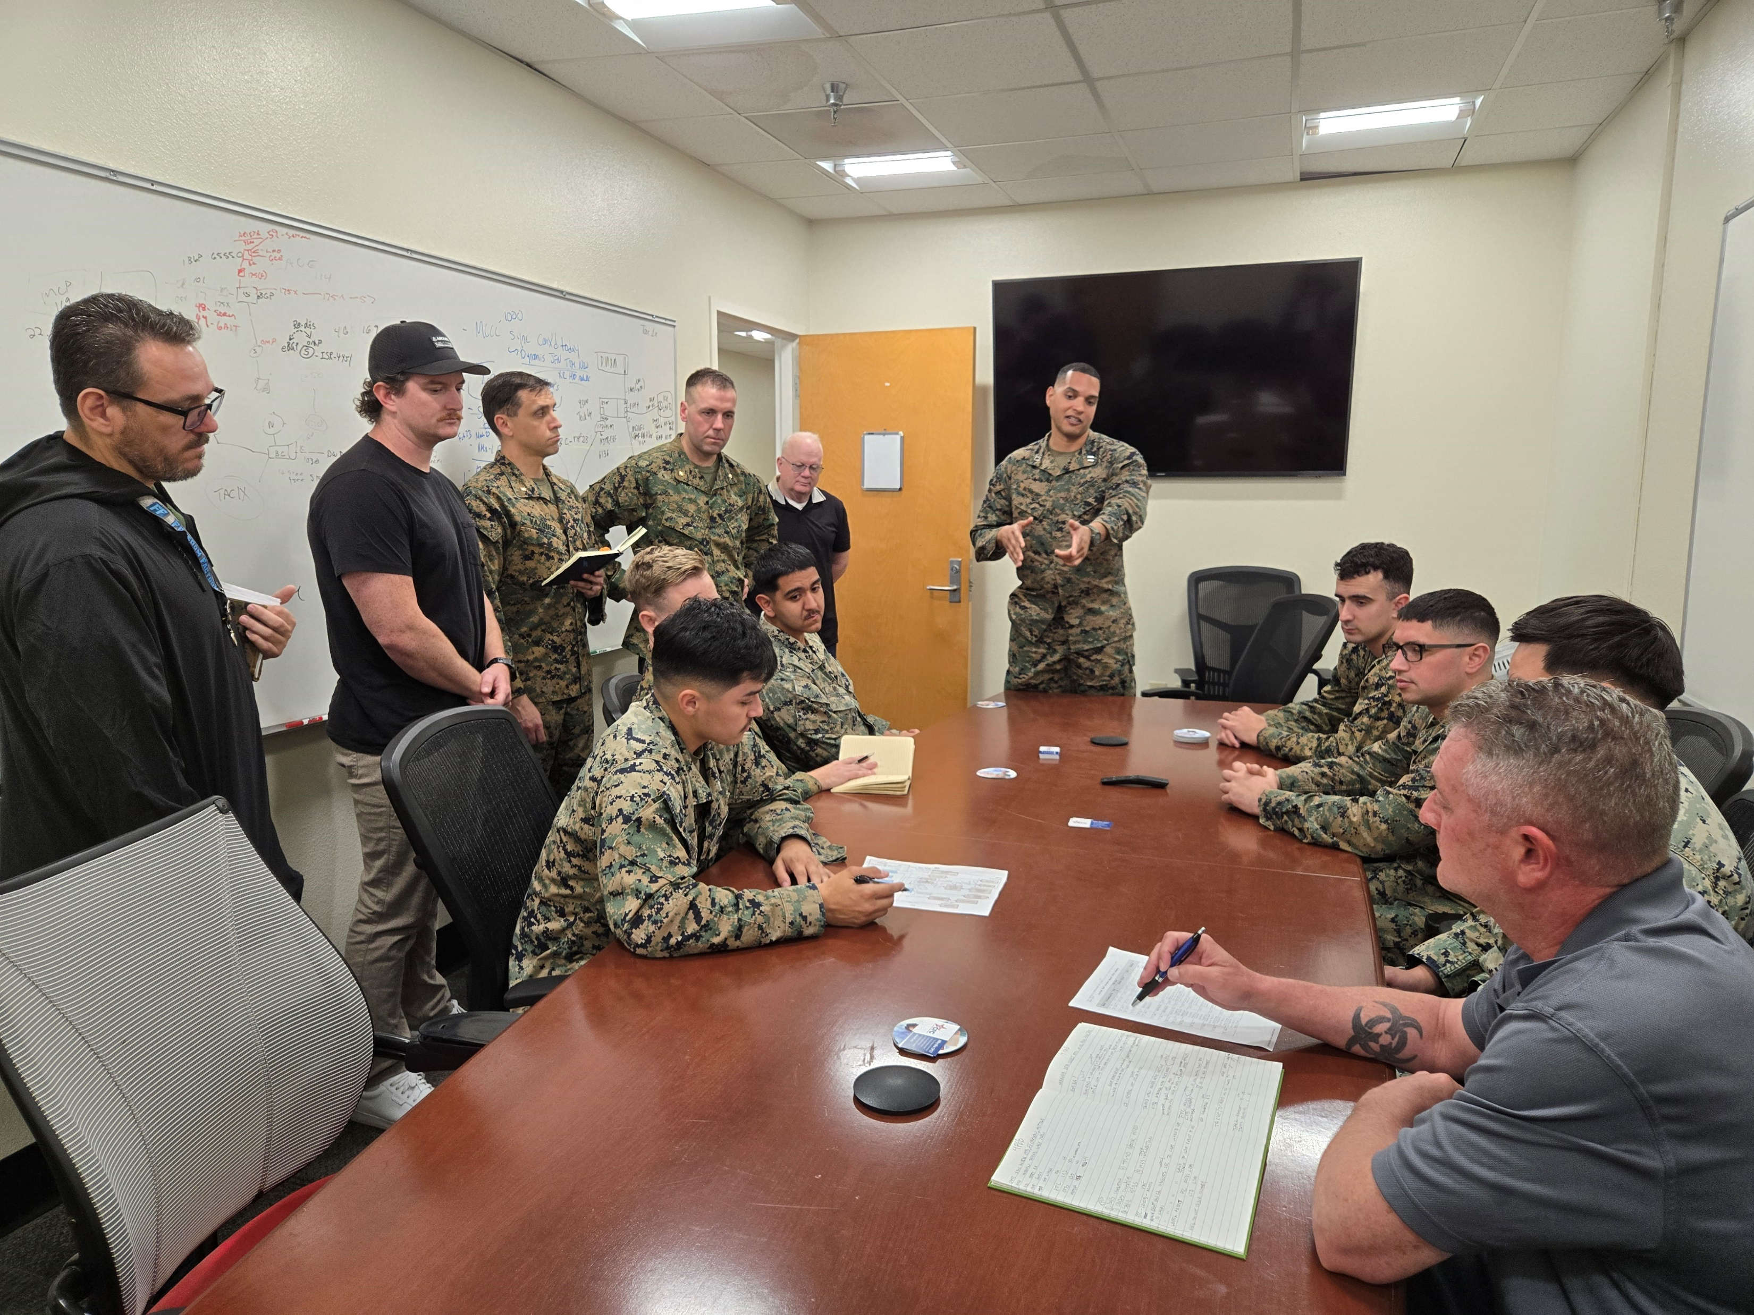
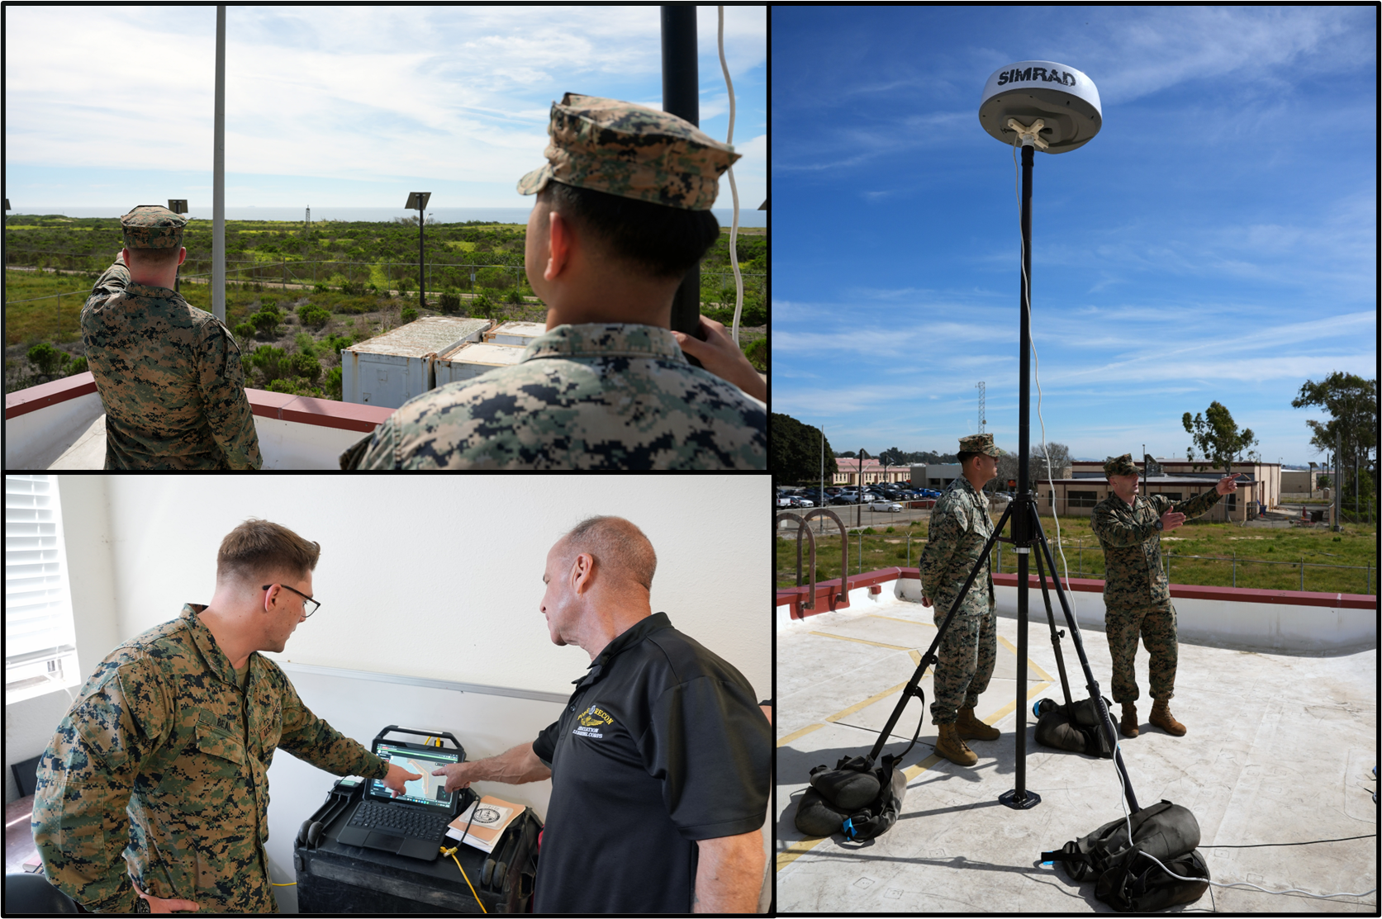
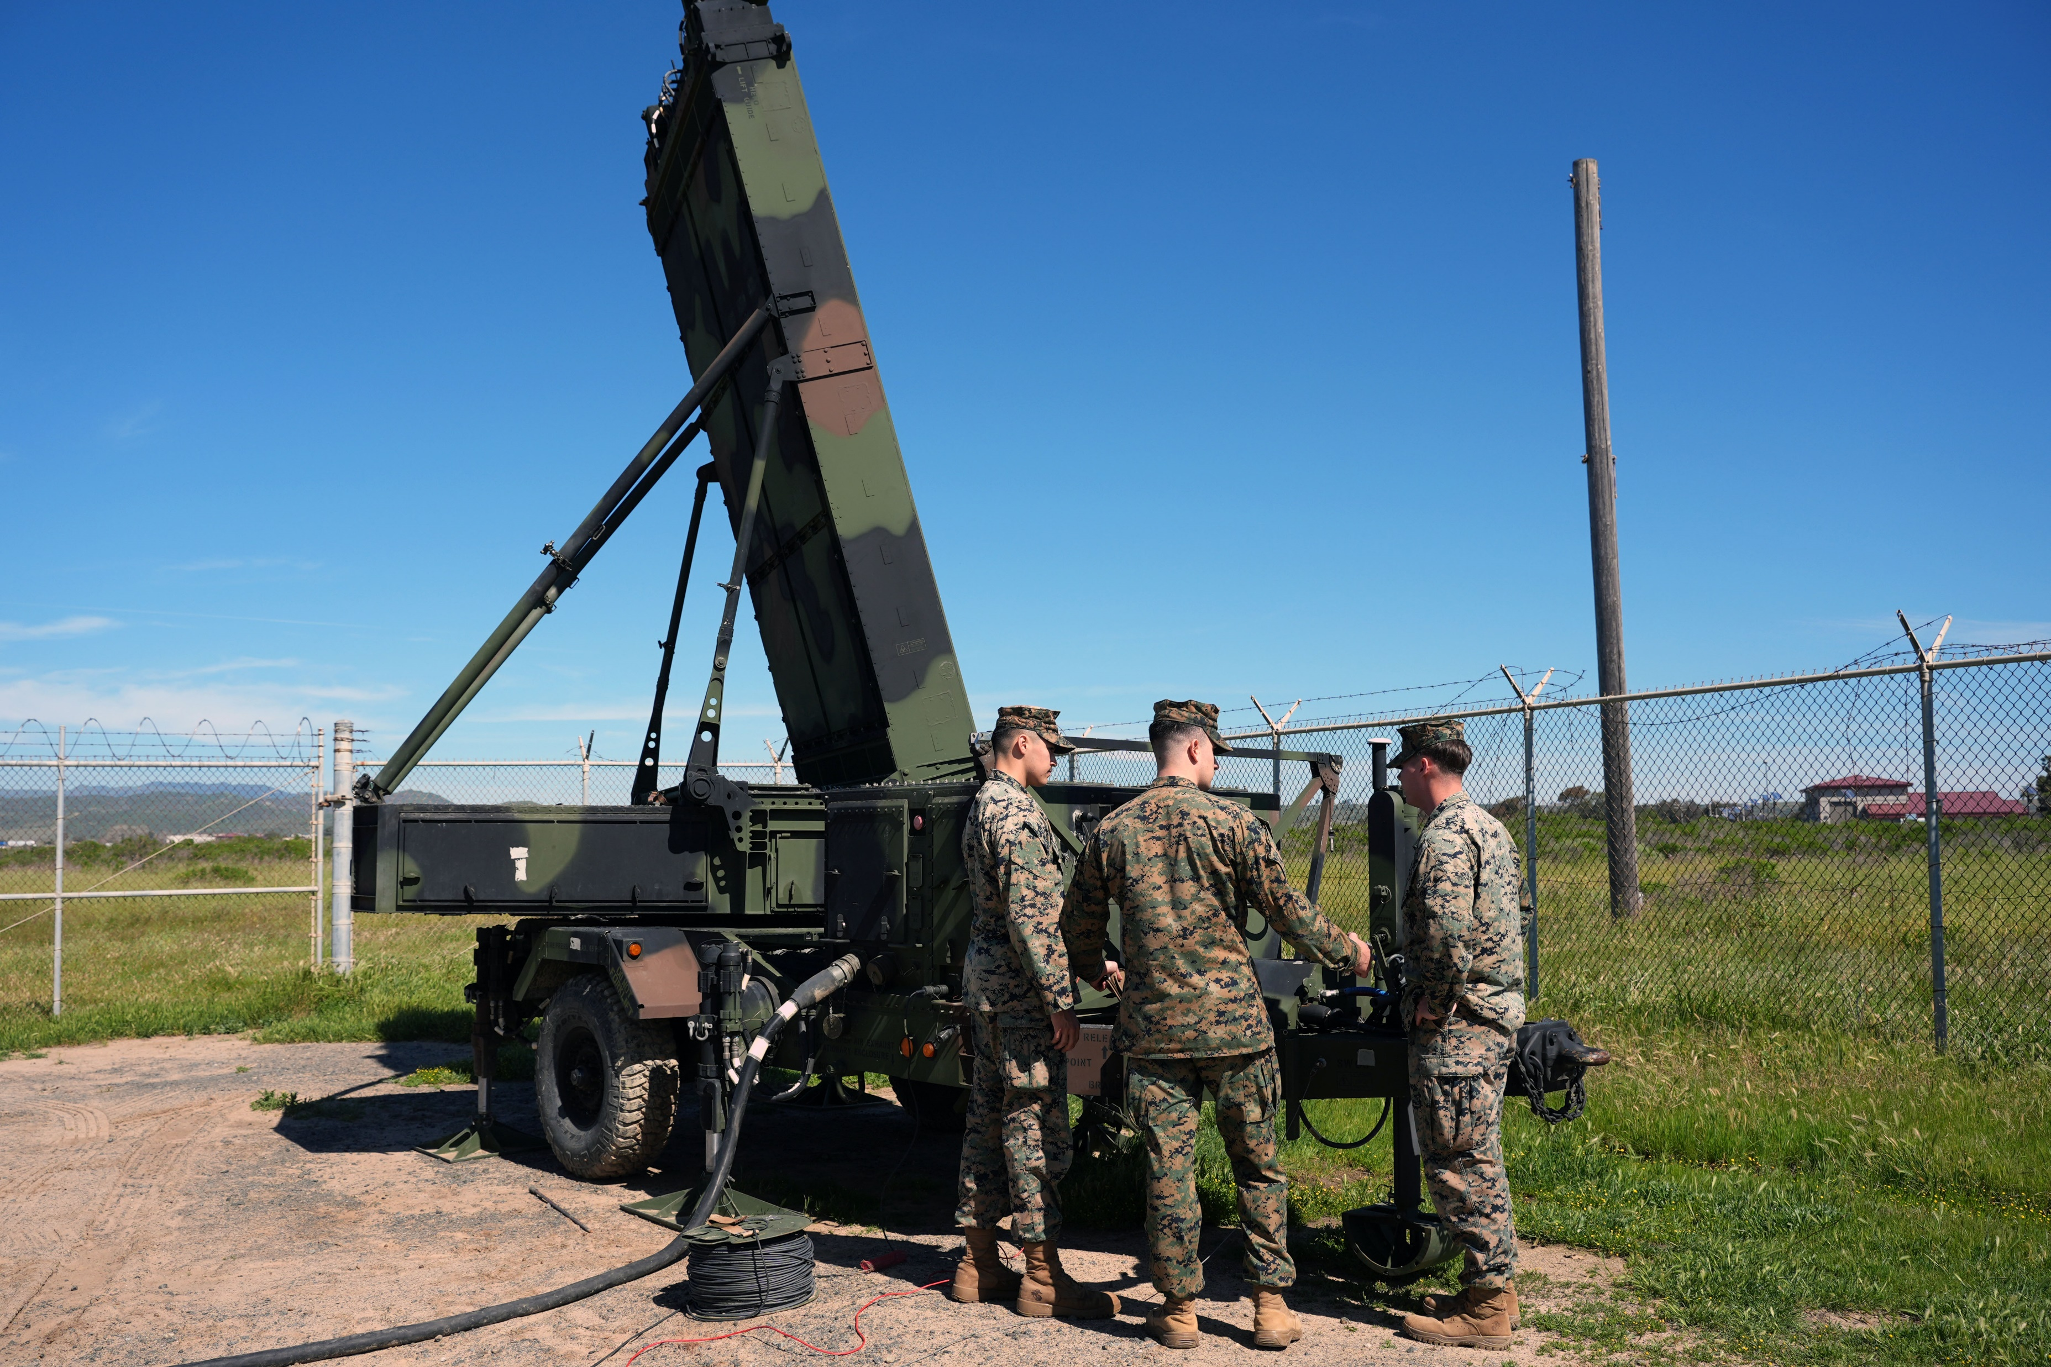
Project Overmatch – Dynamis Series – Serial 004
Accelerating AI-Powered Decision Advantage Through Operationally Realistic Agile Capabilities Development
Between February 17 and February 27, 2026, Project Dynamis executed Serial 004 of the Dynamis Series focused on engineering priorities identified through Counter-Air and Counter Surface mission threads during Serial 003. Additionally, Serial 004 integrations included bi-directional syncing between Maven Smart System tools into Lattice Data Mesh (LDM) to include: J-series and K-series messages, target collections, Gaia annotations/geometries, Geotime observations, Gotham objects, Geochat, and Curser on Target (CoT) XML data.
LDM Integrations Debrief
Maritime surveillance Radars
Counter-Air Surveillance Radars
Serial 004 was supported by operators from I MEF, including MASS-3/MACG-38, 11th Marines, and 9th Comm Bn. FMF participation and user feedback is a critical enabler of iterating with speed.
Marines leverage Crusader, developed by the Marine Corps Software factory, to control the maritime surveillance radar and push SBU-E sensor data to the MCP on IL-6.
Future Dynamis Series events will incorporate an increasing number of tactical edge sensors feeding the joint C2 common operational picture through LDM.
-.. .- - .-

Slide 7
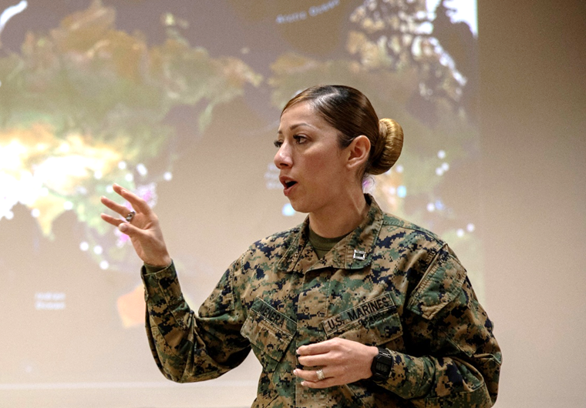
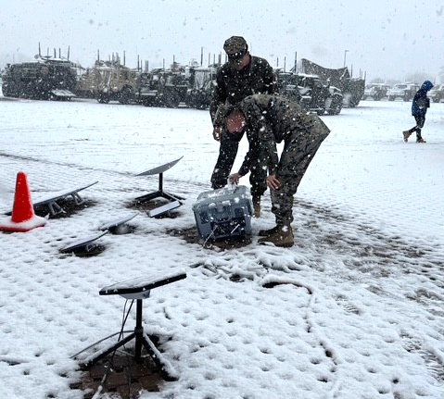
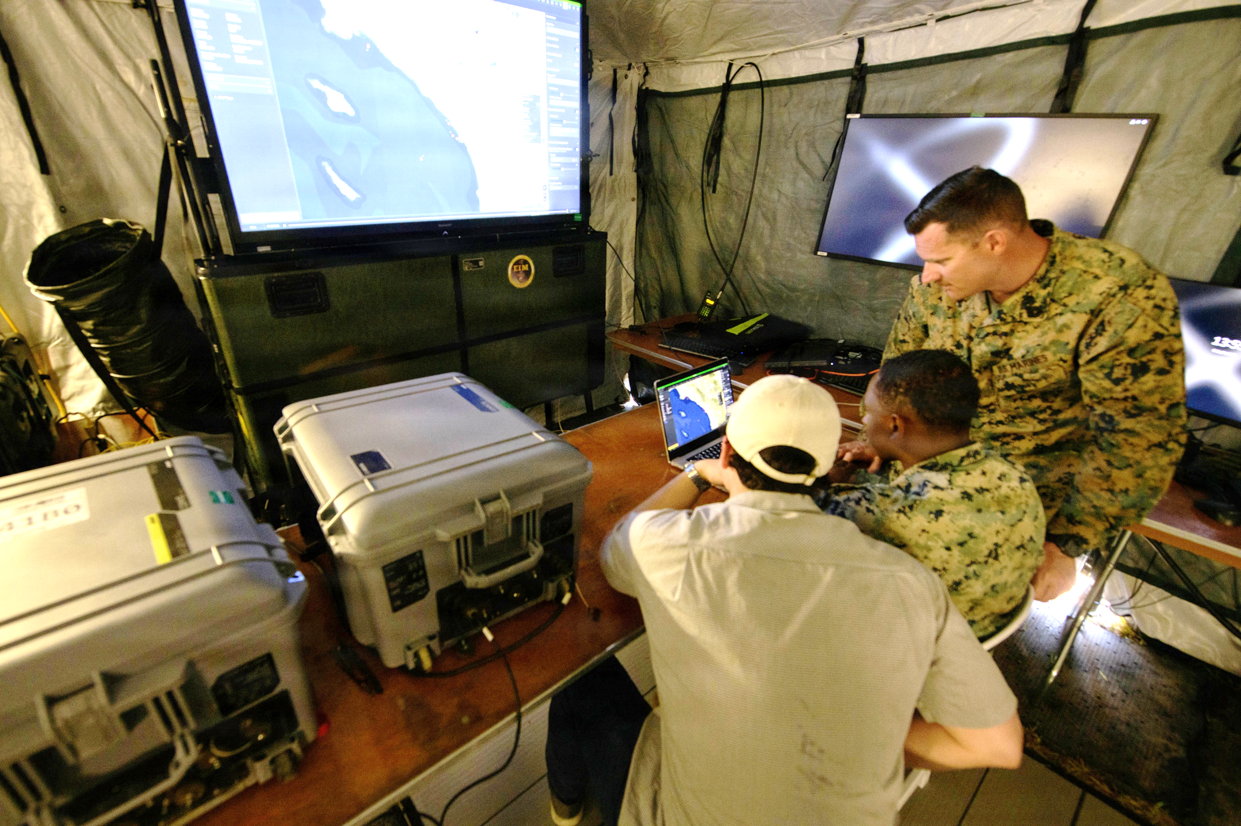
Project Overmatch – Dynamis Series – Serial 005
Accelerating AI-Powered Decision Advantage Through Operationally Realistic Agile Capabilities Development
From 1-20 March, Project Dynamis executed Serial 005 in collaboration with 4th Infantry Division’s Ivy Sting V at multiple geographic locations. This exercise enabled joint development to advance future C2 systems for both the Army and the Marine Corps. The team, supported by I MEF Fires and Aviation C2 Marines, further integrated Lattice Data Mesh and Maven Smart System into the execution of the Long-Range Precision Fires Mission Thread. In Charleston, SC, at the System of Systems Naval Integration Experiment (SoSNIE), Project Dynamis partnered with Naval Information Warfare Command-Atlantic & 2nd Marine Division to refine Lattice Data Mesh's ability to support a Sea Denial mission thread that included SBU-E maritime sensors, cross-domain solutions, and autonomous unmanned platforms.
Command and Control
Ivy Sting V
SoSNIE
Project Dynamis, MCTSSA, & PM MAGTF C2 deployed to each location to train FMF forces on configuring and deploying the MAGTF C2 Prototype and captured the Fleet’s lessons learned to refine the equipment for future serials.
I MEF Marines in Fort Carson, CO established a C2 Node with Fires & Aviation C2 specialists to facilitate a Long-Range Precision Fires mission thread. A detailed assessment was conducted to document successes and areas requiring iterative development.
SoSNIE focused on a Sea Denial mission thread, with a cutting edge C2 architecture: SBU-E Maritime Surveillance Radars, Autonomous Surface Vessels and UAVs – all feeding Lattice Data Mesh, concluding in a kinetic (constructive) engagement from both NSM and AEGIS.
-.. .- - .-

