Slide 1
Modern Day Marine
April 2026
Overall Classification: Unclassified

Slide 2

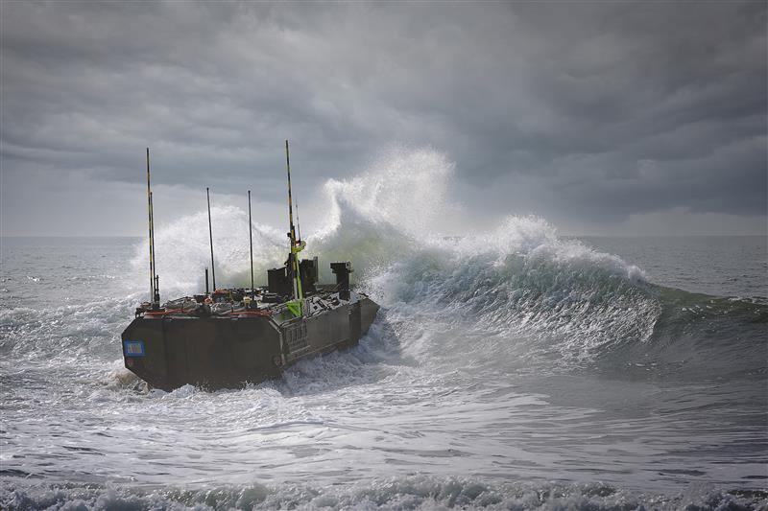
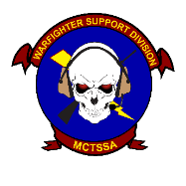
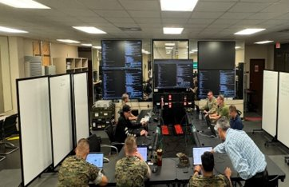
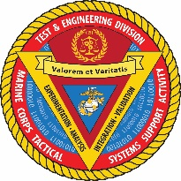
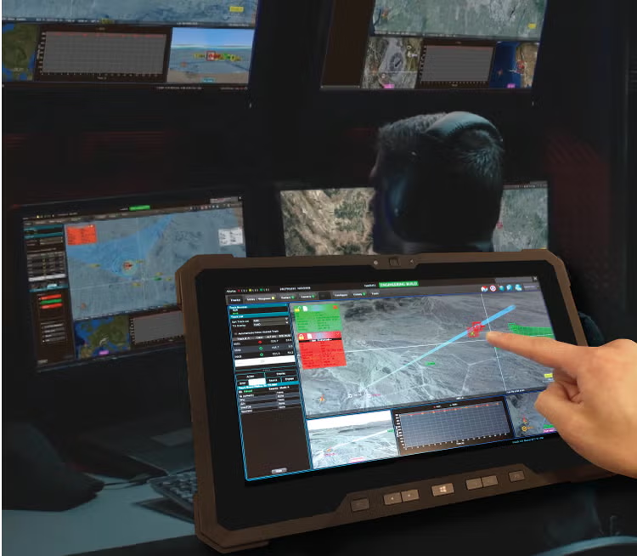
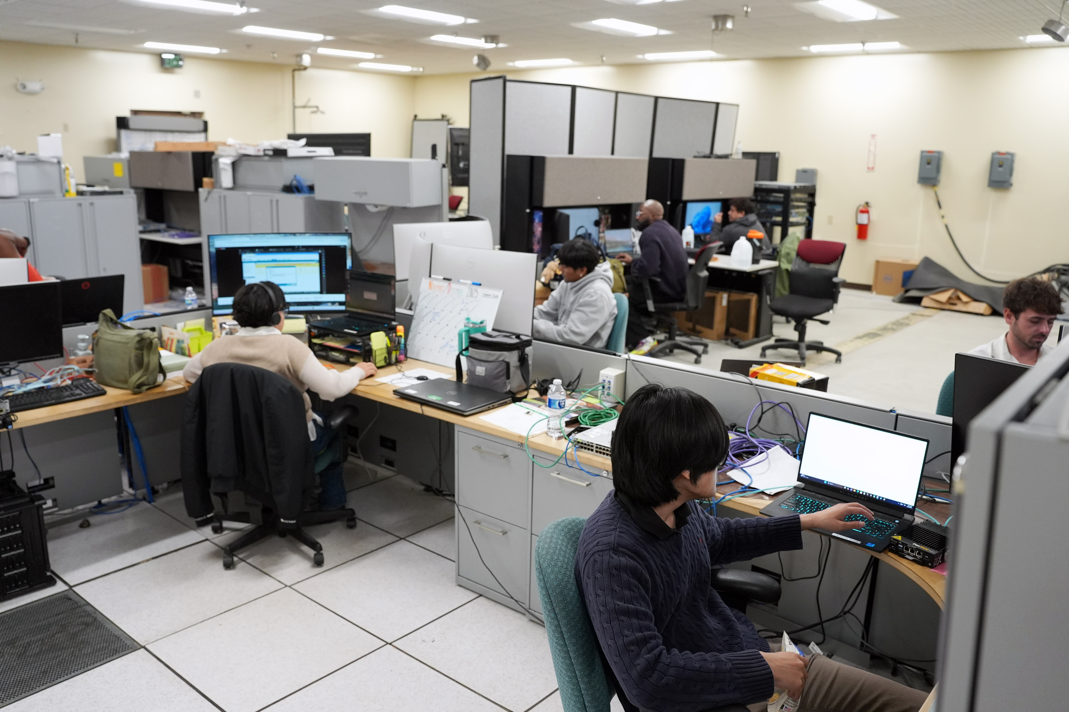
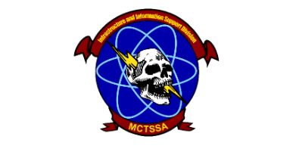
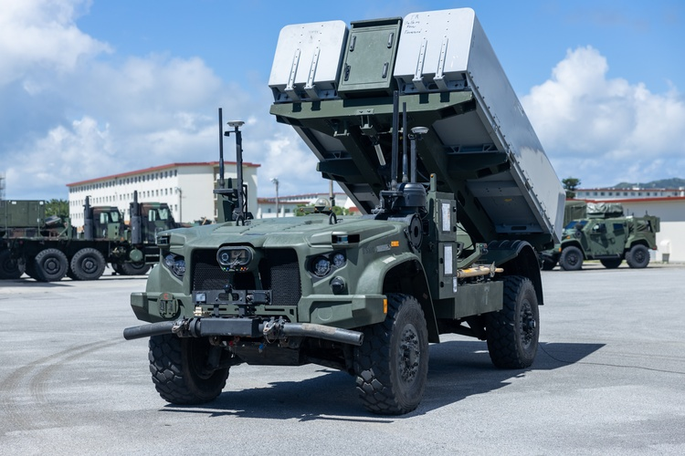
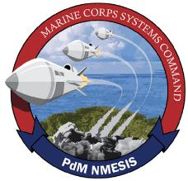
Command Overview
MISSION: MCTSSA provides 24/7 global technical support for Command, Control, Computer, Communications, Cyber, Intelligence, Surveillance, Reconnaissance, and Targeting (C5ISRT) systems; and conducts research and development, engineering, testing and evaluation, and supports experimentation for C5ISRT systems and littoral platforms in order to inform acquisition decisions and make the Fleet Marine Force more capable.
Amphibious Vehicle Test Branch (AVTB) - Plan, execute, analyze, and report developmental and integrated test and evaluation events to characterize the performance of amphibious and ground combat vehicle systems, robotic and autonomous systems, and other platforms that operate in the littorals to enable informed acquisition decisions.
Warfighter Support Division (WSD) - Provide 24/7 global support to the FMF & Joint force to bridge the gap between current or legacy systems and emerging capabilities to optimize operational effectiveness. Collect real-time data from USMC operations and exercises to inform acquisition strategies, while providing agile software development to ensure the FMF remains at the forefront of the technological advantage.
Test and Engineering Division (TED) – Perform threat informed Program Engineering, Developmental, Cyber, Shipboard, and concept-based testing and experimentation of existing and emerging USMC C5I systems in support of the acquisition community and the naval enterprise. Provide Military Standards expertise to achieve interoperable, integrated, and certified solutions to meet USMC, Joint, and Mission Partner requirements.
Infrastructure and Information Support Division (I2SD) – Provide compute, transport, storage services, critical IT infrastructure and Cybersecurity Authorizations as well as Cryptologic Services to support developmental testing and engineering of USMC C5I systems.
NETT - The New Equipment Training Team (NETT) tests and validates updates to the Navy Marine Corps Expeditionary Ship Interdiction System (NMESIS) and instructs newly fielded units on system capabilities and operations.
Priorities: Support to Program Offices – Support to the Warfighter– Support to Force Design

Slide 3
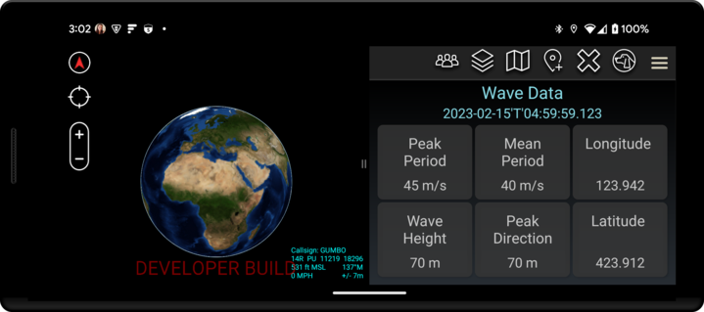
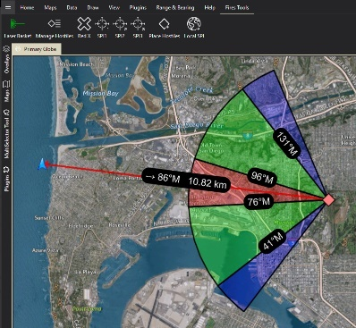
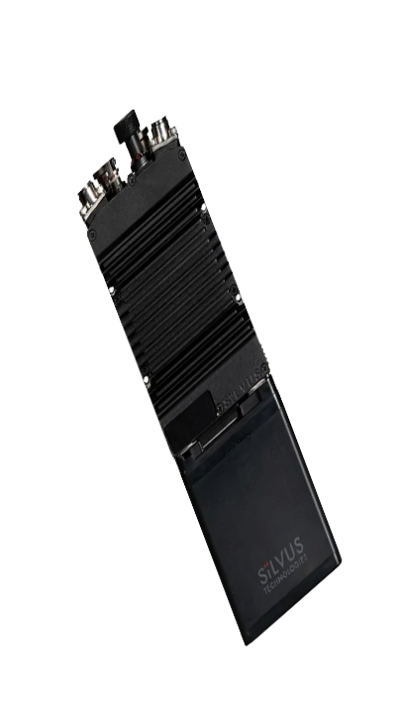
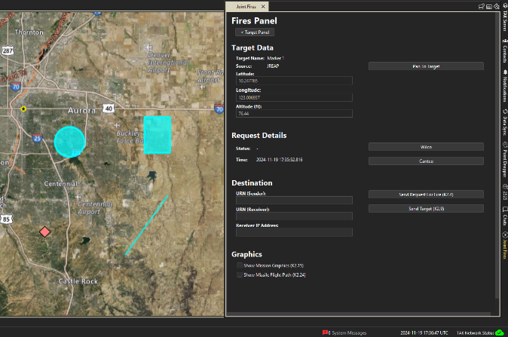
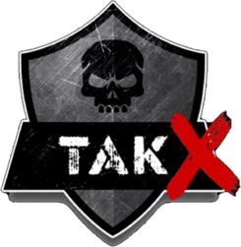
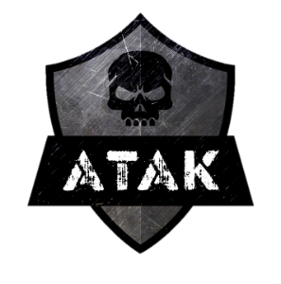
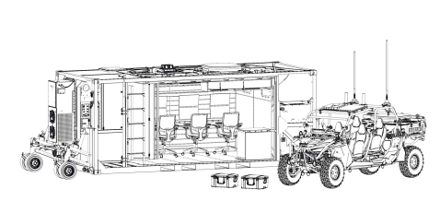


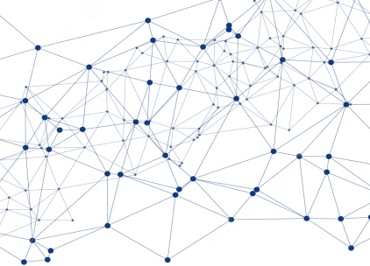

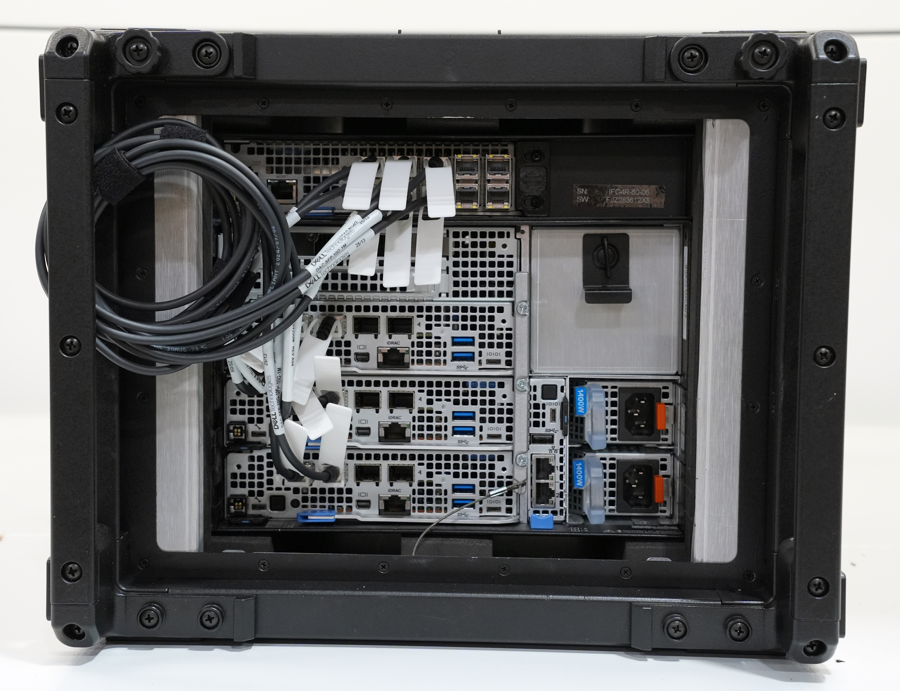



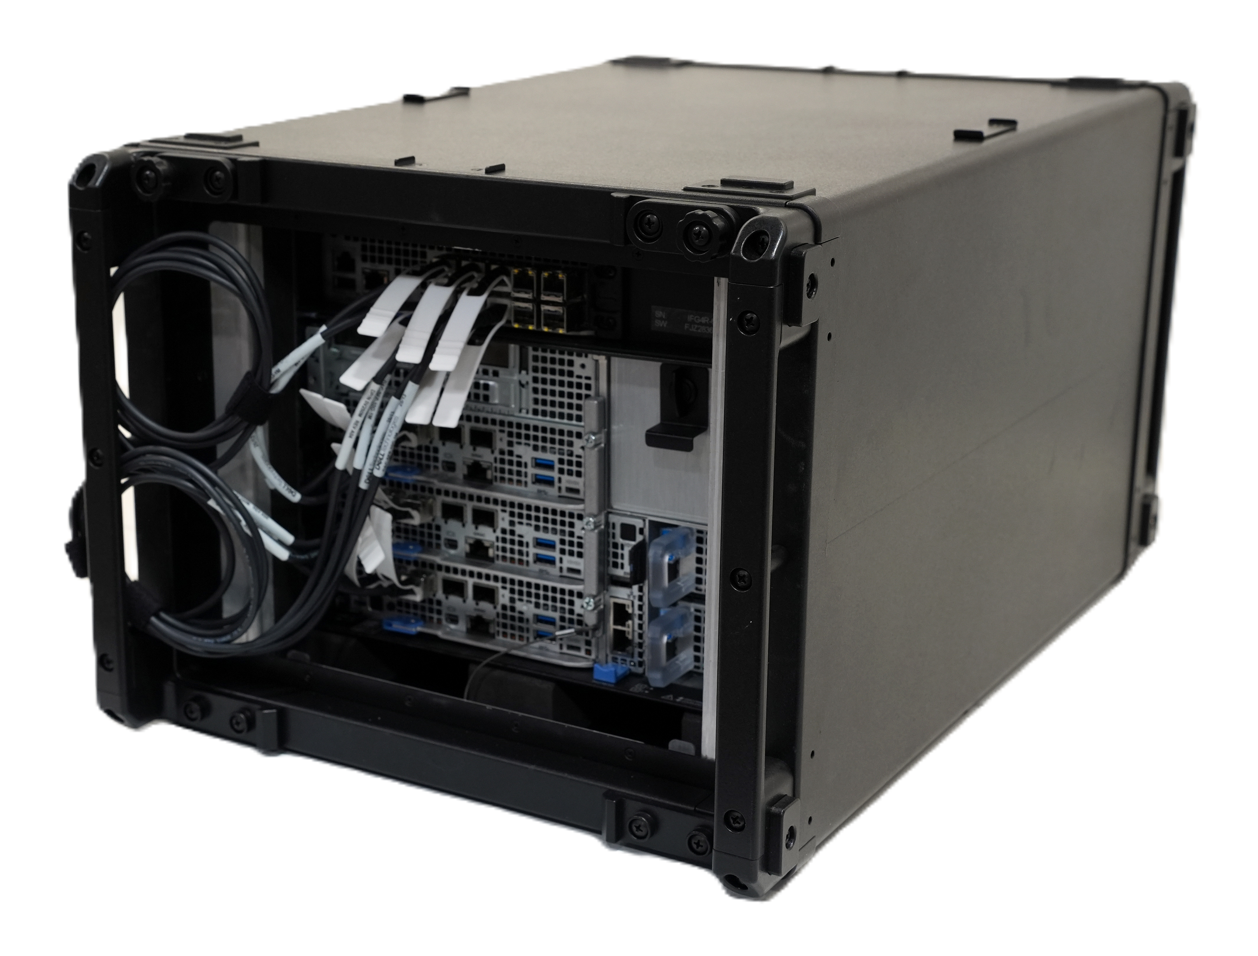

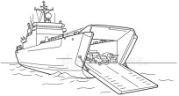
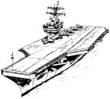

Sensitive But Unclassified – Encrypted Kit
Edge Nodes
Menace / MAGTF C2 Prototype
Tactical Assault Kit/Team Awareness Kit (TAK)
UxS
JFN
Data Mesh
Any
Shooter
MAGTF C2 Prototype v2 (MCPv2)
ARG/MEU
MOC/ ADOC
CVN Edge Node
Joint, Interoperable and resilient data ecosystem

