Slide 1
Force Multiplied: Integrated Solutions for the Modern Marine
Matt “Gucci” Klunder
RADM, USN (ret)
VP for USN/USMC Accounts & DARPA/DoD Labs
IAW GTC-01.06 please include an export disclaimer statement on the cover page. This presentation is eligible for the Non-Export Controlled Statement: THIS DOCUMENT CONSISTS OF INFORMATION THAT IS NOT DEFINED AS CONTROLLED TECHNICAL DATA UNDER ITAR PART 120.33 OR TECHNOLOGY UNDER EAR PART 772.

Slide 2


COMMITMENT
TO THE
WARFIGHTER

Slide 3


TACTICAL COMMUNICATIONS

Slide 4
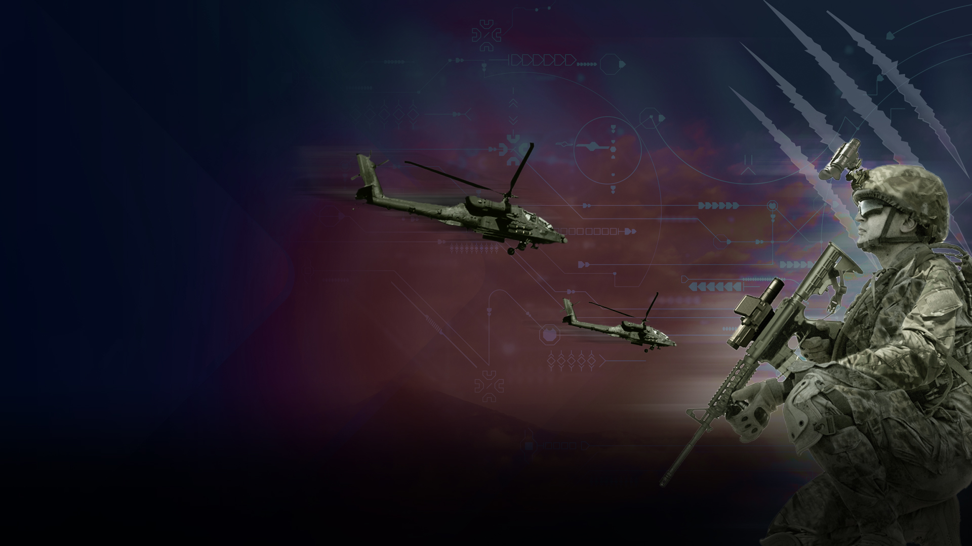
AERIAL LOGISTICS

Slide 5



Slide 6
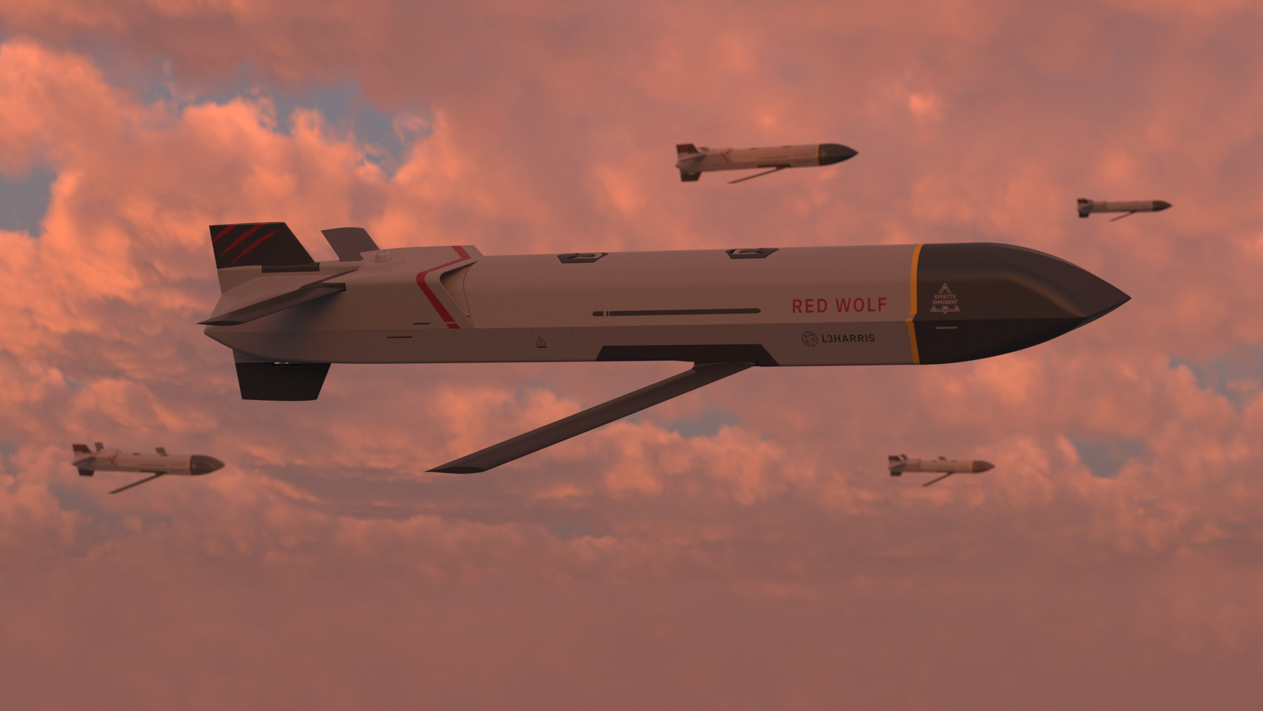



WOLF PACK
Flexible and modular
multirole vehicles
In-flight collaboration and retargeting
Supports swarming of
autonomous aircraft
Interoperable across services and domains
Already borne development and integration costs
Cost-effective alternative to exquisite munitions
Five years of flying
52+ tests and counting
Proven integration across platforms
DISRUPTIVE
AFFORDABLE
ADVANCED

Slide 7


PROVEN
L3Harris’ Red Wolf is the only launched effect proven on the AH-1Z and selected for the
^{U.S. Marine Corps fleet}
Image credit: Navair

Slide 8
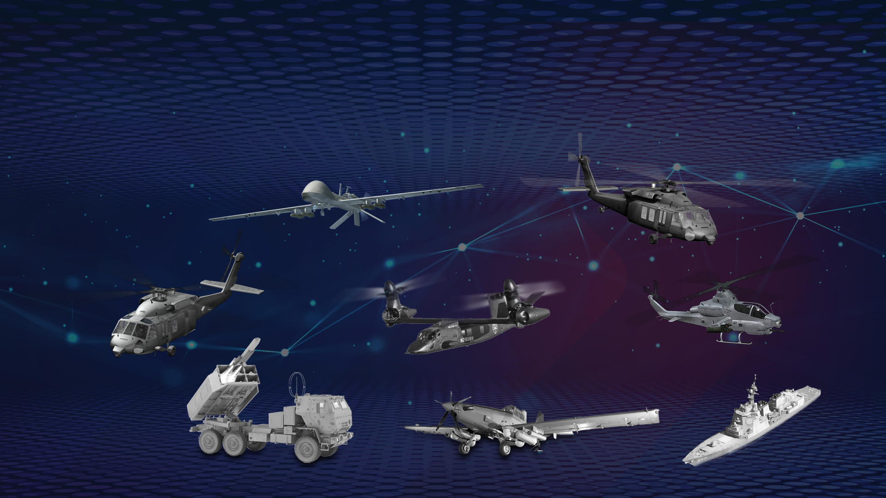
OPPORTUNITIES FOR THE FUTURE
Army Gray Eagle
Army Black Hawk
USMC AH-1Z
Navy SH-60
Army FLRAA
Rocket-Assist
Ground Launcher
L3Harris SKY RAIDER II INTERNATIONALTM
Guided Missile Destroyer

Slide 9

FORCE MULTIPLIER
^{Special Operations}
ISR platform delivering beyond line-of-sight kinetic and non-kinetic effects

Slide 10
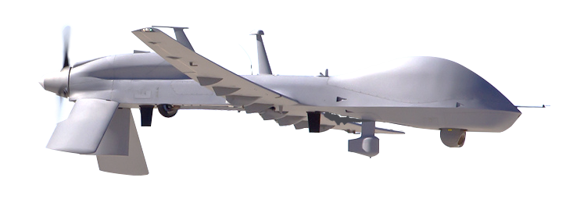
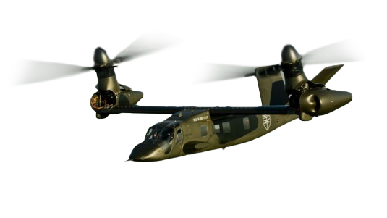
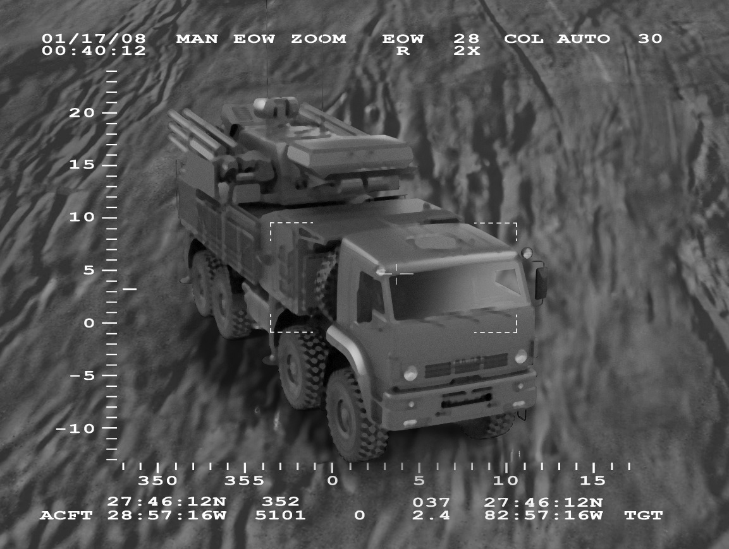
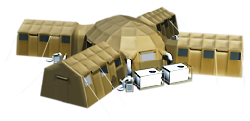
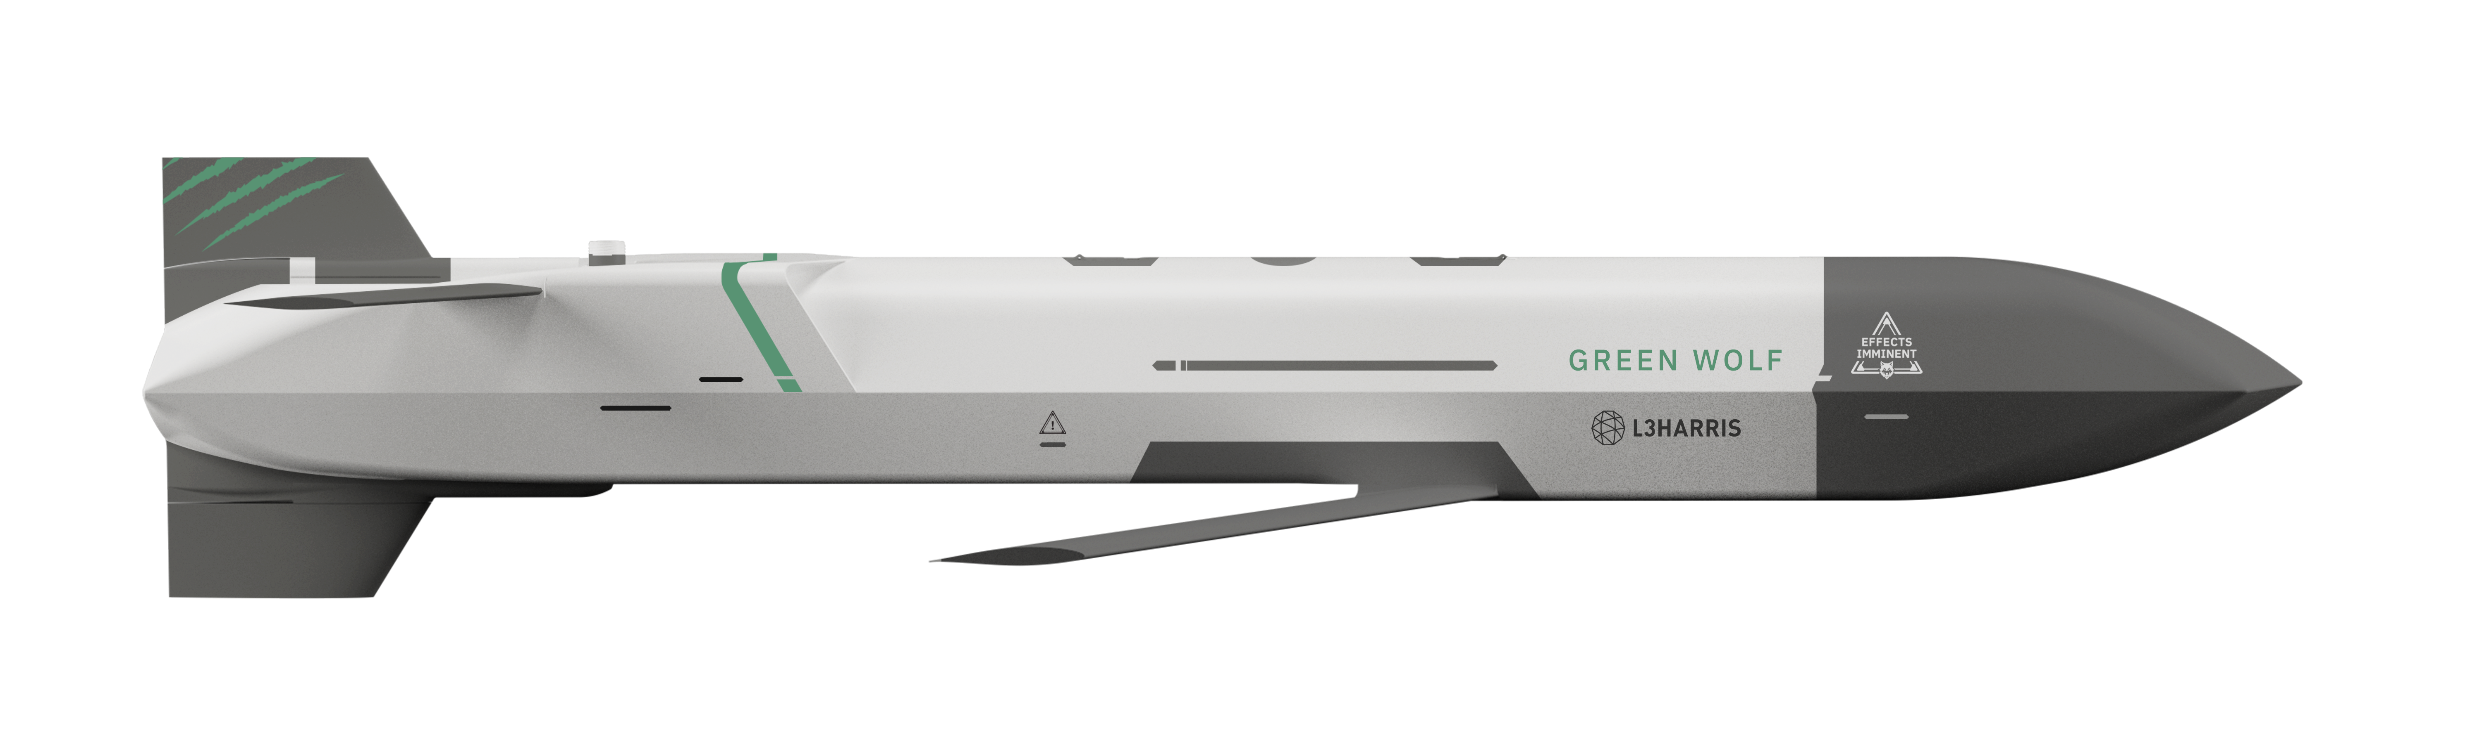
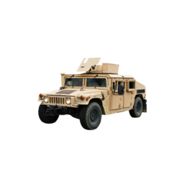
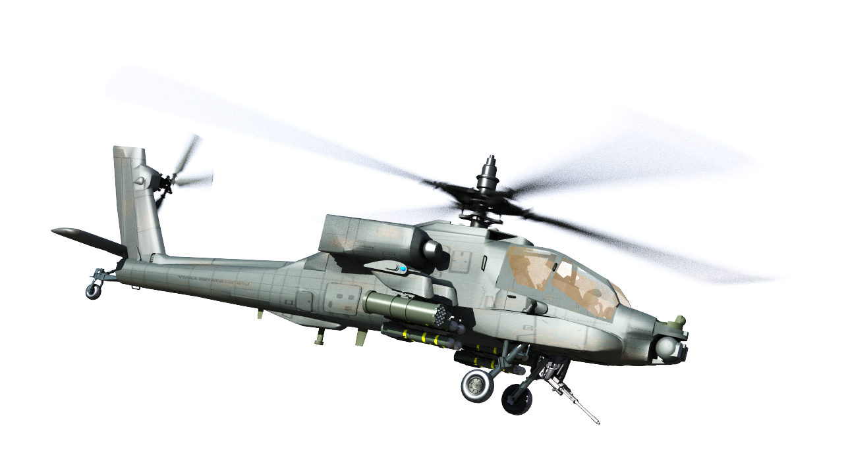



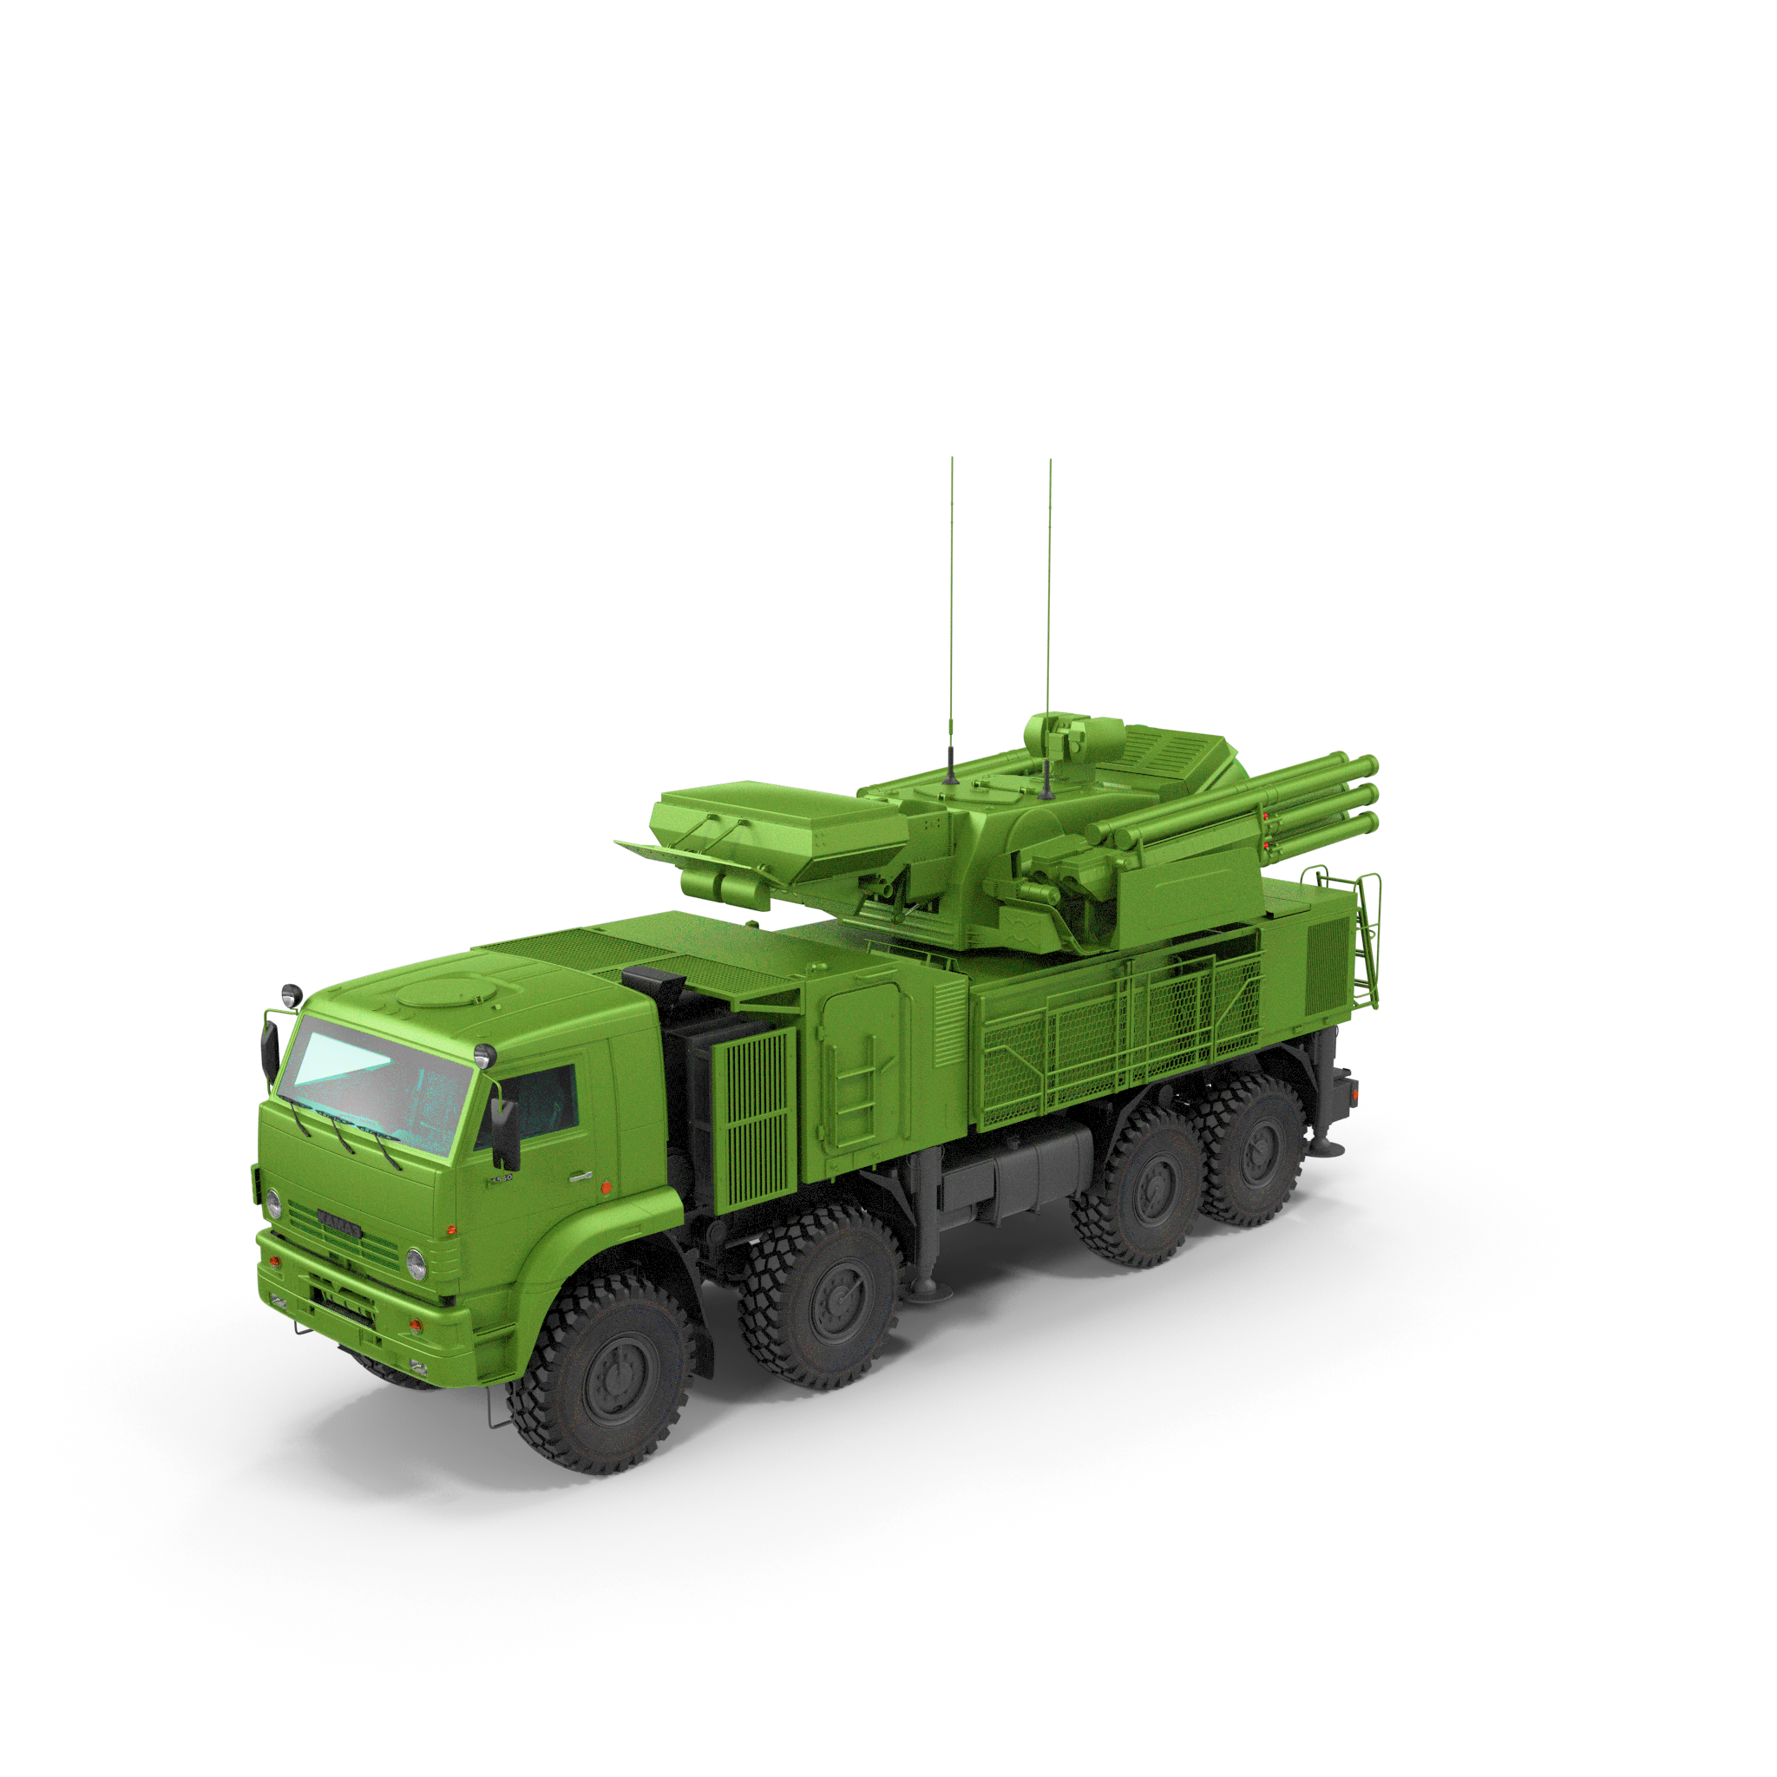
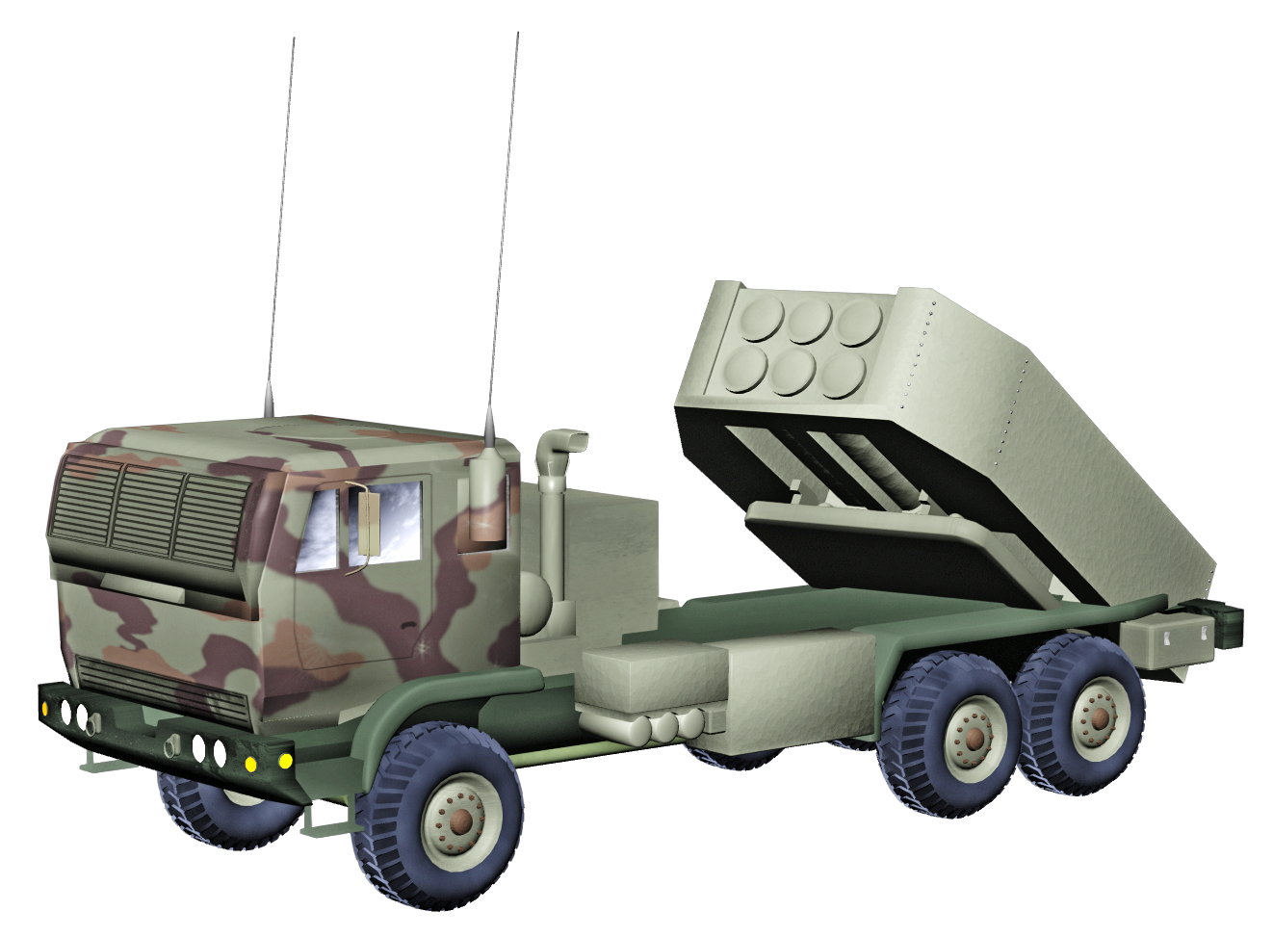

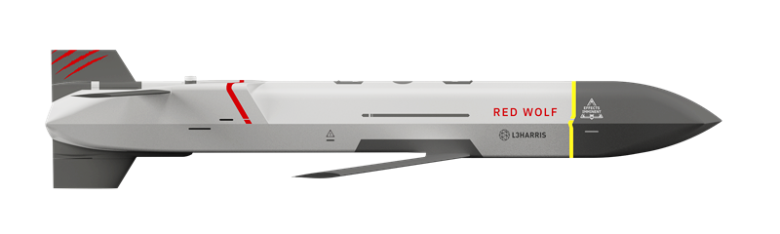

CREATING AN UNFAIR FIGHT
GROUND MISSIONS
GREEN WOLF
DILR
GREEN WOLF
EW DISRUPT
RED WOLF KINETIC
RED WOLF KINETIC
LAUNCHED EFFECTS
CAPABLE

Slide 11
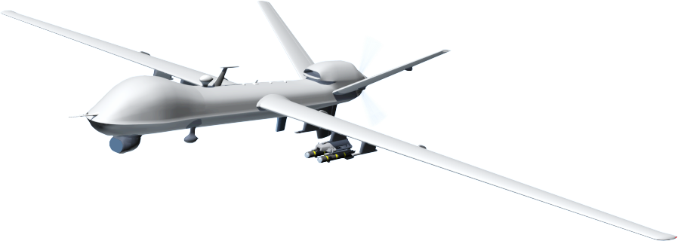

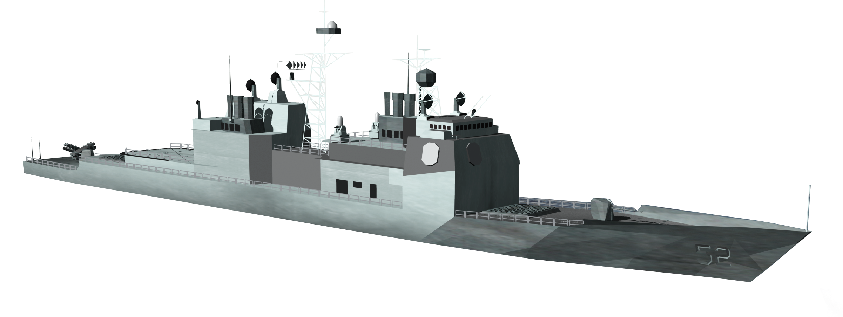
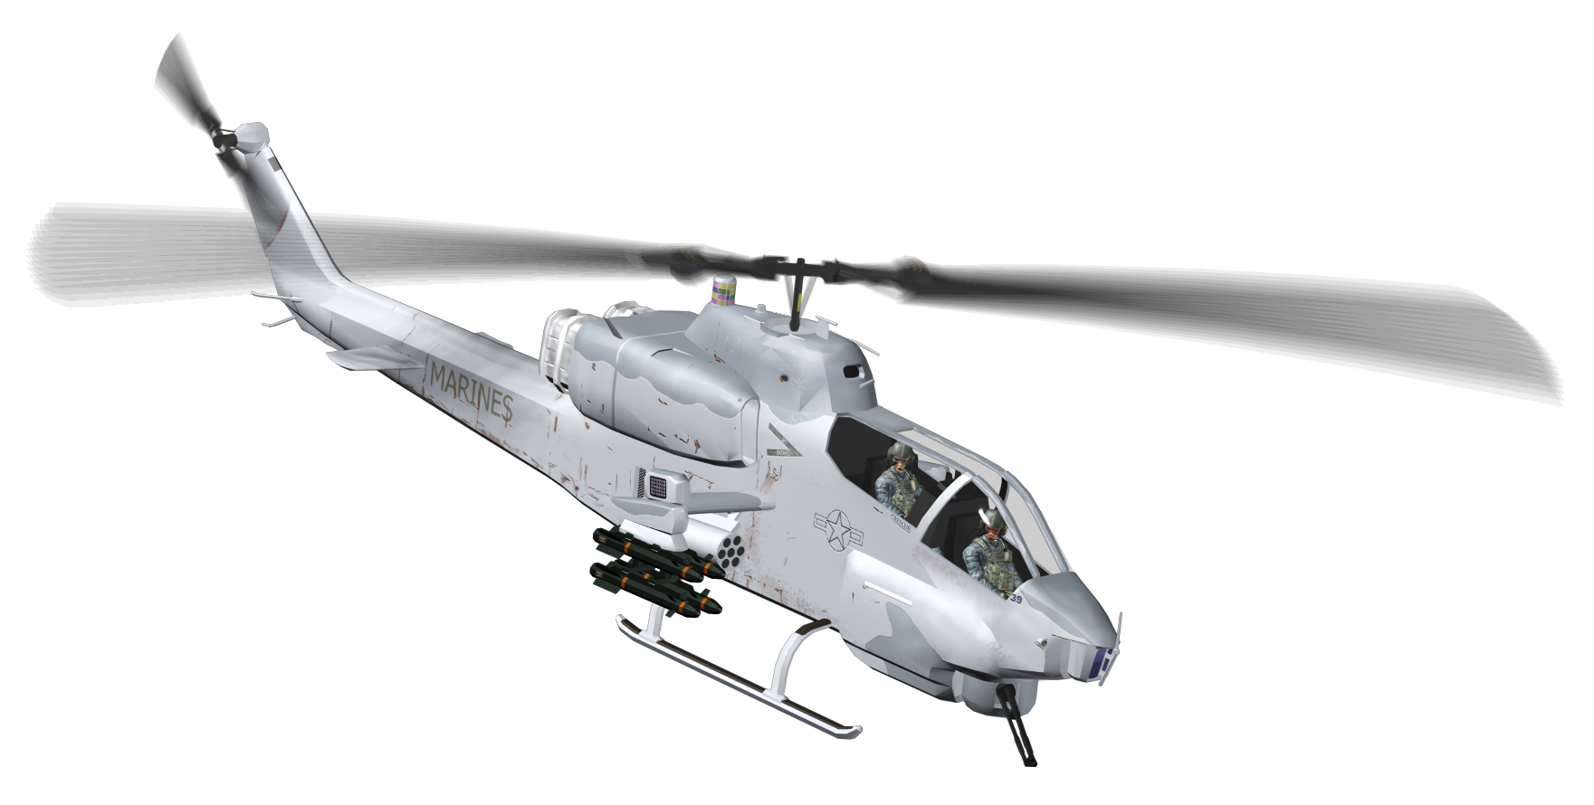


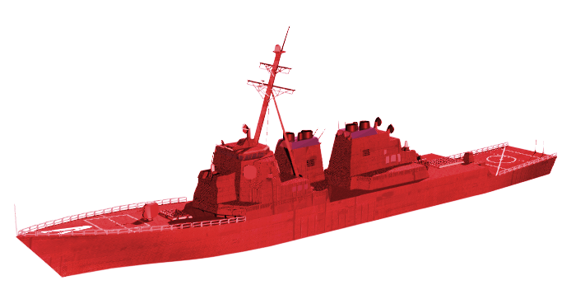
CREATING AN UNFAIR FIGHT
EXPEDITIONARY MISSIONS
GREEN WOLF DILR
RED WOLF KINETICS
GREEN WOLF
EW DISRUPT
RED WOLF KINETIC
RED WOLF KINETIC

Slide 12
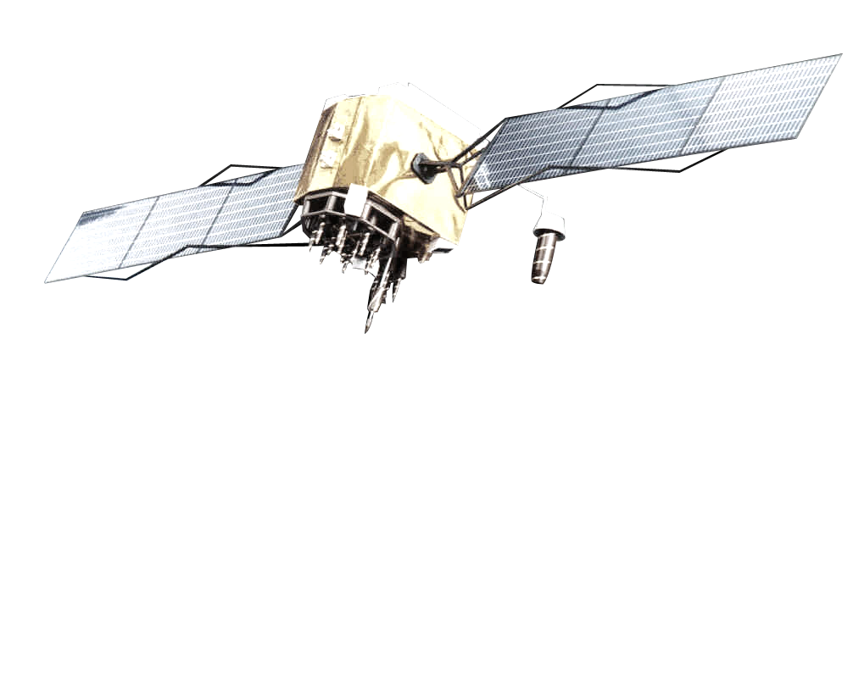
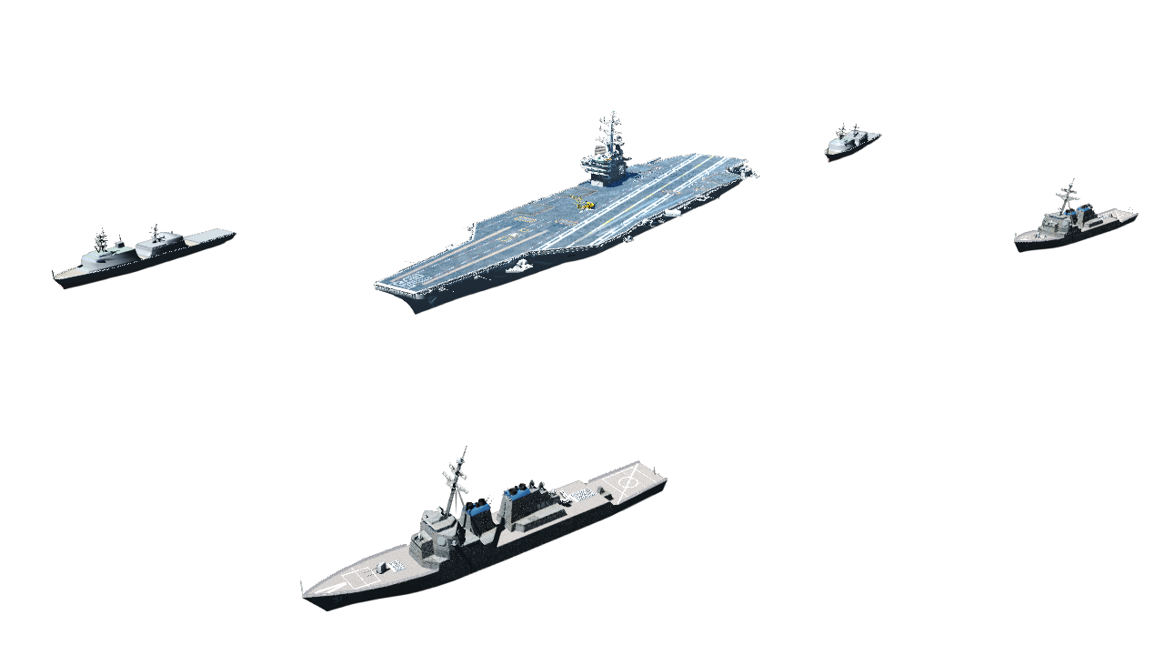
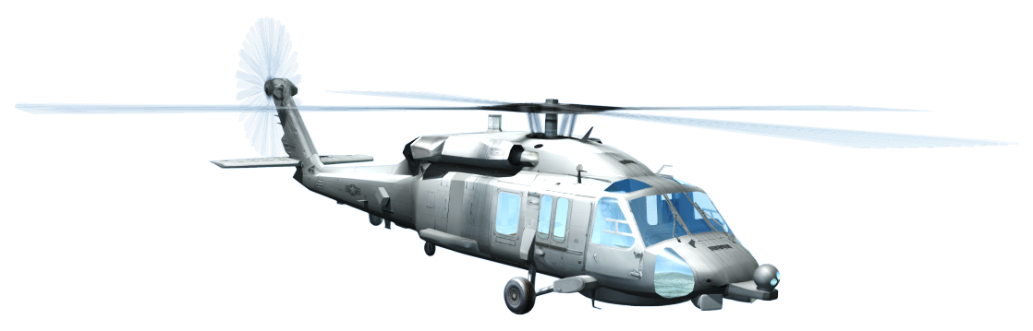
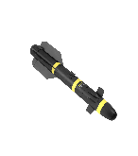

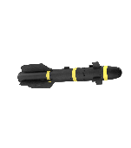
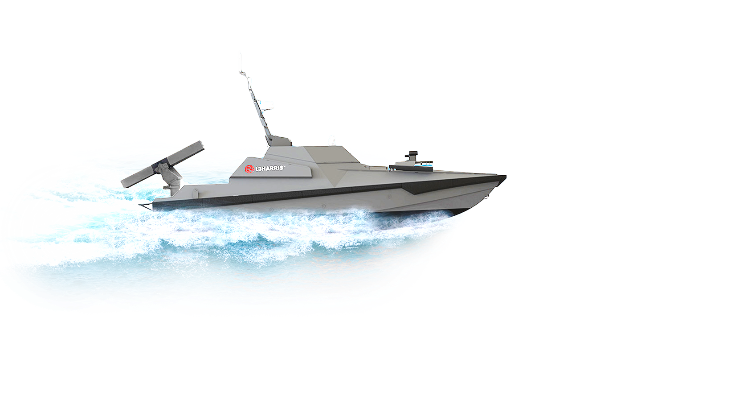
CREATING AN UNFAIR FIGHT
CREATING AN UNFAIR FIGHT
MARITIME MISSIONS
GREEN WOLF
EW DISRUPT
LAUNCHED
EFFECTS
CAPABLE
RED WOLF
KINETICS
GREEN WOLF
DILR
EXPENSIVE
OVERMATCHED
COUNTER-ATTACK
RED WOLF KINETIC
RED WOLF KINETIC

Slide 13
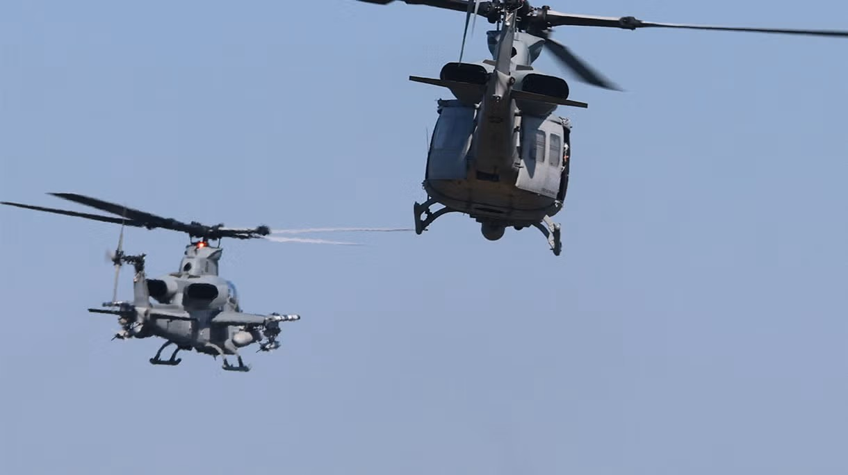



WOLF PACK
Low-rate production today
Build is digital, modular and standard
Full-rate production enhancements underway
Affordable cost
per effect
Easy to integrate,
easy to operate
Brings mass chaos
to the fight
High tech, high maturity
History of
accelerated delivery
Mission-ready effects
RAPID DEPLOYMENT
SCALABLE
PRODUCTION
SIGNIFICANT
ADVANTAGE
Image credit: Navair

