Slide 1
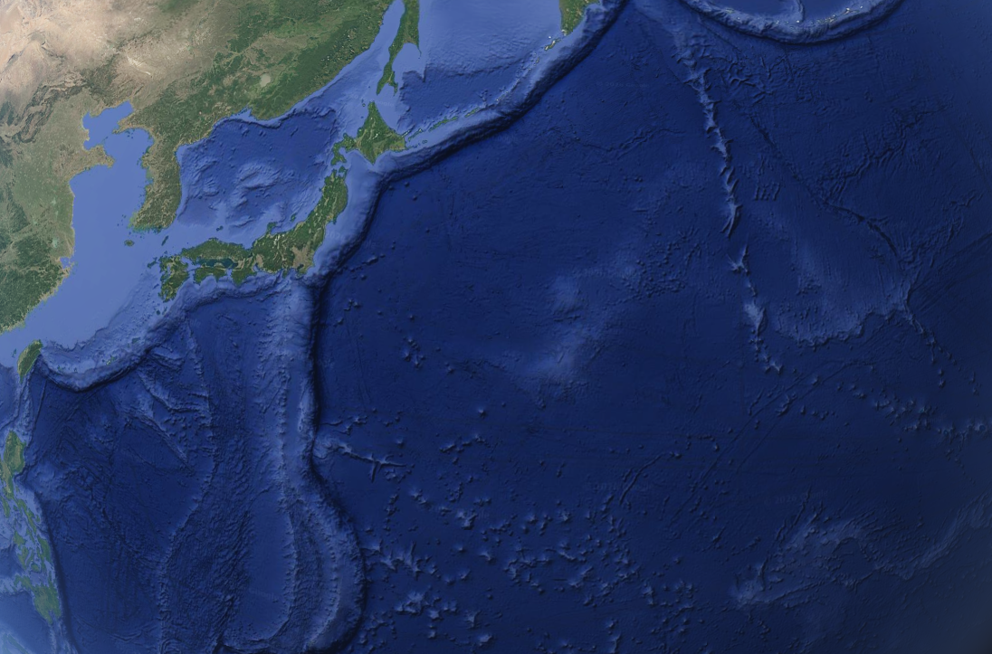
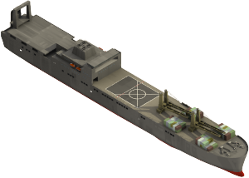
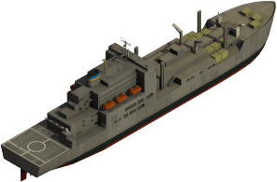
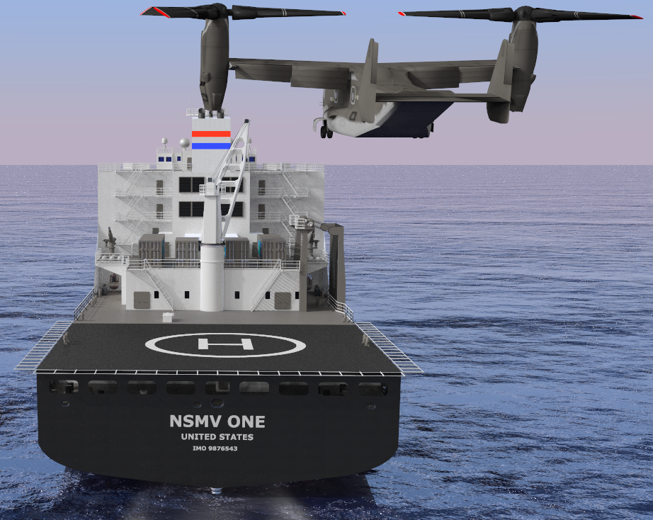

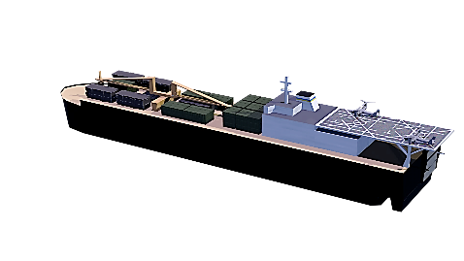



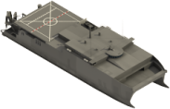

Future MAGTF Support Squadron Regionally Aligned & Globally Deployable
Expeditionary Roll On Roll Off Capacity Vehicle Cargo (T-AKR) | Logistic hub & Sustainment Cargo, fuel Ammunition (T-AKE) | Expeditionary Transportable Repair System (T-ETRS) (T-AVB Recap) | Connectors: INLS Future Connector | Expeditionary Prepositioning MPS(X)
Large equipment capacity (300K ft² each) Floating parking garage to store and maintain equipment in harsh climates Rapid offload in a large deep-water ports using articulating ramps Future organic surface connectors enable sea-based distributed offload (in-stream) | Unitized cargo to support smaller distributed forces and logistic hubs 1,969K gals of fuel for ships and aircraft Parts warehouse sustains aviation and ground operations and the Joint force | Resilient logistic support to sustain distributed aviation & ground operations Battle damage repairs Supports afloat autonomous logistic system distribution Mobile facilities support airfields and logistic hubs ashore and afloat reducing reliance on vulnerable infrastructure Mobile loaded, flexible configurations support supply and repair of multi-mission systems | Digital Autonomous Surface Sub surface Air | Commodity versatility Flexible vertical and surface connector access Swift Response months ahead of strategic sealift surge Global inter-theater reach Scalable to the crises mission requirement Tailored capabilities for distributed maritime operations
Tailorable, effective, efficient commodity offload & distribution | Inter-theater endurance and logistics | Mobile building blocks support MARFOR ‘O to D’ repair and maintenance | Enable littoral access interoperability & survivability | Next Generation Prepositioned Roll On Roll Off Cargo Container Ship
MPF Next Generation: Forward postured to enable campaigning, crisis, and contingency response. Key element of the Global Positioning Network. Provides the value of concentration without the vulnerability of mass

