Slide 1

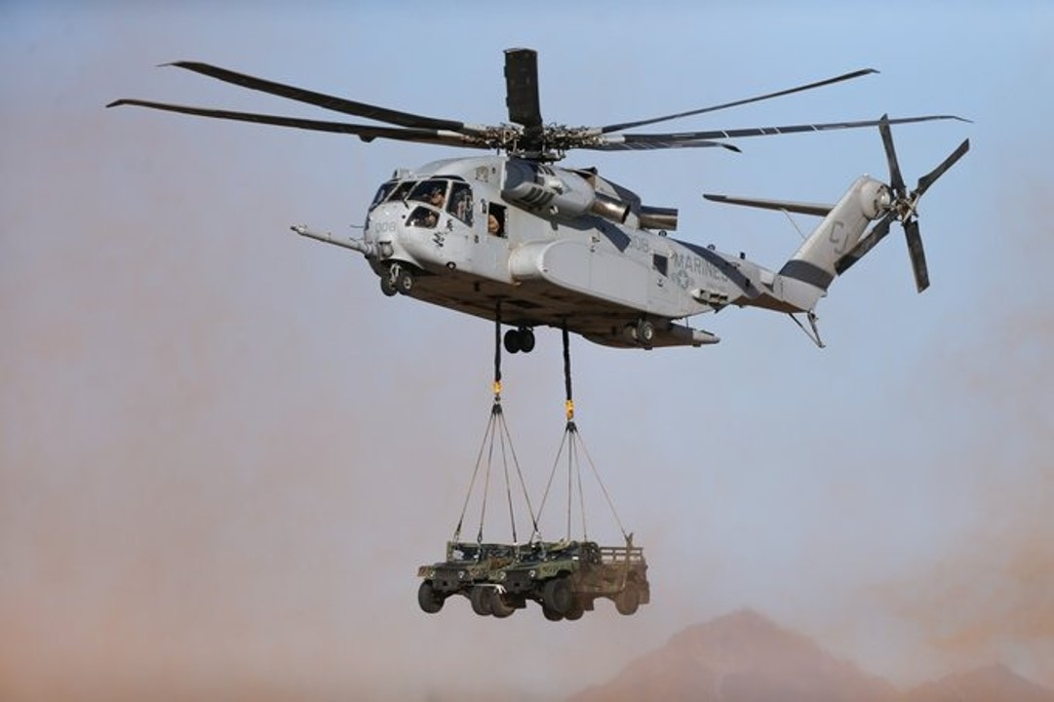
CH-53K King Stallion Update: a framework for sustainment
Modern Day Marine
Washington, D.C.
29 April 2026
Modern Day Marine
Washington, D.C.
29 April 2025
Colonel Kate Fleeger
Program Manager
H-53 Heavy Lift Helicopters
Program Office (PMA-261)
U.S. Marine Corps

Slide 2


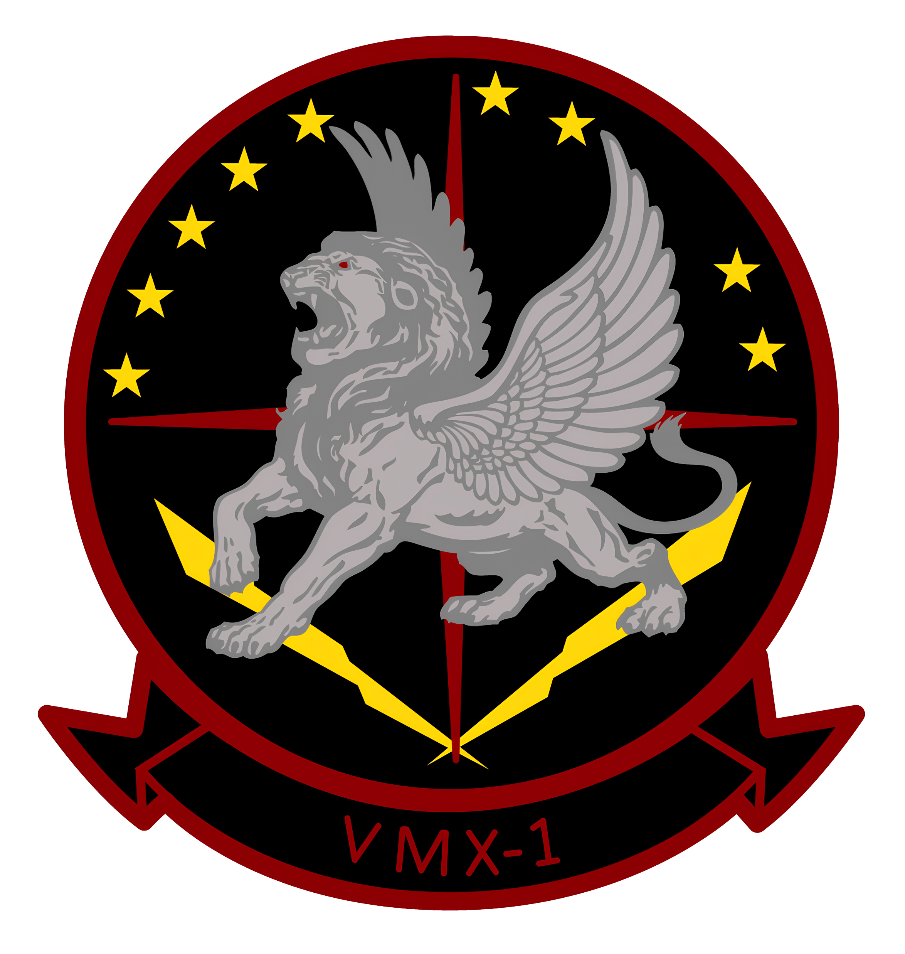
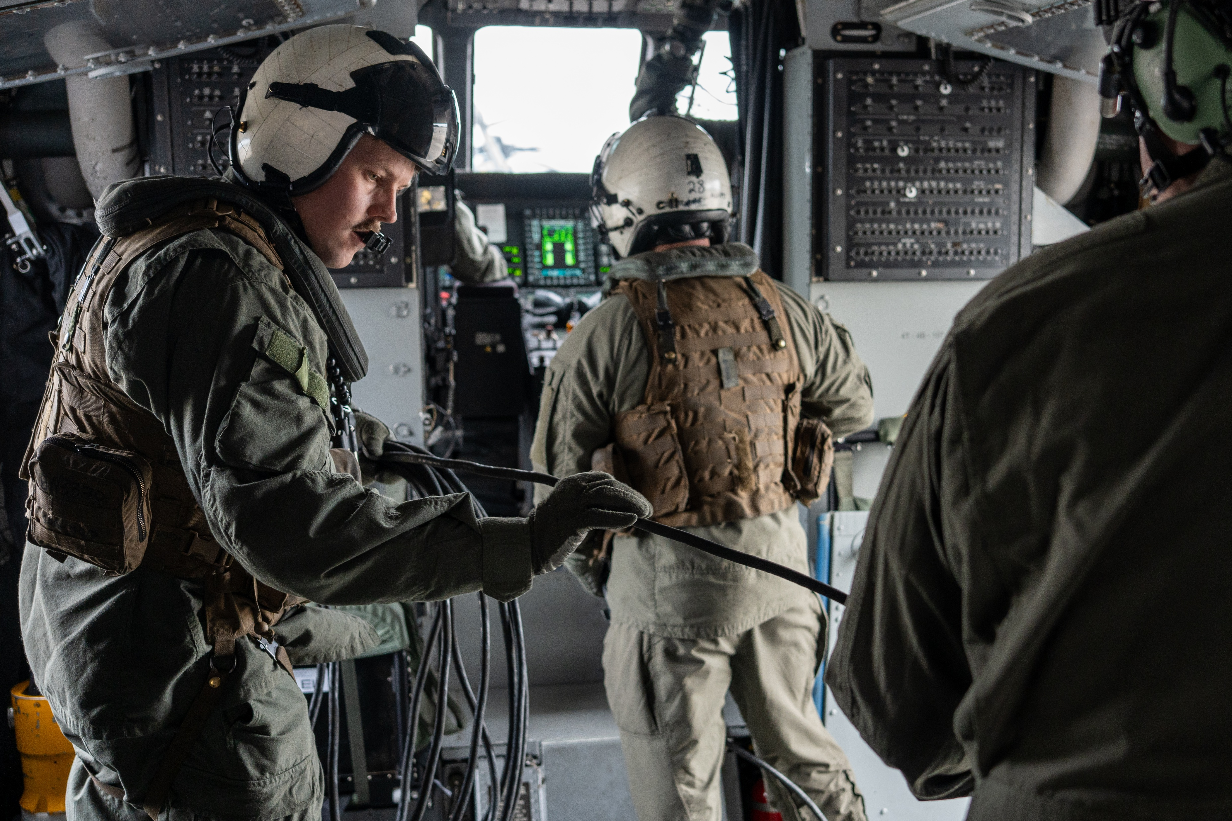
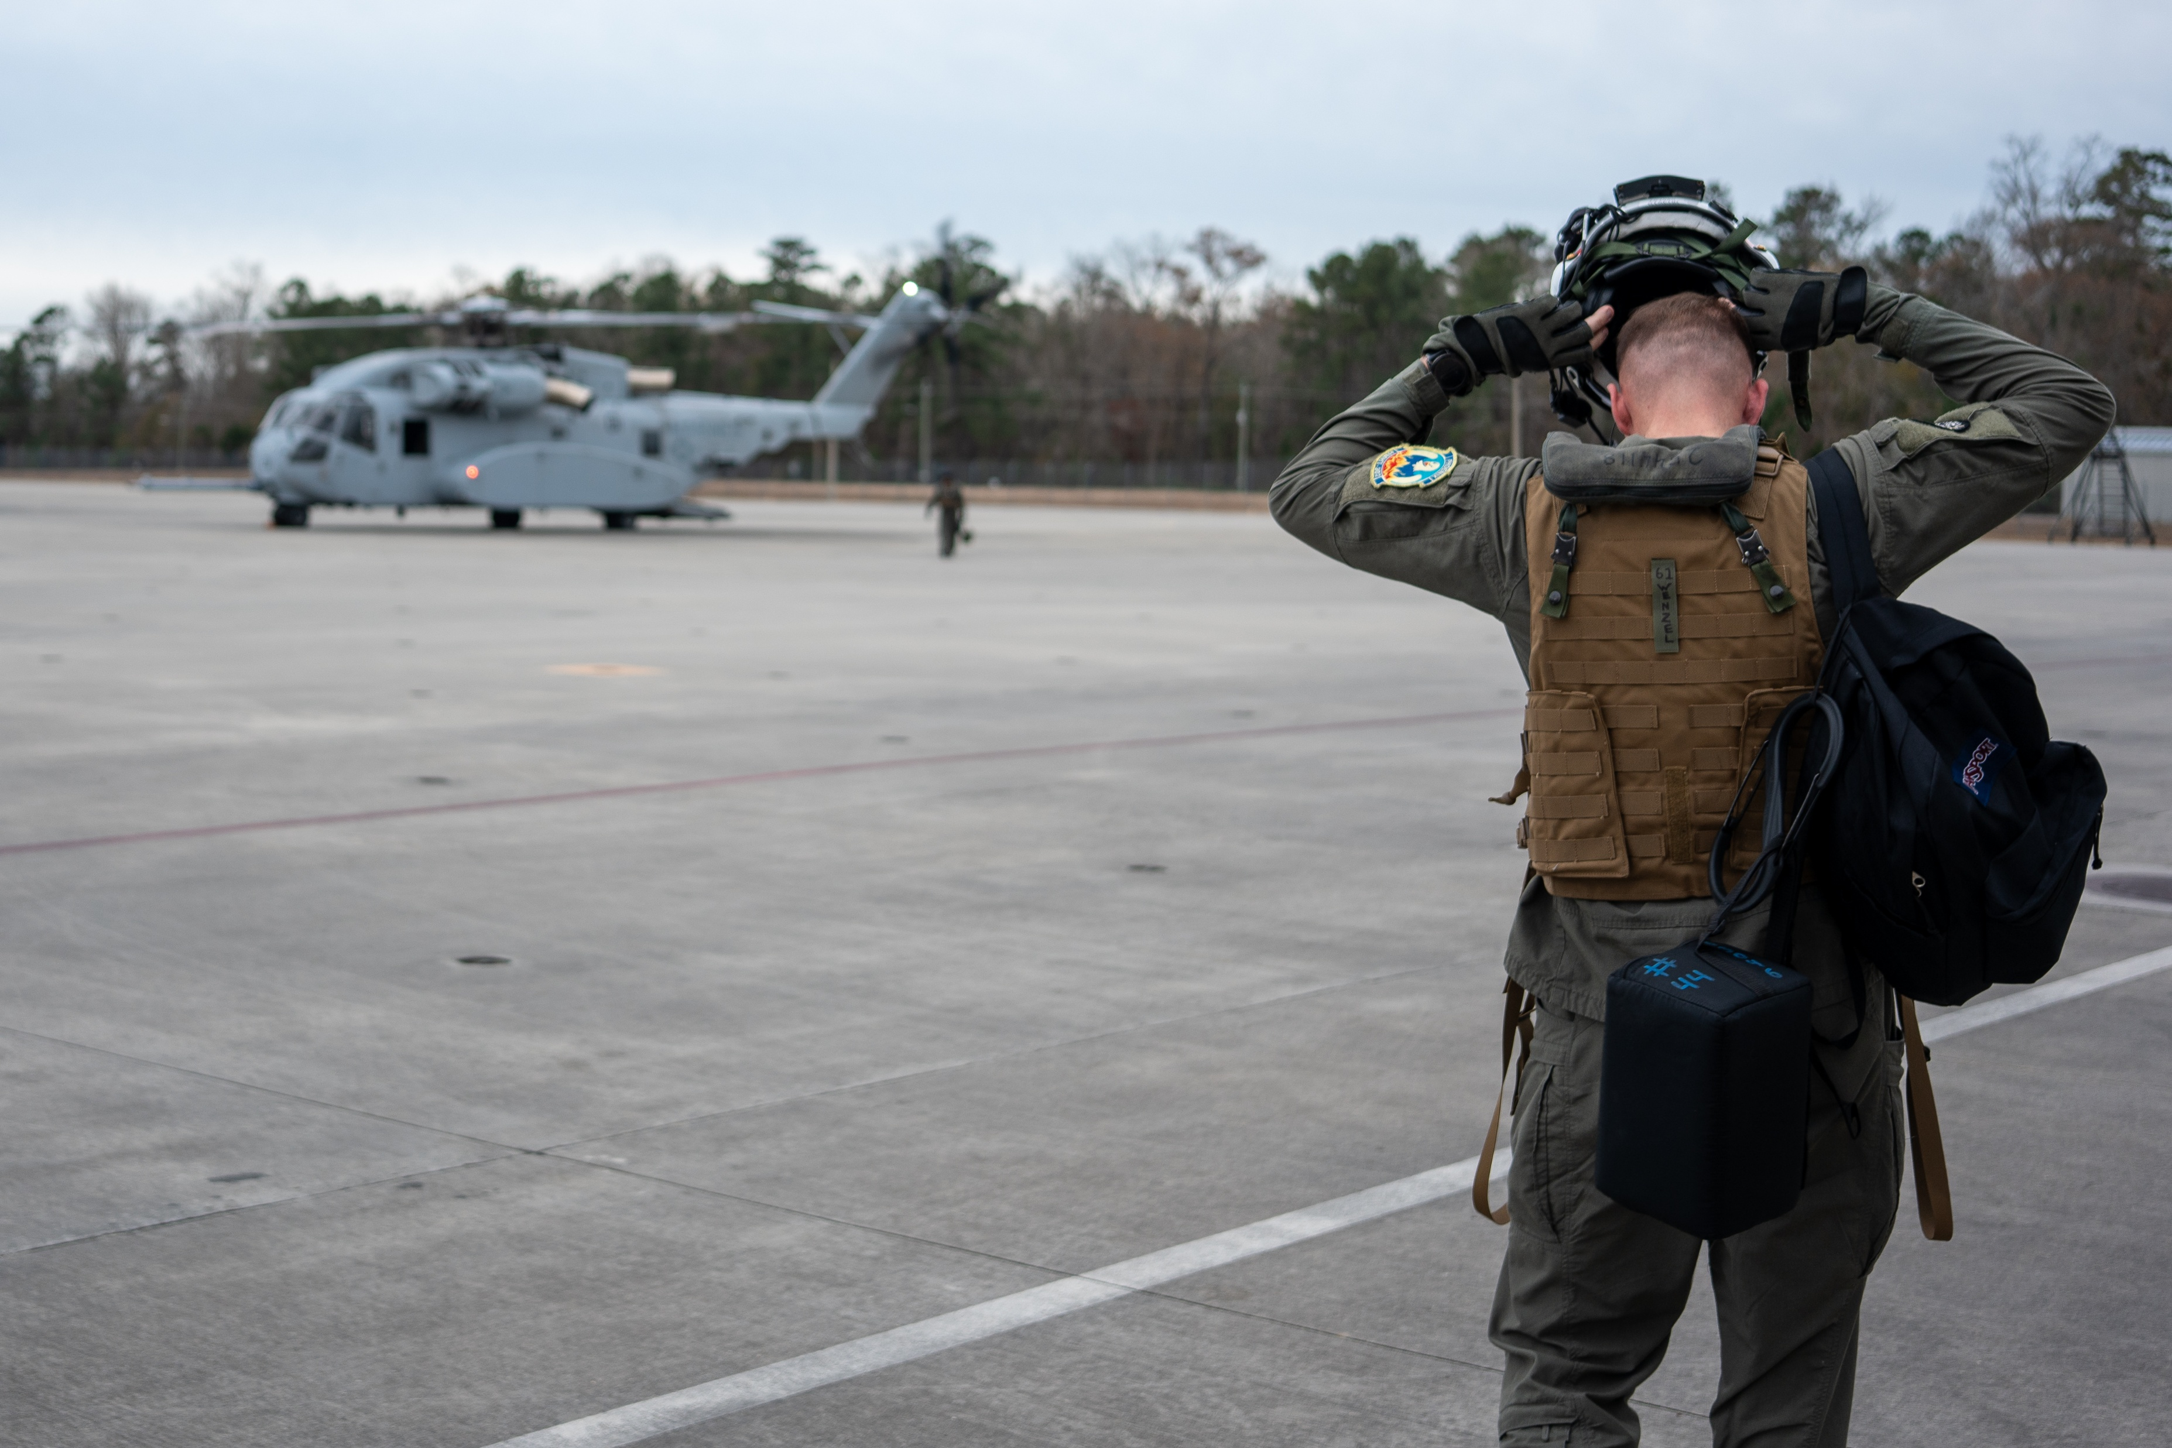
CH-53K in the Fleet

Slide 3
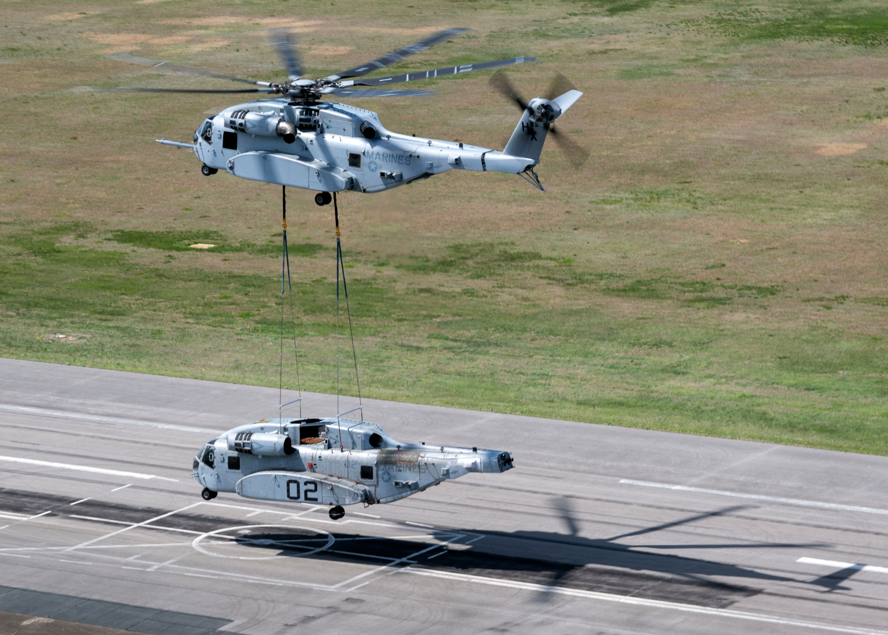
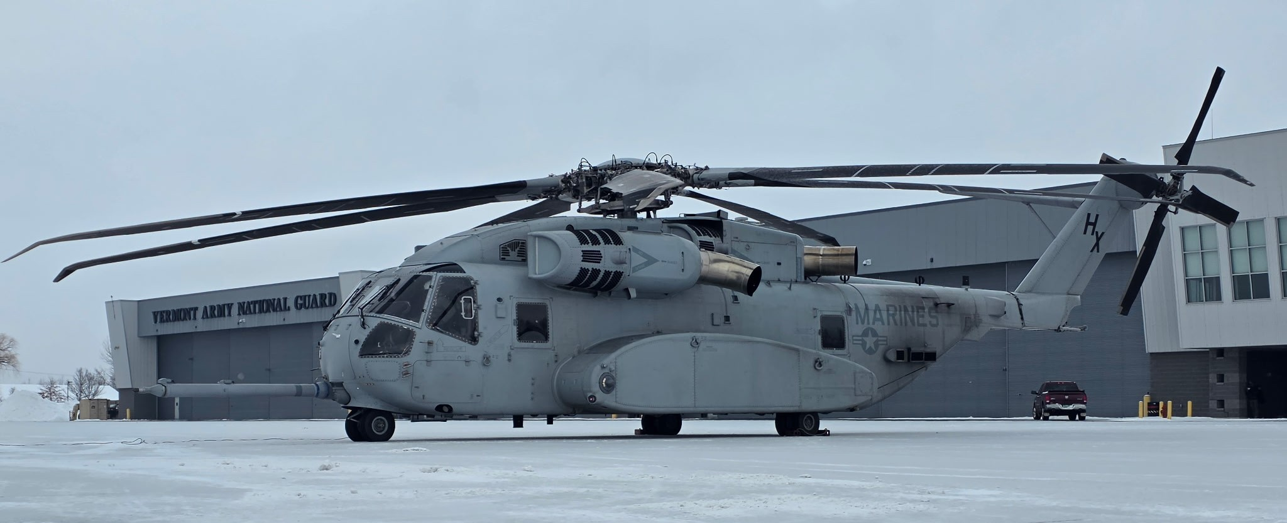
testing aircraft
Notes:
Left image – cold test in Vermont, January ‘26
Right image – lift of EDM CH-53K test in April ‘26

Slide 4
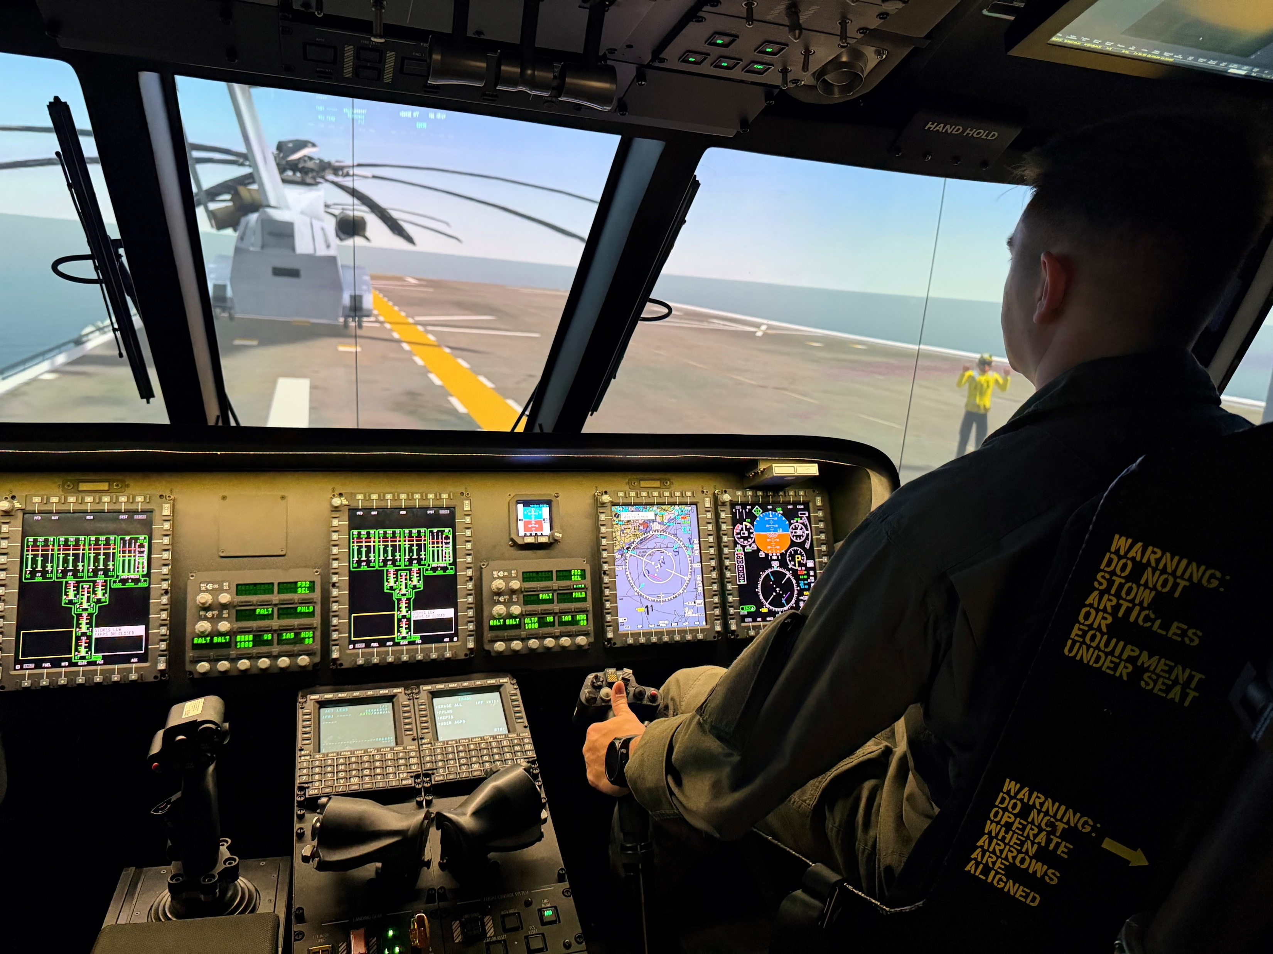
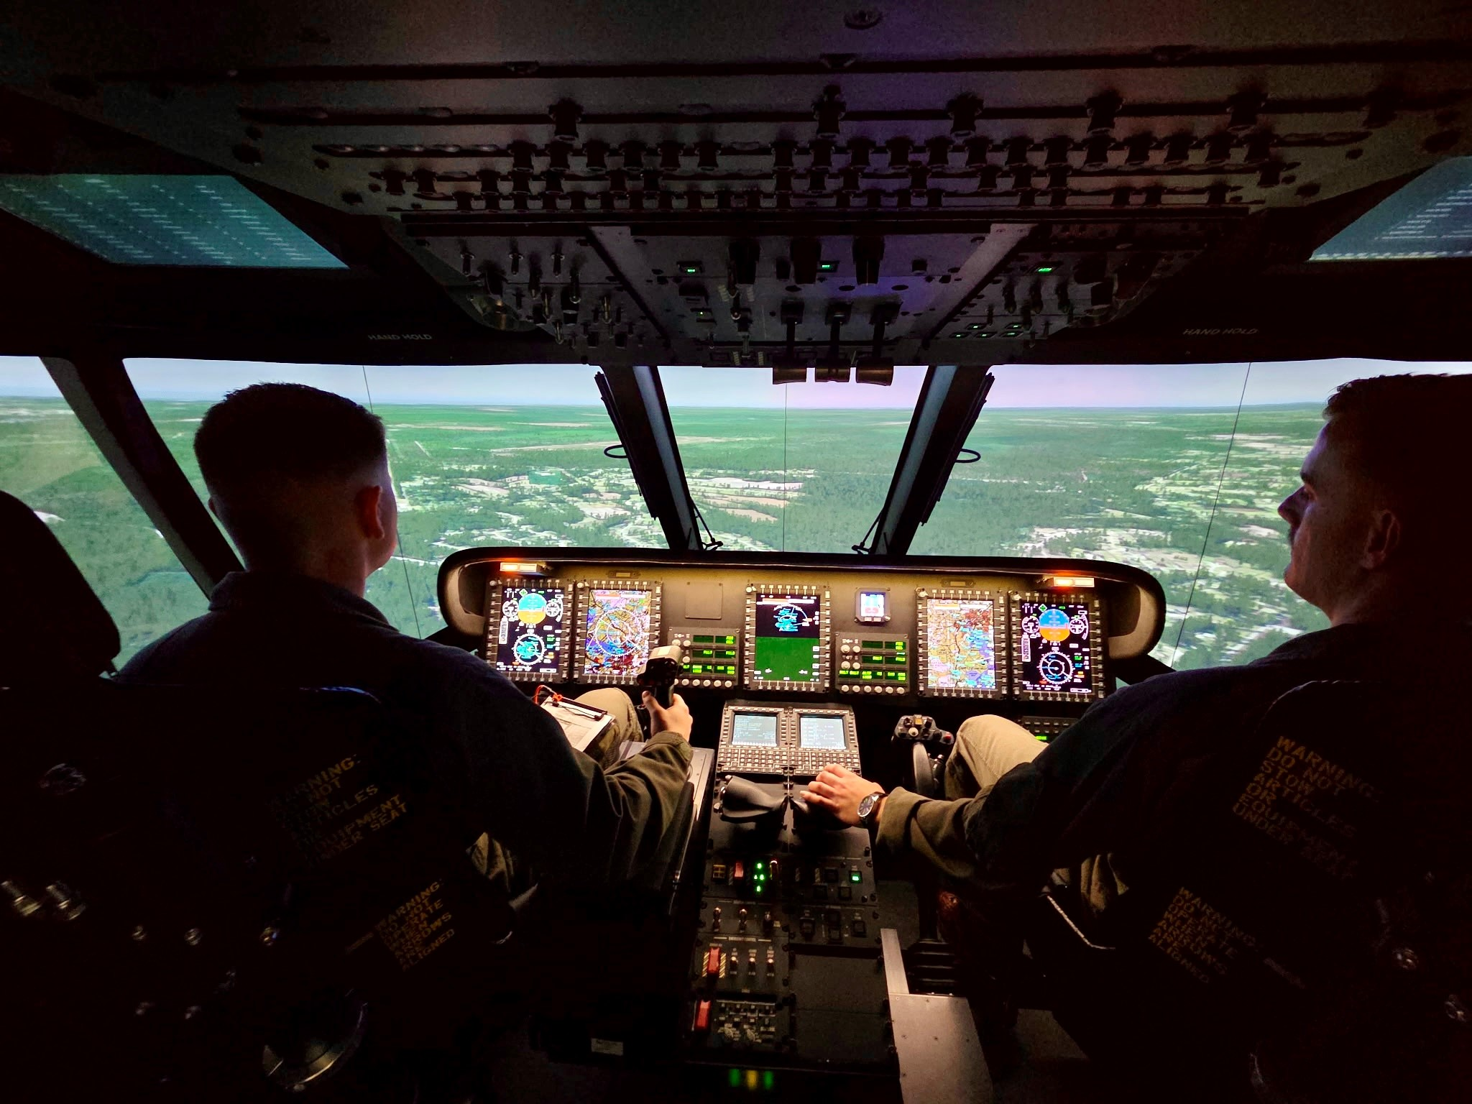
training pilots
Notes:
Images from one of three Containerized Flight Training Devices delivered in the last year (this one is in New River, NC)

Slide 5
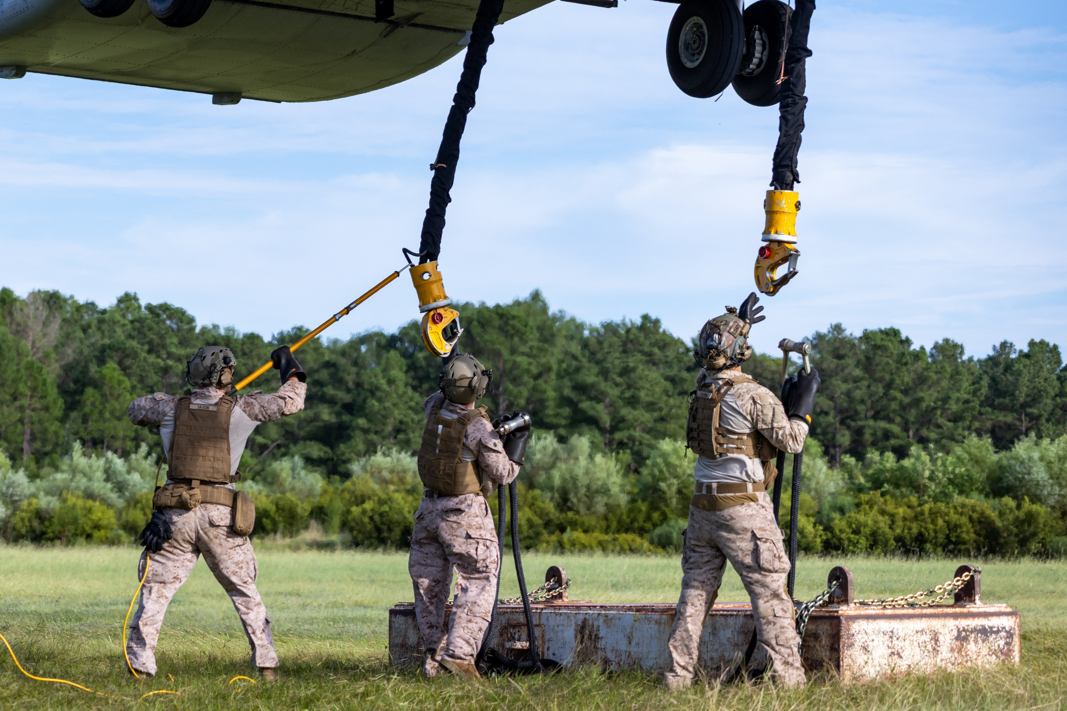
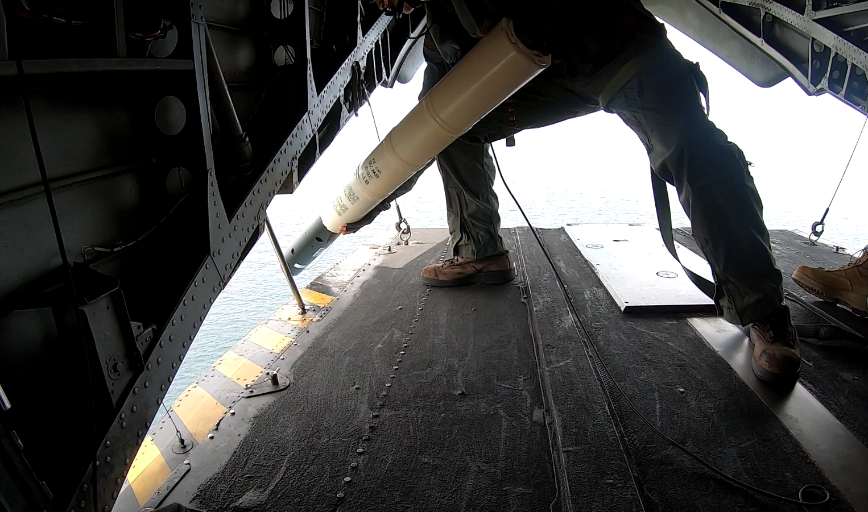
training Marines

Slide 6

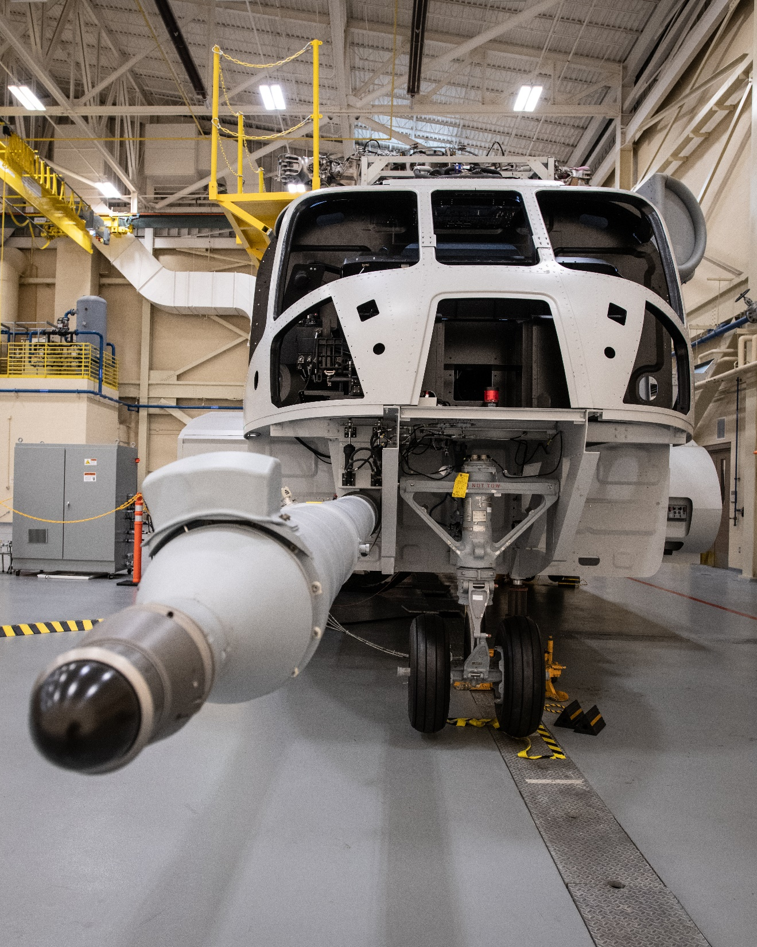
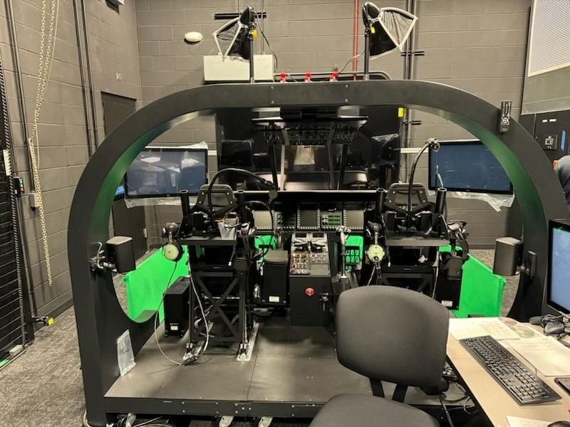
    Containerized Flight Training Device
    Composite Maintenance Trainer
    Advanced Aviation Training Device
    Classroom & Courseware

Slide 7
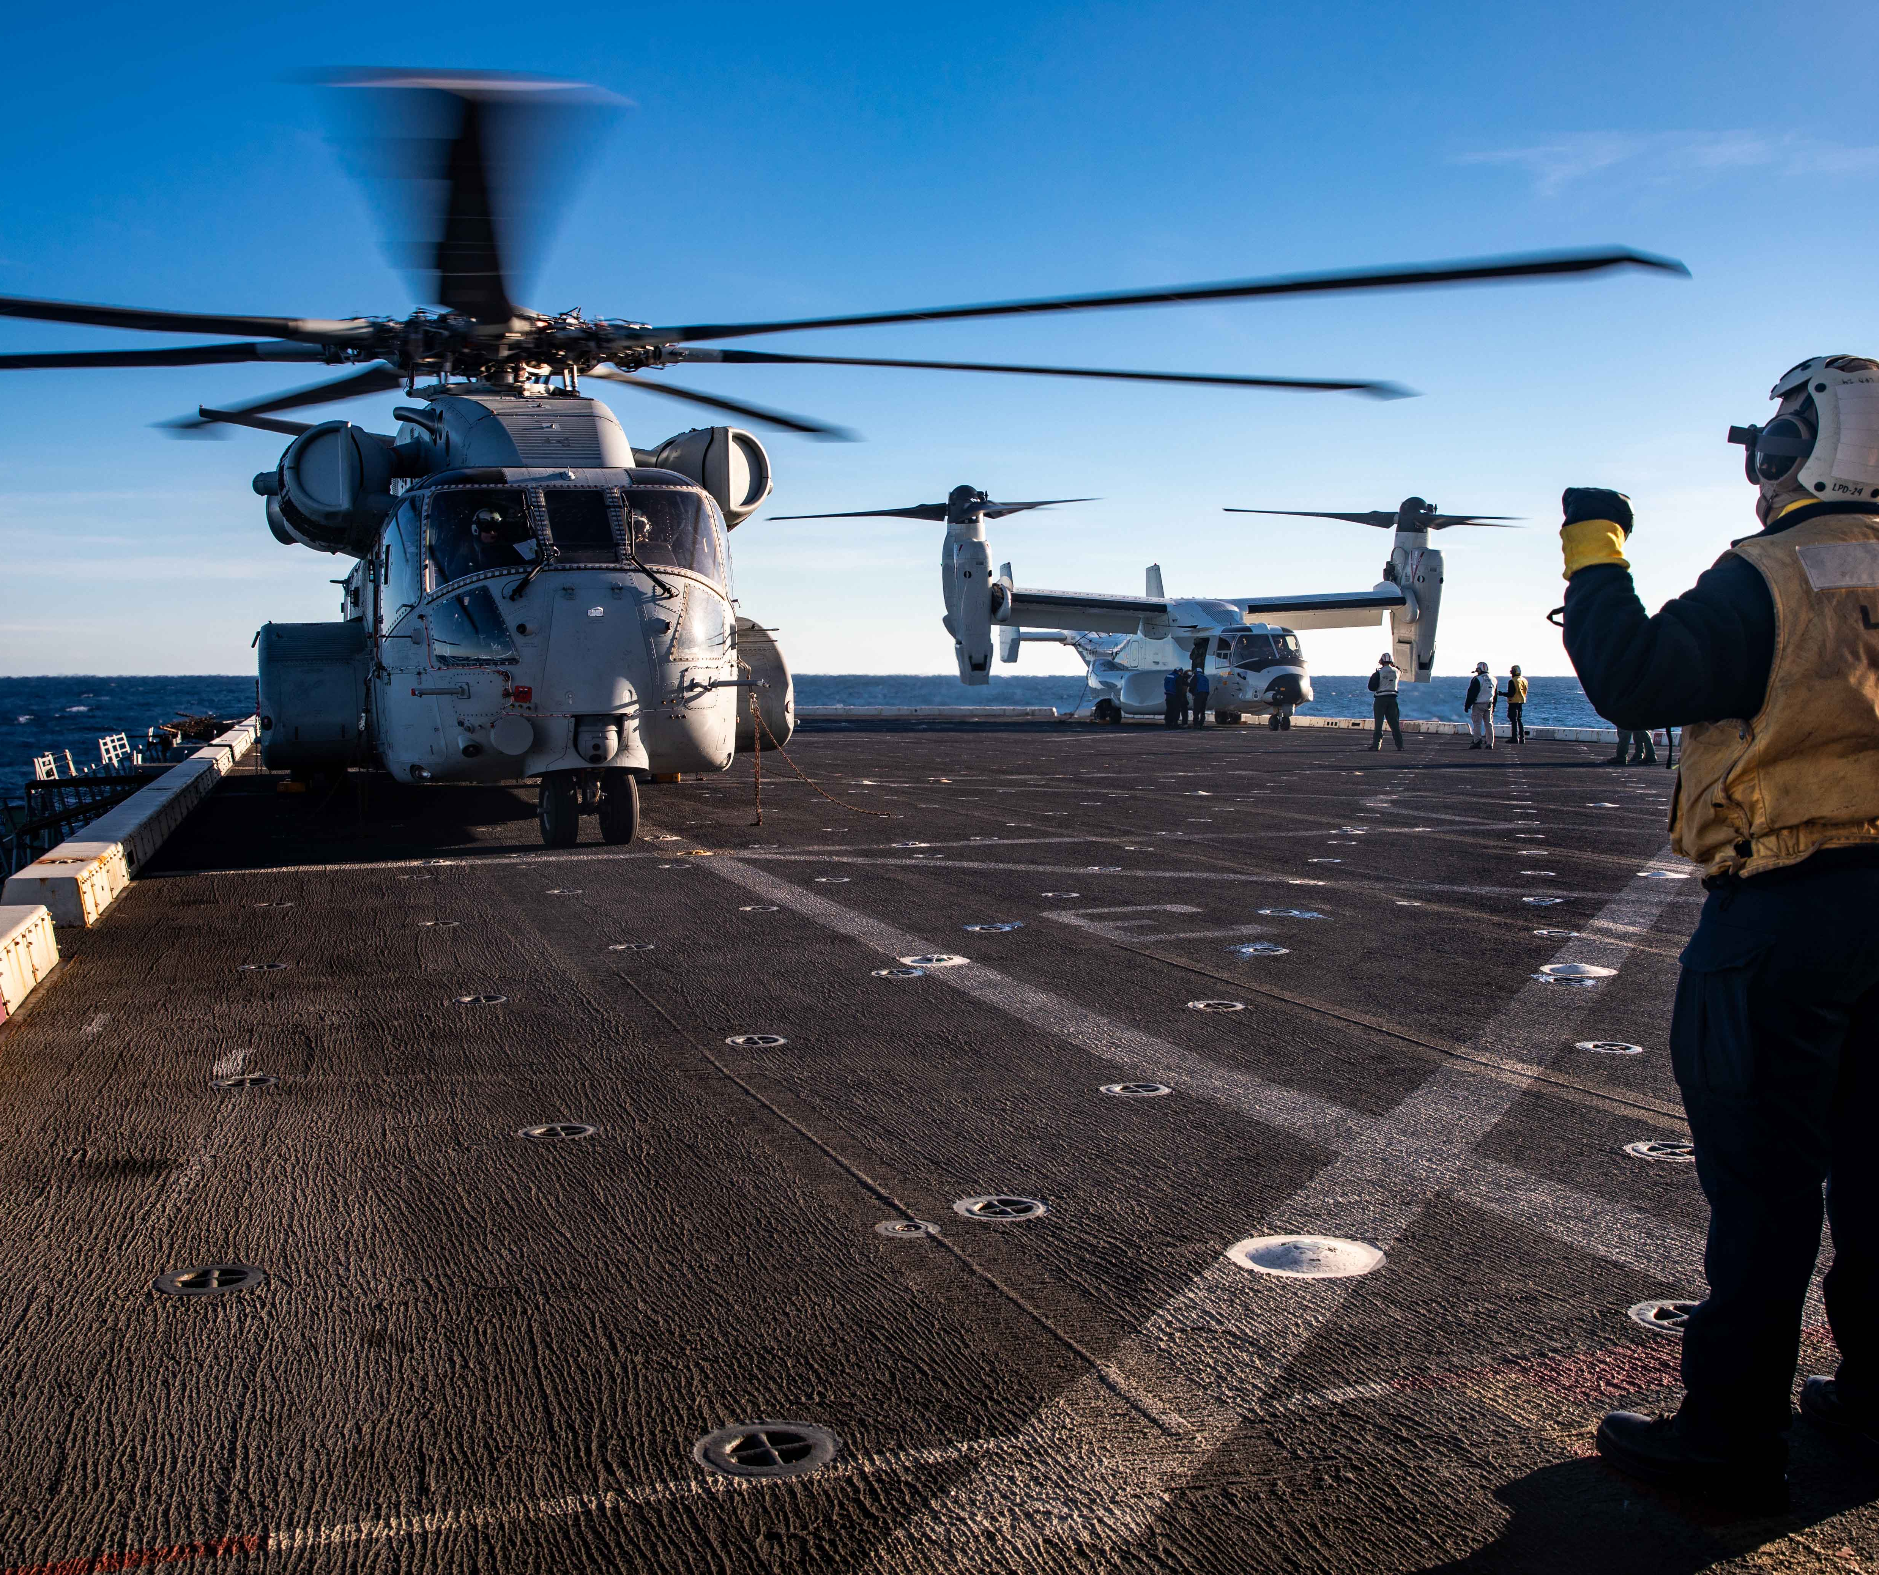
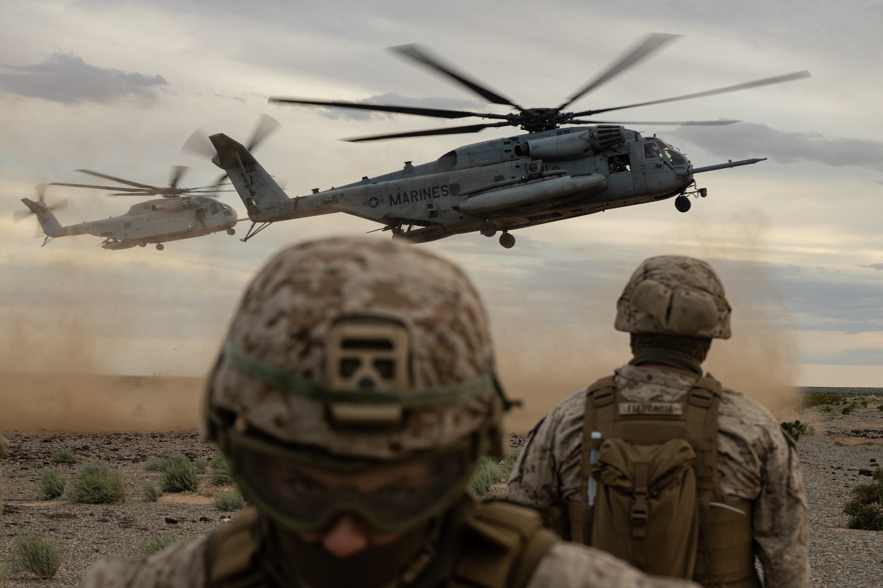
preparing to fight
Notes:
Left image – shows CH-53K in background – working with CH-53E
Right image – CH-53K during sea trials aboard the USS Arlington

Slide 8
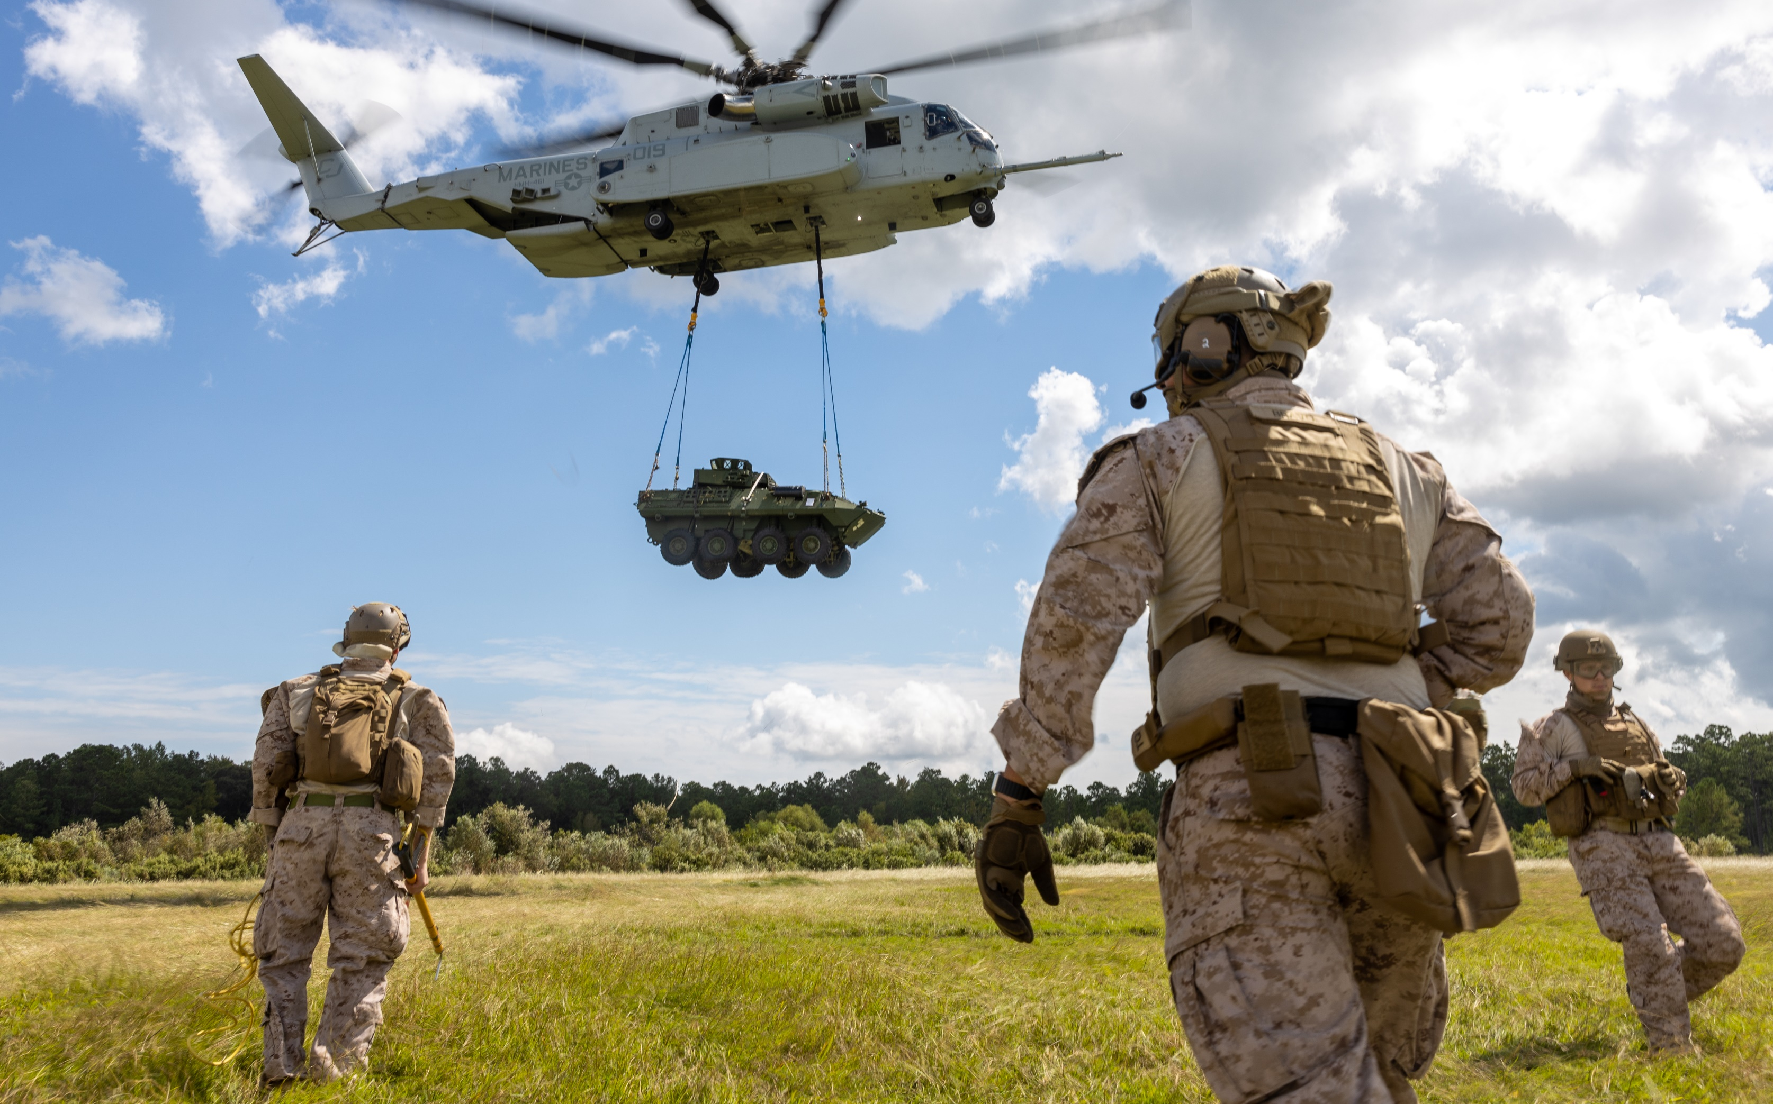
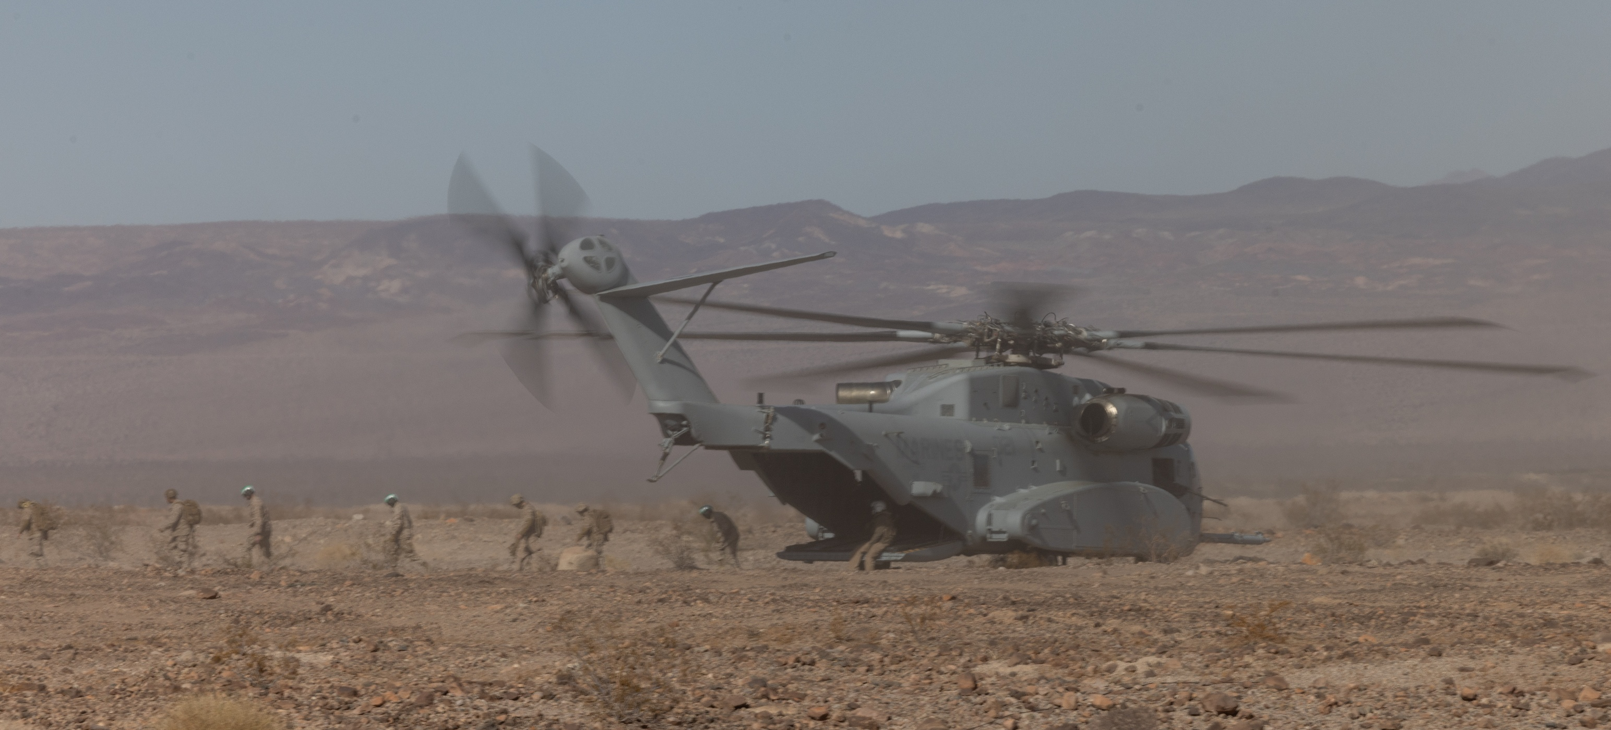
first deployment
Notes:
Left image – HMH-461 conducts aerial delivery and external lift training at SLTE
Right image – a CH-53K lifting a LAV during WTI

Slide 9
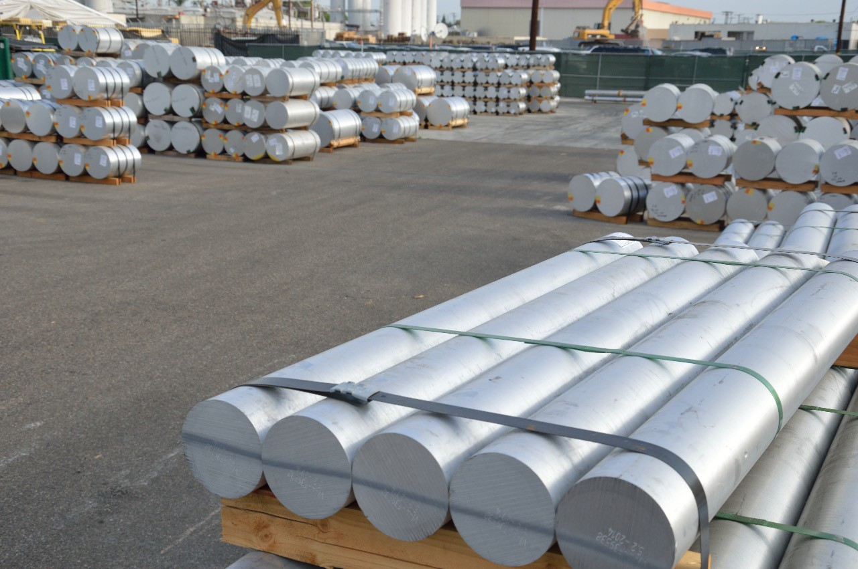
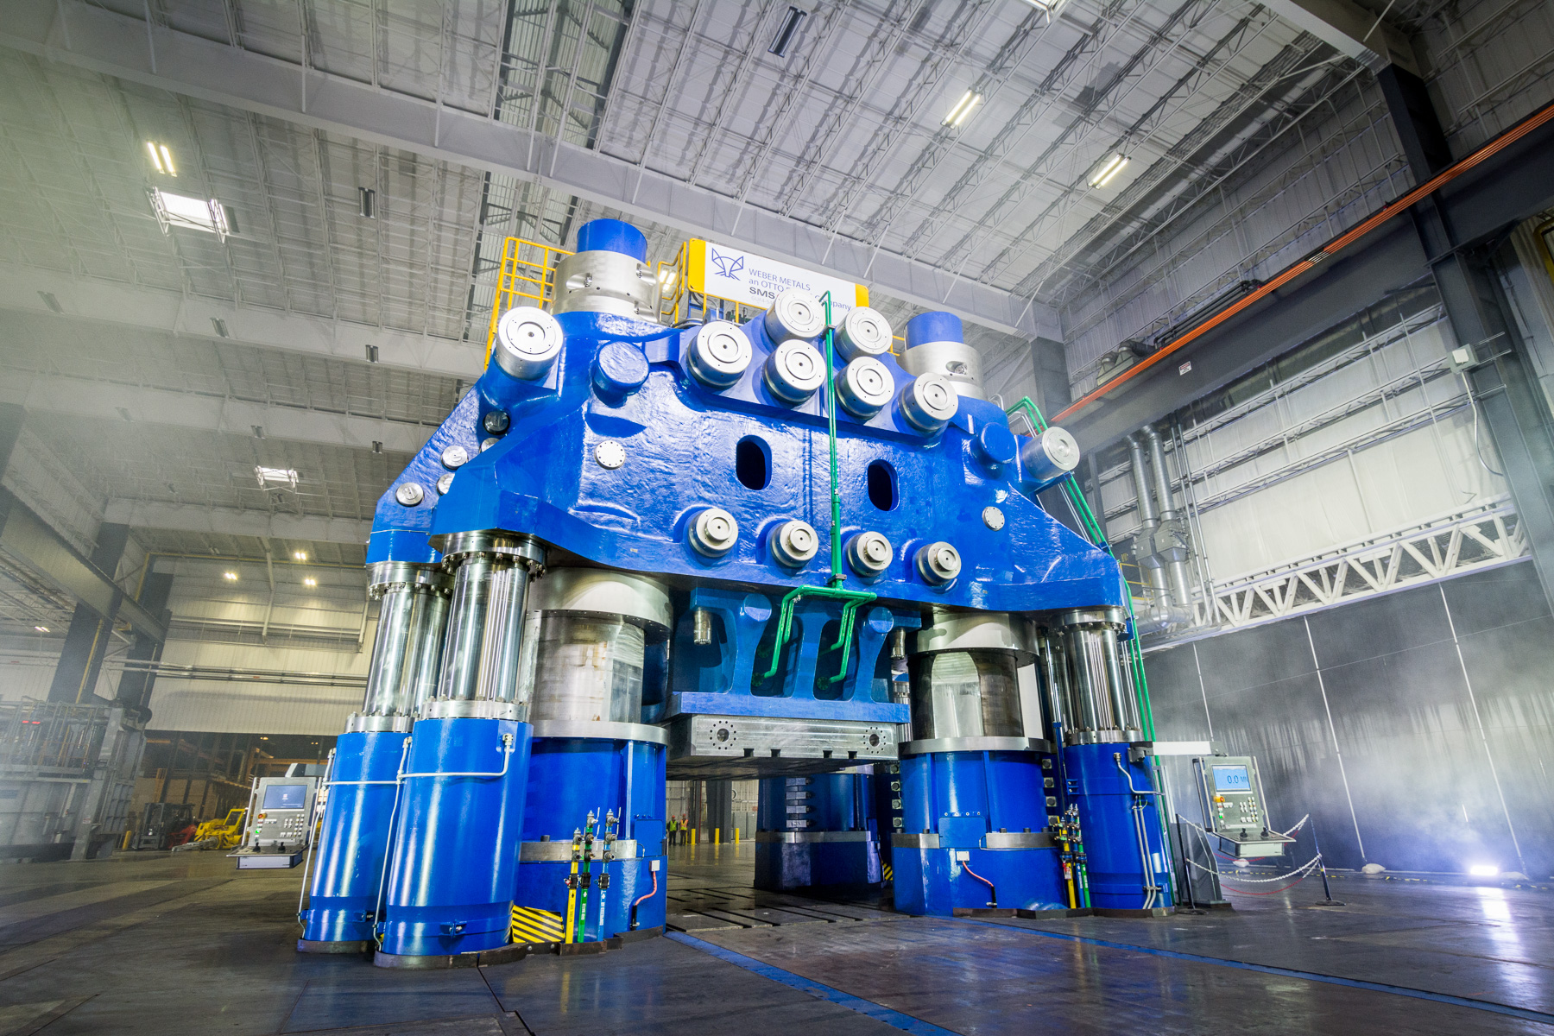
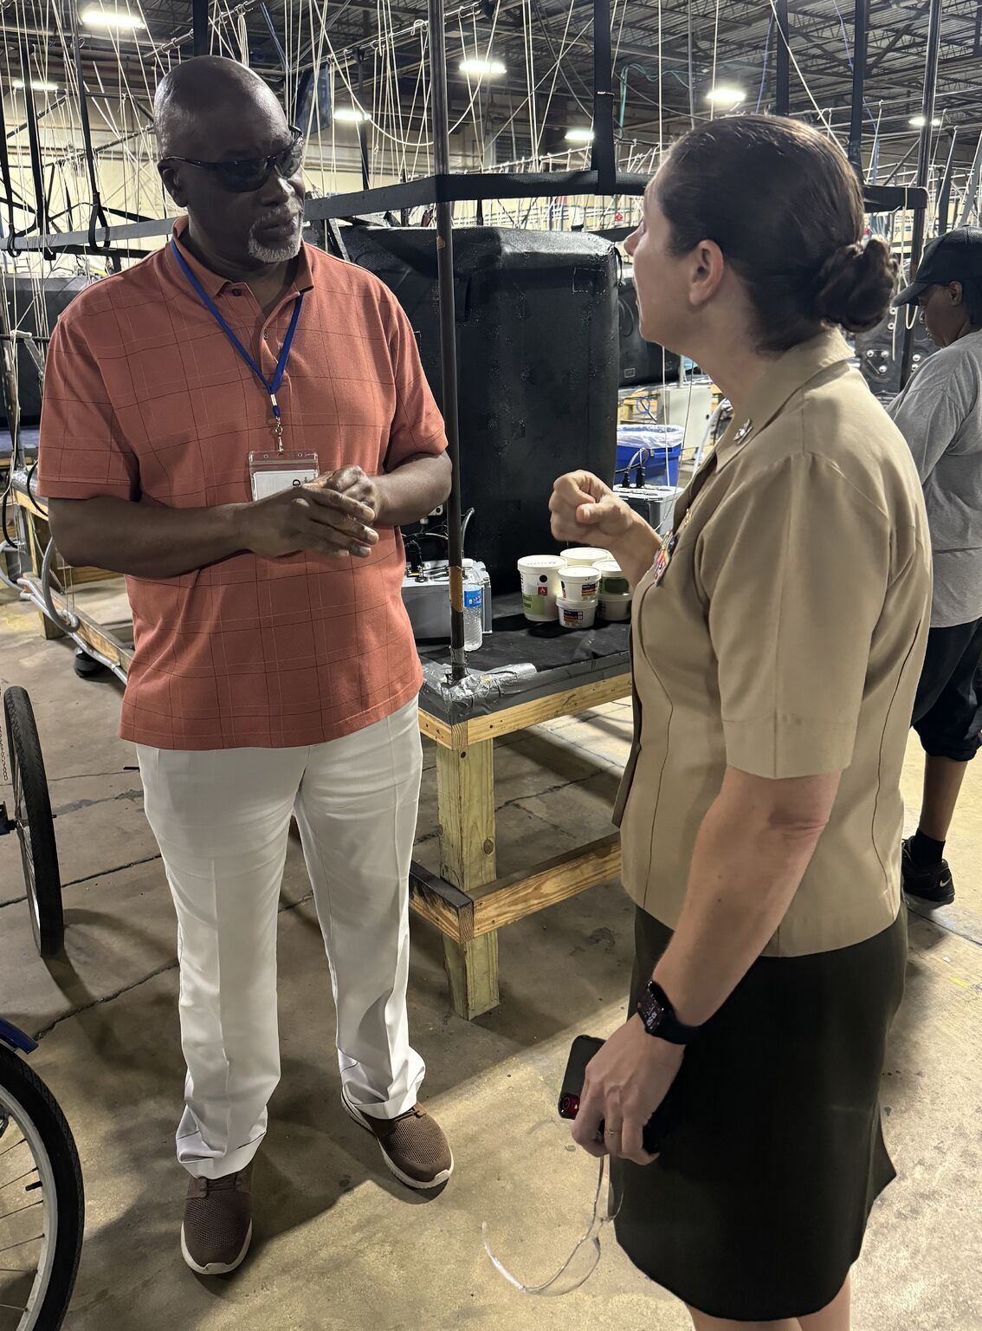
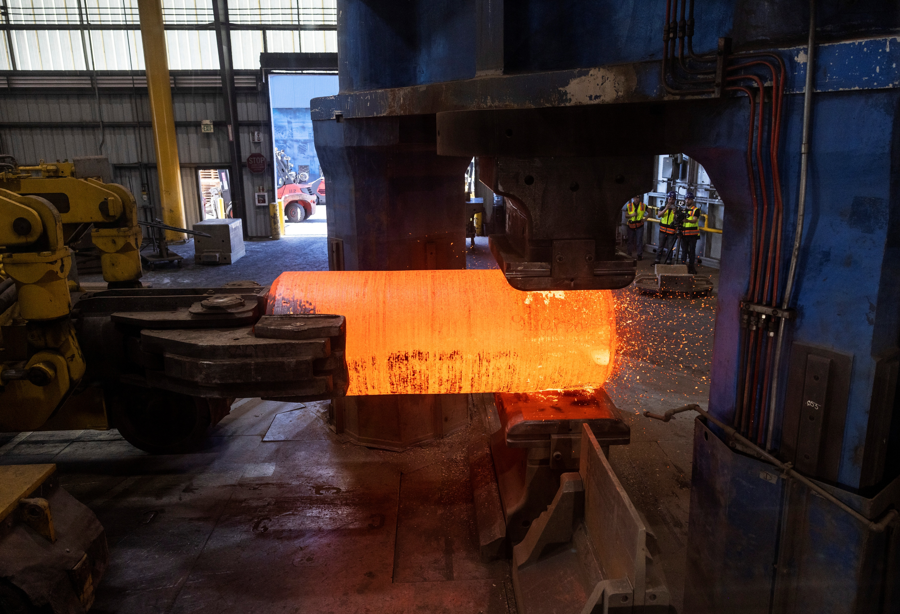
ensuring
sufficient
spares
Notes:
Left image – Weber Metals
Middle Image – Weber Metals

Slide 10
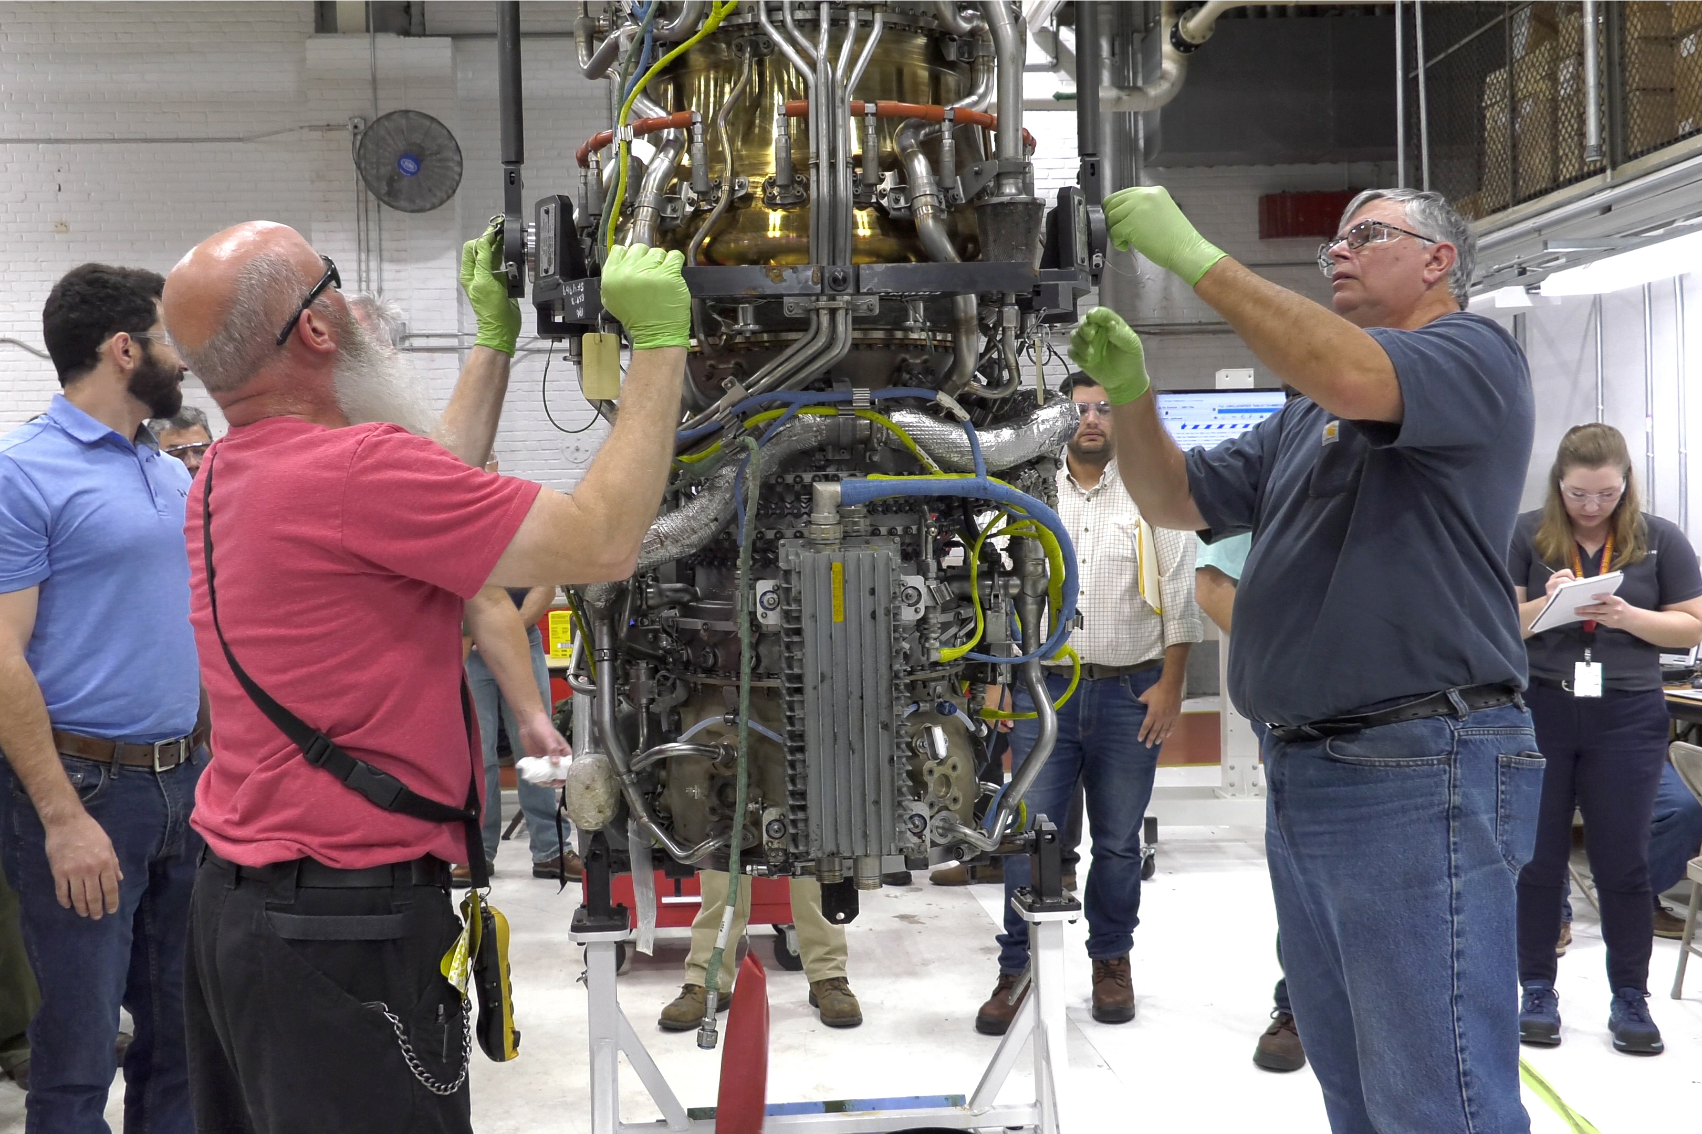
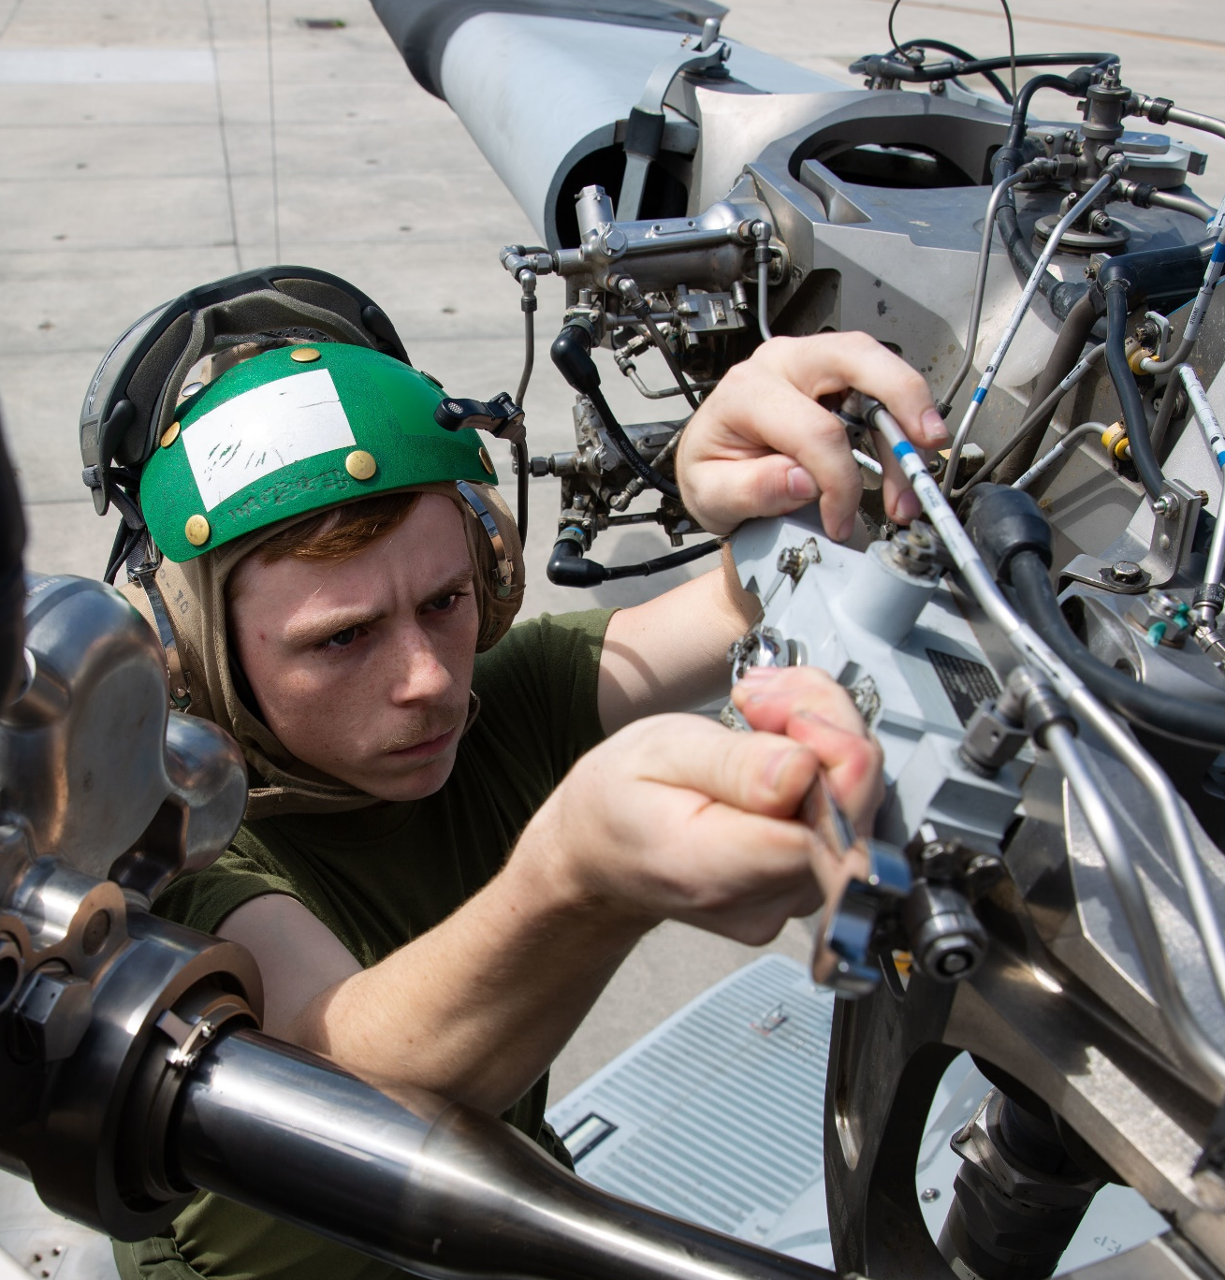
repair capabilities

Slide 11
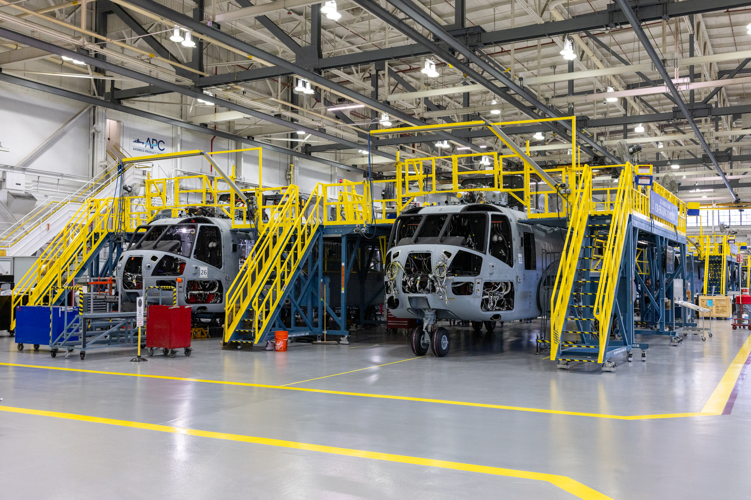
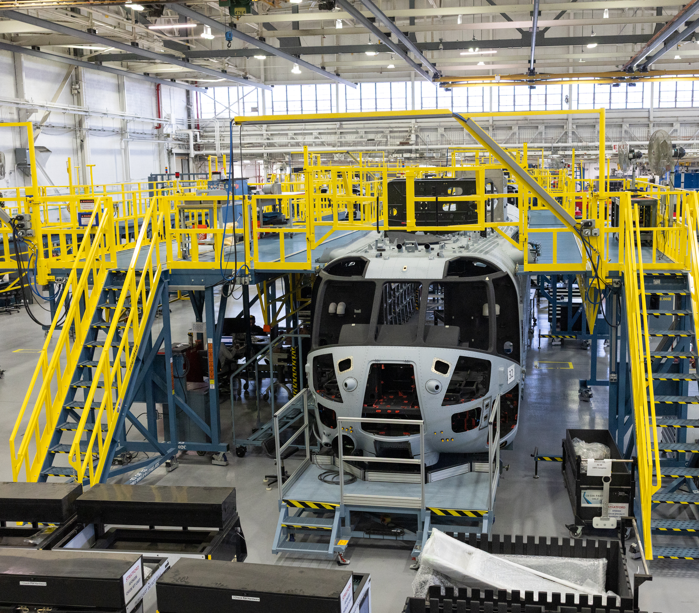
behind the
scenes

Slide 12
Provide stability to industrial partners
Incentivize investment:
  personnel
  process improvement activities
  facilities
  equipment
Continue production without interruptions for the contract period of performance
Improve production efficiency
Eliminate administrative burden of annual contracts
five-year impact

Slide 13
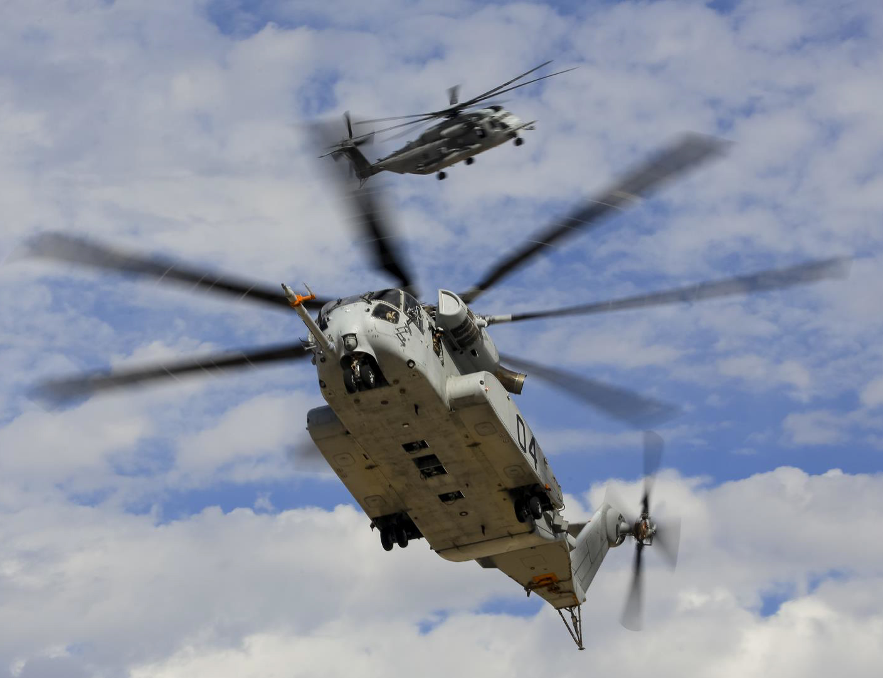
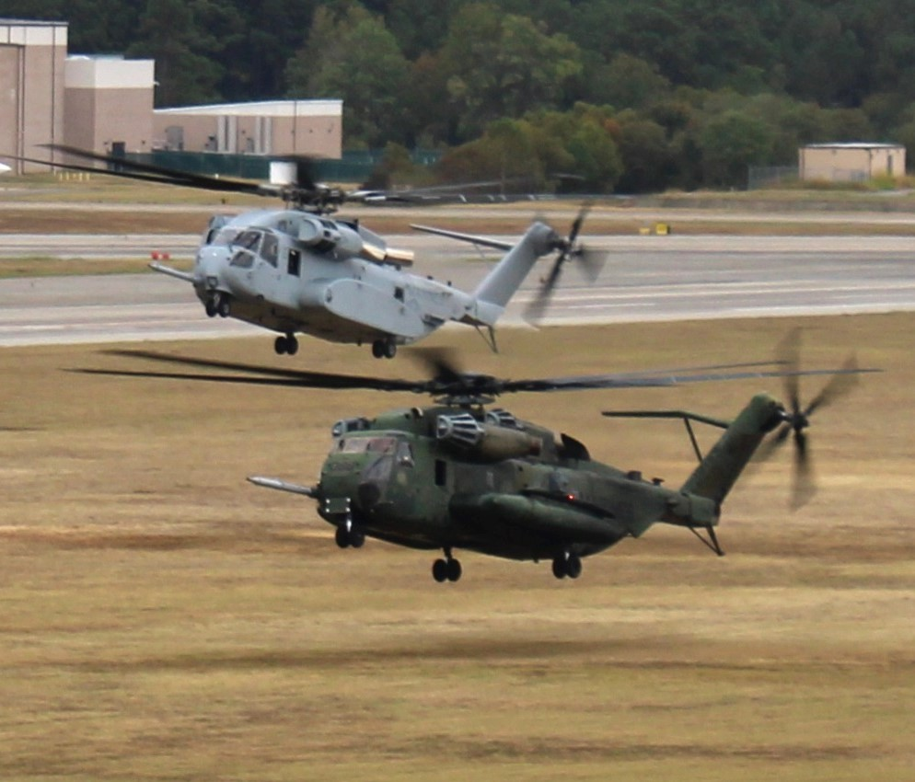
phased transition

Slide 14
?
questions
Notes:
Questions

