Slide 1
Buying at the Speed of War: Leveraging Commercial Technology to Gain the Advantage
Captain White, Captain Miller,
Captain Arvizu, Captain Cavanagh, Captain Jones
*DISCLAIMER: All views and opinions presented in this brief are those of the presenters and are not reflective of the United States Marine Corps or Department of War.

Slide 2
Agenda
Problem Framing
  Assignment Context
  Cumbersome Nature of Acquisitions
  Ukraine Case Study
Proposed Solutions
  COA 1: COTS* Unit Budget
  COA 2: COTS Integration Cell
Timeline comparison
Risk Management
*COTS: Commercial Off The Shelf

Slide 3
Problem Framing

Slide 4
Assignment Context
Assigned Research Question:
Russia and Ukraine Retrospect: What force development process should the USMC make to optimize commercial technology integration?
Targeted Research Questions:
1) What is the USMC process for purchasing COTS equipment?
2) How have Ukraine and Russia fielded COTS technology in their current conflict?
Problem Statement: The current process for acquiring and fielding COTS technology is cumbersome and will not meet the emergent needs of the rapidly changing modern battlefield.

Slide 5
Cumbersome Nature

Slide 6
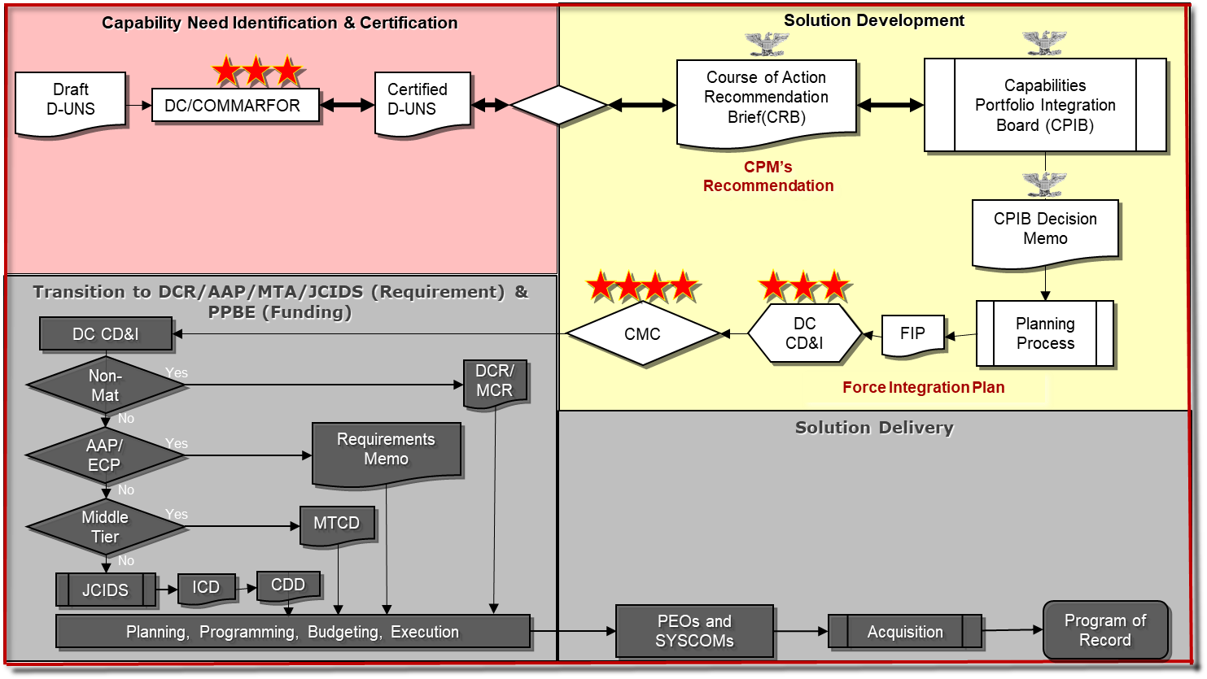
Deliberate Universal Needs Statement (DUNS)
Notes:
Marine Corps typical deliberate acquisitions process is shown above. This is used to develop program of record needs. We focus on the Urgent universal needs statement *transition*

Slide 7
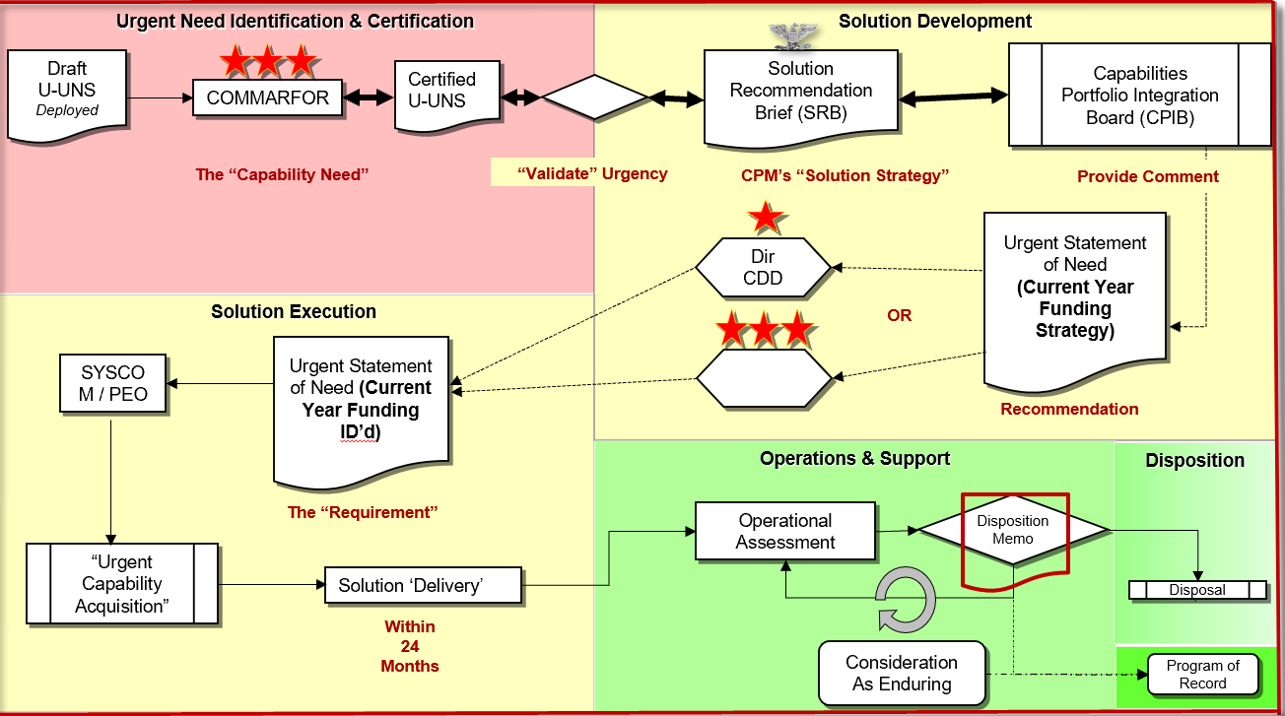
Urgent Universal Needs Statement (UUNS)
SYSCOM / PEO
Notes:
USMC Urgent Universal needs process is meant to fufill combat requirements to avoid casualties or mission failure. Clearly this is a complex process that spans multiple commands and requires understanding of the acquisitions process to decipher. Before we can get to deciphering the process as a whole, lets discuss how the process is intiatied. *transition*

Slide 8
DUNS vs UUNS
DUNS:
G/O level approvals: 3
Total Steps: 15
SYSCOM / PEO
UUNS:
G/O level approvals: 2
Total Steps: 13
Notes:
USMC Urgent Universal needs process is meant to fufill combat requirements to avoid casualties or mission failure. Clearly this is a complex process that spans multiple commands and requires understanding of the acquisitions process to decipher. Before we can get to deciphering the process as a whole, lets discuss how the process is intiatied. *transition*

Slide 9
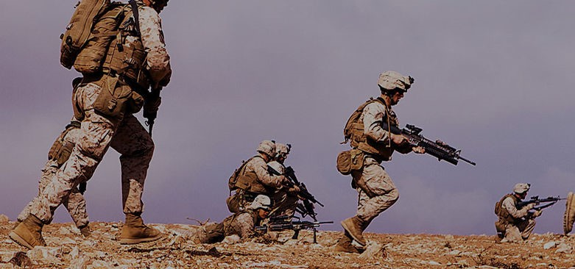
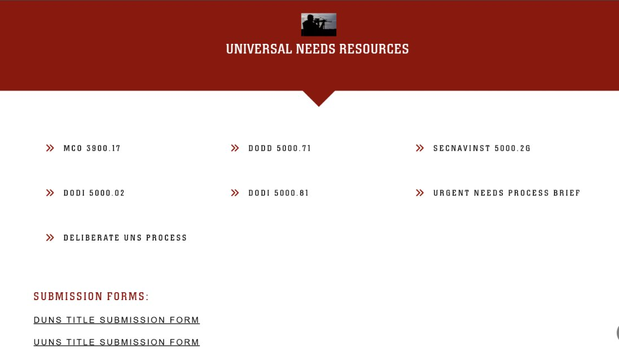
UUNS Initiation in Action
Marines identify an urgent need
Navigate to the CD&I Website and locate Universal Needs Resources
Notes:
Per the order, any marine can initate this process. So a marine identifies a need that can be filled by a COTS solution. The marine googles urgent needs process usmc and travels to the CD&I website, they start with the MCO *Transition*

Slide 10

Initiation Continued
Read the order
Identify broken link in the process
Notes:
After reading through the order it is clear that I need to logon to the virtual urgent universal needs statement (vUUNS) site so I go to the link and its broken. So I head back to the CD&I website *Transition*

Slide 11
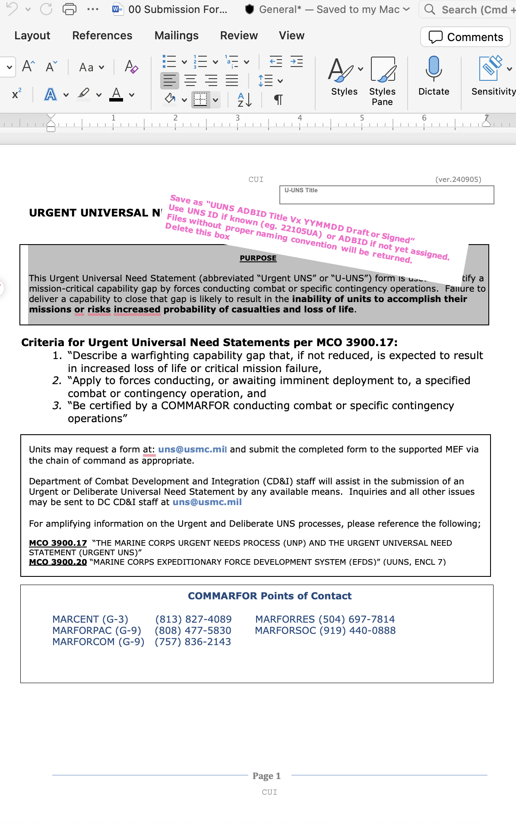
Initiation Continued
Return to the CD&I Website
Open 6 page UUNS Submission Form
Notes:
I choose the submission form and read through the criteria, random instrucitons and try to identify my COMMARFOR POC. *Transition*

Slide 12
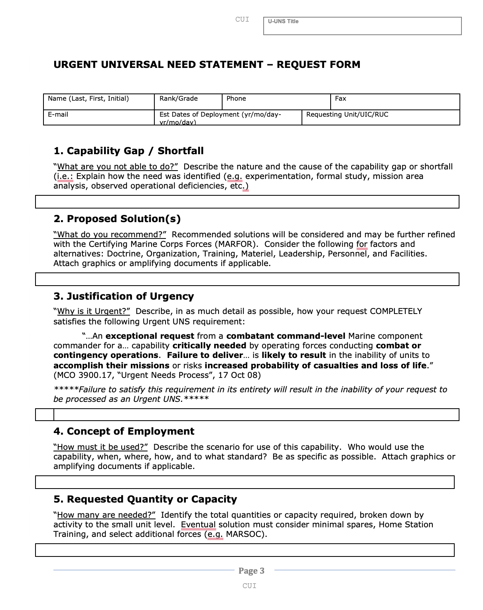
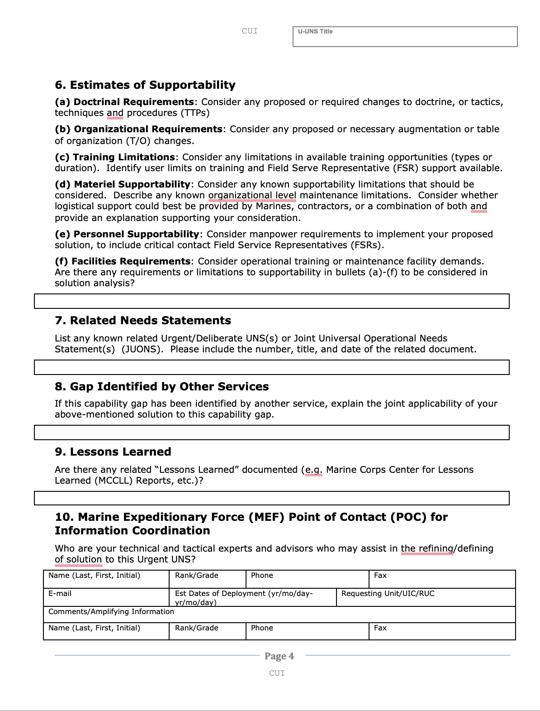
UUNS Submission Form Requirements
Notes:
I realize that I need to email this form, not through vUUNs as stated by the order and then track the form via email. Moving on to the next page ID the 6 steps that need to be filled out to justify why I need this product and the gap it is filling. Makes sense *transition*

Slide 13
Urgent Universal Needs Statement
SYSCOM / PEO
Notes:
All of that work jus to get out of the first command and have my need "validated" *transition*

Slide 14
Cumbersome Nature of Acquisitions
Unclear path to submission
Unreasonable requirements on the individual
  Internet Access
  Access to email
    Submission
    Follow up
Number of steps
  10-part submission form
  Minimum two General Officers need to review
Notes:
Clearly this process is cumbersome and difficult to navigate. Not only does the order contradict the reality, but the individual is required to have internet access and continual access to their email to manage their submission and follow its progress. Finally, the process itself is simply long. A 10 step submission for, at least two general officers and their staffs need to review it and the process of UUNS overall is a minimum of 10 complex steps that you are expected to track in a combat zone. This all naturally brings us to our next problem area *transition* Unrealistic timeline

Slide 15
UUNS Unrealistic Timeline for Current Conflict
*Disclaimer: Our group understands that rapid acquisitions are at the forefront of DoW discussions and have drastically evolved since the beginning of our research.

Slide 16
Ambiguous Total Timeline
SYSCOM / PEO
Notes:
The previous information outlined the mulitple steps, but if you notice

Slide 17
Ambiguous Total Timeline
Target time to get through the CPIB board 60 days
  Only timeline specifically outlined
Target for delivery 730 days
  Average timeline ~330 days
Need Certified
Solution Developed
Solution Executed
~730 Days

Slide 18
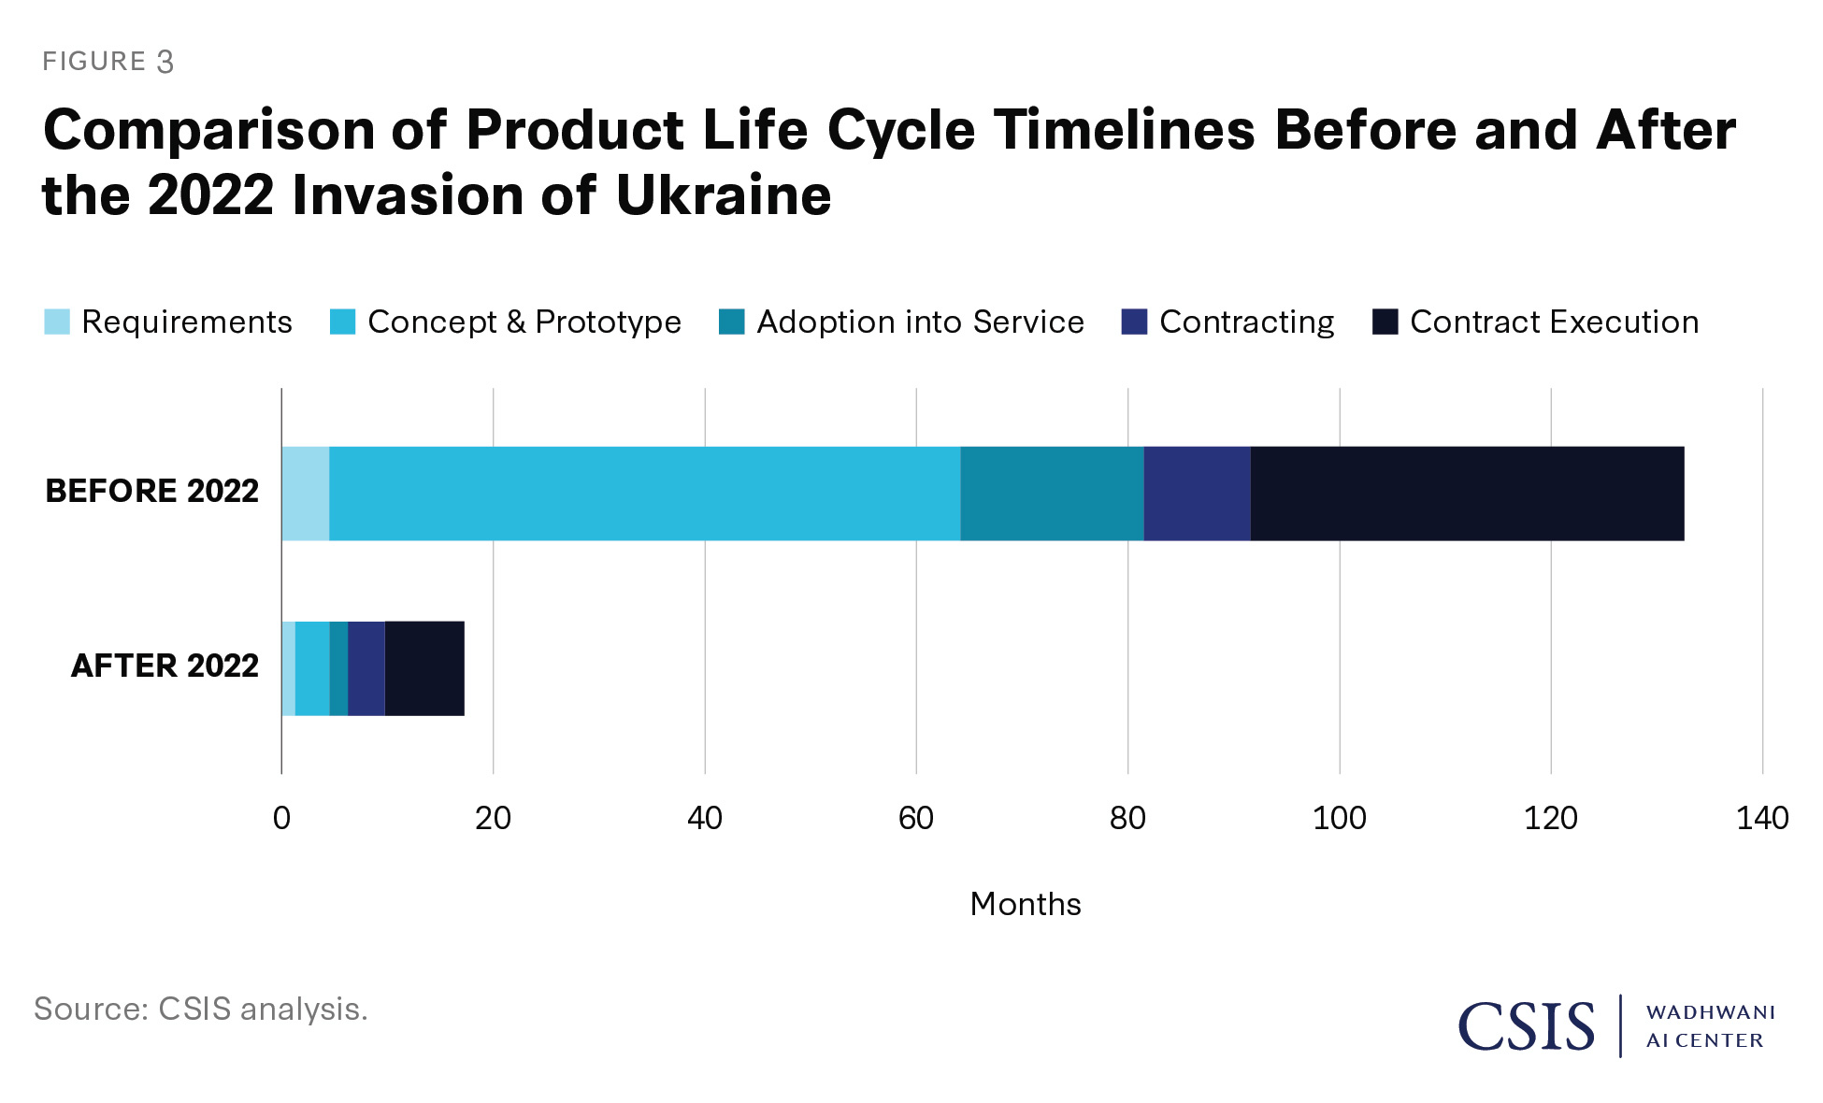
Timelines in Comparison
Ukraine formalized contracting process (Through Adoption into Service)
560 Days maximum
180 Days average
Ukraine open market acquisitions process
Varies, but can have COTS solutions to the warfighter within just a few weeks

Slide 19

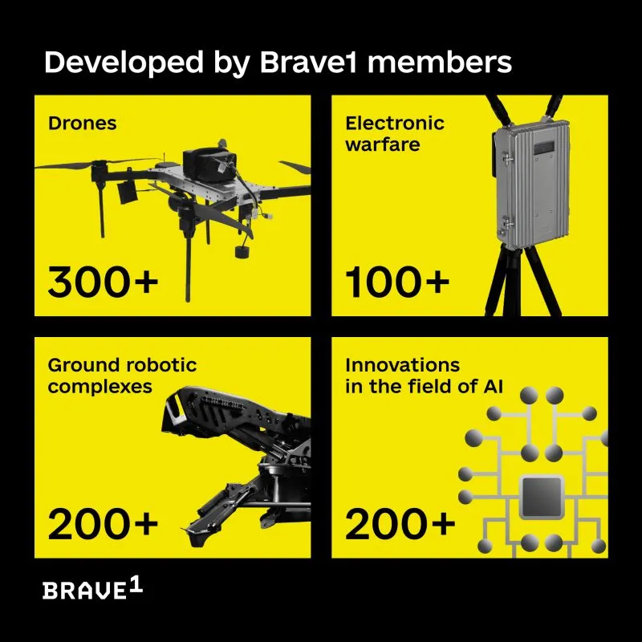
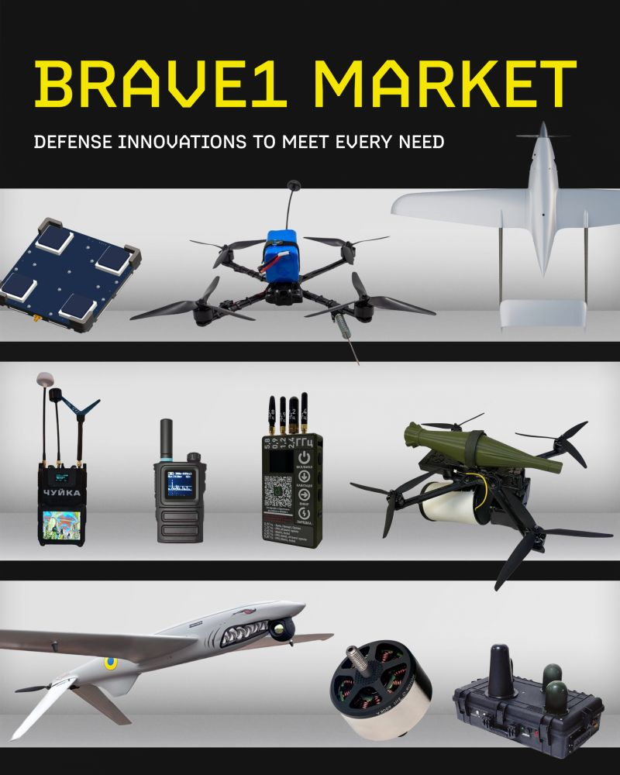

Application 1: Innovation
Rapid push for new technology to the front line
Real-time battlefield testing
Bottom-up refinement
Notes:
UKR MOD relied on experienced veterans to weigh-in on emerging needs
Bottom-up refinement through battlefield testing and the fielding.

Slide 20

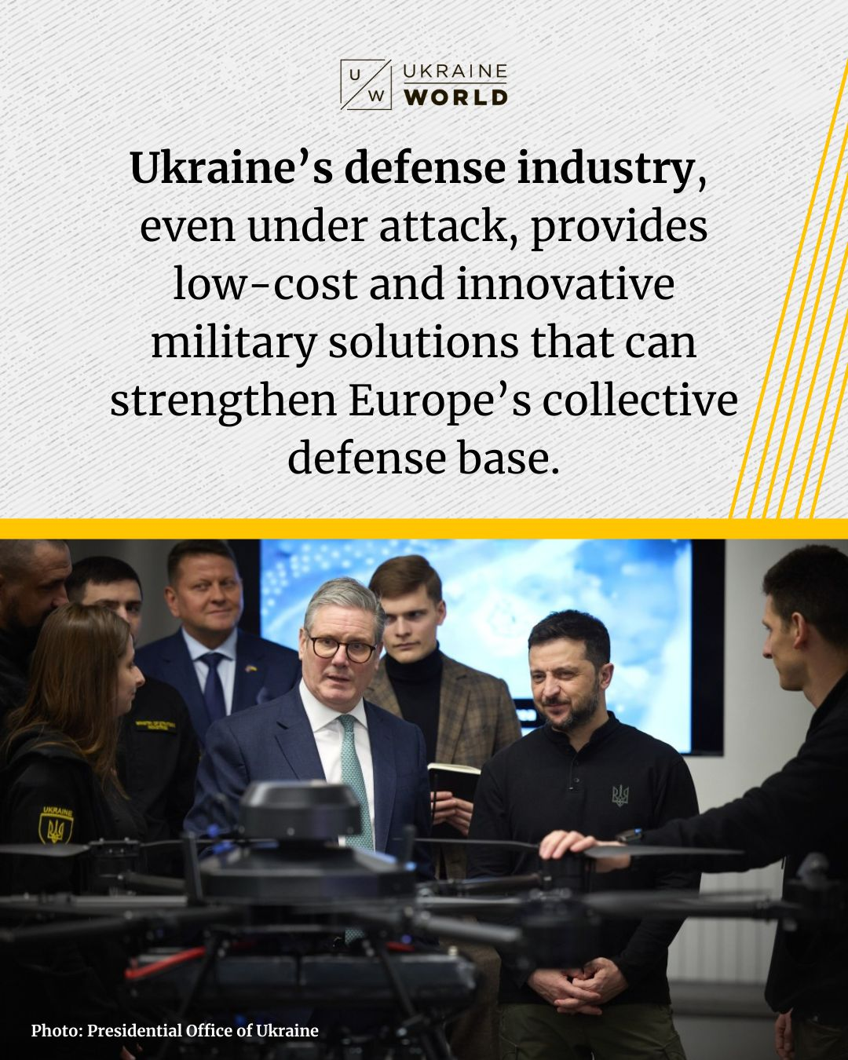

Application 2: Industry Base
Focus on testing / integration vs research / design
Large growth of Ukrainian defense sector
Enables rapid response / flexibility
Notes:
Testing and integration of equipment versus conducting early research and design
Expansion and inclusion of state-owned and private manufacturers for procurement

Slide 21
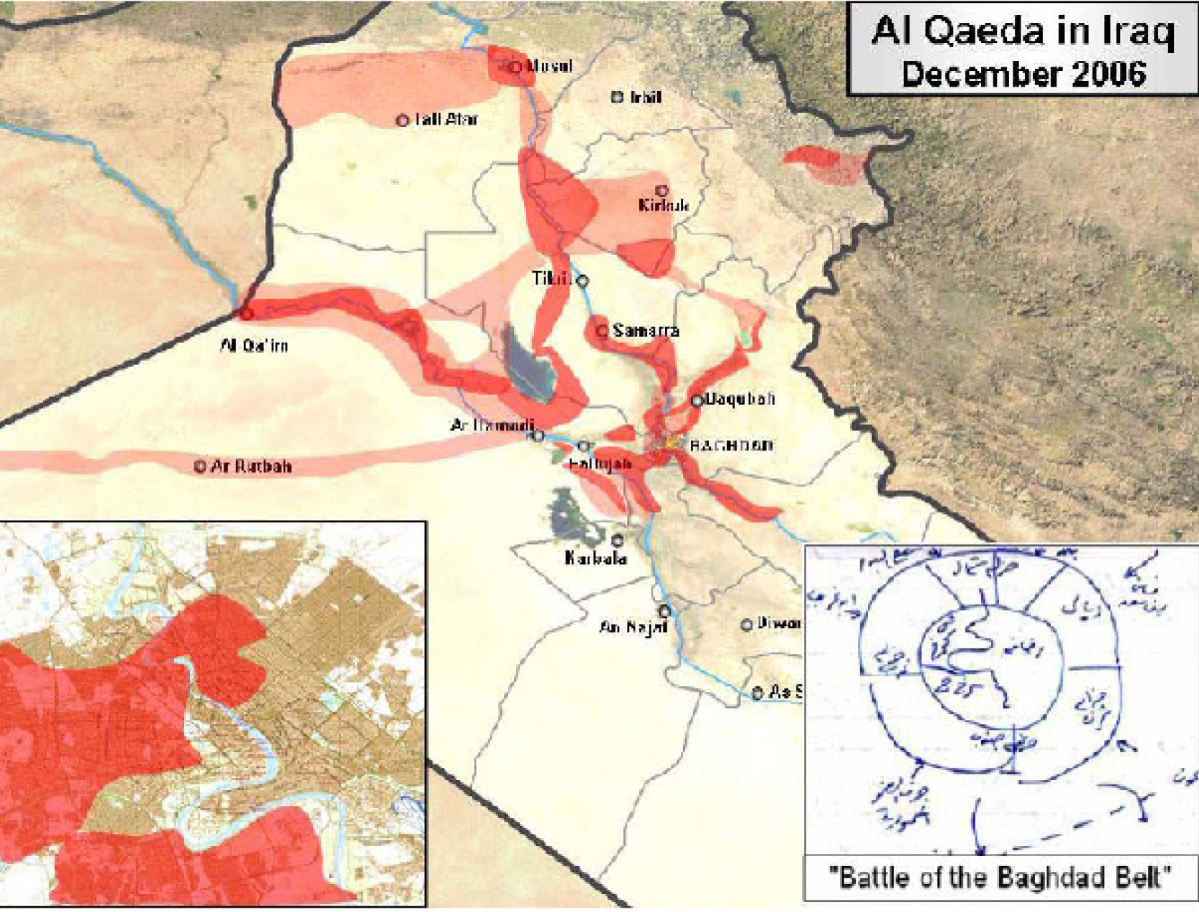
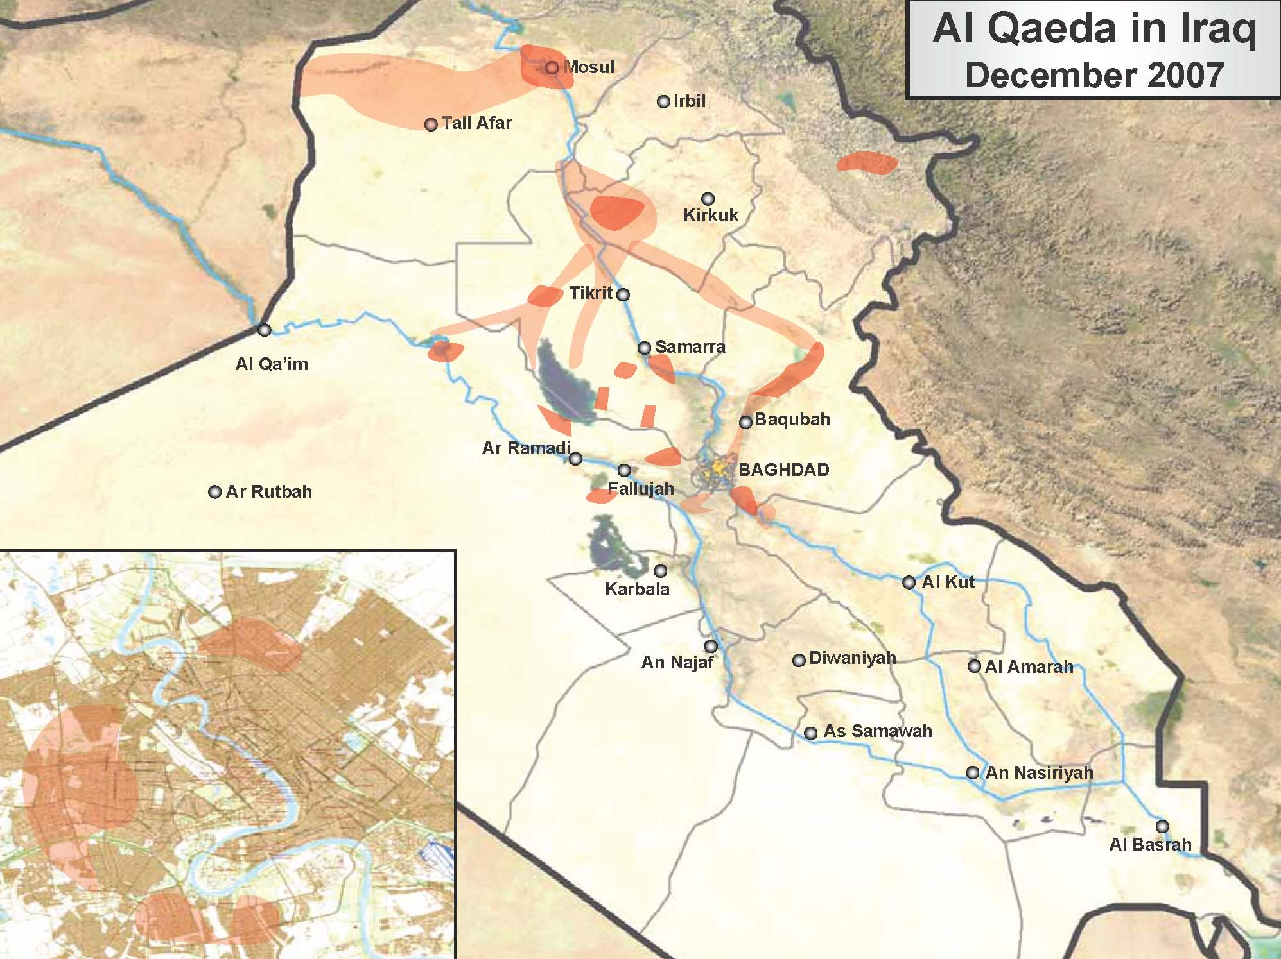
Aging Process
330 Days

Slide 22
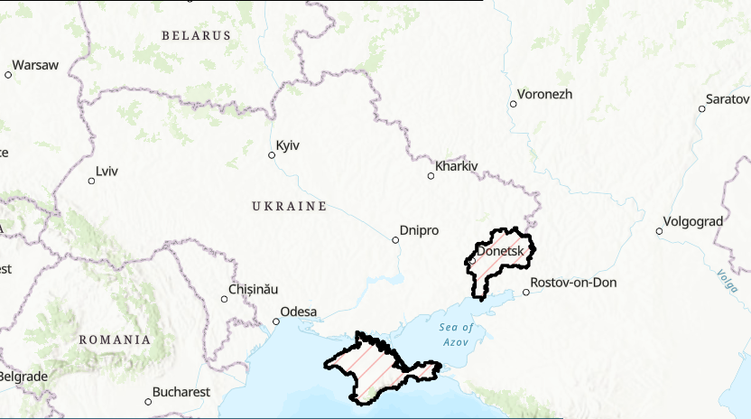
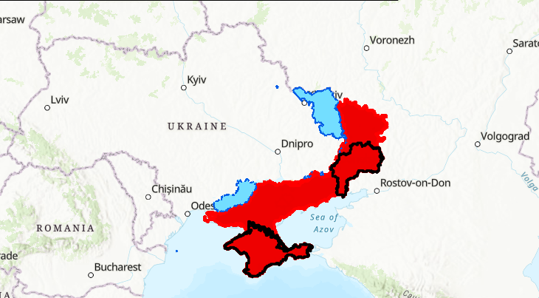
Why Does This Matter?
24 February 2022
20 January 2023
330 Days
2014 Russian occupation
Russian Ukraine (Recaptured)

Slide 23
Proposed Solutions
Note: These proposed solutions are NOT designed to replace the UUNS process; rather, they operate concurrently with existing processes to enable rapid procurement of COTS equipment. These solutions are designed to bridge the gap between identifying a need and the UUNS solution delivery timeline.

Slide 24
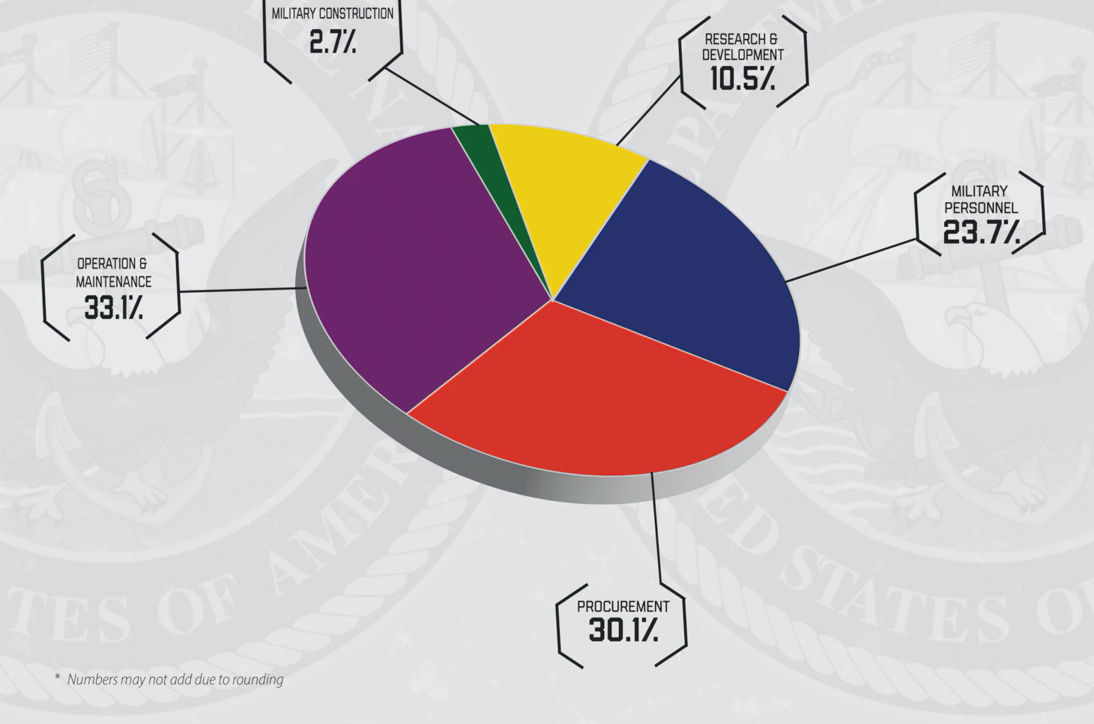
COA 1: COTS Unit Budget
MSC Budget
Personnel
Supply Contracts
Short-Term Solution
COTS-specific funding at MSC level
Approval matches existing fund management
Decentralized procurement
Tailored toward mission sets
COTS Funding
Operations
Maintenance

Slide 25
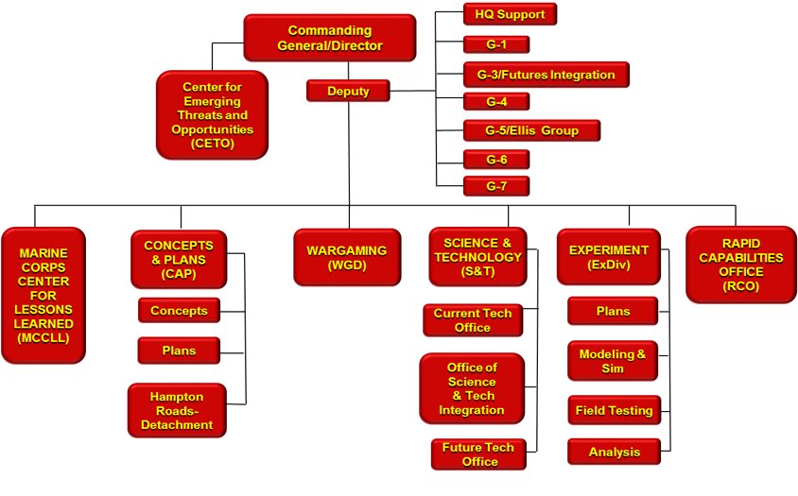
Proposed COA: COTS Integration Cell
Example with oversight cell at MCWL
Long-Term Solution
COTS cells integrated at MSCs
Alleviate end user burden
Staffed by SMEs (Acq Officer OIC, various Occfield SMEs)
Direct reporting to central cell
Alleviate current timeline gap
MSCs
COTS Integration Cell
FMF Cells
*Disclaimer: This structure may no longer be accurate at the time of the brief, and it is used strictly as a visualization tool
Notes:
*disclaimer about CD&I and MCWL force structure

Slide 26
Example COTS Cell Composition
Acquisitions Officer OIC
(O4-O5)
Joint Force Liaison
Contracting
(GS)
C2
(E7-E8)
Information
(E7-E8)
Fires
(E7-E8 / CWO 2-3)
Logistics
(E7-E8 / CWO 2-3)
Maneuver
(E7-E8 / CWO 2-3)
Intelligence
(E7-E8)
Force Protection
(E7-E8)
Core Member
Additional Personnel (When available)
*Each cell should be scalable & tailorable to each FMF unit based off predicted needs*

Slide 27
Timelines in Comparison
Current UUNS process
D-Day
D+60
D+330
D+730
Need Identified /
UUNS Drafted
G/O Need Validation
SRB
CPIB
Urgent Statement of Need (Recommend)
General Officer Decision
Urgent Statement of Need (Requirement)
SYSCOM/PEO RDT&E
“Urgent Capability Acquisition”
Solution Delivery (Avg)
Solution Delivery (Max)
Estimated COTS Cell process
D-Day
D+21
D+42
D+56
D+63
D+90
Need Identified /
UUNS Drafted
COTS solutions ID’d / Test Bed Purchase
Equipment Field Tested
Solution Decision / Purchasing
Field Test & Purchase Reports to Central Cell
COTS Solution Delivery
Continued Equipment performance reports to Central Cell
Event
Decision Point
Equipment Fielded

Slide 28
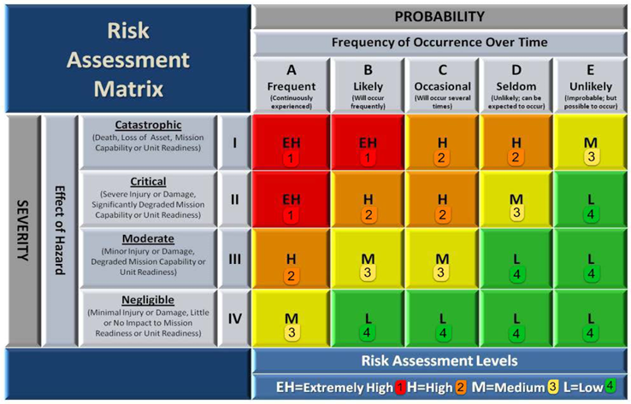
Risk Management
Risk
(Force) – Equipment reliability and safety
(Mission) – Interoperability issues
(Acquisition) – Cost overruns and inefficiency
Mitigation
Centralized reporting
Oversight cell
Field worthiness assessments

Slide 29
In Review
Research Question
  What force development process should the USMC make to optimize commercial technology integration?
Problem Statement
  The current process for acquiring and fielding COTS technology is cumbersome and will not meet the emergent needs of the rapidly changing modern battlefield.
Proposed Solutions
  COA 1: COTS Unit Budget
  COA 2: COTS Integration Cell
Timelines in comparison
Risk Management
  Identified risks and mitigations

Slide 30
Questions

