Slide 1
Amphibious Combat Vehicle
Mr. Chris Melkonian
Program Manager

Slide 2
Program Manager Advanced Amphibious Assault (PM AAA) Overview
Mission
Program Description
Provide and support amphibious combat capabilities that enable our Marines to win.
Full replacement for the legacy AAV in the Marine Division’s Assault Amphibian Battalions
Maneuvers the surface assault elements of the landing force and their equipment from assault shipping during amphibious operations
Provides support to seven standing MEUs and Force Design
A Family of Vehicles program comprised of four variants:
ACV-Personnel, ACV-Command & Control, ACV-30mm Cannon, and ACV-Repair & Recovery
Program Status
Key Events & Focus Areas
Acquisition Phase: Production and Deployment Phase including design and development efforts
Capabilities:
Ship-to-Shore from 12 nm
Risks/Opportunities:
Continue to improve platform effectiveness through reliability and capability improvements
13 Nov 20: Initial Operating Capability (IOC) – P Variant
8 Dec 20: Full Rate Production Decision
8 Oct 24: IOC – Command & Control Variant
19 Sep 24: Fielded Driver’s Training System
3QFY28: IOC – 30mm Cannon Variant
4QFY28: IOC – Repair & Recovery Variant
New Equipment Training Team (NETT) 2.0
Transition Training Unit (TTU)
Proficiency
Testing

Slide 3
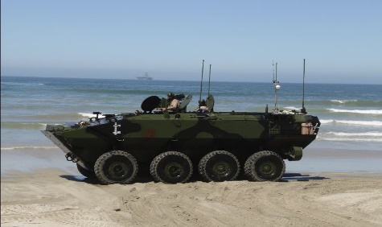
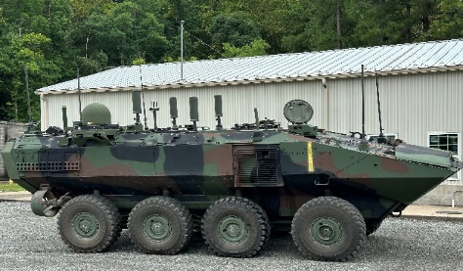
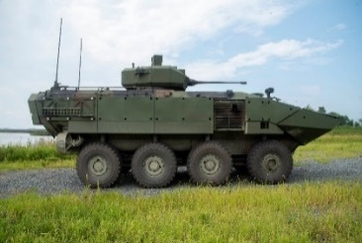
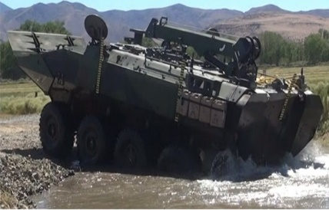
Amphibious Combat vehicle FoV
Engineering Change Proposals (ECP) to the Base Vehicle
ACV-P (Qty: 389)
General Support Lift for Embarked Infantry / Protected Water & Land Mobility
IOC achieved 13 Nov 20
Fielded 150
Fielding improvements to resolve top readiness drivers (shocks, brakes, Central Tire Inflation System)
Base Vehicle
ACV-C (Qty: 33)
Tactical-Echelon Command Post for Regiment / Battalion Stationary / On the Move Comm
Completed Follow-on Operational Test & Evaluations (FOT&E) Jan – Feb 22
Production began FY22
IOC achieved 8 Oct 24
Fielded 21 ACV-Cs
ACV-30 (Qty: 152)
Optimized for Infantry Support and Lethality to Destroy Adversary Armored Vehicles
Completed Developmental, Operational and Live Fire Test & Evaluation (DT&E/OT/LFT&E)
AAO change from 175 to 152
Production of FRP Lot 5 began 4QFY25 (All production lots awarded for 151 ACV-30s (a PRTV will be refurbished to achieve 152 AAO)
Turret Lots 5 and 6 awarded Aug 25 and Dec 25
IOC planned 3QFY28
ACV-R (Qty: 34)
Provides Field Maintenance, Recovery, and Limited Repair
ACV-R PRTV-R1 and PRTV-2 for DT and LFT&E
ACV-R PRTV-R3 for West Coast DT
FRP Lot 6 of production starts 4QFY26
IOC planned 4QFY28
ACV Variants (AAO = 608)

Slide 4
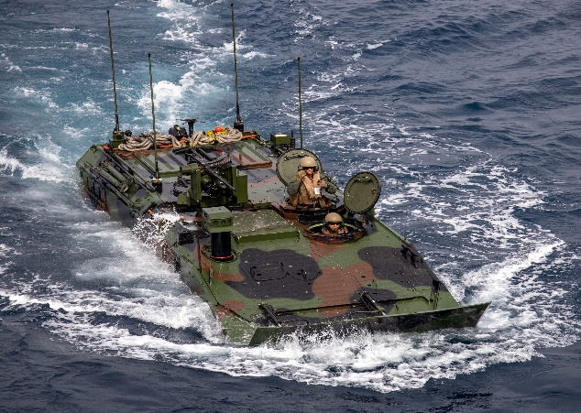
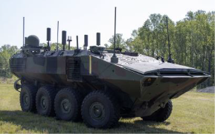
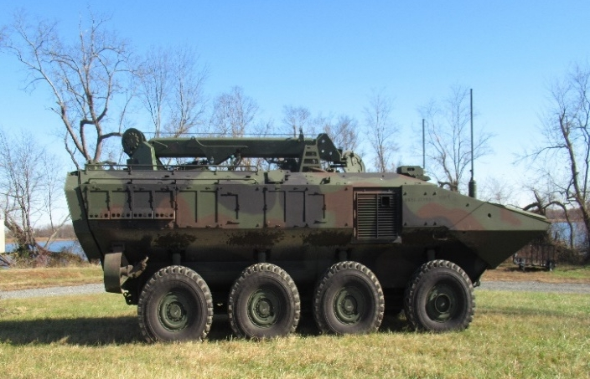
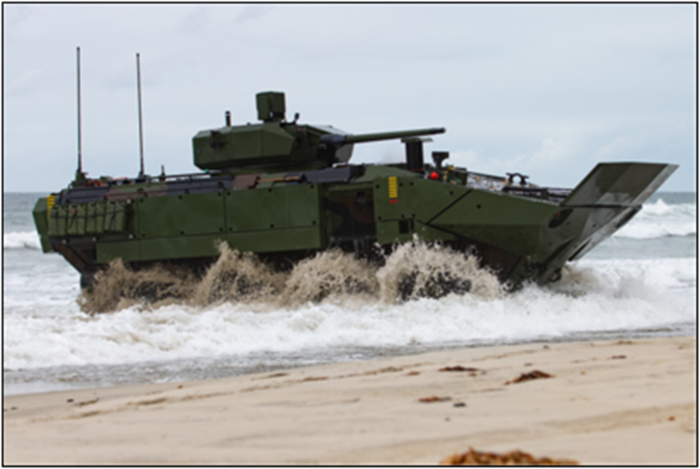
PM AAA – areas where industry can help
Kinetic / Non-Kinetic C-UAS
Dehumidification
Laser Protection
Environmental Control Systems Improvements
Light Weighting
Water Mobility / Propulsions
Situational Awareness
Active Protection Systems
Direct Energy Weapons
Overhead Protection
Signature Management/ Mobile Camouflage
Wheel/Tire Improvements/Lightweight Run Flats
System Safety Enhancements (i.e., Emergency Egress, AFES)
ACV-P
ACV-C
ACV-R
ACV-30

Slide 5
PM AAA – opportunities
TITLE | PLANNED RFP
PM AAA Weekly Industry Technical Exchange | Tuesday (Weekly)
Amphibious Combat Vehicle (ACV) Maneuver Improvements SBIR | 3QFY26
PM AAA Industry Day | 3QFY26
PMO Support | 3QFY27
Continue to work with PM AAA to take advantage of opportunities as we follow the below Modernization Strategy Solutions
Review prioritization yearly and adjust scoping as required based on system requirements, needs statements, and regularly scheduled modernization.
Compile product information relevant to readiness drivers, improved performance, advancing technology, urgent needs, and countering evolving threats. Get involved with Tuesday Industry Meetings, PM AAA Industry Day, and ACV Technology Demonstrations.
PM AAA utilizes compiled information to conduct initial market survey to create an informed RFI
FY27 – Anticipate focused RFI’s based on modernization areas of focus
Define acquisition approach informed by RFI responses and S&T developments leading to initial RFPs in FY27/28
Development to start in FY28

Slide 6
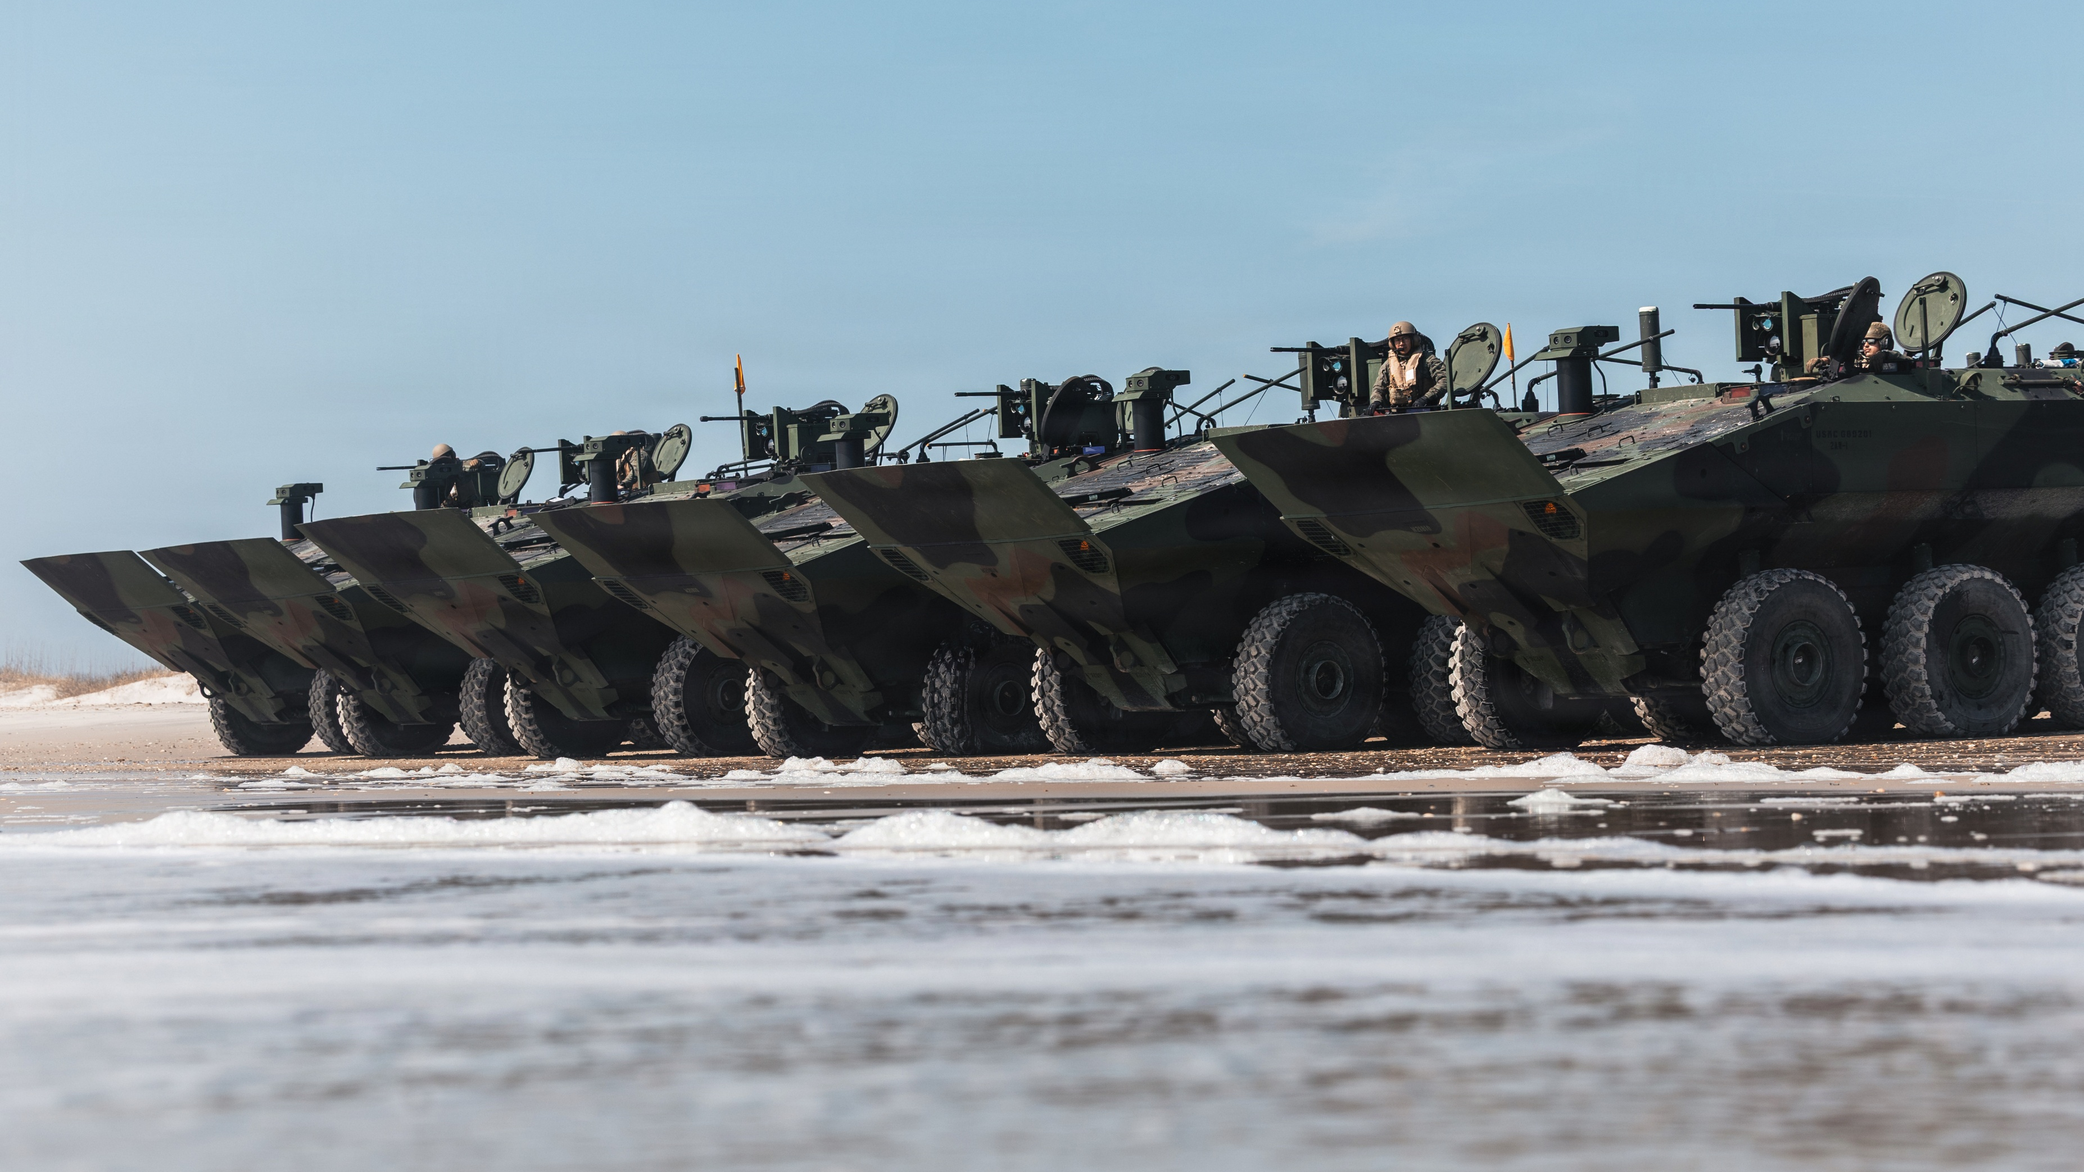
Questions?

Slide 7


Equipping our WARFIGHTERS

