Slide 1

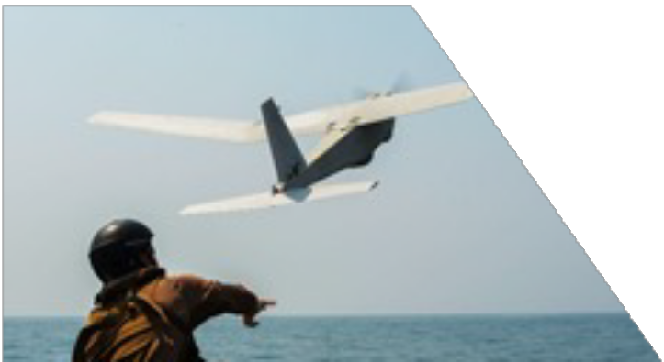
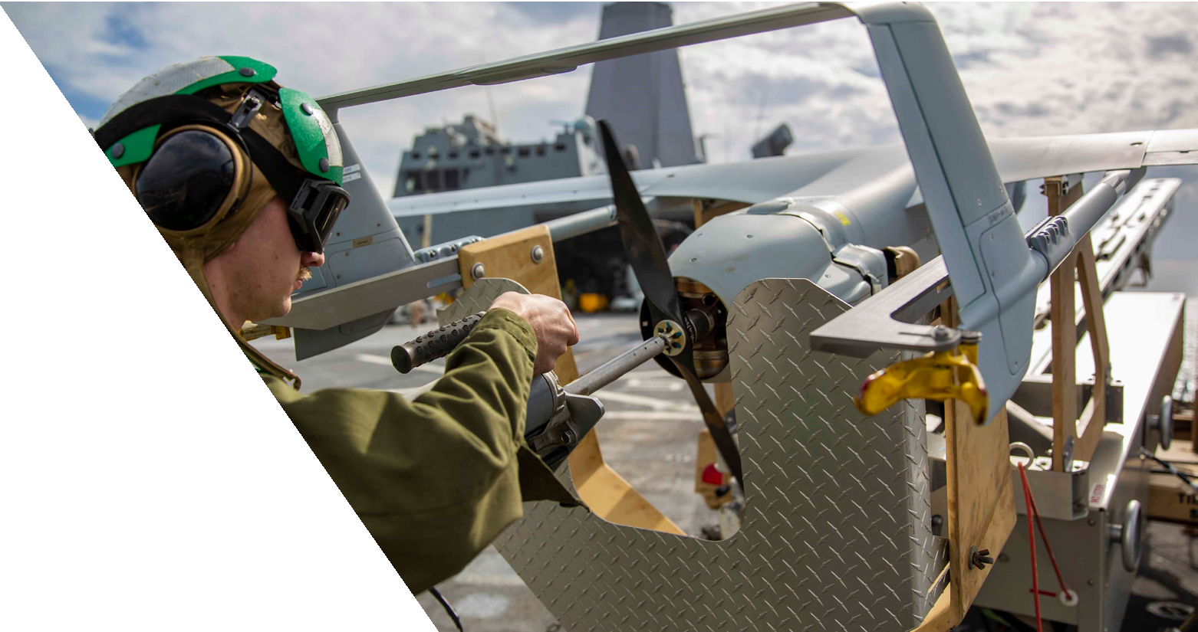
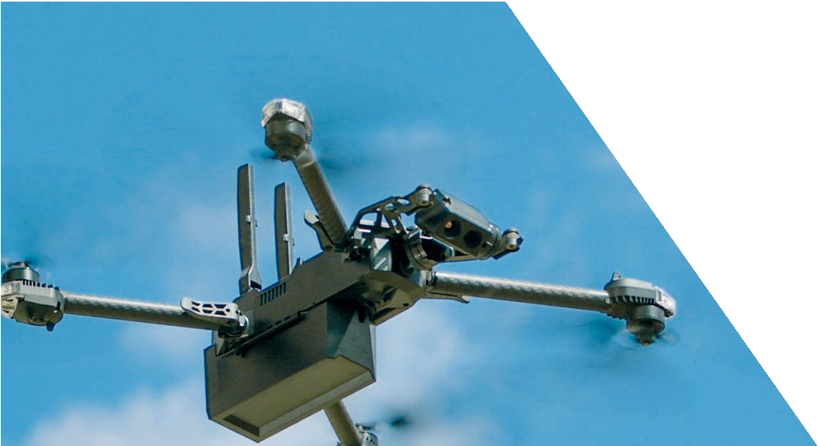
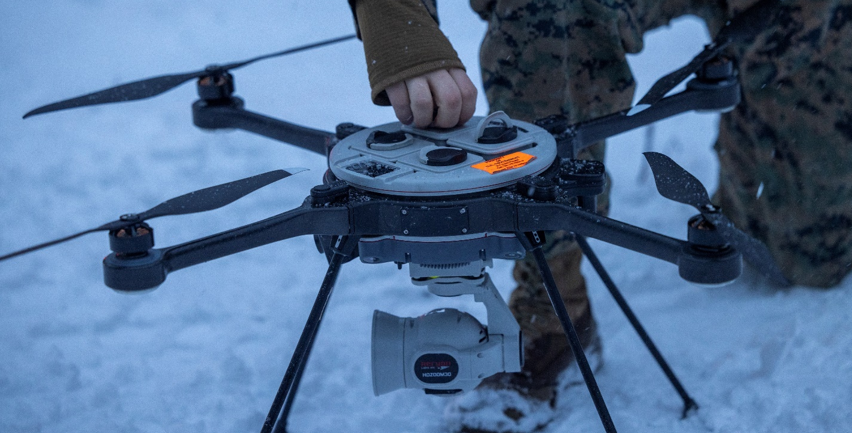
Aircraft Program
Management Office
Modern Day Marine

Slide 2
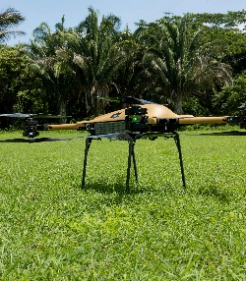
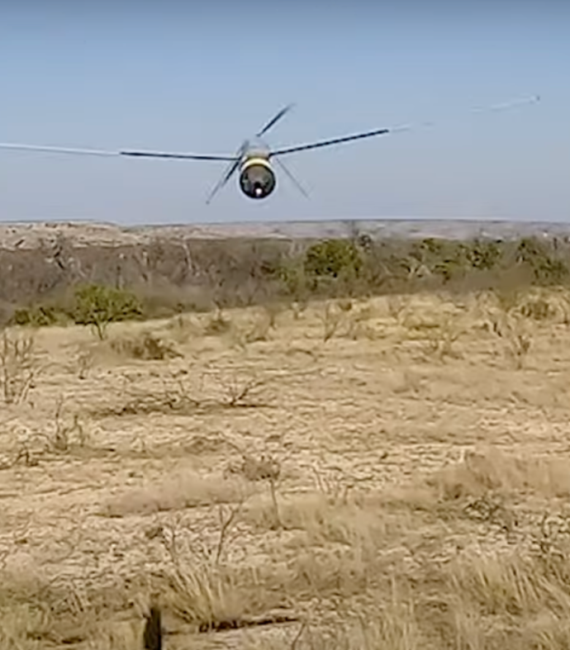
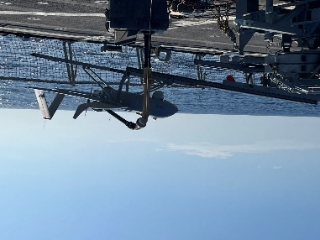

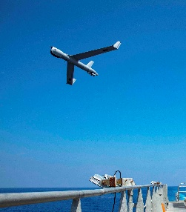
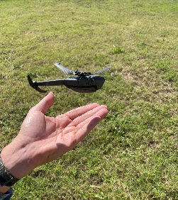
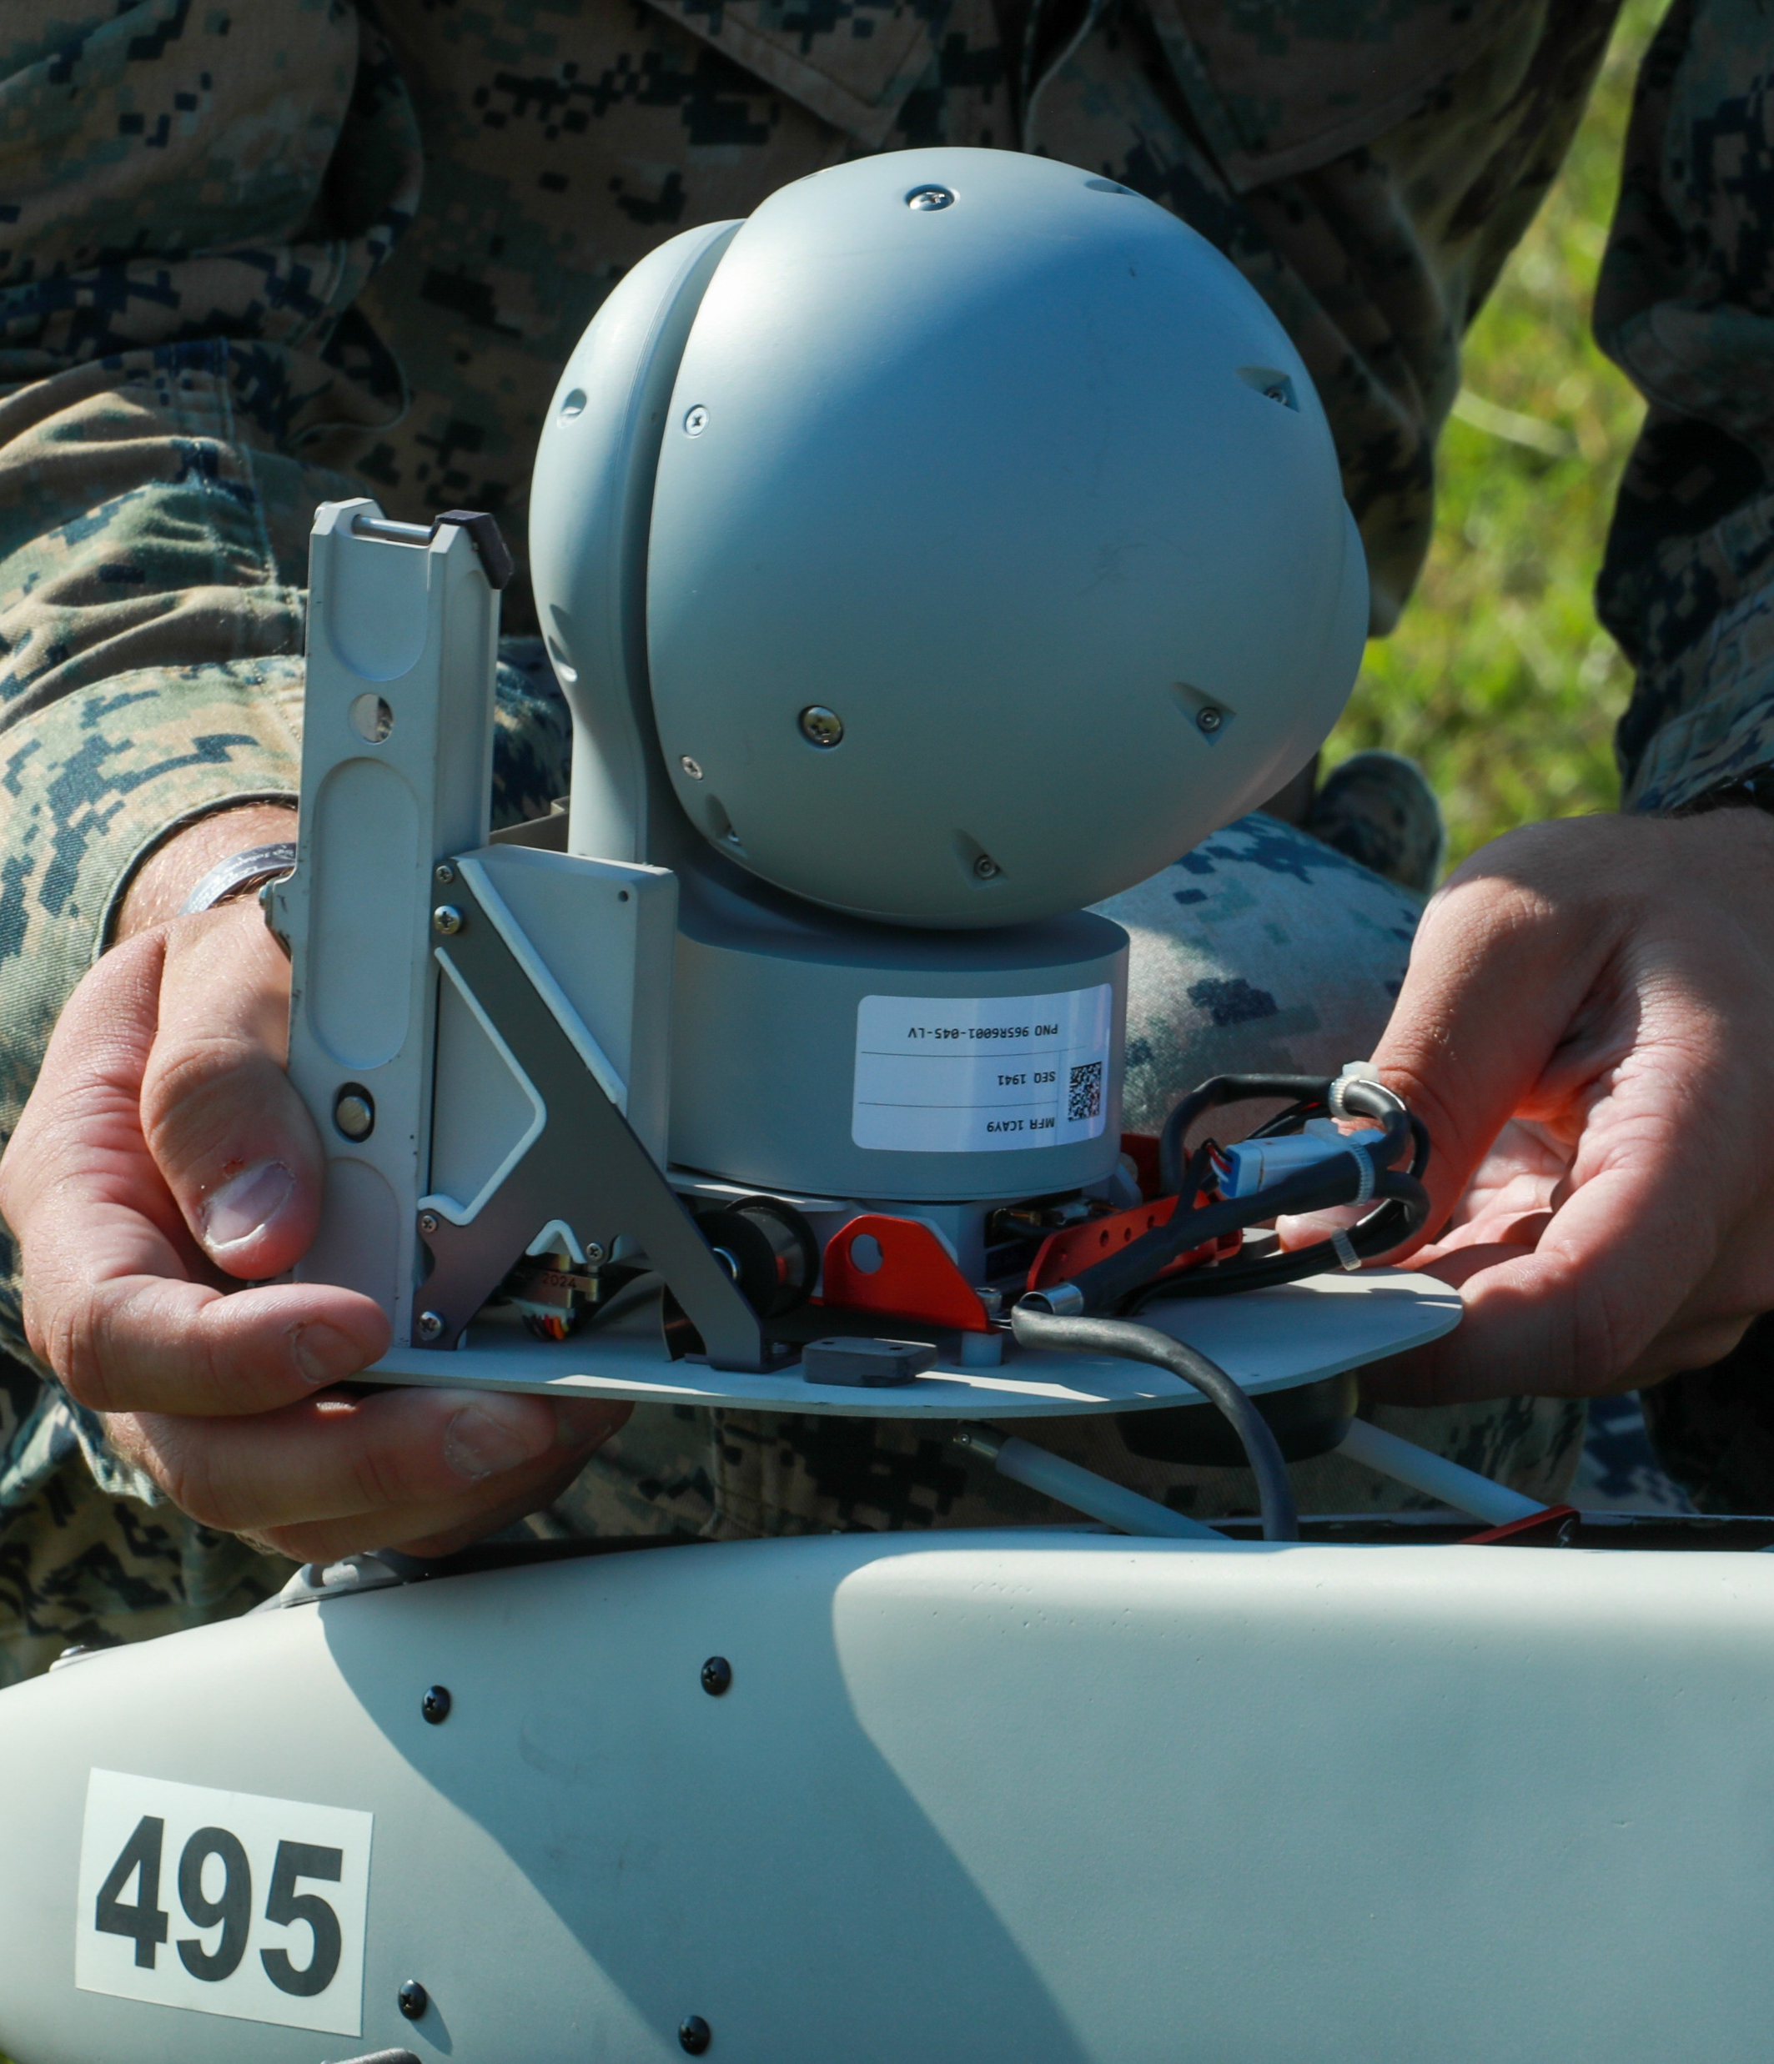
AIR PMO Portfolio
Unmanned Logistics
Small and Medium tactical resupply efforts
Emerging cargo requirements
Contested logistics focused
Loitering Munitions
(Transitioned to PAE RAS AIR PMO)
HAWKEYE
Aggie
Family Vacation
ISR Services
Ship and Land based requirements
Emerging Requirements
Maritime Targeting
Foreign Military Sales
Provided through Building Partnership Capacity, Foreign Military Financing and Foreign Military Sales
Family of Small UAS
Short, Medium and Long Range Tactical
Reconnaissance, Surveillance, and Target Acquisition
Training & Logistics Support Activity
Sensors & Payloads PMO
(Transitioned to PAE RAS S&P PMO)
Ensuring warfighter asymmetrical advantage through acquisition excellence. ​
Distribution Statement A - "Approved for public release; distribution is unlimited"

Slide 3
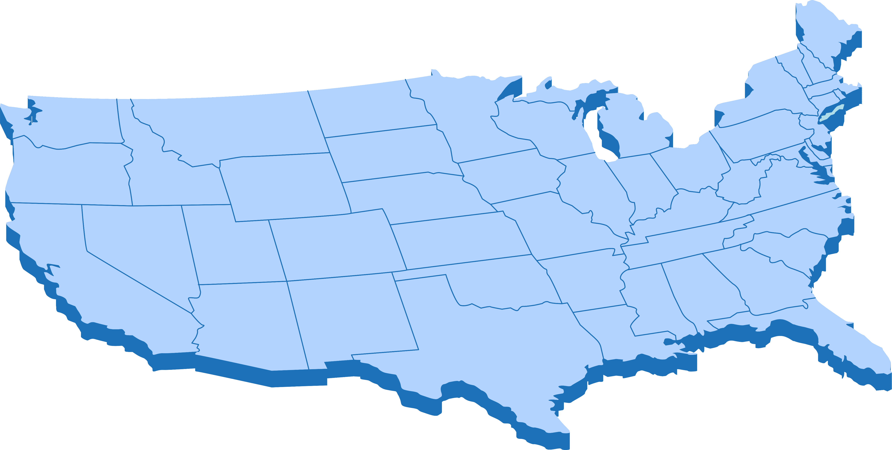
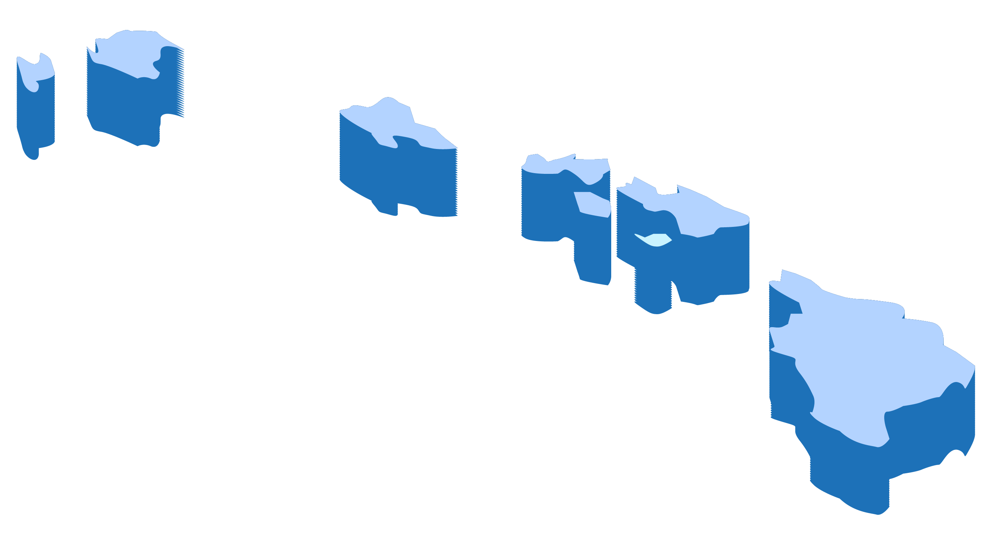
Training and Logistics Support Activities
Navy TALSA-E
NSW Schoolhouse
JEB Little Creek Fort Story, VA
NSW
NECC
I MEF
TALSA-29 Palms
MCB 29 Palms, CA
TALSA ICP
Camarillo, CA
Depot
II MEF
I MEF
NSW
NECC
TALSA-E
MCB Lejeune, NC
TALSA-W
NAVY TALSA-W
MCB Pendelton, CA
NSW
NECC
Navy TALSA-E Annex
Gulfport, MS
III MEF
TALSA-PAC
MCB Kaneohe Bay, HI
Various locations
Attend TALSA-E/W Sites
Or Mobile Training Teams
Reserves
Distribution Statement A - "Approved for public release; distribution is unlimited"

Slide 4
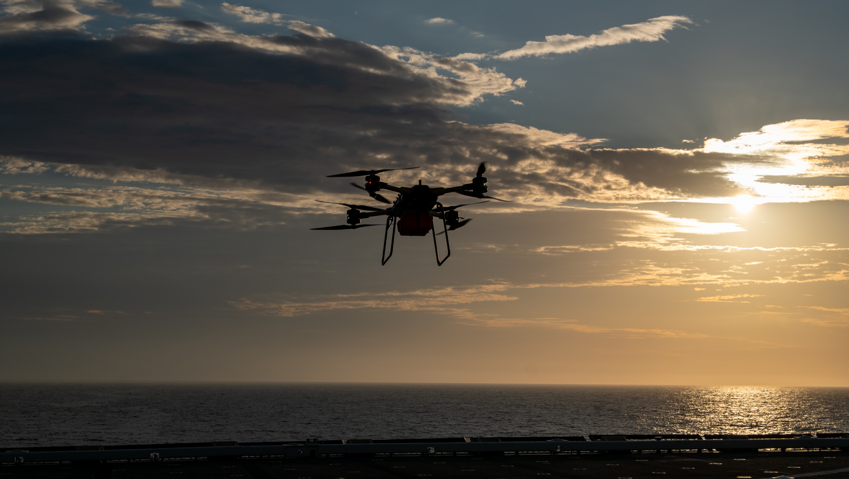
Unmanned Logistics Systems - Air
“Operational units, the PMO, and the NAVAIR test community respond to rapidly evolve the future of expeditionary Fleet logistics and sustainment.”
Voice of the Customer
NAVAIR Public Release SPR-2024-0597. Distribution Statement A - "Approved for public release; distribution is unlimited"

Slide 5
Why Services?
COCO
GOCO
GOGO
To satisfy Warfighter needs, all contracting options are explored and utilized to inform future Organic material solutions.
Land Based: CENTCOM
Sea Based: 4th, 5th, 6th, and 7th Fleet
Expeditionary Tactical UAS
Distribution Statement A - "Approved for public release; distribution is unlimited"

Slide 6
Warfighter Needs
Group 5
Group 2
Group 1
Payloads
Endurance
Airspeed
Size
Weight
Cost
Power
Advanced unmanned technology requires equally modern solutions for improving battlefield performance.
Distribution Statement A - "Approved for public release; distribution is unlimited"

Slide 7
Innovation and Adoption
Adaptive AI
Common Architecture
Additive Manufacturing
Contested Operations
Pursuing innovative ways to expedite new capability to the Warfighter
Distribution Statement A - "Approved for public release; distribution is unlimited"

Slide 8
Questions?
NAVAIR Public Release SPR-2024-0597. Distribution Statement A - "Approved for public release; distribution is unlimited"

