Slide 1
2026 Modern Day Marine V-22 Osprey and the 2026 Marine Aviation Plan
Controlled by: PMA-275​​​ Dissemination Control: Distribution Statement A POC: PMA-275 Public Affairs

Slide 2

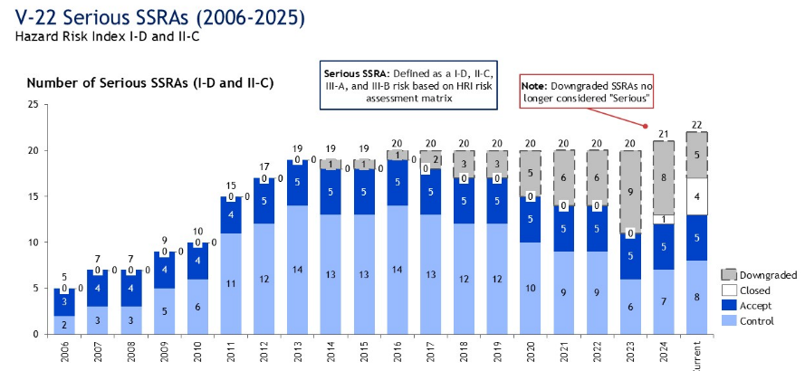
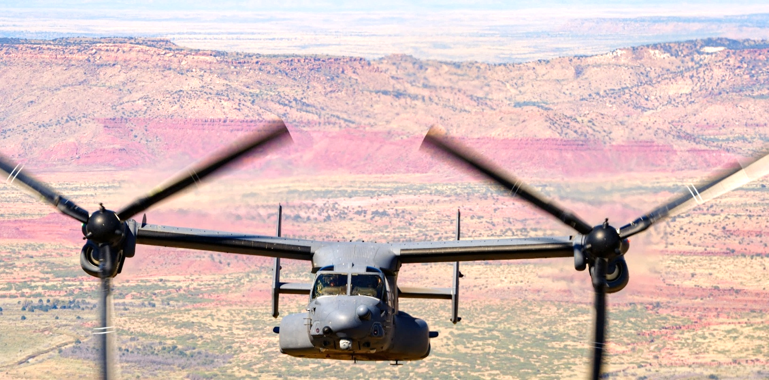
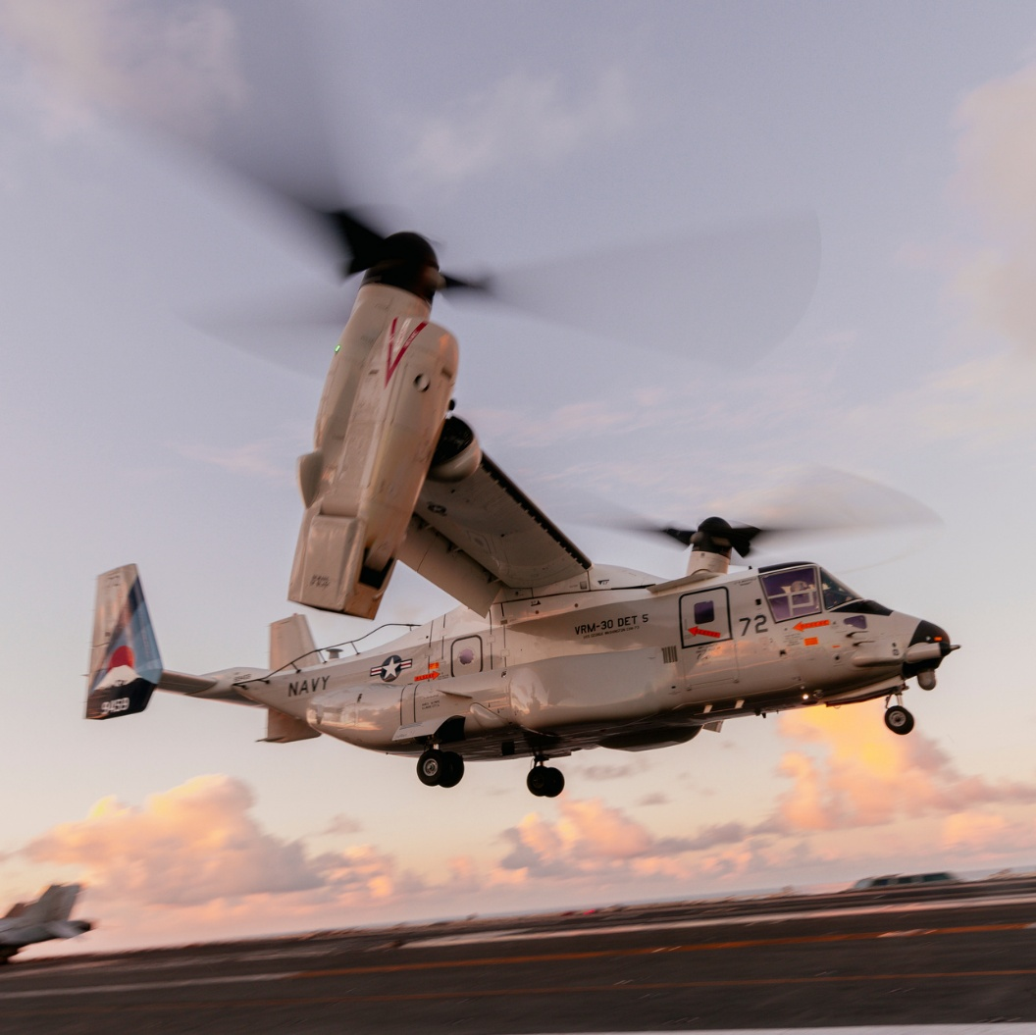
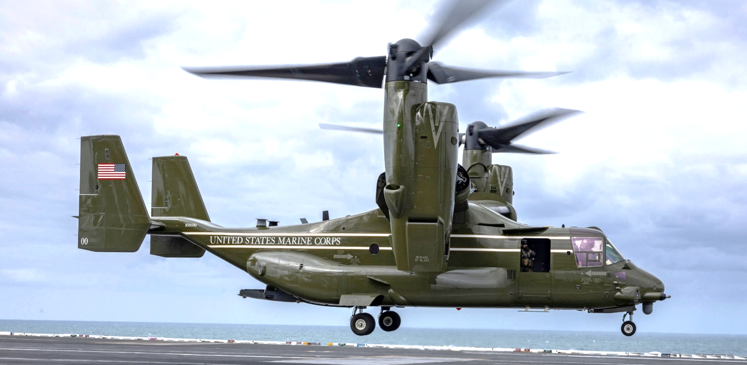
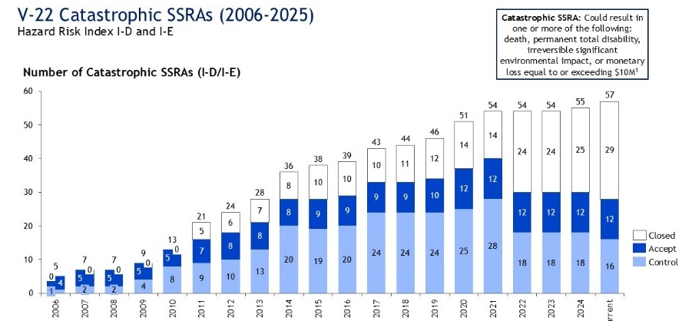
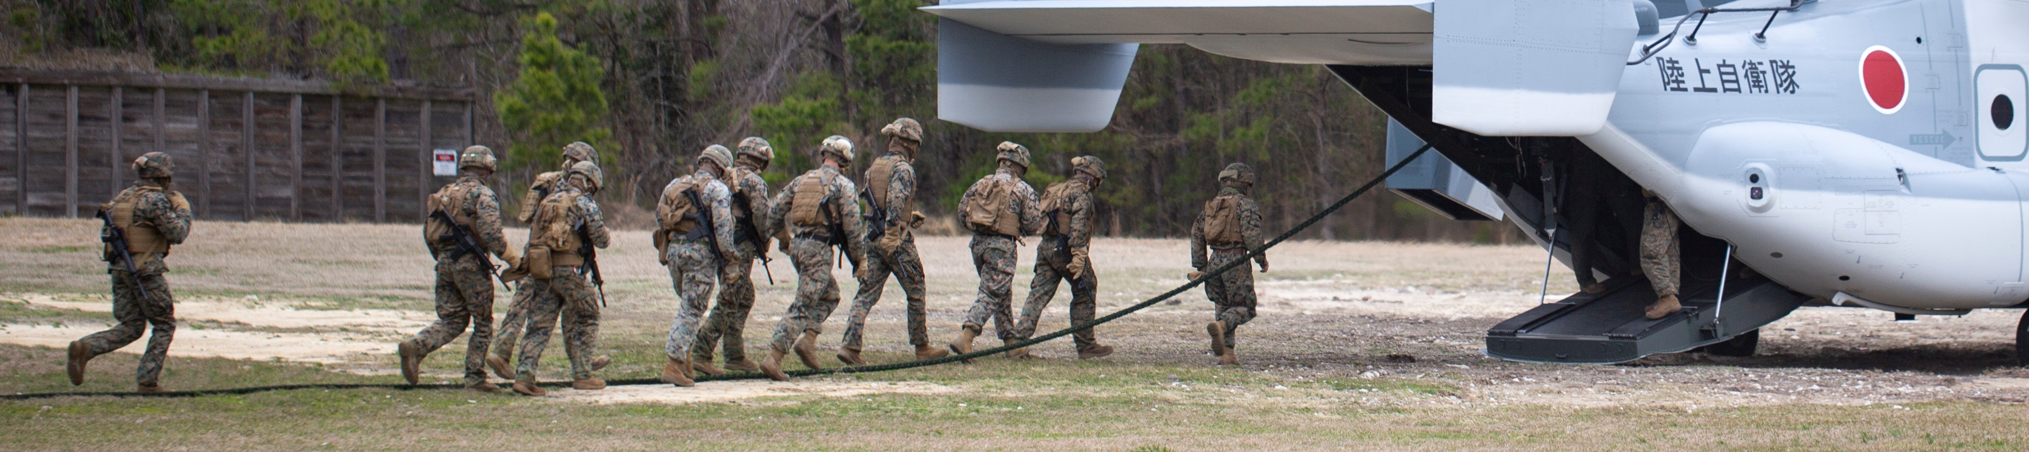
Decades of Risk Management
V-22 SAFETY REVIEWS
System Safety Risk
A measure of both the likelihood of a system failing and the potential consequence for the aircraft and crew.
2001
V-22 Blue Ribbon Panel
Drove a redesign of key aircraft systems and identified solutions for Vortex Ring State.
2009
GAO: V-22 OSPREY AIRCRAFT Assessments Needed to Address Operational and Cost Concerns to Define Future Investments
Found that missions accomplished in Iraq despite operational and cost concerns.
2016
LMSI: V-22 Osprey Independent Readiness review
Provided recommendations to improve the aircraft's readiness by addressing shortfalls in maintenance, parts availability, and aircraft configuration.
2019
DODIG: Evaluation of the V-22 Engine Air Particle Separator (EAPS)
Assess adequacy of the EAPS to protect the V-22 engine while operating in desert environments.
2025
GAO: OSPREY AIRCRAFT Additional Oversight and Information Sharing Would Improve Safety Efforts
Recommended an oversight structure to resolve known risks and to improve sharing of safety, maintenance data, and emergency procedures.​
HOW V-22 RISKS HAVE BEEN ADDRESSED
2025
NAVAIR: V-22 Comprehensive review
Reaffirmed the V-22s Airworthiness while providing 32
recommendations to improve readiness and safety.
Risk avoidance through flight test​
69 safety related deficiencies corrected​
Risk Downgrade/Elimination through aircraft improvement​
176 safety-related hardware mods complete since 2006​
56 safety-related hardware mods in work ​
72 safety-related software mods complete since 2006​
13 safety-related software mods in work
Risk minimization through standardization​
Major flight manual updates released every 2-3 years​
Interim flight manual updates released with new aircraft modifications​
All changes validated by flight test for all three services​
CURRENT RISK IDENTIFICATION PROCESSES
Since 2006​
29 Catastrophic risks eliminated​
5 Serious risks downgraded ​
~50 unique safety analyses performed yearly
Monthly Class Desk Safety Reviews
Semi-annual Program Safety Review Boards
First CV-22 delivered to AFSOC
First CMV-22 delivered to USN
First MV-22 delivered to Japan
First MV-22 combat deployment
MV-22 IOC
CMV-22 IOC
First CMV-22 deployment
First CV-22 combat deployment
Final CV-22 delivery to AFSOC
Final MV-22 delivery to USMC
MV-22 FOC
Yearly System Safety Working Groups
Fleet Support Team engineering analysis
Industry engineering analysis
CV-22 IOC
First MV-22 delivered to Presidential Helicopter Squadron
2006
2007
2008
2009
2010
2011
2012
2013
2014
2015
2016
2017
2018
2019
2020
2021
2022
2023
2024
2025
2026

Slide 3
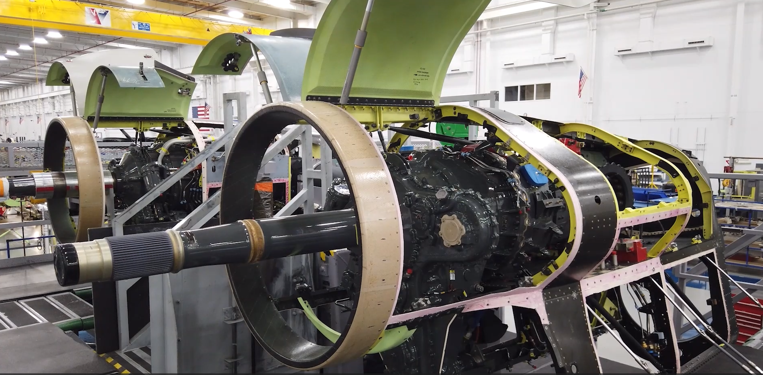
V-22 Osprey readiness through modernization
Initiatives that enhance safety, reliability, readiness, and operational capability to ensure platform relevance through the transition to Next Generation Assault Support aircraft. -2026 Marine Aviation Plan
Safety & Drive System Modernization
Triple melt PRGB, Input Quill redesign, and ODSSHI sensors drive major risk reduction and predictive maintenance improvements.
Nacelle Improvement & Configuration Updates
Full NI fielding from FY28 improves reliability; VFORCE reduces configuration variance across the fleet.
Improved Handling Qualities and Machine/Pilot Interface
Flight Control Computer redesign, and avionics obsolescence (VeCToR).
Predictive Maintenance & Analytics
Fleet-wide shift from reactive to AI enabled predictive maintenance; Aircraft Components Tracking System.
Notes:
Key Takeaways
Cross-Service Coordination & Data Sharing • New Joint V‑22 Leadership Forum and multi‑service MOA strengthen communication, safety data exchange, and performance visibility. • Regular tri‑service reviews and expanded access to AFSAS/RMI improve joint oversight and lessons learned sharing.
Safety & Reliability Improvements • PRGB upgrades (-119 and -123 with triple‑melt steel) progressing toward unrestricted operations by 2027; full fleet upgrades 2029–2033. • Osprey Drive System Safety & Health Instrumentation (ODSSHI) enables vibration-based predictive maintenance; full retrofit FY28–FY31. • Input Quill Assembly redesign and VFORCE configuration standardization reduce failure risks and support readiness.
Maintenance & Sustainment Modernization • ACTS electronic logbook fully implemented across all maintenance levels. • AI-enabled predictive maintenance—including 2nd MAW initiative—offers transformational potential for proactive logistics and supply-chain planning. • Program shifting from reactive to data-driven sustainment with advanced analytics and RCB processes.
Nacelle Improvement (NI) Program • Full NI projected to significantly improve availability, maintenance hours, and reliability; USMC and Navy installations begin FY28. • Funded kit procurements via OBBBA support CMV‑22 upgrades.
Mission-Capable Rates & Readiness • Improvements depend on sustained readiness funding, modernization of drive system components, NI, PRGB upgrades, ODSSHI, VFORCE, and VeCToR cockpit technology.
Legislative Considerations • Program will provide Congress proposals for statutory changes needed to accelerate upgrades and address CR/GAO findings.
I. Vice Admiral John Dougherty IV — QFR & IFR Summaries
QFR 1 (Gooden) – Cross-Service Maintenance Information Sharing
Topic: Improving joint maintenance collaboration Response Summary: NAVAIR established multi‑service V‑22 oversight mechanisms, including: – Tri-Service operating procedure reviews – System Safety Working Group – Integrated Logistics Support forums – A new Joint V‑22 Leadership Forum (JVLF) to remove barriers, improve oversight, and enhance safety/readiness.
IFR 1 (Garamendi/Kelly) – Maintenance Issues & OEM Role
Topic: Maintenance improvements and Bell Boeing’s involvement Response Summary: Maintenance best practices are shared via logistics forums; fleet maintainers are integrated into design processes. Bell Boeing continues to serve as SME and partner in readiness and safety improvement.
IFR 2 (Garamendi) – NDAA Legislative Needs for V‑22 Issues
Topic: Potential legislative action Response Summary: Program continues to assess CR/GAO recommendations and will provide Congress proposals for legislative changes if necessary.
IFR 8 (Ryan) – PRGB Upgrade Status & Fleet Safety
Topic: PRGB safety upgrades and timeline Response Summary: PRGB upgrades progressing from -119 (2025) to -123 (2026) models with triple‑melt steel. – Restrictions remain on older gearboxes until limits are met. – Unrestricted flight for all in-reporting aircraft expected by 2027. – Full fleet upgrades: Navy/USAF in 2029; USMC in 2033.
IFR 9 (Ryan) – Accident Rate Mitigation Needs
Topic: Technology needed to reduce accidents Response Summary: Risk reduction efforts include: – Redesign of Input Quill Assembly – Improved X‑53 triple‑melt steel PRGB – ODSSHI sensor system for predictive maintenance – VFORCE configuration reduction initiative.
IFR 10 (Ryan) – Tools for Early Component Degradation Detection
Topic: Maintenance diagnostic tools Response Summary: ACTS electronic logbook fully implemented. ODSSHI sensor suite being fielded to support vibration-based predictive maintenance. Full retrofit by FY28–FY31 depending on variant.
IFR 11 (Ryan) – Use of Data for Maintenance Decisions
Topic: Data analytics and GAO findings Response Summary: Traditional RCM and Reliability Control Board processes inform maintenance. The program sees major benefit in AI-enabled predictive maintenance and ODSSHI integration.
IFR 12 (Ryan) – Performance Data Visibility Across Services
Topic: Cross-service data sharing gaps Response Summary: New MOA across Navy, Air Force, and SOCOM updates information-sharing processes; multiple JPO-led forums now ensure cross-service data visibility.
II. Brigadier General David Walsh — QFRs & IFRs
QFR 1 (Mace) – Nacelle Improvement (NI) Program Performance
Topic: Impact of full NI shift and fleet fielding timeline Response Summary: NI improves availability, maintenance hours, and reliability. – USMC shifting from TNI to full NI – Installations begin FY28 – Navy funded via OBBBA for 12 kits starting FY28.
QFR 3 (Davis) – AI-Based Predictive Logistics at 2nd MAW
Topic: AI in sustainment and supply chain management Response Summary: 2nd MAW’s AI tool offers major potential for readiness gains and predictive sustainment. Once validated, it should be deployed enterprise-wide.
QFR 4 (Davis) – ODSSHI/“Odyssey” System Status Update
Topic: Drive system health monitoring Response Summary: ODSSHI sensors enable predictive maintenance. Retrofit timelines: – CV‑22: FY28 – CMV‑22/MV‑22: FY31 Program is fully funded.
QFR 5 (Davis) – Improving Stagnant Mission-Capable Rates
Topic: Readiness improvement while balancing broader impacts Response Summary: Must continue to fund readiness and modernize via: – Data-enabled predictive maintenance – ODSSHI, NI, PRGB upgrades – VFORCE configuration alignment – VeCToR cockpit modernization.
IFR 3 (Garamendi) – Legislative Needs for V‑22 Upgrades
(Same Q as Dougherty’s IFR 2.) Topic: Legislative support Response Summary: Program assessing CR/GAO actions and will propose legislative needs as identified.
IFR 4 (Garamendi) – PRGB Production Rate Limitations
Topic: Why PRGB production cannot exceed 12/month Response Summary: Higher rates would: – Create industrial base spikes difficult to sustain – Require removing unrestricted aircraft from inventory, harming readiness – Not expedite unrestricted fleet dates due to complex risk balancing.
IFR 5 (Garamendi) – Unified V‑22 Safety Database Barriers
Topic: Safety data sharing limitations Response Summary: New multi‑service MOA now enables reciprocal access across Air Force (AFSAS) and Navy (RMI) systems. JPO forums ensure systematic cross‑service sharing.
IFR 6 (Garamendi) – Restrictions on Non-Triple-Melt PRGB Aircraft
Topic: Operational limitations and readiness impacts Response Summary: Restrictions involve additional ORM and mission planning, but engineering analysis shows no negative impact on mission readiness or pilot proficiency.
IFR 13 (Ryan) – PRGB Upgrade Status (Repeated Topic)
Topic: Safety, flight restrictions, and upgrade timeline Response Summary: Same as IFR 8 summary above.
IFR 14 (Ryan) – Accident Rate Reduction (Repeated Topic)
Topic: Technologies to reduce accidents Response Summary: Same as IFR 9 summary above.
IFR 15 (Ryan) – Maintenance Detection Tools (Repeated Topic)
Topic: ACTS & ODSSHI Response Summary: Same as IFR 10 summary above.
IFR 16 (Ryan) – Maintenance Data Use (Repeated Topic)
Topic: Data sufficiency and modernization Response Summary: Same as IFR 11 summary above.
IFR 17 (Ryan) – Cross-Service Performance Data Sharing (Repeated Topic)
Topic: MOA and data visibility Response Summary: Same as IFR 12 summary above.

Slide 4
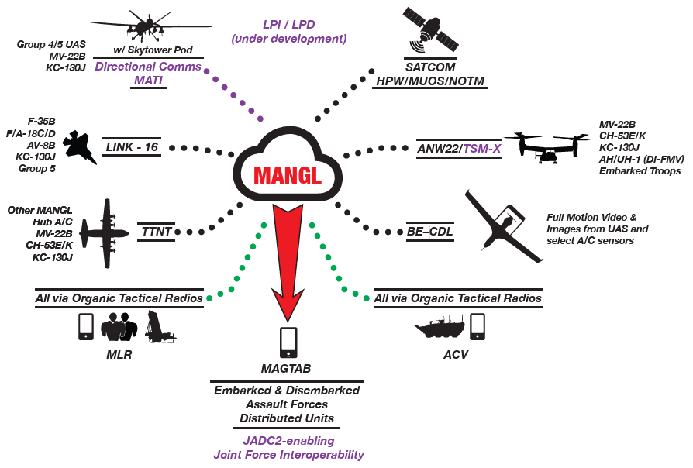
V-22 support of Distributed Aviation Operations (DAO)
DAO is Marine Aviation’s central contribution to Expeditionary Advanced Base Operations (EABO) and the Corps’ ability to operate inside contested maritime spaces. -2026 Marine Aviation Plan
Road so far - Cornerstone of the MAGTF
Provides support to ground forces in multiple theaters of operation from expeditionary sites and afloat.
111 operational deployments and over 600,000 flight hours since Initial Operational Capability in 2007
Road ahead - Data as a warfighting capability
Lead platform for DI/MANGL to bring on Link 16, CDL, ANW2, and TTNT
proliferated low-Earth Orbit (pLEO)
Shortened decision-making processes

Slide 5
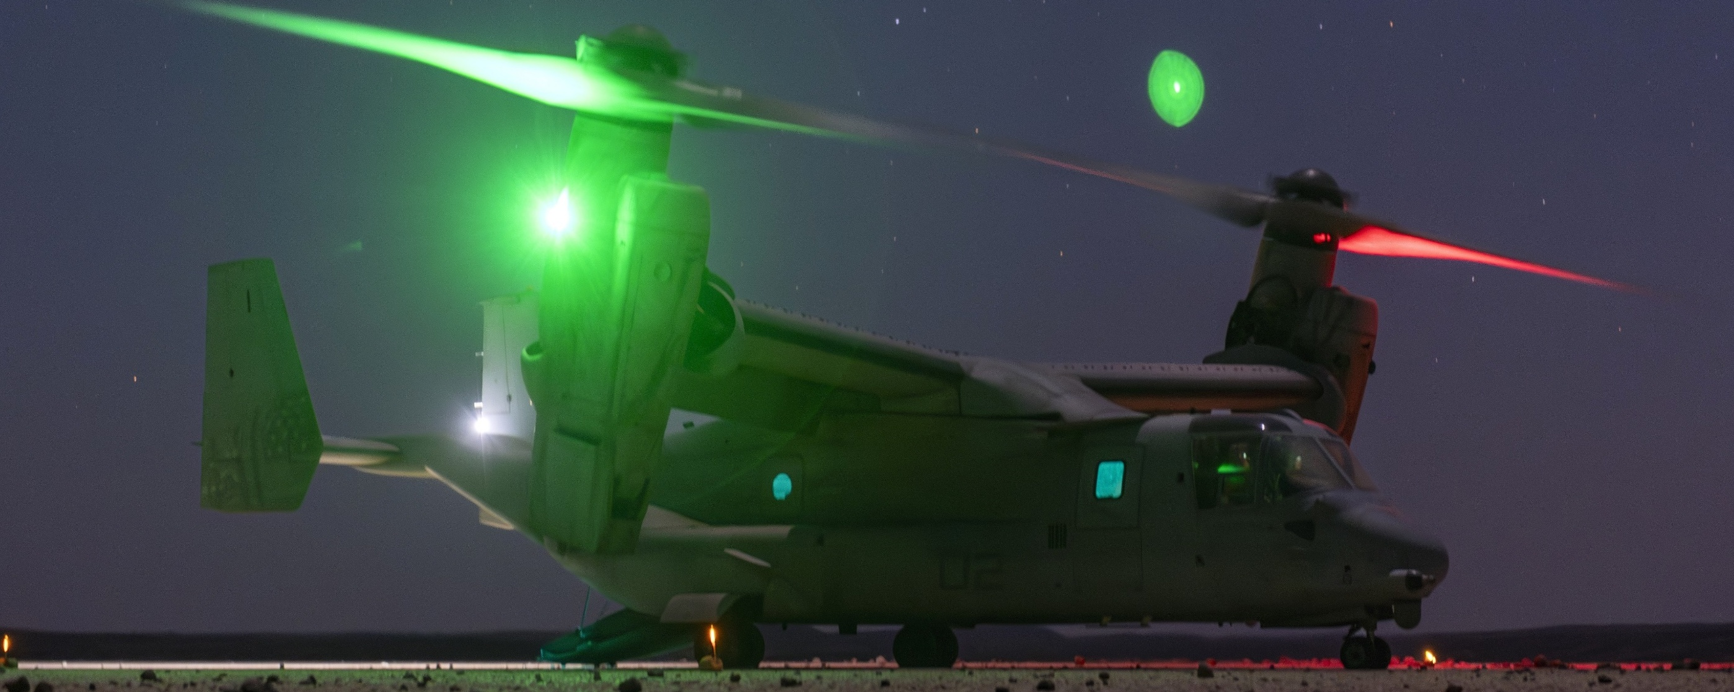
Questions & Comments

